Slide 1

LEAVERS AND GRADUATES
March 31, 2026

Slide 2

AGENDA – LEAVERS AND GRADUATES
Overview
Timeline
Promotion Logic
Reports
Business Rules
The Path towards Success
Scenarios
Questions

Slide 3


OVERVIEW

Slide 4
OVERVIEW
Effective beginning in the 2025-2026 school year, current-year leaver and graduation data will be reported in both the:
  PEIMS Summer Submission.
  PEIMS Extended Year Submission.
TEA updated both submissions to include all necessary data for determining leaver and graduate status.
Additional changes will be released on April 13, 2026, for Extended Year Submission for reporting Industry-Based Certifications and Associate Degrees.

Slide 5

TIMELINE

Slide 6
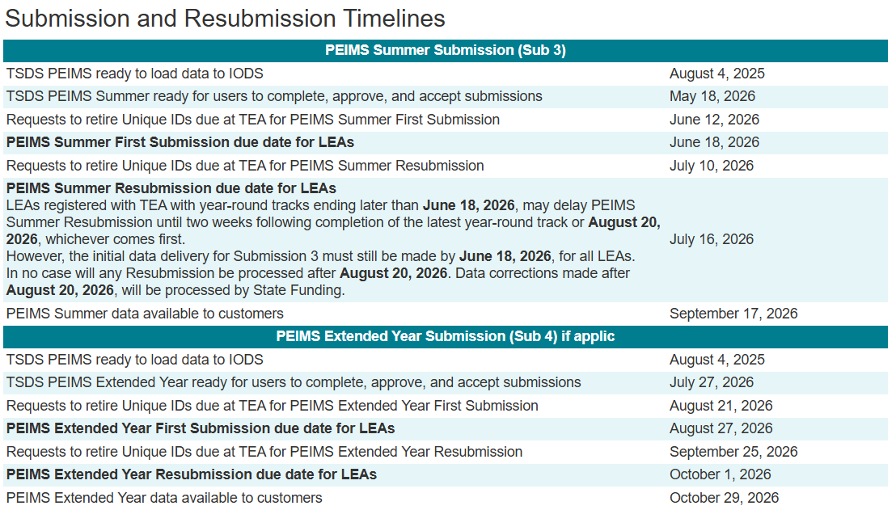
TIMELINE
2025-2026 school year Leavers and Graduates will be reported in the 2025-2026 PEIMS Summer and Extended Year Submissions.

Slide 7

PROMOTION LOGIC

Slide 8
NEW DATA IN PEIMS SUMR & EXYR
The Student > School Leaver subcategory will now be promoted in PEIMS Summer and Extended Year.
StudentAcademicRecord.Diploma data will now be promoted into the Student > Graduation Program subcategory.
No changes to the other Student subcategories:
  All reported Leavers are enrolled at some point during the school year.
    Student Basic Information, Enrollment (School Association), and
    All student attendance entities
  All expected campus, program, attendance, truancy, etc. data sets will be promoted for Leavers.

Slide 9
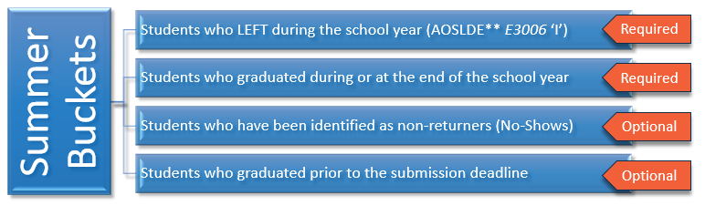
PROMOTION LOGIC – PEIMS SUMMER
Leavers are defined as exiting 7th – 12th grade students who are reported with an ExitWithdrawType (C162) in one of the following broad categories*:
completed high school or high school equivalency program
moved to another educational setting
withdrawn by school district
other *TWEDS References>PEIMS Leaver Data
**AOSLDE=AsOfStatusLastDayEnrollment

Slide 10
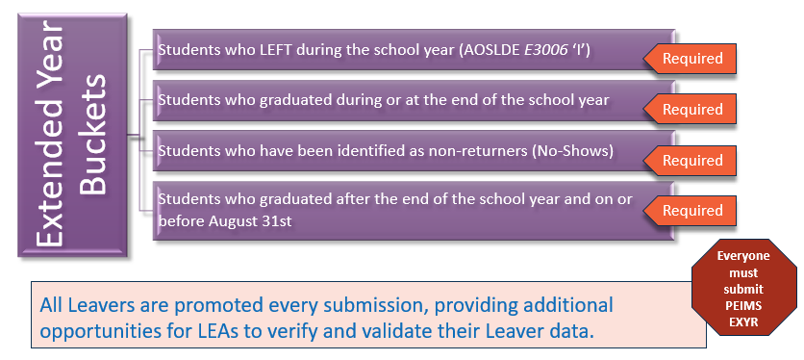
PROMOTION LOGIC – PEIMS EXTENDED YEAR

Slide 11
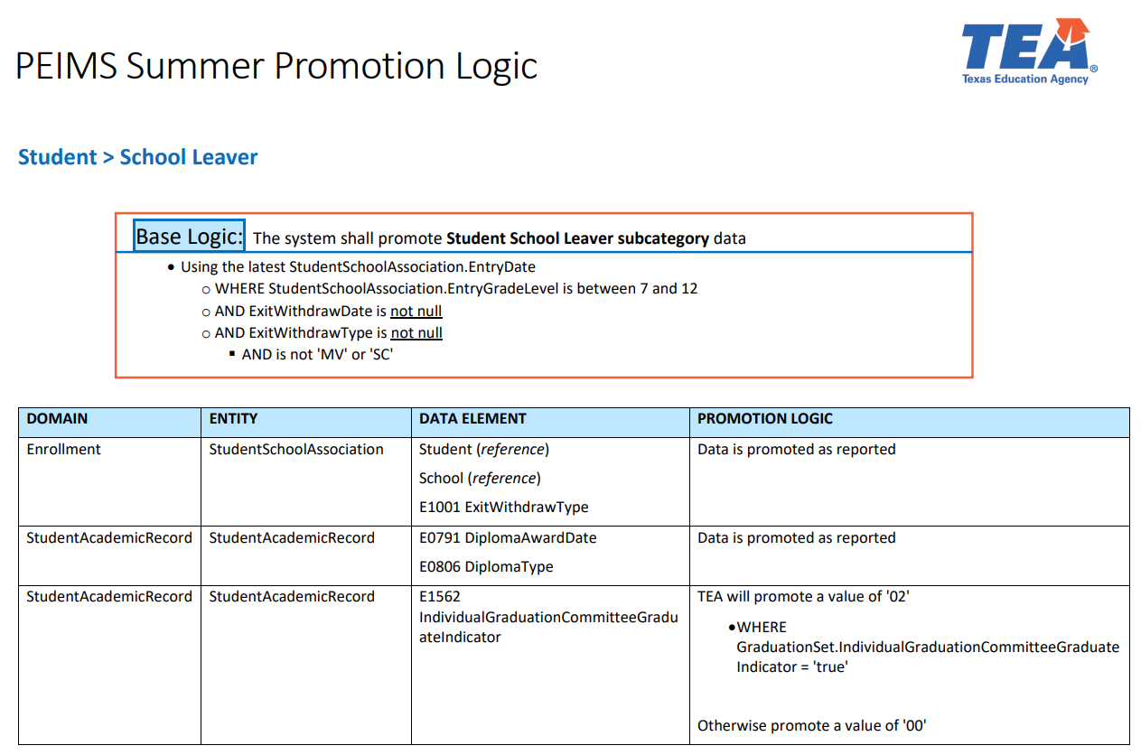
SIMPLIFIED PROMOTION LOGIC DOCUMENT
Visit the Data Collection Documentation webpage to view all published simplified promotion logic documents.

Slide 12

REPORTS

Slide 13
LEAVER REPORTS MOVING TO SUMMER
PDM3-124-001 – Dropout Students by Gender, Ethnicity & Grade
PDM3-124-002 – Dropout Roster
PDM3-124-003 – Graduates by Gender, Ethnicity, and Graduation Type
PDM3-124-004 – School Leaver Roster
PDM3-124-005 – School Leaver Summary
PDM3-124-006 – Non-Dropout Non-Graduates Leaver Roster
PDM3-124-007 – Graduate Roster by Graduation Type
PDM3-220-001 – Graduates Already Reported in Previous Year
PDM3-404-004 – Duplicate Student Report for Graduation
  Note: PEIMS Fall Submission Report: PDM1-403-001

Slide 14
LEAVER REPORTS INCORPORATED INTO SUMMER
PDM1-124-008 – School Leavers report has been incorporated into the PDM3-124-004 School Leaver Roster report
PDM1-120-018 – Student Foundation High School Program Graduate Roster has been incorporated into the
  PDM3-124-007 Graduate Roster by Graduation Type report

Slide 15
NEW REPORTS FOR SUMMER & EXTENDED YEAR
Proposed New Submission Comparison Reports
PDM4-221-001 – Leaver Comparison Roster Report
PDM4-221-002 – Leaver Comparison Summary Report
These new comparison reports will provide submission-to-submission insight into the reported leavers. It will answer the questions:
Was the Leaver reported already?
Was there a change to reported Leaver data?
Was the Leaver removed from this submission instance?
SUMR version will be available in PEIMS Summer 2026-2027.

Slide 16
UPDATED REPORTS FOR SUMMER
PDM3-230-002 – Submission Summary Report
PDM3-231-002 – Percentage of Change from Previous Year
Leavers and Graduates will be added to each of these reports.
Comparison to PEIMS Fall 2025-2026 for this year only.
School year 2026-2027 will be compared to PEIMS EXYR 2025-2026 accepted data.

Slide 17
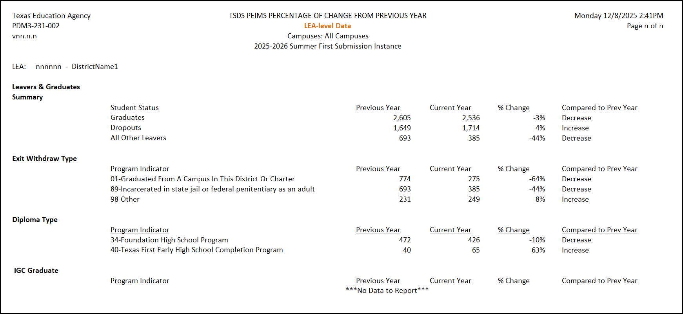
STATEMENT OF APPROVAL (SOA) REPORT

Slide 18
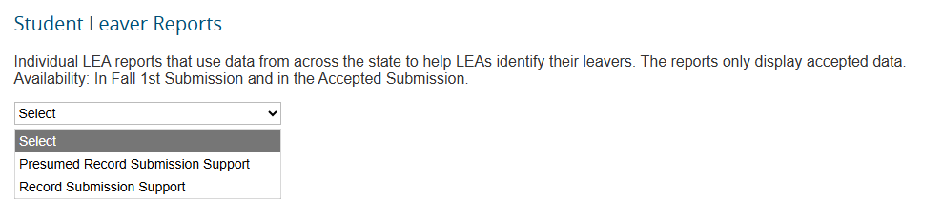
STUDENT LEAVER REPORTS
The new leaver reconciliation process is under review, and the report development has begun.
Note: More information coming in future FCN Webinars and other trainings.

Slide 19
PEIMS EXTENDED YEAR REPORTS UPDATES
Moving from PEIMS Fall |  | Updated to include Leavers & Grads
PDM4-124-001 |  | PDM4-230-002
PDM4-124-002 |  | PDM4-231-002
PDM4-124-003
PDM4-124-004 |  | New Submission Comparison Report
PDM4-124-005 |  | PDM4-221-001
PDM4-124-006 |  | PDM4-221-002
PDM4-124-007
PDM4-220-001
Available for the 2025-2026 school year!

Slide 20

BUSINESS RULES

Slide 21
BUSINESS RULES MOVING
The following list of rules are added to the PEIMS Summer and Extended Year Submissions.
Student Leaver | Student Graduation Program
40203-0048 | 48011-0018
40203-0049 | 48011-0019
40203-0050 | 48011-0020
40203-0051 | 48011-0028
40203-0052 | 48011-0030
40203-0053 | 48011-0031
 | 48011-0032
 | 48011-0033
 | 48011-0034

Slide 22
STUDENT LEAVER CATEGORY

Slide 23
STUDENT GRADUATION PROGRAM CATEGORY

Slide 24

THE PATH TOWARDS SUCCESS

Slide 25
PATH TO SUCCESS FOR AN LEA
Document
Document the withdrawal reason for withdrawals during the year.
By the last day of school, all students who withdrew during the year have an appropriate documented ExitWithdrawType.
Prepare
Prepare all graduate reporting details
Working with counselors, ensure that all required data for expected graduates is documented.
Determine
Determine year-end process for students who finish the school year enrolled.
The status of the student for Leaver reporting is unknown until the new year starts and the student returns.
Update
Update data for summer graduates.
Identify
Efficiently identify non-returning students after the new school year starts.
Including IGC graduates, summer school participants, EOC retakers, etc.
When school resumes, locate no-show students and their new educational setting.

Slide 26
WHAT IS THE TIMELINE?
PEIMS SUMR
Close of school-start window
PEIMS EXYR
PEIMS SUMR Resub
PEIMS EXYR Resub
October 1st
September 25th
August 27th
July 16th
June 18th

Slide 27
MOVERS
Students enrolled in the school year must be accounted for through leaver data (leaver, graduate, TxCHSE) or proof of enrollment in anther Texas-public school by the end of the school-start window (mover).
Mover Best Practices:
  Use TEA reports and the Enrollment Tracking application to locate students who moved.
  If in doubt report the student with an ExitWithdrawType 98 (Other, reason unknown or not listed).
  The TEA Leaver Reconciliation process will use the PEIMS Fall Enrollment Submission and the PEIMS Summer Submission attendance data to identify a student as a mover rather than a leaver.

Slide 28
SPPI-14 PREPARATION
SPPI-14
Exit Withdraw Type
Served in Special Education
SPPI-14
ExitWithdrawType
  ‘01’, ’24’, ‘88’, ‘90’, or ‘98’
Student served in special education during the school year they exited.
Confirm any changes that occur between PEIMS SUMR and PEIMS EXYR.
  For example: A student is initially reported as ’01’ Graduated in PEIMS SUMR. After graduation, the parent requests reenrollment for continued IEP services. Because the student returned to receive services, the student should not be reported as a final leaver in PEIMS EXYR.

Slide 29

SCENARIOS

Slide 30
MID-YEAR WITHDRAW
Zach Morris:
  Zach withdraws from Bayside High School in March. Zach does not return before the end of the school year and does not enroll elsewhere by year end.

Slide 31
MID-YEAR WITHDRAW 1
Discussion:
  Is Zach a mover or a leaver?
  Leaver
  Which submission(s) apply?
  PEIMS Summer Submission

Slide 32
ENROLLED LAST DAY, DOES NOT RETURN
Kelly Kapowski:
  Kelly is enrolled on the final instructional day of school. Kelly does not return during the next school-start window.

Slide 33
ENROLLED LAST DAY, DOES NOT RETURN 1
Discussion:
  Why is this not automatically a Summer leaver?
  Need to know if Kelly returns during the school-start window.
  When does the LEA know enough to report?
  After the close of the school-start window.

Slide 34
TEXAS PUBLIC-TO-PUBLIC TRANSFER
Samuel “Screech” Powers:
  Screech withdraws in May and enrolls and attends another Texas public school before the close of the school-start window.

Slide 35
TEXAS PUBLIC-TO-PUBLIC TRANSFER 1
Discussion:
  Should the Screech be reported as a leaver?
  Screech is a mover, not a leaver.
  Does this change if Screech does not enroll and attend another Texas public school until after the close of the school-start window?
  Yes, if Screech does not enroll and attend the student is a leaver.

Slide 36
SCHOOL-YEAR GRADUATE
Lisa Turtle:
  Lisa completes graduation requirements on April 21, 2026.

Slide 37
SCHOOL-YEAR GRADUATE 1
Discussion:
  Is Lisa reported as a graduate in the PEIMS Summer or Extended Year Submission?
  Lisa is reported a graduate in the PEIMS Summer Submission and TEA will continue to promote the graduation information in the PEIMS Summer Resubmission and PEIMS Extended Year Submission and Resubmission.

Slide 38
TENATIVE MOVER WHO NEVER ATTENDS
Jessie Spano:
  Jessie ends the school year at Bayside High School, and a records request is received from Valley High. Jessie never attends Valley High during the school-start window.

Slide 39
TENATIVE MOVER WHO NEVER ATTENDS 1
Discussion:
  How should this be handled initially?
  Jessie is initially a mover and will not be promoted as a leaver.
  What should be done when the LEA determines Jessie never attends Valley High?
  BHS should attempt to determine Jessie’s new educational setting and if none can be determined, Jessie is reported with an ExitWithdrawType 98 in the PEIMS Extended Year Submission.

Slide 40
SUMMER GRADUATE
A.C. Slater:
  A.C. completes graduation requirements on July 15, 2026.

Slide 41
SUMMER GRADUATE 1
Discussion:
  Is A.C. reported in the PEIMS Summer or Extended Year Submission as a graduate?
  TEA will promote the ExitWithdrawType 01 (Graduate) as soon as it is loaded in the LEAs IODS.

Slide 42
DOCUMENTATION ARRIVES LATER
Zach Morris:
  Zach withdraws from Bayside High School in March. Zach does not return before the end of the school year. In late August, the LEA receives documentation to support Zach attending a private school.

Slide 43
DOCUMENTATION ARRIVES LATER 1
Discussion:
  Can the PEIMS Summer Submission record be updated?
  The LEA should update the information in their student information system. The updated information will be in the LEAs IODS and promoted by TEA in the subsequent submissions.
  What happens when Zach’s leaver information is changed in the LEAs IODS in August, will the leaver information be changed?
  Yes, TEA will promote the updated information in the LEAs IODS.

Slide 44
IBC EARNED IN JULY
Kelly Kapowski :
  Kelly earns an Industry-Based Certification on July 10, 2026.

Slide 45
IBC EARNED IN JULY 1
Discussion:
  When is the IBC reported?
  Kelly’s IBC will be promoted by TEA to the PEIMS Extended Year Submission and again in the PEIMS Extended Year Resubmission.

Slide 46

QUESTIONS
QUESTIONS

