Slide 1
TSDS UPDATES
John Reese, Connor Briggs, Candice DeSantis – Subject Matter Experts
March 2019

Slide 2
CONTENTS
TSDS Updates
  Unique ID
  studentGPS® Dashboards
  PEIMS
New TSDS Collections & Projects
  Classroom Roster
  Organization Data
  Foster Care Reports
  Web-Enabled TEDS
2019-2020 Release Schedule
  Data Loading
  Application Updates

Slide 3
Unique id

Slide 4
Unique id: by the numbers
As of: March 18, 2019
    Enrollment Events Processed:
      Batch Files 28,042
      On-Line Entry 95,748
    ID Assignments Processed:
      Batch Files 47,094
      On-Line Entry 12,697
      Web Service calls 32,858

Slide 5
Unique id: Enrollment Reminders
    REMINDER: Unique ID assignment files must not contain Enroll/Withdraw Event Type and Enroll/Withdraw Event Data.
    REMINDER: Only weekly enrollment event changes are needed after the initial cumulative file has been processed.
    REMINDER: Utilize the TSDS UID Enrollment Submission Summary Report (UID0-000-006) located in the Global Reports Viewer to monitor the weekly submission of an LEA’s enrollment data loads.

Slide 6
Unique id: Name length changes
    Upcoming Change for 2019-2020:
    The Unique ID system will be configured to allow 60 characters for First Name, Middle Name and Last Name. This will be the same length allowed in the Operational Data Store (ODS) to ensure consistency across all TSDS applications.
      This is defined in TEDS final version publication (March 2019).
      This change will affect TSDS PEIMS and ECDS which include Reports, Application User Interfaces and Validation Rules where student/staff names are displayed.

Slide 7
Unique id: Name length changes Contd.
      The only change is to the number of characters allowed.
      The domain of Values for these name fields is unchanged.
        E0703 First-Name (A-Z, 0-9, ', -,[space])
        E0704 Middle-Name (A-Z, 0-9, ', -,[space])
        E0705 Last-Name (A-Z, 0-9, ', -,[space])
      The validations for character lengths will be performed during batch upload and on-line entry of ID Assignments and Enrollment Events.
      This should minimize the number of UID discrepancies during PEIMS data submissions.

Slide 8
Unique id: Frequently asked questions
Why am I receiving an ‘Event Creation Failed’ error message when submitting my enrollment event file.
    The file is not being processed due to duplicate trans_serial_numbers within the enrollment file. This is a unique number within the Unique ID application created when the data is processed.
    The Unique ID application has been updated to resolve the issue. TEA is currently working with their vendor to clean up the duplicates that still exist in the application.
    Guidance: LEAs are encouraged to submit a TIMS ticket with the duplicated trans_serial_number causing the ‘Event Creation Failed’. TEA will assist the LEA with deleting the duplicate to allow the processing of their submitted enrollment file.

Slide 9
Unique id: Frequently asked questions
Why do students show up on my UID0-000-001 Presumed Duplicate Student Report for Enrollment with only a withdrawal event listed from the previous LEA?
    This is due to a missing entry event for that student in the current school year. The report logic is under review to determine if the previous year’s entry (corresponding with the exit date) will correct this problem. Please continue to monitor the Known Issues and Release Notes for more information on when this issue will be resolved or for future guidance from TEA.

Slide 10
Unique id: Frequently asked questions
Can I edit an enrollment event from prior years?
    No. The system will restrict a user from editing an event not within the current school year. If a prior year enrollment event needs to be edited, please open a TIMS ticket and TEA will work with that LEA on resolving the issue.

Slide 11
Unique id: technical Resources
Technical Specifications:
TEDS Section 9
Web Services
Technical Support:
TSDSCustomerSupport@tea.texas.gov
Knowledge Base Articles:
TSDSKB-531 Data Loading Guidance for Batch Format 3.0
TSDSKB-530 Batch File Format 3.0 – ID Assignment
TSDSKB-535 Batch File Format 3.0 – Enrollment Event
TSDSKB-538 Enrollment Events – FAQ

Slide 12
Dashboards

Slide 13
Dashboards: by the numbers
As of: March 18, 2019
  Districts with a dashboard: 84
  Total number of students in the dashboards: 221,687
ESC | # LEAs
ESC 01 | 0
ESC 02 | 4
ESC 03 | 0
ESC 04 | 0
ESC 05 | 7
ESC 06 | 5
ESC 07 | 0
ESC 08 | 12
ESC 09 | 0
ESC 10 | 1
ESC | # LEAs
ESC 11 | 34
ESC 12 | 5
ESC 13 | 1
ESC 14 | 0
ESC 15 | 2
ESC 16 | 0
ESC 17 | 0
ESC 18 | 0
ESC 19 | 4
ESC 20 | 9

Slide 14
Dashboards: new version released
Dashboards were updated in December 2018.
New Functionality:
  Dynamic Watch Lists
  Configurable Student Goals and Grading Scales
  Usage Module
Updated Onboarding Process
  Streamlined process: An LEA only needs to submit one TIMS ticket to request the Dashboards. The “QA Dashboard” ticket is no longer needed.
  Refer to TSDSKB-499 for more information.

Slide 15
Dashboards: student transcript change
REMINDER: LEAs no longer need to load prior year EducationOrganization and MasterSchedule interchanges to populate a student’s historical transcript. This system requirement was removed in August 2018.
Due to this change, any courses that have not been included in the current year EducationOrganization and MasterSchedule interchanges appear in the dashboards Student Transcript page with ‘N/A’ (or blank) as the course Description and ‘N/A’ as the Subject Area.

Slide 16
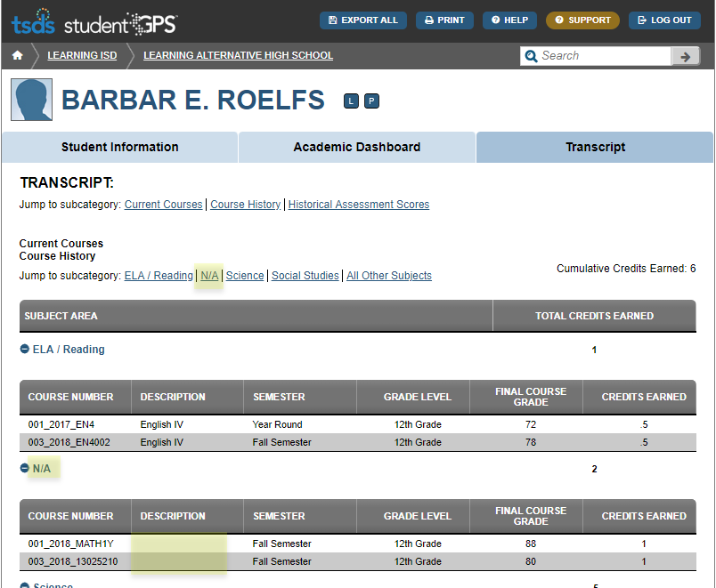
Dashboards: Student transcript change
Current issue in the 2018-2019 Student Transcript:

Slide 17
Dashboards: Student transcript change
2019-2020 TEDS Change
To correct this issue, the following data elements will be added to the CourseTranscriptExtension complex type in the InterchangeStudentTranscriptExtension.
  E1186 SUBJECT-AREA
  E1187 COURSE-DESCRIPTION
The ODS and Dashboards will be updated in August 2019 to allow for these additional elements.

Slide 18
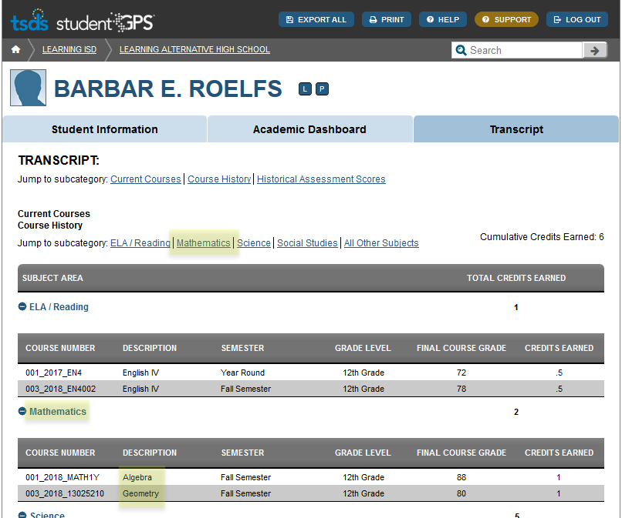
Dashboards: Student transcript change
2019-2020 Student Transcript with Subject Area and Course Description loaded:

Slide 19
Dashboards: preparing for End-of-year
End-of-Year (EOY) Data Loading:
  State Assessments
  Final Attendance
  Final Grades
ESC Champions should work with participating LEAs to review the quality of their current Dashboard metrics and load any missing data.
LEAs are encouraged to verify STAAR results from the Spring and Summer administrations.

Slide 20
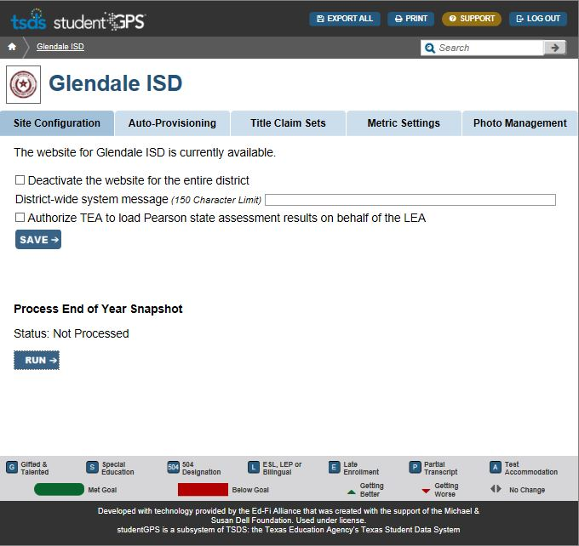
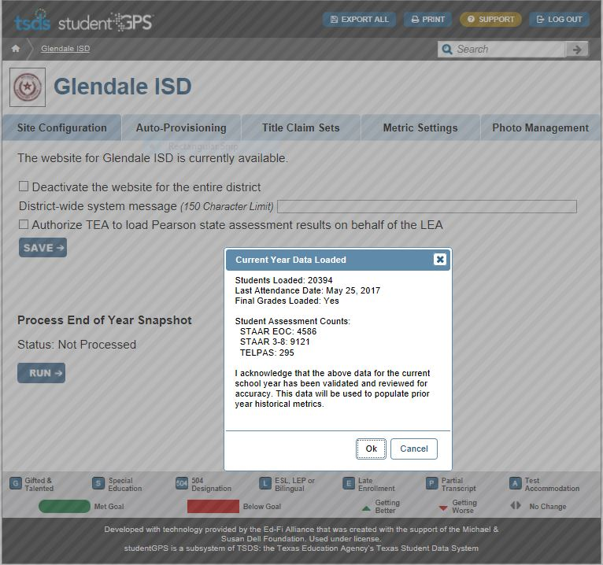
Dashboards: preparing for End-of-year
The EOY option will be available in late May.
District-Facing Option
Verify Data Counts
TEA will complete processing for LEAs that choose not to run their own EOY snapshot.

Slide 21
dashboards: demo site update
The TSDS demo site is currently being updated.
New Functionality:
  Dynamic Watch Lists
  Configurable Student Goals and Grading Scales
  Usage Module
URL and login information:
  The URL will remain the same (tsdsdemo.com).
  Refer to TSDSKB-494 for login information.
Future Updates:
Going forward, the TSDS demo site will be updated on a more frequent basis and will be closer aligned to the current version of dashboards in Production.

Slide 22
teds-AI: overview & update
TEDS-AI:
  Texas Education Data Standards (TEDS) + Assessment Importer (AI)
  Allows users to convert specific assessment files into TEDS-compliant XML files that can be loaded to the ODS and viewed in the dashboards.
Assessment Conversion for:
  SAT
  PSAT
  ACT
  AP
  Eduphoria! Aware

Slide 23
Teds-ai: new assessments
New assessment metrics will be added to the dashboards prior to end of 2018-2019 school year.
  Texas Success Initiative (TSI) Assessment
  Texas Kindergarten Entry Assessment (TX-KEA)
TSDS integration is planned for TEDS-AI by the start of next school year.

Slide 24
Dashboards: upcoming training
TSDS Continuing Education Online Training:
  August 13, 2019
  August 20, 2019
  August 27, 2019
New User Onsite Workshop
  October 29-30, 2019 (9:00am-4:30pm each day)

Slide 25
dashboards: technical Resources
TSDS Demo Site:
https://tsdsdemo.com/
TEDS-AI Download:
https://collab.region10.org/display/TSDSTOOLS
Knowledge Base Articles:
TSDSKB-215 TEAL Auto-Provisioning Steps
TSDSKB-363 End-of-Year (EOY) Process
TSDSKB-467 TEDS-AI Information
TSDSKB-494 Dashboard Demo Login Credentials
TSDSKB-499 How to activate the studentGPS® Dashboards

Slide 26
peims

Slide 27
Peims: Outstanding report issues
Pending report issues for Summer:
PDM3-130-001 Superintendent’s Report of Student Attendance
  The totals for rows J through Q are a sum not an average
  The cumulative section is not calculating correctly
PDM3-120-004 TSDS PEIMS Disaggregation of PEIMS Summer Attendance Data
  Student Count by Grade is not correct
  ‘Percent in Attendance’ section Days Membership column calculation is incorrect
PDM3-130-005 Comparison of Current and Prior Year Attendance
  The refined ADA calculations are incorrect
PDM3-130-011 Flex Attendance – Superintendent’s Report of Student Attendance
  Incorrect FTE and ADA calculations
PDM3-130-014 Flex Attendance - Superintendent’s Summary Report of Student Attendance
  Incorrect FTE and ADA calculations

Slide 28
Peims: Outstanding report issues
Pending report issues for Summer (continued):
  PDM3-130-008 Superintendent’s Summary Report of Student Attendance
    Incorrect FTE and ADA calculations
  PDM3-130-012 Flex Attendance – Superintendents Report of Career & Technical Education Eligible Days
    Incorrect Eligible Minutes and Equivalent Days
  PDM3-132-006 Campus Attendance Diagnostic Messages
    Incorrect Incident count
  PDM3-125-003 Student Restraint Events by Grade
    Not showing student's Primary disability records when Primary Disability parameter is selected

Slide 29
PEIMS: Outstanding validation issues
Pending validation rule issues for Summer:
  30040-0002
    Users are unable to promote staff members information when the staff member is assigned to service id’s for both PK/KG and 1-12.
  40110-0192
    If a student transfers between two LEAs, with one LEA having a DAEP/JJAEP and the other LEA does not, the LEA that does not have the DAEP/JJAEP is receiving the fatal validation rule for Campus ID of Accountability when they should not.

Slide 30
Peims: Effective date changes
  2019-2020 TEDS Changes
  StudentSpecialEdProgramAssociationExtension Complex Type
  3 effective dates
    TX-EffectiveDateSpEd
    TX-EffectiveDateDisabilities
    TX-EffectiveDateServices
  Fall Submission
    All data elements promoted to PEIMS
    Effective date on or before the PEIMS Fall snapshot date
  Summer Submission
    Three data elements promoted to PEIMS
      Instructional Setting
      Primary Disability
      Multiply Disabled
    The latest effective date

Slide 31
NEW TSDS collections & projects

Slide 32
Classroom Roster
The new Classroom Roster collection will be submitted two times per year, Fall and Winter.
Classroom Roster Fall submission
  As of the last Friday in September
  Submission due date 10/15
Classroom Roster Winter submission
  As of the last Friday in February
  Submission due date 3/15

Slide 33
Classroom Roster
The new collection will include the following complex types:
Organization data:
  LocalEducatonAgencyExtension Complex Type
  SchoolExtension Complex Type
Campus Course Section data:
  CourseOffering Complex Type
  SectionExtension Complex Type
Staff data:
  StaffExtension Complex Type
  TeacherSectionAssociationExtension Complex Type
Student data:
  StudentExtension Complex Type
  StudentSectionAssociation Complex Type

Slide 34
Classroom Roster Timeline
Governance Approval:
  The data collection schedule has been presented and approved by all three governance committees.
TEDS Publication:
  The data collection was published in the 2019-2020 TEDS final version on March 1, 2019.
Begin Collecting data via TSDS:
  Classroom Roster collection will begin loading data in TSDS August 2019 for the 2019-2020 School year.

Slide 35
Organization data
The original plan was to move the organization data from its current database into the TSDS ODS.
Upon further technical review, the decision has been made to add effective date and historical tracking to the current database.
Starting with the 2019-2020 school year, TSDS applications will incorporate the effective date into the TSDS applications.
  Effective Date of Org Status changes
  Near real-time access to org data
  DISTRICT-NAME & CAMPUS-NAME will no longer be submitted through InterchangeEducationOrganizationExtension
    This name date will be retrieved from the org data.

Slide 36
Foster care reports
The TSDS team is currently working with the Foster Care Division on matching data from the Texas Department of Family & Protective Services (DFPS) with Unique ID data to assist LEAs with ensuring all Foster Care student are accurately reported in PEIMS.
The goal is for DFPS to send a nightly or weekly file of their foster care students. TEA will attempt to match those students against Unique ID.
Reports will be provided at the LEA level listing foster care students enrolled in their LEA.

Slide 37
Web-enabled teds
The TSDS teams are continuing to work on the web-enabled TEDS (TWEDS) application.
  TEA has received feedback from a small work group of ESCs and is in the process of developing the application.
  The deployment is scheduled for August 2019.

Slide 38
2019-2020 release schedule

Slide 39
Release schedule
ODS / Data Loading
  August 2, 2019
    2019-2020 TEDS Final
  October 4, 2019
    2019-2020 TEDS Addendum

Slide 40
Release schedule
PEIMS Application
  September 6, 2019
    2019-2020 TEDS Final PEIMS Fall updates
  October 4, 2019
    2019-2020 TEDS Addendum PEIMS Fall updates
  November 8, 2019
    2019-2020 TEDS Final/Addendum PEIMS Midyear updates
  March 2, 2020
    2019-2020 TEDS Final/Addendum PEIMS Summer & Extended year updates

Slide 41
Release schedule
ECDS
  October 4, 2019
    2019-2020 TEDS All Versions
Residential Facility Tracker
  September 6, 2019
    2019-2020 TEDS All Versions
SPPI - 14
  September 6, 2019
    2019-2020 TEDS All Versions
Classroom Roster
  August 5, 2019
    2019-2020 TEDS All Versions

Slide 42
TSDS collection due dates
  TSDS Classroom Roster Fall submission 10/17/2019
  TSDS PEIMS Fall 1st submission 12/05/2019
  TSDS PEIMS Fall resubmission 01/16/2020
  TSDS PEIMS Midyear 1st submission 01/23/2020
  TSDS ECDS Kindergarten submission 01/30/2020
  TSDS PEIMS Midyear resubmission 02/06/2020
  TSDS SPPI-14 submission 02/20/2020
  TSDS Classroom Roster Winter submission 03/16/2020

Slide 43
TSDS collection due dates
  TSDS PEIMS Summer 1st submission 06/18/2020
  TSDS PEIMS Summer resubmission 07/16/2020
  TSDS ECDS Prekindergarten submission 07/16/2020
  TSDS ECDS Private Prekindergarten submission 07/16/2020
  TSDS RF Tracker submission 07/30/2020
  TSDS PEIMS Summer year-round LEAs 08/13/2020
  TSDS PEIMS Extended Year 1st submission 08/27/2020
  TSDS PEIMS Extended Year resubmission 09/17/2020

Slide 44

Questions?
www.texasstudentdatasystem.org

