Slide 1
Student Attendance Accounting Handbook
Joe Herrera, Financial Compliance

Slide 2
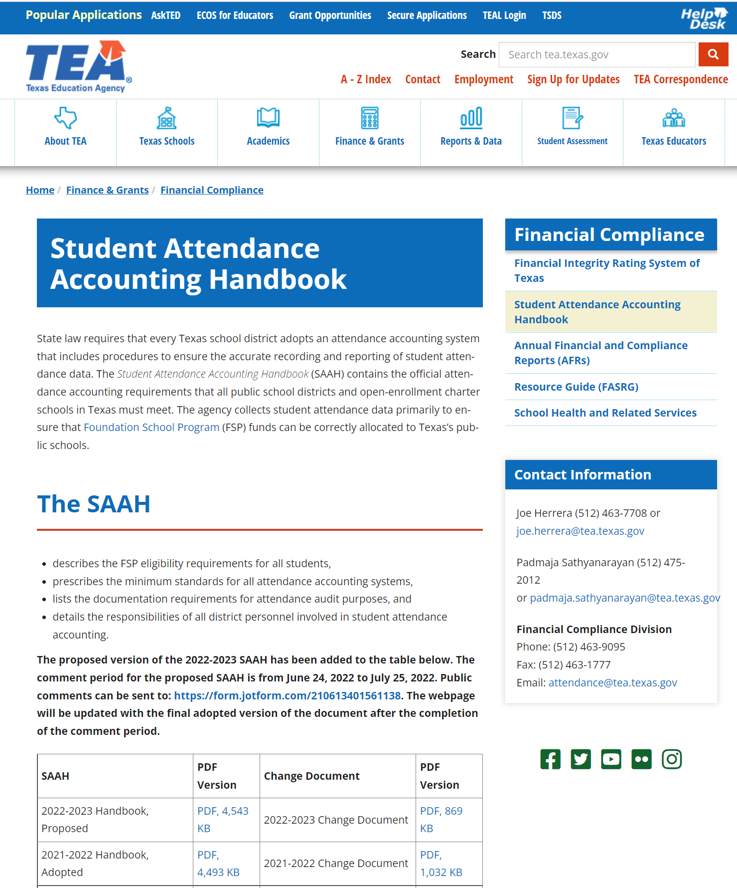
SAAH Website

Slide 3
SAAH: Why and How
Statutory Citations Relating to Amendment to 19 TAC Chapter 129, Student Attendance,
Subchapter AA, Commissioner's Rules, §129.1025, Adoption by Reference: Student Attendance
Accounting Handbook

Slide 4
SAAH by Section: 1-13
1: Overview
2: Audit Requirements
general, system, documentation
3: Attendance
responsibilities, attendance taking, calendars
4: Special Education
ECSE
5: Career and Technology (CTE)
contact hours, documentation
6: Emergent Bilinguals/English Learners
7: Prekindergarten
8: Gifted/Talented
9: Pregnancy Related Services
10: AEP and Disciplinary Removals
11: Nontraditional Programs
dual credit, OFSDP
12: Virtual Remote and Electronic Learning
13: Appendix / Glossary

Slide 5
2024-2025 Updates

Slide 6
Proposed

Slide 7
SAAH Section 2.3.1 Student Detail Reports
18. attendance data totals for all students, summarized by grade and including:
days membership (both eligible and ineligible students)
days absent (both eligible and ineligible students)
total days present (both eligible and ineligible students) (in-person, remote synchronous, and remote asynchronous)
ineligible days present and total ineligible minutes present for OFSDP or HSEP students
eligible days present and total eligible minutes present for OFSDP or HSEP students
eligible days present for bilingual/ESL students (in-person, remote synchronous, and remote asynchronous)
eligible days bilingual/ESL dual language one-way program (in-person, remote synchronous, and remote asynchronous)
eligible days bilingual/ESL dual language two-way program (in-person, remote synchronous, and remote asynchronous)
eligible days bilingual/ESL dual language two-way program (Non EL-EB/English Proficient) (in-person, remote synchronous, and remote asynchronous)
eligible days present for PRS students (in-person, remote synchronous, and remote asynchronous)

Slide 8
SAAH Section 2.3.2 Campus Summary Reports
5. attendance data totals for all students, summarized by grade and including:
days membership (both eligible and ineligible students)
days absent (both eligible and ineligible students)
total days present (both eligible and ineligible students)
ineligible days present
eligible days present (in-person, remote synchronous, and remote asynchronous)
eligible days bilingual/ESL (in-person, remote synchronous, and remote asynchronous)
eligible days bilingual/ESL dual language one-way program (in-person, remote synchronous, and remote asynchronous)
eligible days bilingual/ESL dual language two-way program (in-person, remote synchronous, and remote asynchronous)
eligible days bilingual/ESL dual language two-way program (Non EL-EB/English Proficient) (in-person, remote synchronous, and remote asynchronous)
eligible days PRS (in-person, remote synchronous, and remote asynchronous)
eligible days special education mainstream (in-person, remote synchronous, and remote asynchronous)
eligible days early education allotment educationally disadvantaged (grades kindergarten through three), if applicable

Slide 9
SAAH Section 2.3.3 District Summary Reports
5. attendance data totals for all students, summarized by grade and including:
days membership (both eligible and ineligible students)
days absent (both eligible and ineligible students)
total days present (both eligible and ineligible students)
ineligible days present
eligible days present (in-person, remote synchronous, and remote asynchronous)
eligible days bilingual/ESL (in-person, remote synchronous, and remote asynchronous)
eligible days bilingual/ESL dual language one-way program (in-person, remote synchronous, and remote asynchronous)
eligible days bilingual/ESL dual language two-way program (in-person, remote synchronous, and remote asynchronous)
eligible days bilingual/ESL dual language two-way program (Non EL-EB/English Proficient) (in-person, remote synchronous, and remote asynchronous)
eligible days PRS (in-person, remote synchronous, and remote asynchronous)
eligible days special education mainstream (in-person, remote synchronous, and remote asynchronous)
eligible days early education allotment educationally disadvantaged (grades kindergarten through three), if applicable

Slide 10
SAAH Section 2.3.4 Reconciliation of Teacher’s Roster Information and Attendance Accounting Records
20. board-approved local policy that defines the instruction methods (i.e., synchronous, asynchronous, or a combination of both) (This local policy should include the official attendance times for synchronous instruction. Additionally, if the board policy indicates approval for asynchronous method, the LEA must create an asynchronous instructional plan.)
21. documentation of a student's instructional schedule, whether synchronous or asynchronous, that includes the minimum amount of instructional time to meet the two-through-four rule

Slide 11
SAAH Section 2.3.5 Additional Required Documentation
20. board-approved local policy that defines the instruction methods (i.e., synchronous, asynchronous, or a combination of both) (This local policy should include the official attendance times for synchronous instruction. Additionally, if the board policy indicates approval for asynchronous method, the LEA must create an asynchronous instructional plan.)
21. documentation of a student's instructional schedule, whether synchronous or asynchronous, that includes the minimum amount of instructional time to meet the two-through-four rule
22. any and all bell schedules used during the school year

Slide 12
SAAH 3.2.1.1 Code 0 Enrolled, Not In Membership
A student receiving special education and related services who has graduated but returned to school or is continuing enrollment after meeting graduation requirements and is scheduled for fewer than two hours of instruction per day
a student who receives all his or her special education and related services through an approved contract with a nonpublic day or nonpublic residential school

Slide 13
SAAH 3.2.1.10 Code 9 Enrolled, Not In Membership Due to Virtual Learning
Code 9 applies to a student who is enrolled in a virtual learning program but not in membership. This code applies to students who are attending a virtual program under SB15 and are not eligible to participate in the program.

Slide 14
SAAH 3.2.2 Funding Eligibility

Slide 15
SAAH 3.2.2.4 Funding Eligibility of Students Who Have Met All Graduation Requirements
If a student has completed all the requirements for a high school diploma, the student is not eligible to continue to generate ADA for funding purposes. Exceptions are students who are eligible to graduate but who continue their education to meet the requirements of a higher high school diploma standard; students enrolled in a TEA-designated Pathways in Technology Early College High School (P-TECH) and coded in TSDS PEIMS (E3063); students who have not met the assessment requirements for graduation; students who are continuing enrollment to receive special education services; or students who have returned to school to receive special education services after receiving a diploma. (See 3.2.2.5 Funding Eligibility of Students Who Have Met All Graduation Requirements Except Passing Required State Assessments and 3.2.3 Age Eligibility).

Slide 16
SAAH 3.3.5 Entry and Reentry Dates
The student’s entry date is the first day the student is physically or virtually present during the official attendance accounting period on a particular campus at the attendance taking time (see 3.6.2 Time of Day for Attendance Taking). A student’s reentry date is the first day the student is physically present during the official attendance accounting period at the attendance taking time after having been withdrawn from the same campus. A student cannot be absent on either the entry or the reentry date. Also, a student cannot be absent on the first day of school.
The student is in membership on both the entry date and the reentry date. See 3.2 Membership and Eligibility for Attendance and Foundation School Program (FSP) Funding for minimum time requirements for a student to be in membership.
Students that begin school as homebound, including CEHI, may indicate their “official entry date” as the first day of the school year as long as all the documentation requirements are met and the full number of hours needed are provided by the end of that week.

Slide 17
SAAH 3.3.6.3 Entitlement of Students of Active Military Servicemembers and Peace Officers to Transfer
Districts must accept the transfer application of students whose parent or guardian is an active military servicemember or peace officer and requests a transfer to another campus in the currently enrolled district or to another adjoining school district.

Slide 18
SAAH 3.3.9 Infants and Toddlers Who Are Deaf or Hard of Hearing or Have Visual Impairments or Both
The following information is required to enroll an infant or toddler in the district or RDSPD that will be providing the appropriate services as described in the IFSP:
Parent or guardian name
Family’s home address
Legal name of the child
Child’s date of birth
Child’s identified disability/disabilities for which district services will be provided
Copy of current IFSP (Services are required to start within 28 days of the signed IFSP)
Districts do not need proof of age or identity or current immunization records. Infants and toddlers receiving services under an IFSP, which is through the early childhood intervention (ECI) program coordinated by the Texas Health and Human Services Commission (HHSC) generally do not receive services at an actual school building; therefore, immunization records are not needed until the child transitions to IDEA Part B (school-age) services at age three or older. If an infant or toddler is attending a school-based program, the family will have to present the same enrollment documentation as is expected for any child who is attending school.

Slide 19
SAAH 3.4.4 Information and Record Transfer
if a language other than English is identified, the original copy of the home language survey
initial/end-of-year Language Proficiency Assessment Committee (LPAC) documentation, if applicable
parental permission/denial forms for bilingual education programs, or English as a second language (ESL) program services, if applicable

Slide 20
SAAH 3.7 General Education Homebound (GEH) Program
Note: A student who has an infant (0-6 months) considered medically fragile and who meets the criteria in the bullets listed above may also be considered for the GEH program.

Slide 21
SAAH 3.8 Calendar

Slide 22
SAAH Section 3.8.1.3 Low-Attendance Day Waivers
Note: An instructional day that experienced low attendance but does not meet the qualifications for the waiver must still report that date as a day of instruction and should not be changed to a non-instructional day, even if the LEA has excess minutes in the calendar. Local education agencies are responsible for submitting current, complete, and accurate data required for each PEIMS and TSDS collection.
Each person entering data into the attendance accounting system must attest that the data he or she has entered are true and correct to the best of his or her knowledge. The superintendent must affirm that he or she has taken measures to verify the accuracy and authenticity of the attendance data (see SAAH, Section 3.1 Responsibility).

Slide 23
SAAH Section 3.8.1.4 Staff Development Waivers
Note: Effective with the 2025–2026 school year, districts and open-enrollment charter schools that are four-day-school-week LEAs are not eligible to receive a staff development waiver.

Slide 24
SAAH Section 3.8.1.4 Staff Development Waivers 1
Note: Districts or charter schools must demonstrate that they are providing high quality staff development that will impact student outcomes. The waiver is applicable only to real-time staff development that all district staff participate in simultaneously in lieu of student instruction (i.e.,“exchange/trade” days or professional development that staff receive on their own time outside of the school/workday may not be counted toward the waiver minutes allotted for staff development).

Slide 25
SAAH Section 3.8.1.8 School Safety Training Waiver
A waiver of operational and instructional time may be applied for by a district requiring each educator employed by the district to attend an approved Texas School Safety Center (TxSSC) school safety training course. As the waiver is for operational and instructional minutes, it may not be used prior to the first day of student instruction or after the last day of student instruction. In order to qualify for the waiver, the training course must be listed on the TxSSC’s List of Approved Trainings for Operational and Instructional Time Waivers for School Safety Training. The waiver is limited to a maximum of 420 minutes but must reflect actual training minutes provided for the approved training course.
An application for school safety training minutes must be submitted using TEA’s automated waiver application system and the School Safety Waiver application, which is available in TEAL. Your district must include the following items in its application:
the specific TxSSC approved training course information; and
a copy of the board agenda at which the board approved the specific waiver request.
The district must locally retain documentation and records of all staff taking the training, including the date and hours or minutes of the training. The agenda should clearly identify the type(s) of training and how long each agenda item took to cover the material.

Slide 26
SAAH Section 3.11 Examples
See Section 3 Examples

Slide 27
SAAH Section 4.1 Responsibility
Note: Your district must not assign attendance personnel the responsibility of determining the coding information for a student who is receiving special education services. Special education staff members, directors, or teachers should provide attendance personnel with names and coding information of students who are eligible and whose documentation is in order. Special education directors and staff members are responsible for reviewing special education data and totals for accuracy and completeness. They are also responsible for ensuring that attendance personnel are aware of any changes in a student’s services and the effective dates of those changes. The attendance personnel are then responsible for entering the changes in the student attendance accounting system. At the end of each six-week reporting period, special education staff members should check the Student Detail Report for any coding errors.

Slide 28
SAAH Section 4.7.2 Code 00 No Instructional Setting (Speech Therapy)
Instructional Setting Code 00: Information Specific to TSDS PEIMS StudentSpecialEducationProgramAssociation Entity
The TSDS PEIMS StudentSpecialEducationProgramAssociation Entity allows for only one instructional setting code to be reported for a student.
A student will have an instructional setting code of 00 reported on the TSDS PEIMS StudentSpecialEducationProgramAssociation Entity when:
a student is receiving speech therapy (regardless of whether the therapy is provided by a push-in model in a general education classroom or pull-out model in another location) and no other special education instructional or related services; or
a student is receiving speech therapy and one or more related services (supportive services that do not constitute instructional services such as occupational therapy, physical therapy, etc.) (regardless of whether the related services are provided by a push-in model in a general education classroom or pull-out model in another location) but no special education instructional services.

Slide 29
SAAH Section 4.7.2 Code 00 No Instructional Setting (Speech Therapy) 1
A student whose instructional setting code is reported as 00 on the TSDS PEIMS StudentSpecialEducationProgramAssociation Entity must have a speech therapy indicator (SpecialEducationProgramService (C341)) 24 (Special Education Student Receives Speech Therapy Only).
A student will NOT have an instructional setting code of 00 reported on the TSDS PEIMS StudentSpecialEducationProgramAssociation Entity when the student receives speech therapy (regardless of whether the therapy is provided by a push-in model in a general education classroom or pull-out model in another location) and also receives special education instructional services. In this case, the code used for the TSDS PEIMS StudentSpecialEducationProgramAssociation Entity will be the student’s primary instructional arrangement and will indicate a speech therapy indicator (SpecialEducationProgramService (C341)) 25 (Special Education Student Receives Speech Therapy and Other SPED Instructional Setting). If the student receives related services, the time spent in those related services in a special education setting will be considered when determining the student’s instructional arrangement setting.
Instructional Setting Code 00: Information Specific to TSDS PEIMS SpecialEducationProgramReportingPeriodAttendance Entity
The TSDS PEIMS SpecialEducationProgramReportingPeriodAttendance Entity (for special education attendance data - student) allows for multiple instructional setting code to be reported for a student for a given period. If two instructional setting codes are reported for a student for a given period, one of them must be 00. The only time two setting codes would be reported is when a student receives special education instructional services in addition to speech therapy.

Slide 30
SAAH Section 4.7.2 Code 00 No Instructional Setting (Speech Therapy) 3
A student who is receiving speech therapy services and is not receiving special education instructional services through any other instructional setting (for example, the resource room) for a given period should have only one instructional setting code reported on the TSDS PEIMS SpecialEducationProgramReportingPeriodAttendance Entity for that period: 00. Code 00 is used regardless of whether the therapy is provided by a push-in model in a general education classroom or a pull-out model in another location and if the student is receiving any other related services.
A student who receives speech therapy services and who also receives special education instructional services in a special education setting (see exception below as to why special educational instructional services in a general education setting cannot be reported through the TSDS PEIMS Special EducationProgramReportingPeriodAttendance Entity) for a given period should have two instructional setting codes reported on the TSDS PEIMS SpecialEducationProgramReportingPeriodAttendance Entity for that period: 00 and the code for the other instructional setting through which the student is receiving special education instructional services

Slide 31
SAAH Section 4.7.2 Code 00 No Instructional Setting (Speech Therapy) 4
Exception: The SpecialEducationProgramReportingPeriodAttendance Entity does not permit reporting of the 40 - Mainstream instructional setting code. If a student receives their special education instructional services in a general education instructional setting and also receives speech therapy services, the SpecialEducationProgramReportingPeriodAttendance Entity should have only one instructional setting code reported: 00.

Slide 32
SAAH Section 4 Updates
4.7.2 Code 01 - Homebound
4.7.3 Code 02 - Hospital Class
4.7.4 Code 08 - Vocational Adjustment Class (VAC)
4.7.19 Code 81, 82, 83, 84, 85, 86, 87, 88, 89, or 89 – Residential Care Treatment Facility (Not School District Resident)
4.7.20 Code 91, 92, 93, 94, 95, 96, 97, or 89 – Off Home Campus
4.8.1 Speech Therapy Indicator Codes

Slide 33
SAAH Section 4.18 Examples
See Section 4 Examples

Slide 34
SAAH Section 5.5 CTE (Contact Hour) Codes
Each CTE course must be reviewed separately to determine the average minutes per day students attend that course. Three contact hours (V3) is the maximum an LEA may claim for a single course. To receive CTE weighted funding, course periods must be an average a minimum of at least 45 minutes a day. LEAs that including planned early release days, pep rallies, assemblies, modified bell schedules etc. must ensure that the average course length for the calendar year. is at least 45 minutes. Days covered under 3.8.2 Closures for Bad Weather or Other Issues of Health and Safety, 3.8.1.5 Staff Professional Development Minute waivers, and 3.6.6 Modified Schedule State Assessment Testing Day waivers, are not part of the calculation. Three contact hours (V3) is the maximum an LEA may claim for a single course.

Slide 35
SAAH Section 5.12 Examples
See Section 5 Examples

Slide 36
SAAH Section 6 Bilingual/English as a Second Language
The term “exit,” as used in this section, is interchangeable with the term “transfer,” used in the TEC, Chapter 29, Subchapter B. A distinction has been made to clarify the difference between the use of the terms “reclassification” and “exit” in alignment with 19 TAC Chapter 89, Subchapter BB. Reclassification is the process for EB students who have met criteria to be identified as non-EB/English Proficient (EP) by which the LPAC determines that an EB student has met the appropriate criteria to be classified as English Proficient, and the student enters year 1 of monitoring as indicated in TSDS PEIMS. “Exit” describes the process for reclassified students to no longer participate in a bilingual or ESL program is the point at which a student is no longer classified as an EB student and ends bilingual or ESL program participation based on LPAC recommendation and parental approval.
Within this section, the term "parent" includes the parent or legal guardian of the student in accordance with the TEC, §29.052. Also, the term “district” includes all school districts, public open-enrollment charter schools, and districts of innovation.

Slide 37
SAAH 6.2 Identification of Emergent Bilingual (EB) Students and Enrollment Procedures
1. Upon initial enrollment in a Texas public school, a student’s parent completes a home language survey (HLS), indicating which languages are used at home, which languages are used by the child at home, and which languages were used in a previous home setting, if applicable. (see 6.10.1 Home Language Survey (HLS) Requirements). Students in grades nine through 12 may complete the HLS themselves.

Slide 38
SAAH 6.2 Identification of Emergent Bilingual (EB) Students and Enrollment Procedures 1
2. If multiple languages are indicated on questions 1 or 2, LEAs are guided to report the language other than English. If multiple languages other than English are listed, LEAs are guided to ask the parent to indicate (in writing or through documented phone conversation) which of the two non-English languages is used most of the time. This clarification should occur in a timely manner so the identification process can be completed within the 4-week period. If English is indicated on questions 1 and 2 but a language other than English is indicated on question 3, LEAs are guided to report the language other than English for the student language.
Parents may request a correction on the HLS only if the child has not yet been assessed for English proficiency and corrections are made within two calendar weeks of the child’s enrollment date.
If a language other than English is indicated on any of the three required questions on the home language survey, the district must assess the student for English language proficiency using the state-approved assessment. Additionally, if the school district is required to provide a bilingual education program at the elementary grades, a language proficiency assessment in the primary language of the student must be administered for students at the elementary grade levels whose primary language is that of the bilingual education program.

Slide 39
SAAH 6.2 Identification of Emergent Bilingual (EB) Students and Enrollment Procedures 2
3. District personnel who are proficient in the language of the test and trained in the language proficiency testing requirements of the test publisher assess the student for English language proficiency using the state-approved English language proficiency assessment. Additionally, primary language proficiency is assessed, as appropriate, using the state-approved Spanish language proficiency assessment or informal language assessment measures for languages other than Spanish (19 TAC §89.1226(d)).
Important: A student will be identified as EB if the student is not English proficient or the student’s disabilities are so severe that the English language proficiency assessment cannot be administered (19 TAC §89.1226(g)). The student’s primary language proficiency level is not a criteria for identification but is used for subsequent instructional purposes.

Slide 40
SAAH 6.2 Identification of Emergent Bilingual (EB) Students and Enrollment Procedures 3
4. The language proficiency assessment committee (LPAC) convenes to identify the student as EB or as English proficient based on the results of the English language proficiency assessment and recommends placement of the identified EB student in either the bilingual or ESL education program, in accordance with 19 TAC §89.1205 (a) and (c). However, district personnel do not yet assign the student a bilingual or ESL program type code in the attendance accounting system until parental consent is received.

Slide 41
SAAH 6.2 Identification of Emergent Bilingual (EB) Students and Enrollment Procedures 4
5. The LPAC must use the standardized Parental Notification of Identification and Approval of Placement letter to inform the parent that the student has been identified as EB and to request documented parental approval to place the student in the required bilingual or ESL education program. (19 TAC §89.1220(h)).
Documentation of parental approval for bilingual or ESL program participation must be obtained. Parental approval may be obtained in writing with the parent’s signature and date on the Parental Notification of Identification and Approval of Placement letter, through a documented phone conversation, or through an email that is retained in accordance with 19 TAC §89.1220(m).

Slide 42
SAAH 6.2 Identification of Emergent Bilingual (EB) Students and Enrollment Procedures 5
6. Once documented parental approval has been received, district personnel assign the student the appropriate bilingual or ESL program type code and parental permission code in the attendance accounting system.

Slide 43
SAAH 6.2.1 Student Transferring from within Texas
The procedures below must be completed within the first four calendar weeks of a student’s transfer to and enrollment in a Texas public school.
1. District personnel shall obtain student records from the sending district, including the HLS and supporting LPAC documentation. Multiple attempts to obtain records shall be documented in writing.
2. If the sending district cannot provide the original HLS, a new HLS should not be administered if there is sufficient LPAC documentation, such as Texas English Language Proficiency Assessment System (TELPAS) scores, LPAC documents such as parental approval forms, and/or TSDS PEIMS data from the sending district that shows the student was identified as EB. The receiving district documents that the original HLS was not included in the student’s cumulative folder and document the attempts and/or reason why the HLS was not obtained.

Slide 44
SAAH 6.2.1 Student Transferring from within Texas 1
3. The LPAC convenes to analyze student records from the sending district, determines whether the student was previously identified as EB, recommends continuation of program services, as appropriate, and ensures that documented parental approval for current program participation has been obtained.
4. Once documented parental approval has been confirmed by the LPAC, district personnel assign the student the appropriate bilingual or ESL program type code and parental permission code in the attendance accounting system. The date of the student’s enrollment from another Texas public school is the start date for continued program services if the student has been previously identified and served in Texas.

Slide 45
SAAH 6.3 Initial Program Placement/Eligibility
Each EB student must be served according to the following guidelines. On a student’s initial enrollment and at the end of each school year, the LPAC must review all pertinent information on the EB student. The LPAC must: designate, subject to parental approval, the initial instructional placement of each EB student in the required bilingual or ESL program; classify the student’s level of English proficiency according to the results of appropriate tests; identify the level of academic achievement of each EB student; determine whether reclassification criteria has been met at the end of the year only; and recommend the student’s exit from the bilingual or ESL education program, as appropriate, upon reclassification at the end of the year only. 158 Reclassification as English proficient may only occur at the end of the school year, and a student may not be reclassified in pre-K or kindergarten.

Slide 46
SAAH 6.3 Initial Program Placement/Eligibility 2
The LPAC’s responsibilities for each EB student at the time of program placement include the following as stated in TEC §89.1220(g)
Designate the language proficiency level of each EB student in accordance with §89.1226(b)-(f).
For Texas transfer students, review permanent record and LPAC documentation from the previous Texas school district to determine EB identification.
Recommend, subject to parental approval, the initial instructional placement of each EB student without restricting access due to scheduling, staffing, or class size constraints.
Review linguistic progress and academic achievement data of each EB student to inform instructional practices
Facilitate EB student participation in other special programs for which they are eligible while ensuring full access to the language program required under TEC 29.053.

Slide 47
SAAH 6.10.1 Other Required Documentation
The student’s record must contain documentation of all actions impacting the EB student. This documentation must include the following:
1. the original home language survey
2. the identification of the student as EB
3. the designation of the student’s level of language proficiency
4. the recommendation of program placement
5. parental approval or denial of placement into the program
6. the date of placement in the program
7. documentation of state assessment participation decisions, any designated supports provided, and the justification for these decisions
8. additional instructional linguistic accommodations provided to address the specific language needs of the student
9. documentation of the student’s eligibility to use the special provision for the end-of-course exam for English I/ESOL I, if applicable
10. the date of reclassification as English proficient by the LPAC and the date of exit from the program with parental approval

Slide 48
SAAH 7.2.2.1 Documentation Required
If the student is eligible for pre-K based on the identification as emergent bilingual, the following documentation must be on file.
HLS. The HLS is administered in English and the home language. For students of other language groups, the HLS is translated into the home language whenever possible. The survey contains the following questions:
“What language(s) is/are used in the child’s home most of the time?”
“What language(s) does the child use most of the time?”
If the child had a previous home setting, what language(s) was/were used for communication in that home setting?
Proof that the student's score on the state’s English oral language proficiency test is below the level designated for indicating English proficiency.
Documentation of the LPAC’s identification of the student as emergent bilingual.

Slide 49
SAAH Section 11.5 Additional Days School Year (ADSY)
In June 2019, the passage of House Bill 3 (HB3) by the 86th Texas Legislature added Additional Days School Year (ADSY) provides half-day formula funding for school systems that add instructional days to any of their elementary schools starting in the 2020–2021 school year pre-K through fifth grade serving campuses (TEC, §48.0051). Districts will generate half-day funding for each instructional day after their 180th instructional day up to their 210th instructional day. ADSY funding is available at the campus level. To be eligible for ADSY funding, a campus must meet the following requirements:

Slide 50
SAAH Section 11.5.1 ADSY Program Design
Should an LEA utilizing ADSY funding file for and receive a low attendance waiver as described in Section 3.8.1.4, the granting of a low attendance waiver does not reduce the 180 days of instruction for ADSY purposes. As such, an ADSY waiver is not required to be filed for the same date as an approved low attendance day waiver.

Slide 51
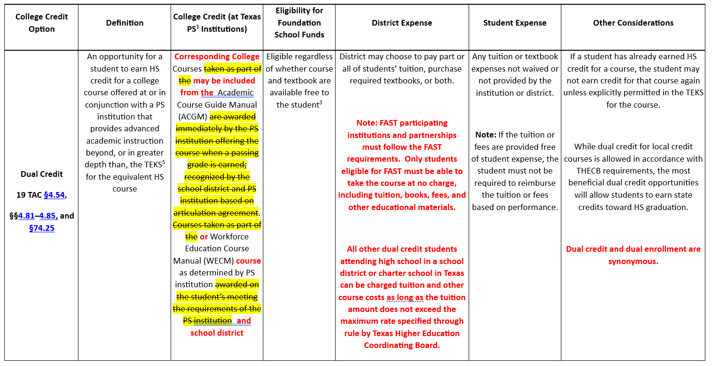
SAAH Section 11.3 College Credit Programs

Slide 52
SAAH Section 11.3.1 Dual Credit (High School and College or University) Programs
A public junior college, college, or university may offer a course in which a high school student may enroll and for which the student may receive both high school and college credit.

Slide 53
SAAH Section 11.3.1 Dual Credit (High School and College or University) Programs 1
A dual credit or dual enrollment course must meet the following requirements:
The course is offered pursuant to an agreement under §4.84 (relating to Institutional Agreements)
A course for which the student may earn one or more of the following types of credit:
joint high school and junior college credit under Education Code, §130.008, or
another course offered by an institution of higher education, for which a high school student may earn semester credit hours or equivalent of semester credit hours toward satisfaction of:
a Career Technical Education course defined in §4.83 satisfies a requirement necessary to obtain an industry-recognized credential, certificate, or an associate degree
a foreign language requirement at an institution of higher education;
a requirement in the core curriculum, as that term is defined by Education Code, §61.821, at an institution of higher education; or
a requirement in a field of study curriculum developed by the Coordinating Board under Education Code, §61.823.
Dual credit includes a course for which a high school student may earn credit only at an institution of higher education (previously referred to as a dual enrollment course) if the course meets the requirements of Texas Administrative Code, chapter 4, subchapter D. Dual credit and dual enrollment are synonymous. An institution is not required to offer dual credit courses for high school students.

Slide 54
SAAH Section 11.3.1.1 Student Eligibility for Dual Credit Courses
11.3.1.1 Student Eligibility for Dual Credit Courses
A high school student is eligible to enroll in dual credit courses if the student demonstrates college readiness by achieving the minimum passing standard(s) on a qualifying assessment instrument in alignment with Texas Administrative Code, Title 19, Part 1, Chapter 4, Subchapter C, §§4.51 - 4.63 and 19 TAC Part 1, Chapter 4, Subchapter D. 19 TAC §4.85

Slide 55
SAAH Section 11.3.1.1 Student Eligibility for Dual Credit Courses 2
Student Eligibility Requirements Specific to Academic Dual Credit Courses
A high school student is eligible to enroll in academic dual credit courses if the student:
demonstrates college readiness by achieving the minimum passing standards under the provisions of the Texas Success Initiative as set forth in 19 TAC §4.57 (relating to College Ready Standards) on relevant section(s) of an assessment instrument approved by the Texas Higher Education Coordinating Board as set forth in 19 TAC §4.56 (relating to Assessment Instrument); is not a degree-seeking student as defined in §4.83(9) and demonstrates that he or she is exempt under the provisions of the Texas Success Initiative as set forth in §4.54 of this chapter (relating to Exemption); or
demonstrates that he or she is exempt under the provisions of the Texas Success Initiative as set forth in 19 TAC §4.54 (relating to Exemptions, Exceptions, and Waivers).college readiness by achieving the minimum passing standards under the provisions of the Texas Success Initiative as set forth in §4.57 (relating to Texas Success Initiative Assessment College Readiness Standards) on relevant section(s) of an assessment instrument approved by the Board as set forth in §4.56.

Slide 56
SAAH Section 11.3.1.1 Student Eligibility for Dual Credit Courses 3

Slide 57
SAAH Section 11.3.2 College and Career Readiness School Models: Student Eligibility Requirements
A student enrolled in a TEA-designated ECHS or P-TECH program may enroll in dual credit courses if the student demonstrates college readiness in alignment by achieving the minimum passing standard(s) on a qualifying assessment instrument or has demonstrated dual credit eligibility, as shown in the chart on the preceding page. with Texas Administrative Code, Title 19, Part 1, Chapter 4, Subchapter C, §§4.51 - 4.63 and 19 TAC Part 1, Chapter 4, Subchapter D.

Slide 58
SAAH Section 12.3.1 Remote Conferencing-Regular Education Students
Students participating through remote conferencing will generate attendance in the following ways:
Students in grades pre-K to five must receive the equivalent of four hours of instruction with at least two hours of synchronous instruction each school day. This instruction does not need to be consecutive.
Students in grades six to 12 must receive at least four hours of instruction through synchronous instruction each school day. This instruction does not need to be consecutive
Additionally, attendance will be generated based on whether the student is virtually “present” at the official attendance-taking time. The student’s attendance must be marked Remote Synchronous - Present in the LEA’s local student management system. Instruction must be provided synchronously, which means two-way, real-time/live virtual instruction between teachers and students. The instruction cannot be concurrent, which means remote students must not be taught by a teacher who is also teaching in-person students at the same time. Note: A student who is served through remote conferencing and who is at a grade level at which state standardized assessments are to be administered is not eligible to generate attendance on state standardized assessment days.

Slide 59
SAAH Section 12.3.1 Remote Conferencing-Regular Education Students 1
A district can submit a request for a general “Other” waiver using TEA’s automated waiver application system, which is available in TEAL. When submitting a waiver request, one or both requirements must be cited in item 3 of the General Waivers section. (Item 3 reads: Cite the sections(s) of Texas Education Code or the Texas Administrative Code that the district or campus wishes to waive.) If the student is not on campus and receiving face-to-face instruction at the official attendance-taking time, cite 19 TAC §129.1025. Your district can submit a request for a general waiver using TEA’s automated waiver application system, which is available in TEAL. When submitting a waiver request, cite the following requirements in item 3 of the General Waivers section: 1) the requirement that a student be on campus at the official attendance-taking time in order to be considered present for FSP funding purposes, as required by 19 TAC §129.21 and the handbook, which is adopted annually through 19 TAC §129.1025, and 2) the agency’s policy of considering only face-to-face instruction as classroom time for purposes of FSP funding.

Slide 60
SAAH Section 12.3.2 Remote Conferencing-Students Receiving Special Education and Related Services
Students participating through remote conferencing will generate attendance in the following ways:
Students in grades pre-K to five must receive the equivalent of four hours of instruction with at least two hours of synchronous instruction each school day. This instruction does not need to be consecutive.
Students in grades six to 12 must receive at least four hours of instruction through synchronous instruction each school day. This instruction does not need to be consecutive
Additionally, attendance will be generated based on whether the student is virtually “present” at the official attendance-taking time. The student’s attendance must be marked Remote Synchronous - Present in the LEA’s local student management system. Instruction must be provided synchronously, which means two-way, real-time/live virtual instruction between teachers and students. The instruction cannot be concurrent, which means remote students must not be taught by a teacher who is also teaching in-person students at the same time. Note: A student who is served through remote conferencing and who is at a grade level at which state standardized assessments are to be administered is not eligible to generate attendance on state standardized assessment days.

Slide 61
SAAH Section 12.3.2 Remote Conferencing-Students Receiving Special Education and Related Services 2
A district can submit a request for a general “Other” waiver using TEA’s automated waiver application system, which is available in TEAL. When submitting a waiver request, one or both requirements must be cited in item 3 of the General Waivers section. (Item 3 reads: Cite the sections(s) of Texas Education Code or the Texas Administrative Code that the district or campus wishes to waive.) If the student is not on campus and receiving face-to-face instruction at the official attendance-taking time, cite 19 TAC §129.1025. Your district can submit a request for a general waiver using TEA’s automated waiver application system, which is available in TEAL. When submitting a waiver request, cite the following requirements in item 3 of the General Waivers section: 1) the requirement that a student be on campus at the official attendance-taking time in order to be considered present for FSP funding purposes, as required by 19 TAC §129.21 and the handbook, which is adopted annually through 19 TAC §129.1025, and 2) the agency’s policy of considering only face-to-face instruction as classroom time for purposes of FSP funding.

Slide 62
SAAH Section 12.6 Virtual Instruction (Local Remote Learning Programs under the TEC, §29.9091, or as Modified by the TEC, §48.007(c))
12.6 Virtual Instruction (Local Remote Learning Programs under the TEC, §29.9091, or as Modified by the TEC, §48.007(c))
SB 15 that allowed virtual instruction expired on September 1, 2023

Slide 63
SAAH Appendix
Bilingual/ESL—Weight: 0.1 or 0.15 if the student is in a bilingual education program using a dual language immersion/one-way or two-way program model; additional 0.05 weight for programs using a dual language immersion/two-way program model for students not described by the TEC, §48.105(1).
Bilingual/ESL funding pays for bilingual/ESL program staff salaries and additional resources. For more specific funding guidance please see the BEA and Title III Funding Guidebook.

Slide 64
SAAH Glossary
bilingual/English as a second language (ESL) eligible days – A term used to describe the days that students with parental permission to participate in a bilingual education or ESL program were in attendance. This includes students participating in a standard bilingual education or ESL program per 19 TAC §89.1210(c) and (d) and students participating in a temporary alternative language program (ALP) approved by TEA under a bilingual education exception or an ESL waiver (Section 6 Bilingual/English as a Second Language (ESL).

Slide 65
SAAH Glossary 1
prekindergarten (pre-K) – A grade level for children aged three and four years. These children include students in a state-funded pre-K program or a locally funded pre-K program.
The state-funded pre-K is operated for a half day. Attendance in pre-K is eligible for half-day (ADA eligibility code 2). A pre-K student with disabilities may be eligible for full-day (ADA eligibility code 1) if the student is served through a combination of pre-K and special education and all eligibility requirements are met (see Section 4 Special Education and Section 7 Prekindergarten (Pre-K)).
Students in a state-funded pre-K program that is coordinated with a Head Start program to provide a full-day program are only counted as half-day (ADA eligibility code 2) for attendance accounting purposes.

Slide 66
SAAH Glossary 2
reclassification - The process by which the language proficiency assessment committee (LPAC) determines that an emergent bilingual/English learner has met the appropriate criteria to be classified as non-EL/ English Proficient and is coded as such in TSDS PEIMS. This is distinguished from the term “exit,” which describes the process for reclassified students who no longer participate in a bilingual education or ESL program is the point at which a student is no longer classified as an EB student and ends bilingual or ESL program participation based on LPAC recommendation and parental approval.

Slide 67
Questions
Public Comment Changes
Questions?

Slide 68
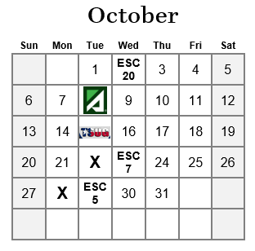
ESC Visits 2024

Slide 69
SAAH Staff
Joe Herrera
(512) 463-7708
joe.herrera@tea.texas.gov
Padmaja “Pija” Sathyanarayan
(512) 475-2012
padmaja.sathyanarayan@tea.texas.gov
Attendance@tea.texas.gov
Student Attendance Accounting Handbook | Texas Education Agency

Slide 70
\ ][poiytreq
Public Comment Changes
Thank you!
Questions?

