Slide 1

Curriculum Update
JESSICA SNYDER
CURRICULUM STANDARDS AND STUDENT SUPPORT DIVISION

Slide 2

Foundation High School Program

Slide 3

Foundation High School Program
Proposed 2019-2020 changes to graduation requirements
The SBOE will consider revisions to the Foundation High School Program for
second reading and final adoption authorization at the April 2019 SBOE meeting.

Slide 4
Foundation High School Program
Proposed 2019-2020 changes to graduation requirements
Addition of two currently approved innovative courses, IB Film Standard Level and IB Film Higher Level, to the list of courses that may satisfy the fine arts requirement
Addition of a new cybersecurity pathway for the science, technology, engineering, and mathematics (STEM) endorsement

Slide 5

Cybersecurity TEKS

Slide 6

Cybersecurity Courses
The 85th Texas Legislature, Regular Session, 2017, passed House Bill (HB) 3593, requiring that the SBOE approve courses in cybersecurity for high school credit.
The legislation also required the SBOE to adopt or select five technology applications courses to be included in a cybersecurity pathway for the STEM endorsement.

Slide 7
Cybersecurity TEKS
At the January/February 2019 meeting, the SBOE gave preliminary approval to the following.
Two proposed new technology applications courses in cybersecurity:
  Foundations of Cybersecurity
  Cybersecurity Capstone
Pathway reflected in proposed new cybersecurity option under the STEM endorsement

Slide 8
Cybersecurity Courses
A To the Administrator Addressed (TAA) letter was posted on January 17, 2019 notifying school districts about technology applications courses eligible for career and technical education (CTE) weighted funding under HB 3593 for the 2018-2019 school year.
The cybersecurity technology applications courses approved by the SBOE for the cybersecurity pathway will be the technology applications courses eligible for CTE weighted funding beginning with the 2019-2020 school year.

Slide 9
Cybersecurity Courses
2018-2019 Technology Applications Courses Eligible for CTE Funding
Fundamentals of Computer Science
Computer Science I
AP Computer Science Principles
2019-2020 Proposed Cybersecurity Technology Applications Courses for the STEM Endorsement*
Foundations of Cybersecurity*
Computer Science I
AP Computer Science Principles
AP Computer Science A*
Cybersecurity Capstone*
*Pending SBOE approval

Slide 10
STEM Endorsement: Cybersecurity Pathway
*A coherent sequence of four
courses in cybersecurity to
consist of
Foundations in Cybersecurity;
Cybersecurity Capstone; and
two additional courses to be selected from the following courses:
.
Computer Science I
OR
AP Computer Science Principles
OR
AP Computer Science A
OR
OR
OR
Digital Forensics
Computer Maintenance (CTE)
Internetworking Technologies I or II (CTE)
OR
Networking (CTE)
*Approved for first reading and filing authorization at the January/February 2019 SBOE meeting

Slide 11
Cybersecurity TEKS Adoption and Amendments to Endorsements
Approved for first reading and filing authorization
January/February SBOE
Public comment period opens
Mid-February 2019 through
Effective beginning with the 2019-2020 school year
Second reading and final adoption
(Jan 28 – Feb 1, 2019)
March 29, 2019*
  April SBOE
  (April 2 – 5, 2019)
* Opportunity for public input on proposed changes

Slide 12

Dual language immersion

Slide 13
Dual Language Immersion Program
A student may satisfy one credit of the two LOTE credits required for graduation by successfully completing a dual language immersion program in elementary school.
The award of credit must be clearly indicated on the student’s transcript using the appropriate high school course service ID.
To successfully complete a dual language immersion program, a student must satisfy the criteria adopted by the SBOE in 19 TAC §74.12(b)(5)(F)(i).

Slide 14
Dual Language Immersion Program
To successfully complete a dual language immersion program, a student must
have participated in a dual language immersion program for at least five consecutive school years;
achieve meets or masters grade level on the STAAR® in English or Spanish, as applicable; and
achieve scores of proficient or higher in the reading and speaking domains on language proficiency or achievement tests in both English and the language other than English.
Notes:
Spanish Curriculum Standards

Slide 15

Dual Language Immersion Program
Dual language immersion program data elements for the student record have been created to enable LEAs to capture information needed to determine whether a student has successfully completed a dual language immersion program.
Notes:
Spanish Curriculum Standards

Slide 16

Dual Language Immersion Program
Dual Language Immersion Program Data Elements
In which number in a series of school years (first-fifth) a student is participating in a dual language immersion program
The school year in which a student participates in a particular number in the series of school years in the program (1st- 2018-2019);
The language other than English that the student studied
Notes:
Spanish Curriculum Standards

Slide 17
Dual Language Immersion Program
Dual Language Immersion Program Data Elements
The student’s proficiency in both languages as demonstrated by performance on language proficiency or achievement tests
Completion of the requirements outlined in 19 TAC §74.12(b)(5)(F) to successfully complete a dual language immersion program
Notes:
Spanish Curriculum Standards

Slide 18

Alternate Graduation Requirements for Students Entering Grade 9 prior to 2011-2012

Slide 19
Alternative graduation requirements for students who entered grade 9 prior to 2011-2012
Alternative graduation requirements for students who first entered ninth grade prior to 2011-2012 were adopted to be effective May 3, 2018.
19 TAC Chapter 74, Subchapter BB, §74.1027

Slide 20
Alternative graduation requirements for students who entered grade 9 prior to 2011-2012
This option applies only to individuals who successfully completed curriculum requirements for high school graduation, but who
    have not performed satisfactorily on an assessment instrument or part of an assessment instrument required for graduation, and
    have been administered the assessment instrument or part of the assessment instrument at least three times, including an alternate assessment instrument.

Slide 21
Alternative graduation requirements for students who entered grade 9 prior to 2011-2012
An individual must be permitted to qualify to graduate and receive a high school diploma if the individual meets one of the following:
Met the performance standard on an alternate assessment
Performed satisfactorily on the applicable subject-area test of a state-approved high school equivalency examination
Provided evidence of an industry-recognized postsecondary license or certification in accordance with §74.1003
Provided evidence of current active duty service in the armed forces or a DD Form 214 indicating honorable or general discharge from the armed forces
Successfully completed college-level coursework and earned college credit.

Slide 22
Alternative graduation requirements for students who entered grade 9 prior to 2011-2012
The school district or open-enrollment charter school shall maintain documentation to support the decision to award or not award an individual a high school diploma.
All graduates, including students who met alternative graduation requirements under 19 TAC §74.1027, are reported as graduates in Submission 1.

Slide 23
Questions?

Slide 24
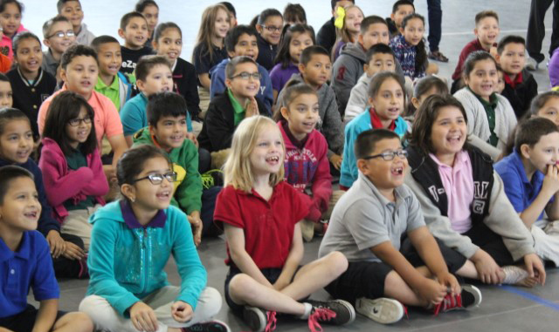
Thank you!
Curriculum Standards and Student Support Division

