Slide 1
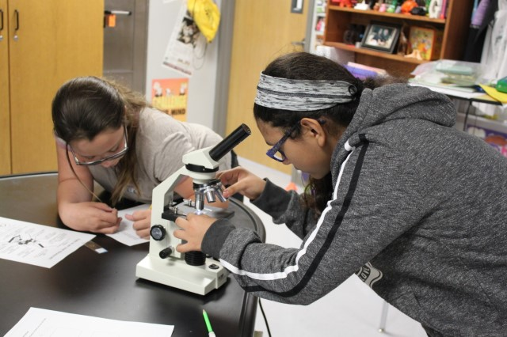
Armed Services Vocational Aptitude Battery (ASVAB),
College and Career Readiness Models (CCRSM), and
Career and Technical Education (CTE)
ESC PEIMS Coordinator Meeting
March 26, 2019

Slide 2

Objectives & Agenda
Participants will:
  Gain a baseline knowledge of ASVAB and CCRSM
  Understand who must submit ASVAB and CCRSM PEIMS data
  Know resources available for ASVAB and CCRSM
Agenda
ASVAB
CCRSM
  Early College High School (ECHS)
  Pathways in Technology Early College High School and Industry Cluster Innovative Academy (P-TECH/ICIA)
  Texas Science, Technology, Engineering, and Mathematics (T-STEM)
2

Slide 3
ASVAB

Slide 4
Armed Services Vocational Aptitude Battery
Two different ASVAB tests
ASVAB Career Exploration Program (ASVAB CEP) (10th, 11th, 12th grade students)
  ASVAB: The aptitude test estimates your performance in academic and vocational endeavors.
  FYI: The interest inventory measures your work-related interests.
  OCCU-Find: A career catalog provides activities to help you put a plan together
ASVAB for military enlistment (11th and12th grade students)

Slide 5
SB 1843 -ASVAB
(85th regular session)
Each school year, each district and open-enrollment charter school must:
  Provide students in grades 10, 11, and 12 the opportunity to take the Armed Services Vocational Aptitude Battery (ASVAB) and consult with a military recruiter
School districts and open-enrollment charters must:
  Schedule the ASVAB during normal school hours
  Schedule the ASVAB at a time that limits conflicts with extracurricular activities

Slide 6
SB 1843 -ASVAB
(85th regular session)
Schools may offer an alternative test that:
  assesses a student's aptitude for success in a career field other than a career field that requires postsecondary education;
  is free to administer;
  requires minimal training and support of district or school faculty and staff to administer the test; and
  provides the student with a professional interpretation of the test results that allows the student to:
    explore occupations that are consistent with the student's interests and skills; and
    develop strategies to attain the student's career goals
TEA shall report, no later than August 1 of each year, schools that elect not to provide the ASVAB

Slide 7
ASVAB Reporting Timeline
2017-2018 school year
  Reporting via Survey Monkey May 15 –June 15, 2018 for the 2017-2018 school year
2018-2019 school year (and beyond)
  PEIMS fall submission

Slide 8
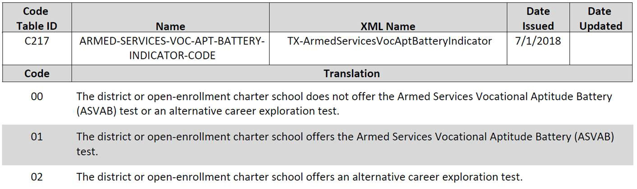
ASVAB PEIMS Indicator

Slide 9
ASVAB Resources
TEA Website
  www.tea.texas.gov/ASVAB
  Frequently Asked Questions (FAQ) document
  Recorded webinar from December 2017 with Department of Defense
  PEIMS Indicator one pager with additional FAQ
  2017-2018 school year required report
Department of Defense ASVAB Program Website
  https://www.asvabprogram.com/

Slide 10
Questions?

Slide 11


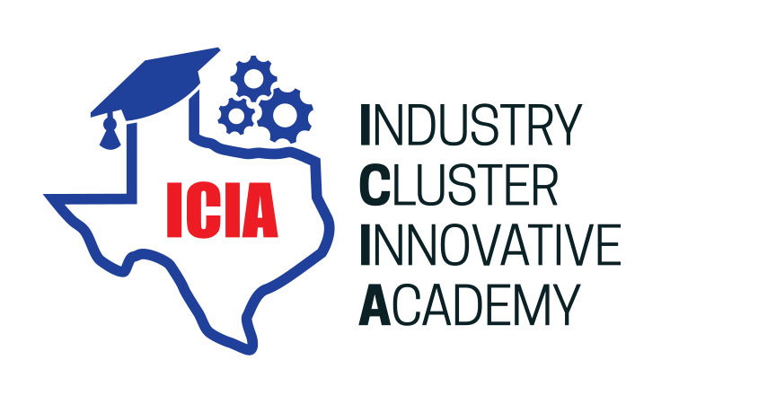

College and Career Readiness School Models
(CCRSM)

Slide 12
College and Career Readiness School Models
The Texas College and Career Readiness School Models (CCRSM) Network is a network of :
  Early College High Schools (ECHS)
  Pathways in Technology Early College High Schools (P-TECH)/Industry Cluster Innovative Academies (ICIA)
  Texas Science, Technology, Engineering and Math (T-STEM) Academies
12

Slide 13
College and Career Readiness School Models
    Provided at no cost to students
    Offer rigorous instruction and accelerated courses
    Provide academic and social support services to help students succeed
    Increase college readiness
    Reduce barriers to college access
    Align to regional workforce needs for P-TECH/ICIA and T-STEM models

Slide 14
CCRSM Apply Annually to be Designated

Slide 15
Path to Become a CCRSM
January
CCRSM Designation Application
Successful planning year designees apply for provisional designation to implement in the following school year
January-December
CCRSM Planning Year
Planning year designees work with the Technical Assistance provider to prepare for implementation in 2 years
October
CCRSM Planning Year Application
Campuses interested in opening a CCRSM campus apply to be a planning year designee.

Slide 16
Designation Basic Tenets
  Designation is tied to a Blueprint
  Designation is for a single cohort of students
    Campuses may have multiple designations IF they serve different cohorts of students for each model
    A school may operate two separate cohorts of students, such as an ECHS cohort and a T-STEM cohort (different students) but may not operate with two separate Blueprints for the SAME students
  A campus may be designated in one model while planning for a different model
  All designees (except planning year) must code their students in PEIMS
16

Slide 17
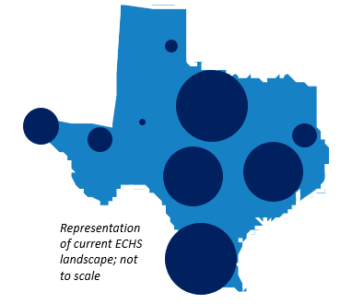
CCRSM: Geographic Reach and Scale
Model | 2018-2019 Campuses
ECHS | 170 designees implementing in 18-19 29 planning year designees to open in 19-20
T-STEM | 94 designees implementing in 18-19 6 planning year designees to open in 19-20
P-TECH | 34 Designees 18-19 29 Planning designees to open in 19-20
17

Slide 18
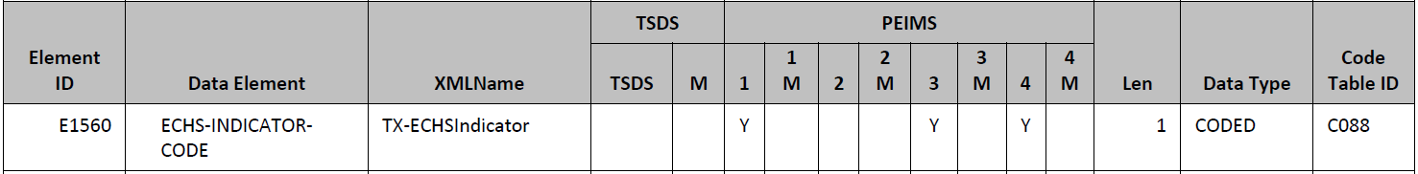
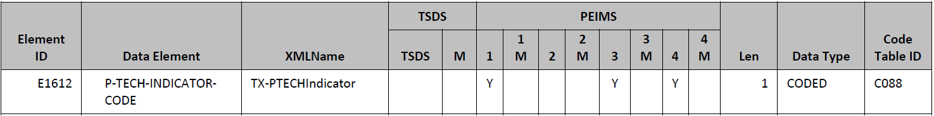
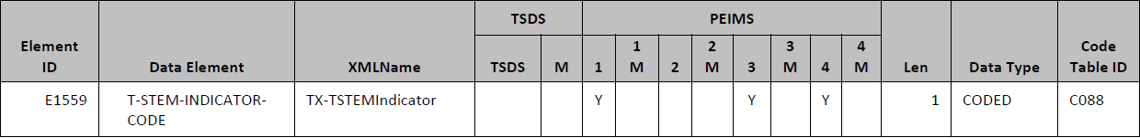
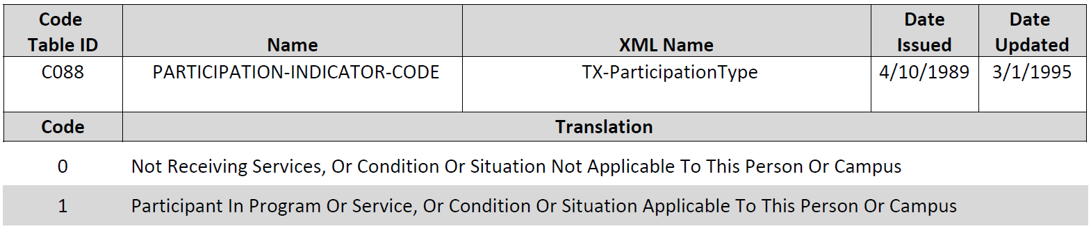
PEIMS Indicator
Required of all designated campuses
  Indicates whether a student is enrolled in a CCRSM Campus
Required in PEIMS submissions:
  Submission 1 - Students enrolled in respective model on the last Friday in October (Fall Snapshot date) are reported.
  Submission 3 - Students enrolled in respective model at any point in time during the school year are reported.
  Submission 4 - Students enrolled in respective model over the summer are reported
18
Notes:
All designated ECHS must ensure that the required ECHS indicator is included as a data element for Submissions 1, 3, and 4.
Validation in the system
Please coordinate with the PEIMS coordinator on the campus or at the district regarding specific PEIMS questions.
TEA will use the CDC number of the campus and the PEIMS indicator data to determine designation status. Additional information will be shared later in this presentation

Slide 19
Questions?

Slide 20
Resources

Slide 21
CCRSM Web Resources
Technical Assistance Provider: ECHS/T-STEM/P-TECH/ICIA
  http://www.texasccrm.org
Texas Education Agency
  http://www.tea.texas.gov/echs
  http://www.tea.texas.gov/T-STEM
  http://www.tea.Texas.gov/PTECH
  http://www.tea.texas.gov/ASVAB
For Information on Designation
  https://ccrm.stemcenter.utexas.edu/
21

Slide 22

Contacts/Questions
Stacy Avery
512.463.8211
stacy.avery@tea.texas.gov

Slide 23
CTE Programs of Study

Slide 24
Overview
Status: On July 31, 2018, the President signed the Strengthening Career and Technical Education for the 21st Century Act into law.
Purpose: Perkins is dedicated to increasing learner access to high-quality Career Technical Education (CTE) programs of study. With a focus on:
  systems alignment and program improvement
  improving the academic and technical achievement of CTE students
  strengthening the connections between secondary and postsecondary education
  improving accountability
Notes:
Status: On July 31, 2018, the President signed the Strengthening Career and Technical Education for the 21st Century Act into law.
Purpose: Perkins is dedicated to increasing learner access to high-quality Career Technical Education (CTE) programs of study. With a focus on:
systems alignment and program improvement
improving the academic and technical achievement of CTE students
strengthening the connections between secondary and postsecondary education
improving accountability

Slide 25
Texas Perkins Grant
Total Amount of Perkins grant in 2018-2019: $105,261,269.
  Secondary: 70%
  Postsecondary: 30%
Funding Formula
  Allocations are based on Census Bureau population and poverty counts of individuals age 5-17.

Slide 26
Programs of Study/Perkins V Timeline
Transition School Year
January – February 2019
March –May 2019
May – August 2019
September 2019 – July 2020
August 2020
Drafting sequences and templates
Statewide Programs of Study Approval
Implementation Year for Programs of Study & Perkins V

Slide 27
Major Components of Perkins V
Maintains a commitment to driving improvement through Programs of Study and includes a robust, formal definition of the term
Defines who is included in the accountability system by including a formal “CTE concentrator” definition, instead of leaving this definition up to states
Focuses on disaggregation of data by maintaining the required disaggregation by student populations, requiring additional disaggregation for each core indicator by CTE program of study or CTE program
Notes:
Maintains a commitment to driving improvement through Programs of Study and includes a robust, formal definition of that term
Introduces a comprehensive local needs assessment that requires data-driven decision-making on local spending, involves significant stakeholder consultation and must be updated at least once every two years. This is arguably the biggest change and biggest impact to districts and how you apply for funding. We will talk more about this specifically in another slide and even talk about what we are doing to mitigate the impact to districts.
Lifts the restriction on spending funds below grade 7 and allows support for career exploration in the “middle grades” (which includes grades 5-8). We have received mixed feedback about this from the field thus far. This will most likely be one of the topics that we will dig deeper into with regional focus groups. There has been very differing opinions on this across the state. It does not provide more funding to do this, but rather just lists it as an allowable expenditure of funds. We can do a lot to support here in addition to providing flexibility for district choice, but this will be a topic we will want to dig into more throughout the year. Remember, as a district, you can always go stricter than the state and not allow this at all. That’s part of the flexibility that we will continue to think through. As a show of hands, how many of you receive less than $15,000 and are in an SSA?
Focuses on disaggregation of data by maintaining the required disaggregation by student populations, requiring additional disaggregation for each core indicator by CTE program. Important to note that the feds do NOT define CTE program. In most instances it references a program of study. We are working with the feds on this because we know that in many of our districts, especially our rural areas, the student number is already small, when you look at concentration within a CTE program of study, this gets even smaller and is personally identifiable. We are working with them on what this looks like when you have to roll it up to protect student identities.
Defines who is included in the accountability system by including a formal “CTE concentrator” definition, instead of leaving this definition up to states. We will talk more about what this means for Texas’s definition, which does not change drastically, but it does make this a standard definition where previously every state had their own definition.
Significantly changes the process for setting performance targets by eliminating the negotiations with the Secretary and replacing these negotiations with a new list of requirements for developing targets and including those targets in state and local plans. The good news here is that we are not handed our measures by the USDOE. However, this does mean that we need to have a state process and formula for how we are setting performance targets and NEGOTIATING with districts on how they achieve their levels. We will be providing baseline data on this to help you make informed decisions.
Shifts the accountability indicators; the most significant changes are the consolidation of the two non-traditional measures into one, and the elimination of the technical skill attainment measure, which is replaced with a “program quality” measure at the secondary level that requires states to choose to report on Work-Based Learning, postsecondary credit attainment or credential attainment during high school. We will talk much more about this later on in the presentation.

Slide 28
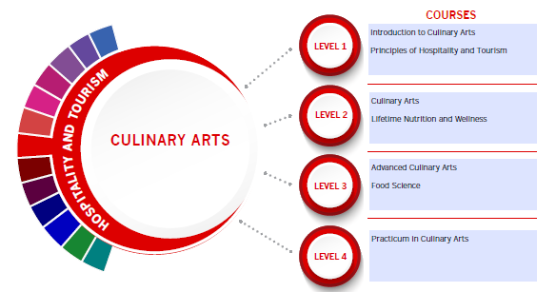
Programs of Study Templates
Districts will be provided with over 50 Statewide Programs of Study with flexible course sequences.
Templates will include occupations and labor market information connected with each Program of Study.

Slide 29
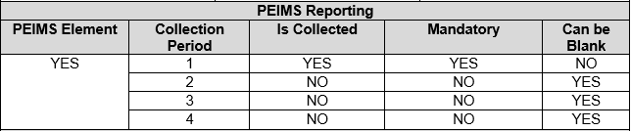
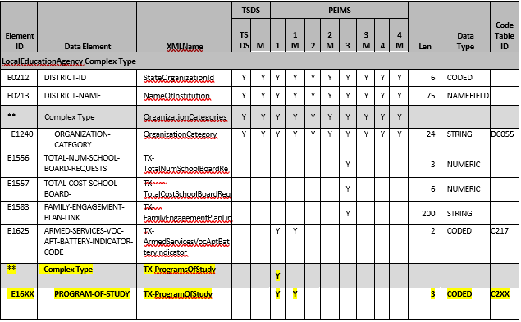
PEIMS Indicator
Required in PEIMS submission:
  Submission 1 – Districts who offer one or more approved state or regional program of study.

Slide 30
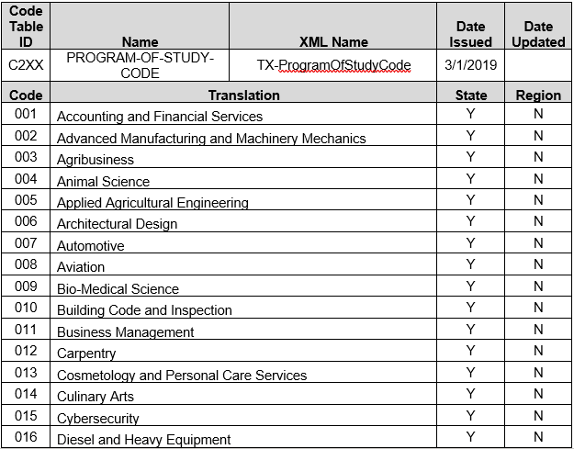
PEIMS Indicator
Districts select statewide programs of
study offered by reviewing course
sequences.
2019-2020 Transition Year
2020-2021 Implementation Year

Slide 31
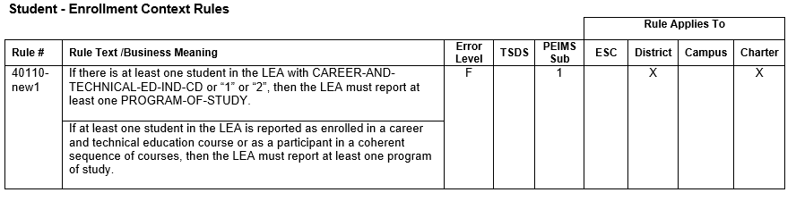
Data Validation Rule

Slide 32
Ryan Merritt
Director, Career & Technical Education
Texas Education Agency
512-936-6358 ryan.merritt@tea.texas.gov

