Slide 1
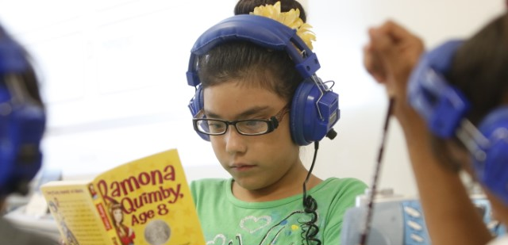
Spring TSDS Vendor Training for Bilingual & ESL Programs
English Learner Support Division
April 2, 2020

Slide 2
Agenda
Program Code Connections
Bilingual Programs
ESL Programs
Alternative Language Programs
Bilingual Education Allotment (BEA) Funding
Bilingual/ESL Funding Code
BEA Weighted Funding

Slide 3
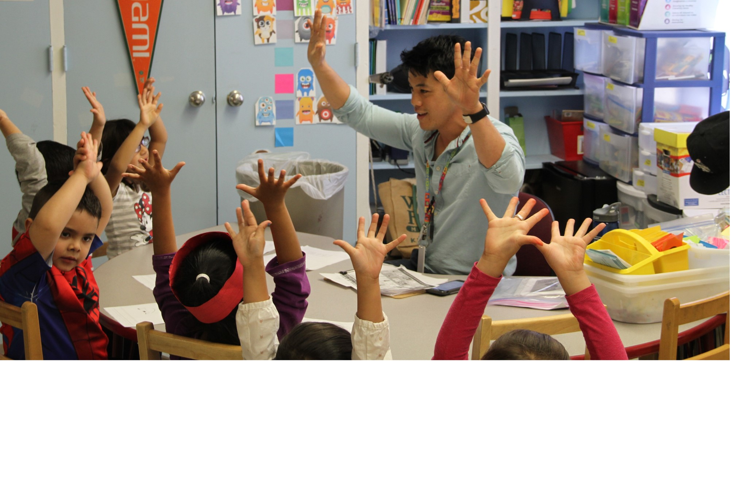
Program Code Connections

Slide 4
Bilingual Education Program Code
Certification Connection
Bilingual Education Program | Certification Requirements | Key Notes
Transitional Bilingual Education (TBE) Early-Exit Late-Exit | When self-contained (1) or departmentalized (2+), TBE teachers must be certified in content/grade level AND bilingual education | TBE program requirements (including certification) continue through the elementary grades (up through 5th grade or 6th grade if clustered with elementary grades)
Dual Language Immersion (DLI) One-Way Two-Way | When self-contained (1) or departmentalized (2+), DLI teachers must be certified in content/grade level AND bilingual education Optional: If paired-teaching (2), may have 1 teacher bilingual education certified (partner language instruction) 1 teacher English as a Second Language (ESL) certified (English instruction) | DLI program goals intend for DLI students to continue with program participation through the duration of the program (elementary grades), including English learners who reclassify as English proficient. DLI programs may extend into middle and high school; certification requirements continue to apply.
Resource: Bilingual Education Exception Scenario Chain
Notes:
Elizet

Slide 5
English as a Second Language (ESL) Program Code
Certification Connection
ESL Program | Certification Requirements | Key Notes
Content-Based | All content area teachers of English learners in Content-Based ESL are certified in content/grade level AND ESL | Content areas include English language arts and reading (ELAR), mathematics, science, and social studies
Pull-Out | English language arts and reading (ELAR) instruction is provided to English learners in Pull-Out ESL by teachers who are certified in content/grade level AND ESL | Pull-Out ESL can be implemented by the ELAR classroom teacher who is ESL certified through co-teaching of an ESL certified teacher and ELAR certified teacher through an additional ESL/ELAR course/block provided by an ESL and ELAR certified teacher
Resource: ESL Waiver Scenario Chain
Notes:
Elizet

Slide 6
Alternative Language Programs
Alternative Language Programs are provided when the district has submitted a bilingual education exception or ESL waiver for the current school year due to insufficient number of appropriately certified teachers.
Key Notes:
English learners participating in an Alternative Language Program are served and do generate BEA funds.
Alternative Language Program codes can only be utilized if a district has submitted a bilingual education exception or ESL waiver.

Slide 7
Parental Permission and Program Code Connection
Parental Permission Code | Definition | Associated Alternative Language Program Code
E | Parent or guardian has approved placement of a LEP/English learner (EL) student in the Bilingual Program, but the district is implementing an Alternative Language Program approved by the Texas Education Agency due to the district's submission of a Bilingual Education Exception for the current school year, per 19 TAC §89.1207 | 01 Alternative Bilingual Language Program
J | Parent or guardian has approved the placement of a LEP/English learner (EL) student in the ESL Program, but the district is implementing an Alternative Language Program approved by the Texas Education Agency due to the district's submission of an ESL Waiver for the current school year, per 19 TAC §89.1207 | 02 Alternative ESL Language Program

Slide 8
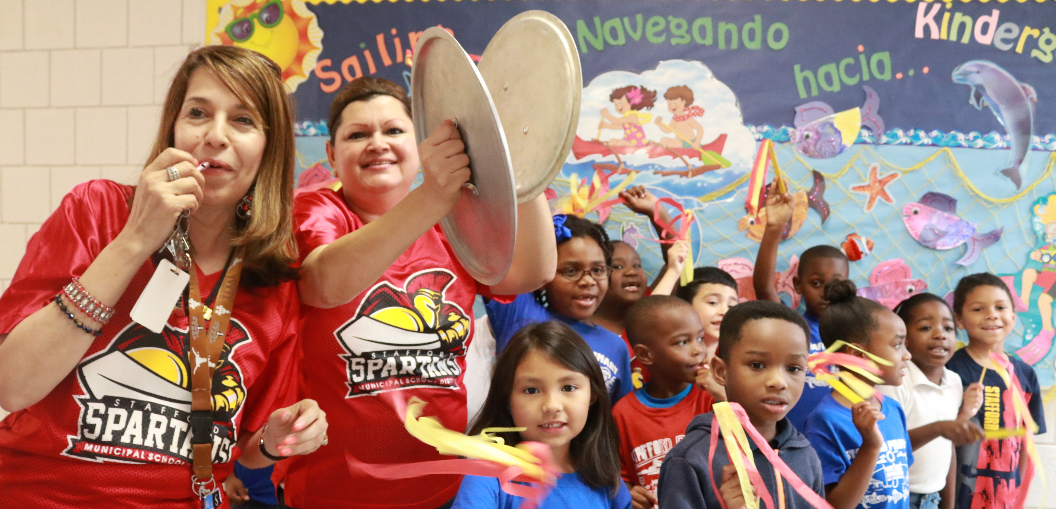
BEA Funding

Slide 9
New Bilingual/ESL Funding Code
New
The Bilingual/ESL Funding Code will be reported in the PEIMS Summer and Extended Year Submissions.
Definition
The Bilingual/ESL Funding Code indicates the language program in which the student participates during the reporting period.

Slide 10
Bilingual/ESL Funding Code Table
Code Table ID | Name | XML Name | Date Issued
C225 | BILINGUAL/ESL-FUNDING-CODE | TX-BilingualESLFundingCode | 8/30/2019
Code | Translation
BE | Student in standard or alternative Bilingual or ESL program
D1 | Student in Bilingual Dual Language Immersion/One-Way program
D2 | Student in Bilingual Dual Language Immersion/Two-Way program

Slide 11
Bilingual Education Allotment (BEA) Funding Weights
LEP/EL Indicator Code | Bilingual/ESL Funding Code | Funding Weight
LEP/EL | BE: (ESL, Transitional Bilingual, or Alternative Language Program) | 0.10
LEP/EL | D1: (Dual Language One-Way) | 0.15
LEP/EL | D2: (Dual Language Two-Way) | 0.15
Non-LEP/English Proficient | D1 or BE: (ESL, Transitional Bilingual, Alternative Language Program, or Dual Language One-Way) | 0
Non-LEP/English Proficient | D2: (Dual Language Two-Way) | 0.05

Slide 12
BEA Funding Weights: Bilingual Education Programs
Teacher(s) appropriately certified for the bilingual/ ESL program (TEC 29.061)? | Is the student LEP/EL? | Description of Program | PEIMS Fall Data Element | PEIMS Fall Code Table | Code Value | BEA Funding Weight | Bilingual/ESL Funding Code (PEIMS Summer submission)
Yes | Yes | Transitional bilingual early exit | E1042 BILINGUAL-PROGRAM-TYPE-CODE | C175 BILINGUAL-PROGRAM-TYPE-CODE | 2 | 0.10 | BE
 |  | Transitional bilingual late exit |  |  | 3 | 0.10 | BE
 |  | Dual language immersion two-way |  |  | 4 | 0.15 | D2
 |  | Dual language immersion one-way |  |  | 5 | 0.15 | D1
 | No | Transitional bilingual early exit |  |  | 2 | 0.00 | None, Bil/ESL attendance not reported
 |  | Transitional bilingual late exit |  |  | 3 | 0.00 | None, Bil/ESL attendance not reported
 |  | Dual language immersion two-way |  |  | 4 | 0.05 | D2
 |  | Dual language immersion one-way |  |  | 5 | 0.00 | None, Bil/ESL attendance not reported

Slide 13
BEA Funding Weights: ESL Programs
Teacher(s) appropriately certified for the bilingual/ ESL program (TEC 29.061)? | Is the student LEP/EL? | Description of Program | PEIMS Fall Data Element | PEIMS Fall Code Table | Code Value | BEA Funding Weight | Bilingual/ESL Funding Code (PEIMS Summer submission)
Yes | Yes | English as a second language content-based | E1043 ESL-PROGRAM-TYPE-CODE | C176 ESL-PROGRAM-TYPE-CODE | 2 | 0.10 | BE
 |  | English as a second language pull-out |  |  | 3 | 0.10 | BE
 | No | English as a second language content-based |  |  | 2 | 0.00 | None, Bil/ESL attendance not reported
 |  | English as a second language pull-out |  |  | 3 | 0.00 | None, Bil/ESL attendance not reported

Slide 14
BEA Funding Weights: Alternative Language Programs
Teacher(s) appropriately certified for the bilingual/ ESL program (TEC 29.061)? | Is the student LEP/EL? | Description of Program | PEIMS Fall Data Element | PEIMS Fall Code Table | Code Value | BEA Funding Weight | Bilingual/ESL Funding Code (PEIMS Summer submission)
No; LEA filed a bilingual education exception for a transitional (early or late exit) or dual language (one-way or two-way) bilingual program | Yes | Alternative bilingual language program | E1642 ALTERNATIVE-LANGUAGE-PROGRAM-CODE | C221 ALTERNATIVE-LANGUAGE-PROGRAM | 01 | 0.10 | BE
 | No |  |  |  | 01 | 0.00 | None, Bil/ESL attendance not reported
No; LEA filed an ESL waiver for a content-based or pull-out ESL program | Yes | Alternative ESL language program |  |  | 02 | 0.10 | BE
 | No |  |  |  | 02 | 0.00 | None, Bil/ESL attendance not reported

Slide 15
Resources
LEP/EL Decision Chart for the LPAC with PEIMS codes
Code Guide for Bilingual and ESL Program Association
Texas Education Data Standards (TEDS) Section 4 2019-2020 EL related code tables

Slide 16
Contact
Carlene Thomas
ESL Program Coordinator
carlene.thomas@tea.texas.gov
Main phone: 512-463-9414
E-MAIL: EnglishLearnerSupport@tea.texas.gov

