Slide 1
P-EBT Pandemic Electronic Benefit Transfer
SY21-22 Upload Training
Thursday, 2/24/2022 10am-12pm

Slide 2
Agenda
P-EBT SY21-22 Eligibility: Campus and Student
Preparing Upload Files: Public Schools and Private Schools
Timeline/Key Dates
Upload process
Point of Contact (POC) for technical and other support
Live Demo
Open Forum/ Q&A

Slide 3
P-EBT SY2022: Campus Eligibility
Campus Eligibility
Must be approved to operate the National School Lunch Program (NSLP)
NSLP-approved campuses also include those operating the Seamless Summer Option (SSO) and those NSLP campuses electing the Community Eligibility Provision (CEP) or Provision 2 (P2)
Must have a school closure OR reduced attendance or hours for at least five (5) consecutive days due to the COVID emergency in the current school year
Reduced attendance refers to at least one single student at the school with five consecutive days of COVID-19-related absences or virtual attendance
This requirement must be met at the individual campus level, not the district level

Slide 4
P-EBT SY2022: Student Eligibility
Student Eligibility (once campus becomes eligible)
The child is enrolled in a Texas school approved to operate NSLP
NSLP-approved campuses include those operating the Seamless Summer Option (SSO) and those NSLP campuses electing the Community Eligibility Provision (CEP) or Provision 2 (P2)
The child has COVID-19-related absences, eligible virtual attendance, or experienced COVID-19-related school closures during SY 2021-2022
The child would have received free or reduced-price school meals under the National School Lunch Program (NSLP) and School Breakfast Program (SBP) if not for the COVID health emergency.
Direct certification
Certified through NSLP household application
Note: All students attending a CEP or P2 campus are considered eligible for free or reduced-price meals for the purposes of P-EBT

Slide 5
P-EBT SY2022: Public Schools
Local education agencies (LEAs) must upload students that meet the following criteria once campus eligibility has been met:
1. Student must be eligible for free or reduced-price meals and identified as economically disadvantaged via PEIMS codes* 01 or 02.
a. 01 – Eligible for Free Meals Under the National School Lunch and Child Nutrition Program
b. 02 – Eligible for Reduced-price Meals Under the National School Lunch and Child Nutrition Program
c. All students enrolled in a CEP or P2 campus are eligible regardless of economic disadvantage status.
*99 should NOT be used - any student coded as 99 can still complete the NSLP household form to become certified eligible for SY 21-22.

Slide 6
P-EBT SY2022: Public Schools
2. Economically Disadvantaged student (01 or 02) or CEP/P2 student must have COVID-19-related absences, received virtual instruction or did not have access to meals at school due to a COVID-19 school closure.
a. Any school closures in response to concerns about a COVID-19 related outbreak would be included in addition to any COVID-19- related absences or days of virtual instruction.
Note: If COVID-19-related absences are not tracked by the LEA, the LEA may include students identified as economically disadvantaged (01 or 02) or CEP/P2 students if they have five (5) or more consecutive excused absences.

Slide 7
P-EBT SY2022: Private Schools
Private Schools will create upload file using the following:
Attendance tracking system to identify:
Absences related to COVID-19
Virtual attendance selected due to concerns about COVID-19
School closures due to COVID-19
Child nutrition system to identify:
Students eligible for free or reduced-price meals in the 2021-22 school year
Check the direct certification list after the 5th day of every month for most current student status
Household application for free or reduced-price meals certified in SY 2021-22
Note: All students attending a CEP or P2 campus are considered eligible for free or reduced-price meals for the purposes of P-EBT

Slide 8
2022 Timeline
February:
___: FNS Approved Texas State Plan
2/24: Upload Training for ESCs via Zoom (hosted by TEA)
Week of 2/28: Upload testing in test environment (private schools)
March:
3/3: Communication to schools announcing SY21-22
3/7-3/11: Upload testing (public schools)
3/28: Reminder email to ESCs and school districts about upload portal being accessible 4/4-4/14
- Upload 4/4-4/8 - Upload corrections 4/11-4/14

Slide 9
2022 Timeline
April:
4/4: HHSC create user accounts for school districts and private schools. You will receive an automated email from DoNotReply@hhsc.state.tx.us informing you an account has been created and how to reset password. Check your junk/spam folder if email not received in your inbox on 4/4. If you haven’t received email by 8:00 AM on 4/4, email pebt_data@hhs.texas.gov for assistance. If you already have an account, you will not receive an email.
4/4-4/14: School districts and private schools to upload first semester student data using HHSC’s CSV file layout – don’t change headings or columns.
- Upload 4/4-4/8 - Upload corrections 4/11-4/14
4/11: Communication to schools about Request for Review/Complaint Process to open on 4/25
4/18-4/22: Benefits issued to children and claim code notices mailed to families
4/25 – 7/15: RFR/Complaint Process and Resolutions

Slide 10
2022 Timeline
May:
5/30-7/15: School districts and private schools to upload second semester student data using HHSC’s CSV file layout – don’t change headings or columns, format remains the same.
July:
7/18-7/22: Benefits issued to children and claim code notices mailed to families
August:
Week of Aug 1st: RFR/Complaints Process email to schools
8/15-10/14: RFR/Complaint Process and Resolutions. HHSC sends forms to schools. Schools will have 15 business days to respond.
TBD – Summer ‘22

Slide 11
Upload Process: P-EBT Upload Portal
The upload portal has been created to provide Pandemic Electronic Benefit Transfer (P-EBT) benefits to eligible students. A school or district representative will use this portal to upload student data from their school or district which will then be used to determine P-EBT eligibility and issue P-EBT benefits to eligible students.
If you are the designated representative for your school or district, you will need to log into the portal. Once you get access to the portal, you can use it to send student data to HHSC.

Slide 12
Upload Process: User Accounts for YTB Access
You need a user account and password to log into YourTexasBenefits (YTB) portal to upload student data
Accounts will be created for new POCs
Existing POCs can use their username and password
Your YTB user name should be in the following format: PEBT_123456_J_Smith.
Your temporary password is included in the account creation email.
You will need to reset your password after signing in using the temporary password
Your temporary password expires in 14 days
Note: PEBT_District ID/CEID_First initial of your first name_full last name. Example: PEBT_654321_J_Smith

Slide 13
Upload Process: Required Information
For students: first name, last name, DOB, gender, SSN or S# (public schools), unique ID (public schools), district ID (public schools), contracting entity ID (private schools), campus ID, school year, and semester
For parents: first and last name is required. DOB is optional but recommended. Email and phone # optional but recommended.
Primary address: required to ensure benefits are issued to the correct parent. Address, City, State, and Zip.
Review HHSC’s shared user guide for upload instructions, file layout guidance, screenshots, and helpful tips to minimize upload errors.

Slide 14
Upload Process: Important Tip #1!
To reduce time resolving upload errors, please contact your local IT team for support and request they whitelist the following sites:
https://www.yourtexasbenefits.com
https://dp.hhscie.txaccess.net

Slide 15
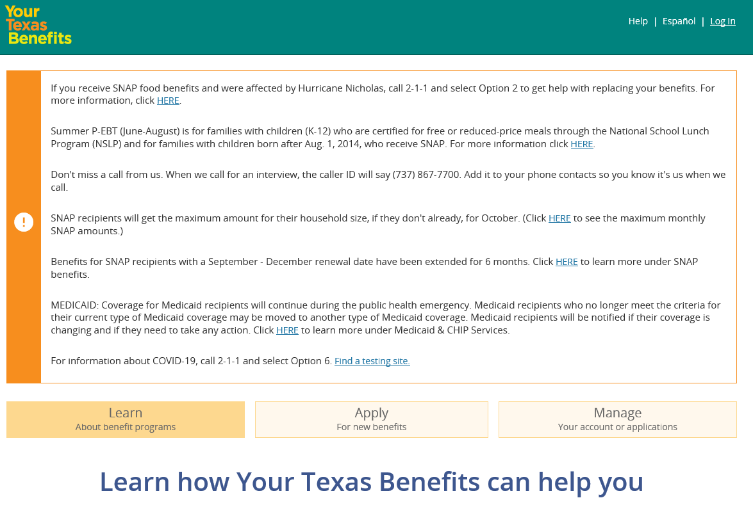
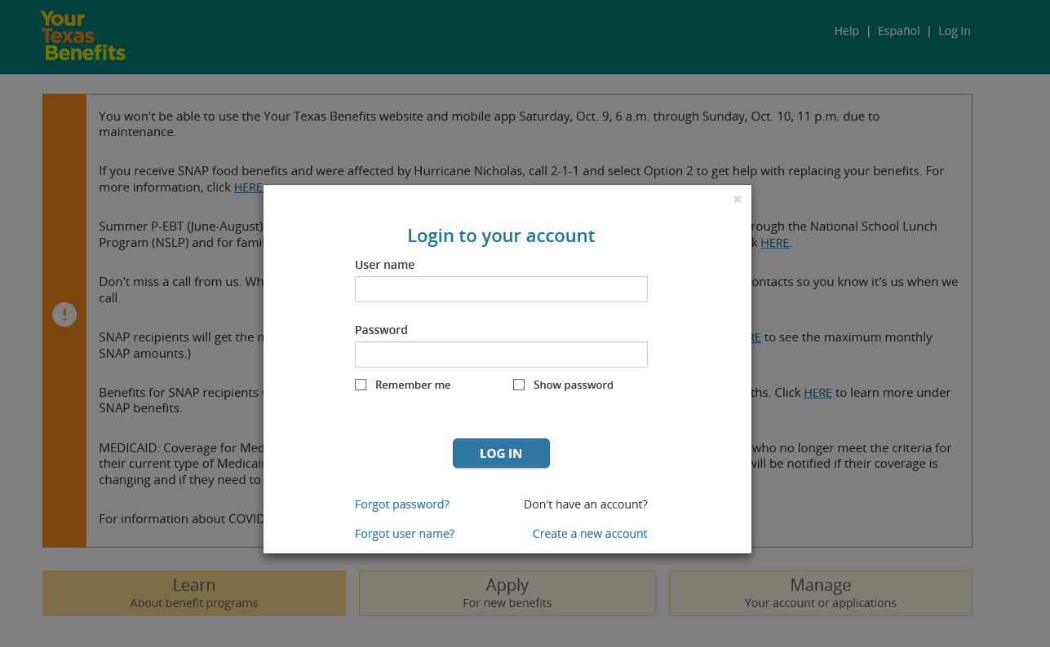
Upload Process
After or during training, attempt to access www.YourTexasBenefits.com link, you should receive/see this: retrieve your username, reset password, and upload data

Slide 16
Upload Process
Only identified public school district and private school Points of Contact (POCs) will have access to HHSC YourTexasBenefits portal to upload data.
HHSC’s CSV file format must be uploaded following the specific format provided (already shared with school districts). Template available on YourTexasBenefits portal.
File layout must include all student information including SSN and DOB. All primary parent information is required. Parent DOB is optional. Number of days student was absent due to COVID-19 is required.
Review HHSC’s shared user guide for upload instructions, file layout guidance, screenshots, and helpful tips to minimize upload errors.

Slide 17
1. School districts create upload from local Student Information System (public) or points of contact prepare file of eligible students for upload
2. School districts log into YTB and upload eligible students using HHSC’s file template 4/4-4/14
3. HHSC receives school district uploaded file and validates for any errors (<24 hours)
4. If errors = POC has to address them and re-upload file. Return to step #2
5. If no errors = proceed to #6
6. HHSC posts upload validation status in YTB.
7. HHSC issues benefits on 4/18-4/22
8. School districts check in YTB for issuance status, after 4/22
Fix Errors: Errors must be addressed by POC and re-uploaded
For information about upload status, refer to the Help Guide

Slide 18
POC for Technical & Other Support
Check the Help Guide for information regarding upload process, upload status, how to access your account.
For file layout, student data upload related assistance, student data/NSLP meal eligibility and/or campus eligibility questions, public school districts and private schools should contact their local ESC.
If ESCs require additional assistance with the above topics, please contact:
Public: TSDSCustomerSupport@tea.texas.gov
Private: PEBT@texasagriculture.gov
For technical upload issues that ESCs need to escalate, contact pebt_data@hhs.texas.gov

Slide 19
Live Demo: Upload Process
HHSC IT overview:
Live demo
Logging into YTB portal
File layout – preparing the file
File upload process (has to be HHSC CSV template)
Potential errors with uploading files
Monitoring uploaded files
Viewing issuance status
Note: have the user guide document accessible/open during the live demo for quick reference.

Slide 20
P-EBT Pandemic Electronic Benefit Transfer
Thursday, 2/24/2022 10am-12pm

