Slide 1
Teacher Incentive Allotment (TIA) Guidance for PEIMS Coding
Lyra Swinney
Jamie Muffoletto
Notes:
Thank you for joining
Discuss TIA and how it relates to PEIMS coding
Jamie's title Data Standards and Governance Manager

Slide 2
Objectives
Understand the eligibility requirements and mechanics of TIA teacher designations
Use guidance to correctly identify and code Role IDs for atypical teaching positions
Notes:
Lyra, then Jamie will give specifics
Regions service center PEIMS Coordinators

Slide 3
Teacher Incentive Allotment Theory of Action
“In addition to helping attract and keep their effective educators in the classroom, public schools implementing these systems would be able to identify their more effective educators and then provide incentives for them to teach at their most challenged campuses, increasing the equitable distribution of effective educators.”
- Texas Commission on Public School Finance
Notes:
Key point: start off with the state’s rationale
Key point: this is a large investment made by the legislature to in direct response to the challenges around recruitment, retention and equity

Slide 4
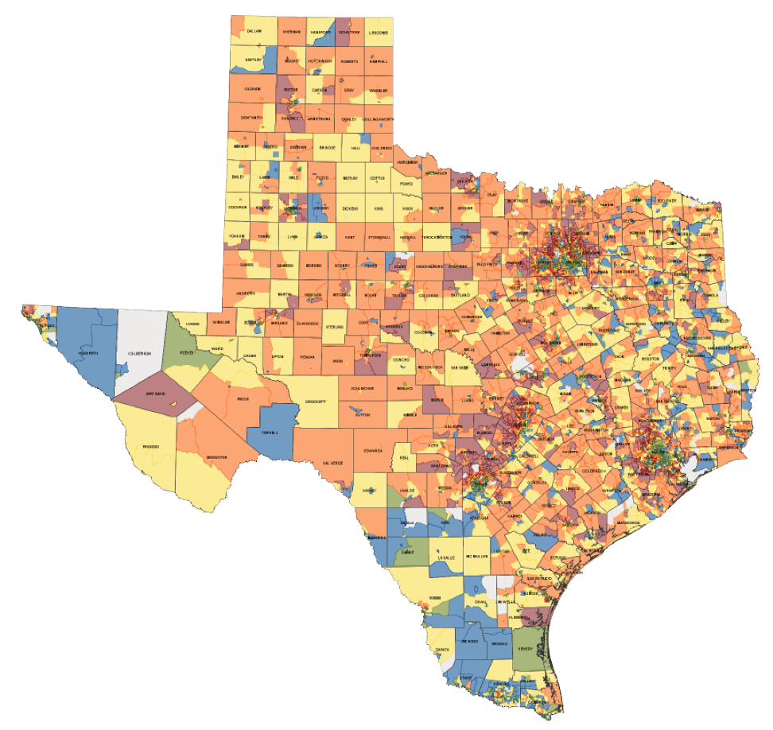
Key Points: Teacher Incentive Allotment (TIA)
3 new designations (Master, Exemplary, Recognized) based on teacher effectiveness, added to teacher’s SBEC certificate
LEAs will receive $3-32K annually per designated teacher
Greater funding for designated teachers on high-needs and/or rural campuses
LEAs must use at least 90% of funds on teacher compensation on designated teacher’s campus
5-year designation validity, regardless of teacher placement (subject, school, LEA)
Notes:
Emph that all districts could be impacted--$$ will come

Slide 5
Two Pathways to Earn Designations
National Board Certification
Individual teacher achieves National Board Certification
Districts may choose to support cohorts of National Board candidates.
Local Optional Teacher Designation System
District-created system
District system is approved
District determines and issues teacher designations
fairly automatic
application & approval process
Notes:
How they earn a designation

Slide 6
Funding per Designation
Master
$12K-$32K
Exemplary
$6-$18K
3 Funding Factors:
Designation Level
Campus socio-economic need
Campus rural status
Recognized
$3-$9K
Notes:
Key point: rural and high-needs face specific challenges and this is used to encourage the equitable distribution of teachers so that our most high-needs kids have access to effective teachers

Slide 7
Eligibility for Designations under TIA
Districts may only submit teachers for designation if they are coded 087 Teacher Role ID.
Are NOT required to be a teacher of record or a campus-based classroom teacher
TEA will ensure that designated teachers only generate annual allotment funds if coded 087 in Winter Class Roster
Goal: 100% of eligible designated teachers generate annual allotment
Notes:
What’s required to earn the designation and continued annual allotment

Slide 8
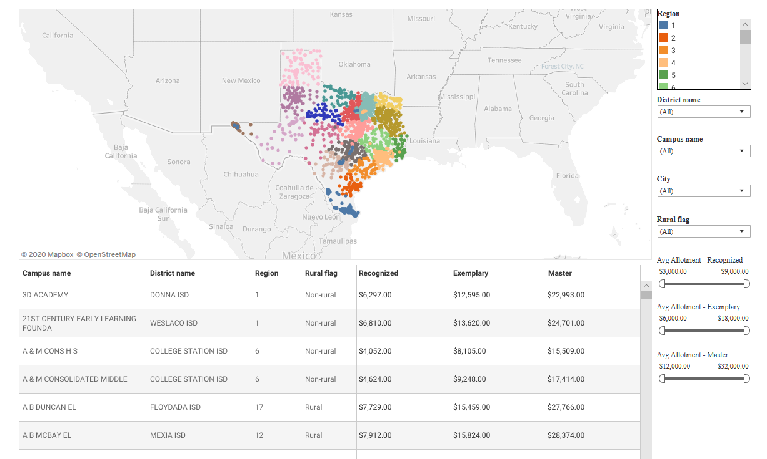
Allotment Funding Considerations
Annual funding ranges from $3-$32K based on the campus(es) where the designated teacher works.
For teachers working at multiple campuses as an 087, the payout will be calculated as an average of each campus’ allotment.
Districts will receive an annual report of funding by designated teacher and campus.
Allotments for centrally assigned teachers will default to the district average.
Notes:
Interactive Map, all campuses across the state and allotment value by designation

Slide 9
Why Winter Roster?
Spirit of legislation: reward highly effective teachers, incentivize highly effective teachers to work with students at high needs and rural campuses.
Once a teacher is designated, must have an automated method to determine eligibility, placement, and position annually.
Commissioner rules for eligibility:
087 Teacher
Creditable year of service
Statute: Allotment funding calculated based on campus of employment and designation level.
Notes:
Fwd thinking about automated method, theory of action is that teachers will move, need to rely on something collected from all districts, not just those who designate

Slide 10
Winter Roster Impact on Designations and Funding
Designated Teacher
(new or returning)
TEA matches educator info in ECOS
TEA matches educator in TSDS
Winter Roster verification of 087 Role ID and CDCN(s)
Designation placed on SBEC certificate
Allotment Funding calculated based on CDCN(S)
Districts receive FSP funding amounts
Teachers compensated
Notes:
Walk through the flow from earning designation to allotment funding reaching the district

Slide 11
Atypical Teaching Positions and TIA
Theory of action: the most highly effective teachers will be incentivized to work at highest needs campuses and/or hard to staff positions.
Districts/campuses often place their most valuable teachers in flexible positions where they can work with the highest number of students based on an identified need for specific instruction.
Reading specialist
Dyslexia teacher
Interventionists (all subjects)
Serving students at multiple campuses
GT
Adaptive PE
BVI
Campus-created positions using Title One funding
Notes:
Synchronous and asynchronous methods this year—may get pulled for these roles

Slide 12
Push-in Support vs. Pull-out Support
Push-in support
Generally 087, Classroom Position Type 02, 03
Teacher is working in the classroom
May provide general support to the teacher of record or work with specific students with special needs (co-teacher, inclusion teacher, behavior support)
Provides instruction to students
Pull-out support
Could be miscoded 113 or 114, should be 087, Classroom Position Type 01
Provides instruction to students, possibly in a separate setting
May be assigned to a campus or centrally assigned
Often not linked to students in attendance system or class roster
Campus and students may vary or rotate based on:
State and local data
Progress through IEP goals, achievement goals, or a program
Notes:
Location doesn’t matter—consistency across campus or student group—punt to Jamie
Classroom position types:
02: Assistant Teacher
03: Support Teacher
Pivot to Jamie

Slide 13
General Guidance for 087 - Teacher
Verify before coding an atypical position 087
Is the primary job function providing regular instruction to students? Instruction is tied to TEKS or program standards.
Must they have a valid teaching certificate to perform their duties?*
*Charter exception
Positions NOT coded 087
May also be in the classroom, but main job function is not providing regular instruction to students
041 - Teacher Facilitator
aka Instructional Coach, Instructional Specialist, Teacher Leader, Mentor Teacher
114 - Other Campus Exempt Professional Auxiliary
113 - Other District Exempt Professional Auxiliary
Notes:
Instruction: TEKS or program standards. Ex dyslexia has program standards that the teacher is working with the students to achieve. Special education could potentially be working towards IEP goals and providing further instruction as to what was provided in standard. Travelling behavior support for specific students.
Direct or indirect...the 114/113 can work with students from time to time. There is no consistent working with students. Could be used at STAAR time, but their overall function is not working with students.
Teacher: A professional employee who is required to hold a valid teacher certificate or permit in order to perform some type of instruction to students
Teacher Facilitator/Instructional Coach/Instructional Specialists: Serves as an exemplary role model in assisting teachers with improving their classroom performance. Mention that districts may create a local title: instructional coach, teacher mentor, classroom specialist. Instructional specialist may require extra detailed investigation, because this could mean instruction to kids or coaching teachers with their instruction.
Other Campus Exempt Professional Auxiliary: Serves as a professional staff member at one or more campuses. Do not use this role unless no other role applies to the staff member.
Some examples of staff who are to be shown with this role are:
• campus/community liaisons
• campus volunteer coordinators
• dean and
• instructional officers assigned to a campus
Other District Exempt Professional Auxiliary: Assign this role to district staff who are professional-level, non-instructional staff who cannot be classified in any other role regardless of where assigned. Physical work location is not a determining factor.
Make sure there is some documentation on file if someone's job description says teacher facilitator and you are reporting them as an 087. How can you justify which students they were working with?

Slide 14
Identifying Teachers in Atypical Roles
Who is responsible?
What happens when a teacher is not on the master schedule?
If a teacher is on more than one campus, who is responsible?
If a teacher is assigned to the district office, who is responsible?
Collaborative effort between, PEIMS, Campus, HR and Finance
Notes:
Hidden teachers not on the master schedule. The nationally certified teachers may not be known by the LEA, but the teacher will know that they have that designation.
Prior to next slide: we are going to review two real examples for what has been seen in the past.
In a perfect world: Check with HR because if a district has hired teachers eligible for the TIA they should have paperwork on them. Do a cross reference to make sure that anyone with the designation is coded as an 087.

Slide 15
Scenarios: Flower ISD, Centrally Assigned Teacher
Glenda has a Recognized designation for being a National Board Certified Teacher (NBCT). She provides dyslexia instruction at five campuses in her district. Students begin and exit the program at varying times based on progress. She rotates on a regular schedule, pulls students to work in the library or small classroom, and takes attendance by hand. She is not linked to her students in PEIMS. Her supervisor is a district-level employee.

Slide 16
Scenario Reporting:
What should be reported in Winter Class Roster:
Glenda should be reported as a teacher (087) in Winter Class Roster.
Additional guidance will be released on the nature of reporting.
Fiscal Impact: $3,000 - $9,000 received by LEA.
Notes:
Should be reported: Responsibility record for the teacher. 90% or more has to be used on that campus for compensation. If centrally assigned a lot of this is going to the teacher, but there is not exact amount. Teachers know that they are designed to receive this and most districts will have a written plan for how that funding will be spent. Some districts are even recruiting these types of teachers due to the extra funding they will bring in.

Slide 17
Scenarios: Flower ISD, Teacher Leader
Flower ISD hired Jarrod for a Teacher Leader position. Jarrod is a Master designated teacher. He provides classroom support to developing teachers. He occasionally works with students or covers classes for teachers to attend ARD meetings. His primary function is to improve teacher performance through observation and feedback cycles. His supervisor is the campus principal.

Slide 18
Scenario Reporting:
What should be reported in Winter Class Roster:
Jarrod should not be reported in Class Roster since he does not provide student instruction.
Fiscal Impact: $12,000-$32,000 received by LEA. LEA is ineligible to receive funds.
Notes:
Jarrod may at time be an "extra" set of hands in the classroom. But his consistent role is not to work with students. Anyone on a campus can pull students.
If talk to the teacher what will they say?

Slide 19
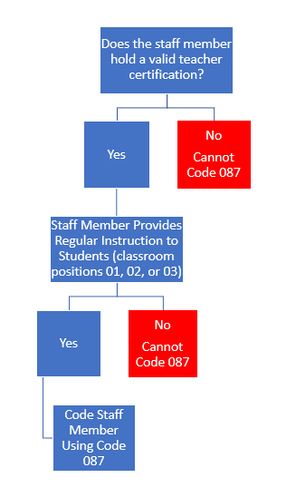
Role ID 087 Complexities
TSDS PEIMS Guidance/Flowchart
Depending on SIS, staff member may need an independent course built to show the values in TeacherSectionAssociationExtension.
Staff member may need to be reported with multiple courses on multiple campuses.
LEA must consider all certified staff members to determine if they provide regular instruction.
Notes:
Yes in Winter, but now is the time to have the LEAs talk with their vendors.
Go into example of PEIMS reporting getting list of all certified people on a campus and making sure there is the necessary role ID on them.

Slide 20
Key Takeaways
Teacher Incentive Allotment funding is dependent on accurate reporting in Winter Class Roster.
Atypical teaching positions may require more investigation prior to assigning Role ID 087.
Teachers providing instruction to students must be coded 087 in Winter Class Roster and tied to the campuses they serve.

Slide 21
Resources
Today’s Deck
TIATexas.org
Questions? TIA@tea.Texas.gov
Notes:
Key point: visit website – will work to update information
Jamie: if you are looking for guidance on the specific coding please submit a TIMS ticket.
Lyra: if you have questions regarding the teacher incentive allotment or teacher eligibility, please email our team at…

