Slide 1
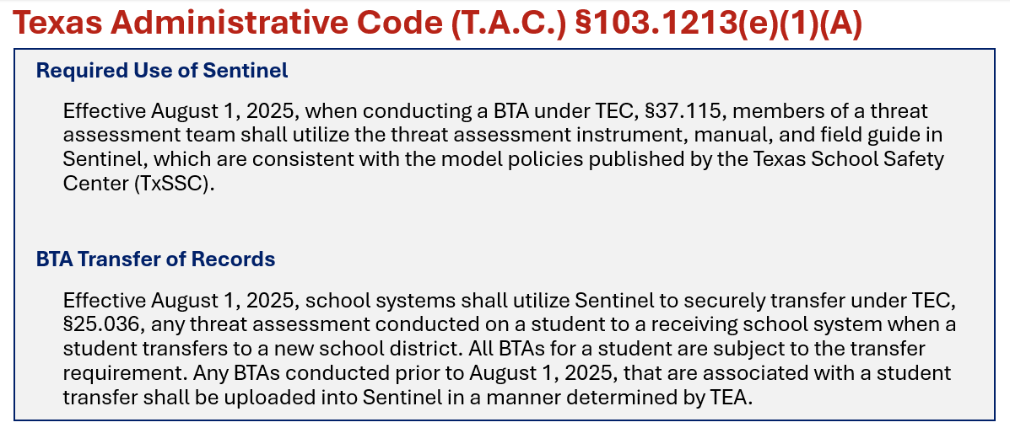
Threat Assessments in Sentinel
Notes:
- LIVE – April 2025
- Required – August 2025
Effective August 1st, Sentinel BTA required to be utilized when conducting threat assessments. As well starting August 1st, Sentinel BTA model will be required to be utilized when transferring threat assessments. LEAs will no longer use TREx to transfer BTA records. Sentinel will do all that transferring for you. Making those BTA transfers more quickly and efficiently.

Slide 2
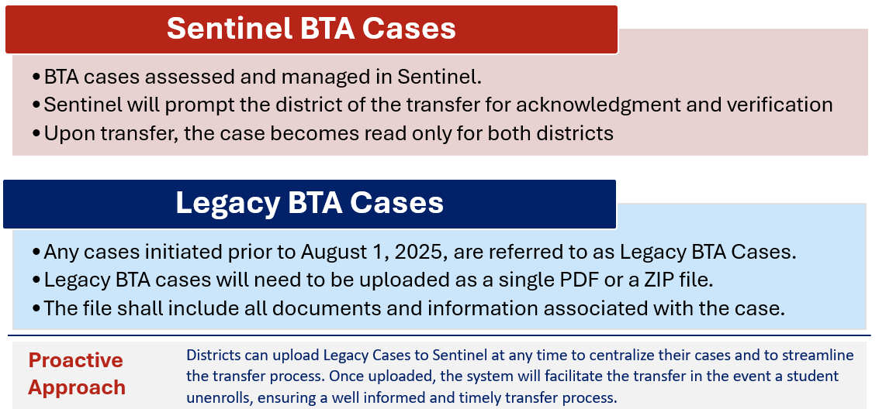
Transfer of Records
Notes:
Note: We are here to help you. We will going to provide guidance on transferring cases.
If you have an Actively Managed case we highly encourage you enter that case into Sentinel.
We are not requiring districts to upload those closed cases into Sentinel. If they choose to, they are welcome to but not necessary.

Slide 3
Why the change?
Sentinel was developed as the official Texas School Safety platform, serving as a centralized, comprehensive system for all school safety functions under the Texas Education Agency.
Effective August 1, all Behavioral Threat Assessments (BTAs) must be conducted and transferred within Sentinel.
Sentinel facilitates secure and direct case transfers from one BTA team to another, while safeguarding personally identifiable information (PII).
This process establishes a streamlined, standardized, and efficient approach to ensure critical BTA case information is shared in a timely and compliant manner.

Slide 4
How Can PEIMS Coordinators Help?
Facilitate Internal Communication
Collaborate with BTA Coordinators to ensure all relevant district and campus staff are informed of the transition from T-REX to Sentinel for BTA case transfers, including key dates and procedural changes.
Support Data Accuracy and Systems Alignment
Communicate student enrollment and withdrawal information to the BTA team in a timely manner to support expediated transfers or supports, especially those with the BTA indicator.
Help reroute Legacy cases to Sentinel for transfer instead of TREx.
Help Identify Key Contacts
Maintain updated BTA and PEIMS contacts at campuses to assist with coordination and accountability in the transfer process.
Promote Cross-Department Collaboration
Encourage a shared understanding of respective roles between PEIMS and BTA teams to ensure a smooth and secure transition process that protects student information and meets state requirements.

Slide 5
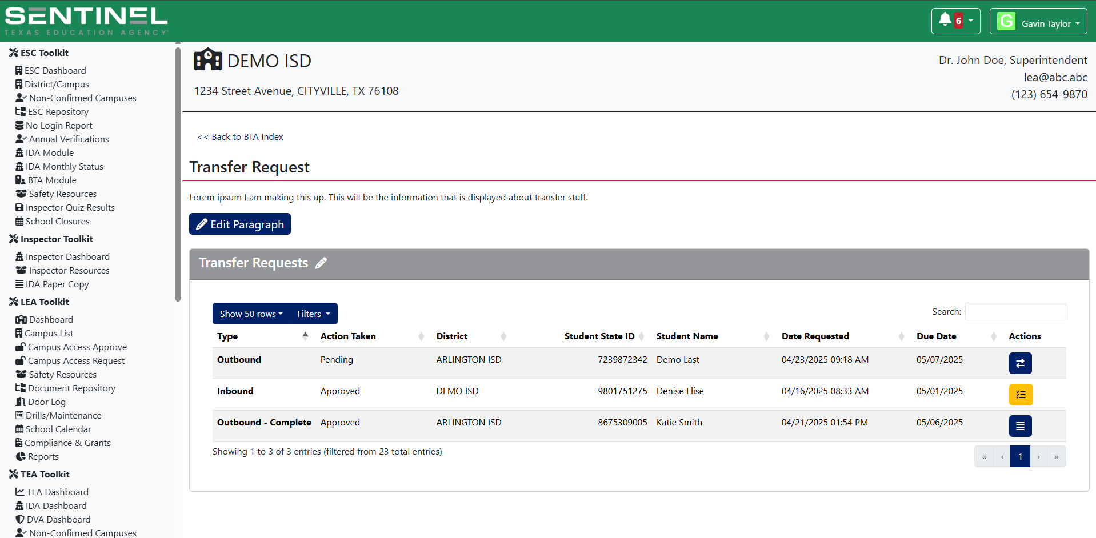
Transfer of Records 1
Notes:
Note: We are here to help you. We will going to provide guidance on transferring cases.
If you have an Actively Managed case we highly encourage you enter that case into Sentinel.
We are not requiring districts to upload those closed cases into Sentinel. If they choose to, they are welcome to but not necessary.

Slide 6

Questions?
Email your questions:
SafeSchools@tea.texas.gov

