Slide 1

TITLE SLIDE: ESC Vendor Training for One Component
DATA STANDARDS IMPACT:
REPORTING LEAVERS AND GRADUATES July 29-31, 2025
<NAME OF COMPONENT> (ALL CAPS) MARCH 19-21, 2024

Slide 2

Agenda – Changes to Reporting Leavers and Graduates
Overview
Timeline
Data Collection Changes
PEIMS Summer Submission
PEIMS Extended Year Submission
Questions

Slide 3

TITLE SLIDE: Overview
OVERVIEW
NAME OF COMPONENT (ALL CAPS) MARCH 19-21, 2024

Slide 4
Overview – 2025-2026 School Year
Effective beginning in the 2025-2026 school year, current-year leaver and graduation data will be reported in both the:
PEIMS Summer Submission.
PEIMS Extended Year Submission.
TEA will update both submissions to include all necessary data for determining leaver and graduate status.
Additional changes will be made to the PEIMS Summer and Extended Year Submissions for reporting Industry-Based Certifications and Associate Degrees to ensure all 2025-2026 school year data is reported during the 2025-2026 school year.

Slide 5
Overview – 2025-2026 PEIMS Fall Submission
PEIMS Fall Submission will no longer include leaver and graduate data after 2025-2026.
2025-2026 is a transition year:
2024-2025 leaver/graduate will still be reported in the 2025-2026 PEIMS Fall Submission.
2025-2026 leaver/graduate data will be reported in the 2025-2026 PEIMS Summer and Extended Year Submissions.
All Industry-Based Certifications and Associate Degrees earned from June 1 to August 31, 2026, will be reported in the PEIMS Summer and Extended Year Submissions.

Slide 6
Important Information
For every PEIMS Summer and Extended Year Submission or Resubmission submitted by an LEA, TEA will promote all the LEA’s leaver and graduate data.
The promoted data comes from the LEA’s Individual Operational Data Store (IODS).
Final leaver and graduate reporting will be based on the Extended Year Resubmission, or the last completed Submission or Resubmission by the LEA.

Slide 7
TITLE SLIDE: Timeline
TIMELINE
NAME OF COMPONENT (ALL CAPS) MARCH 19-21, 2024

Slide 8
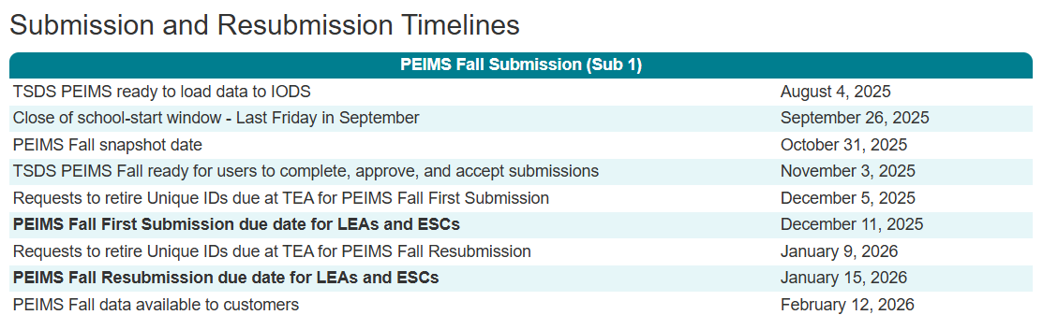
2025-2026 Transition School Year – PEIMS Fall Submission
The 2024-2025 school year Leavers and Graduates are reported in the 2025-2026 PEIMS Fall Submission.

Slide 9
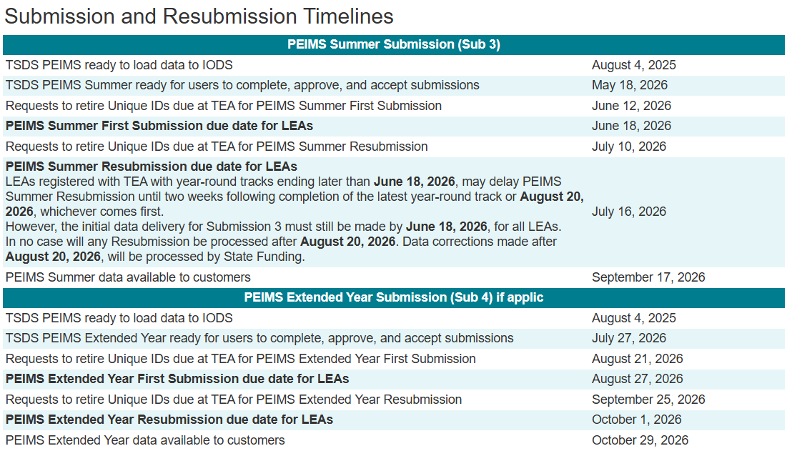
2025-2026 Transition School Year – PEIMS Summer and Extended Year Submissions
2025-2026 school year Leavers and Graduates will be reported in the 2025-2026 PEIMS Summer and Extended Year Submissions.

Slide 10
TITLE SLIDE: Data Collection Changes
DATA COLLECTION
CHANGES

Slide 11

TITLE SLIDE: PEIMS Summer
PEIMS SUMMER
NAME OF COMPONENT (ALL CAPS) MARCH 19-21, 2024

Slide 12
PEIMS Summer Submission
2025-2026 Leavers and Graduates:
Applies to students in grades 7-12 who:
Were enrolled during the year but not on the final day (AsOfStatusLastDayEnrollment (C323) = “I”).
Were enrolled on the final day but have since entered a new educational setting ((C323) = “H” – atypical cases in the PEIMS Summer Submission).
Graduated between the first and last day of school.

Slide 13
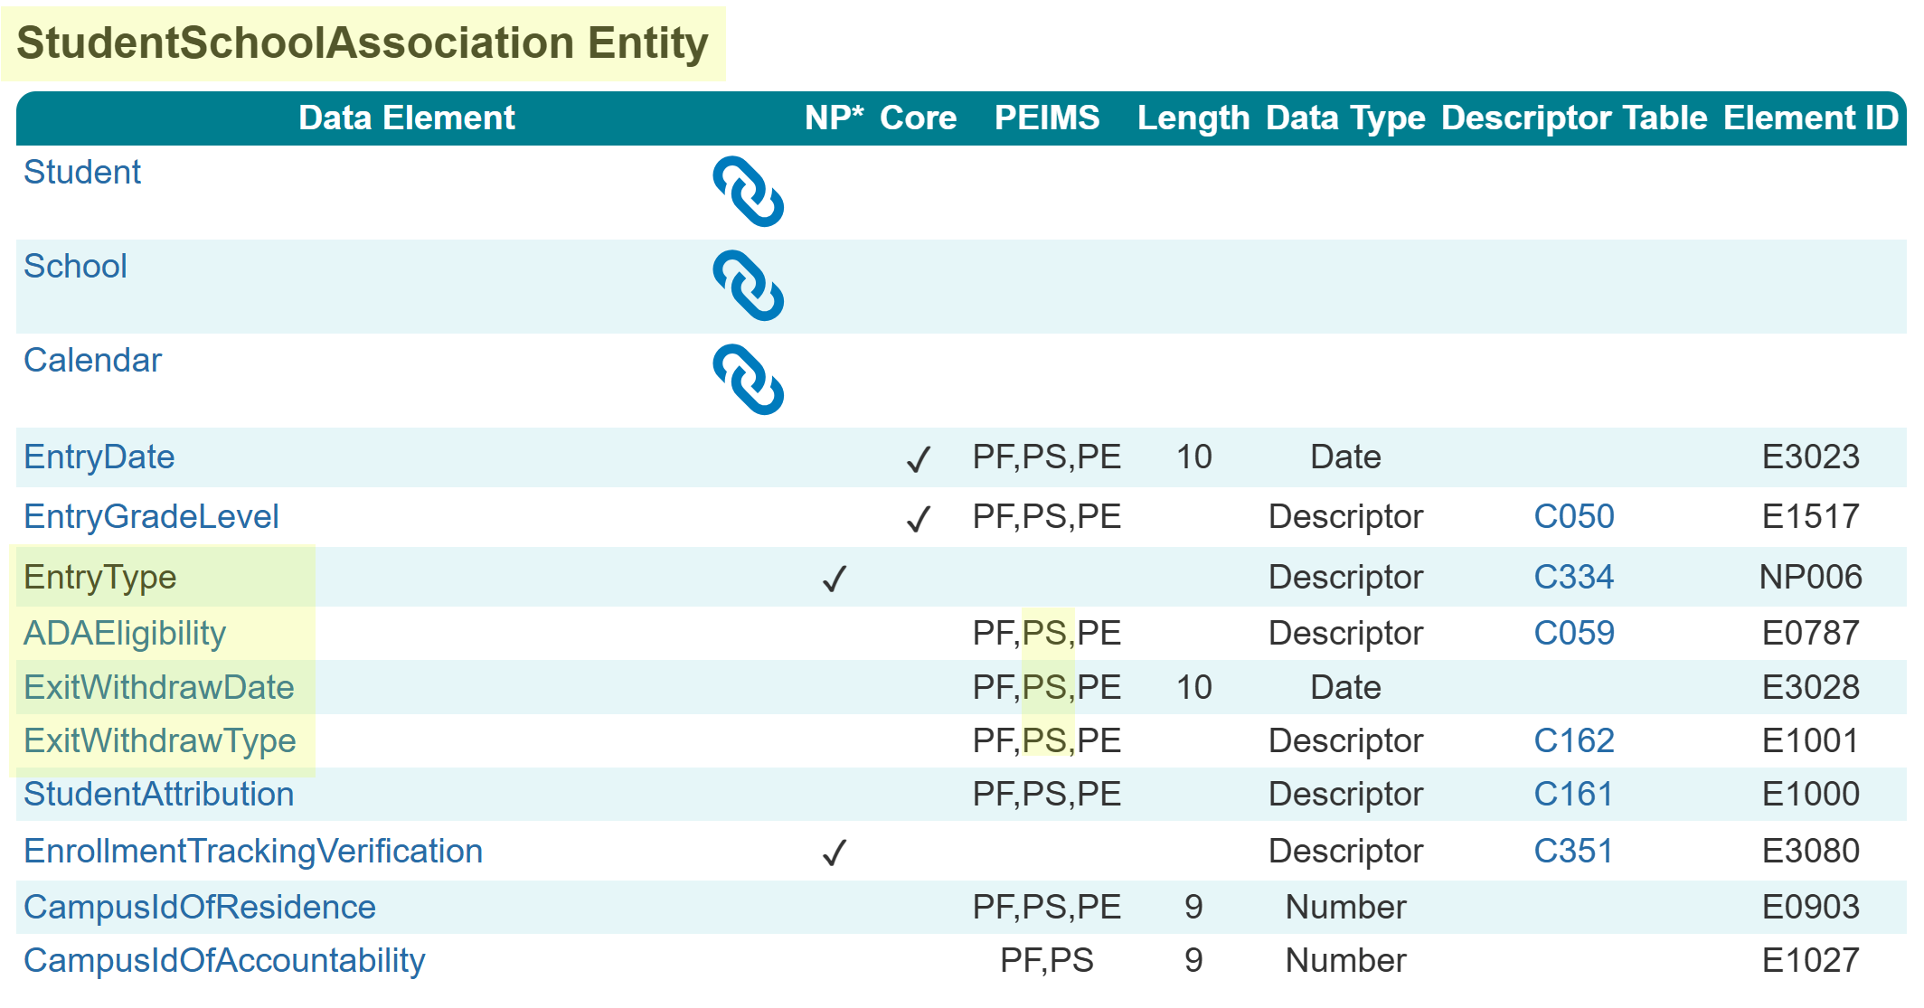
StudentSchoolAssociation Entity Summer
The following is added to the PEIMS Summer Submission:
Data Elements:
EntryType (NP006)
ADAEligibility (E0787)
ExitWithdrawDate (E3028)
ExitWithdrawType (E1001)

Slide 14
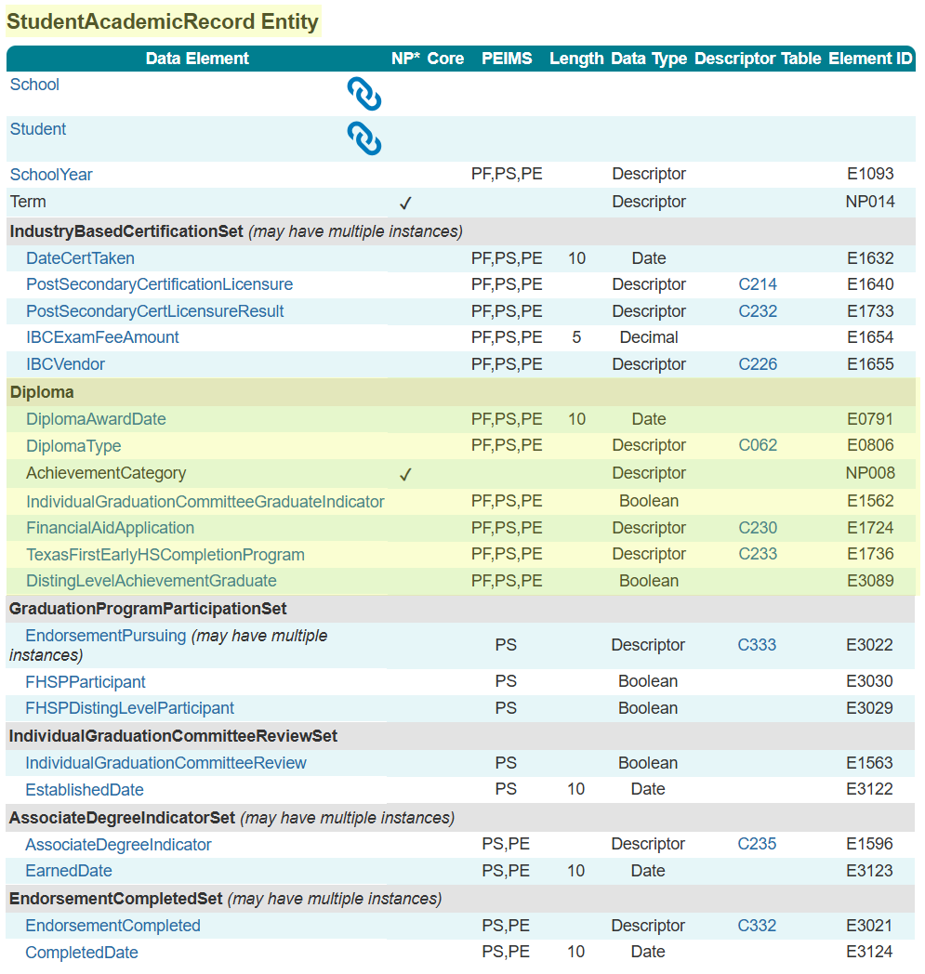
StudentAcademicRecord (SAR) Entity Summer
The following is added to the PEIMS Summer Submission:
Common Type:
Diploma
Data Elements:
DiplomaAwardDate (E0791)
DiplomaType (E0806)
AchievementCategory (NP008)
IndividualGraduationCommitteeGraduate Indicator (E1562)
FinancialAidApplication (E1724)
TexasFirstEarlyHSCompletionProgram (E1736)
DistingLevelAchievementGraduate (E3089)

Slide 15
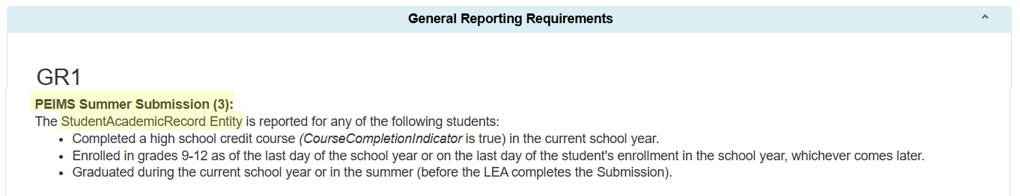
SAR Entity PEIMS Summer Submission Guidance
Students reported in the StudentAcademicRecord Entity:

Slide 16
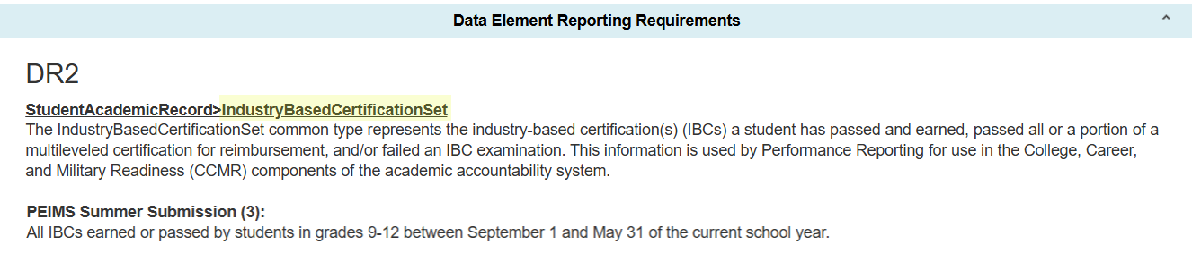
IndustryBasedCertificationSet
StudentAcademicRecord>IndustryBasedCertificationSet Common Type:

Slide 17
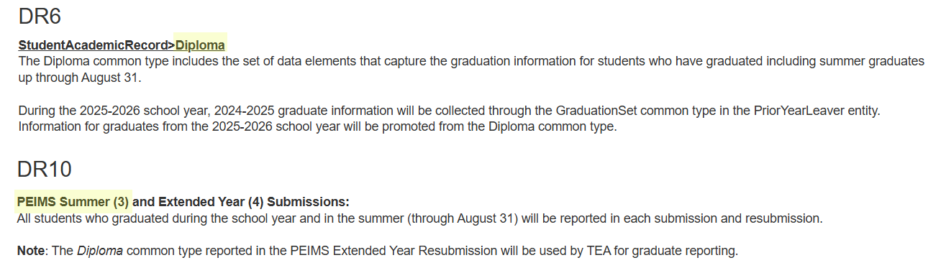
Diploma
StudentAcademicRecord>Diploma Common Type:

Slide 18
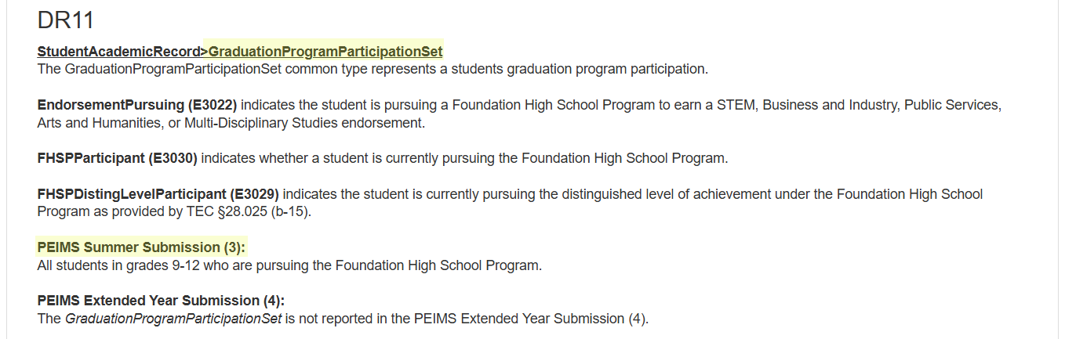
GraduationProgramParticipationSet
StudentAcademicRecord>GraduationProgramParticipationSet Common Type:

Slide 19
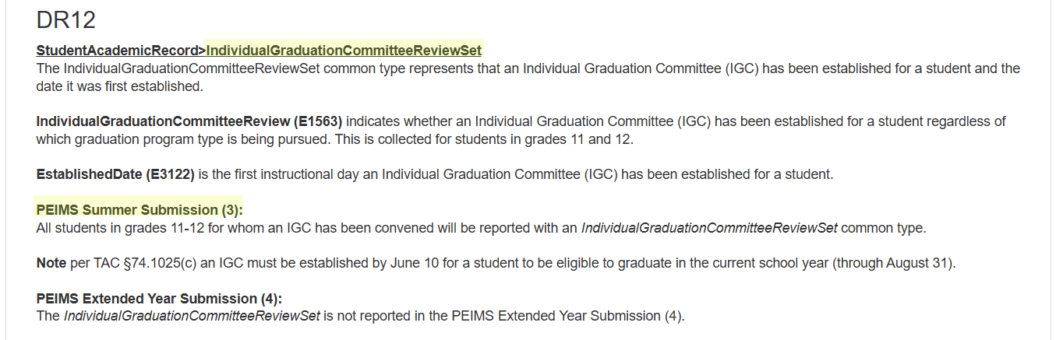
IndividualGraduationCommitteeReviewSet
StudentAcademicRecord>IndividualGraduationCommitteeReviewSet Common Type:

Slide 20
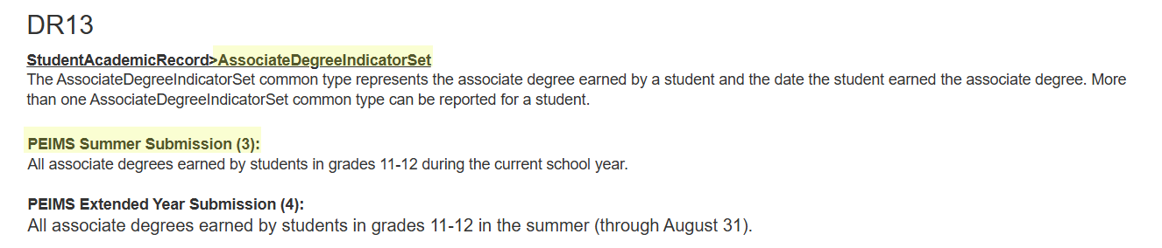
AssociateDegreeIndicatorSet
StudentAcademicRecord>AssociateDegreeIndicatorSet Common Type:

Slide 21
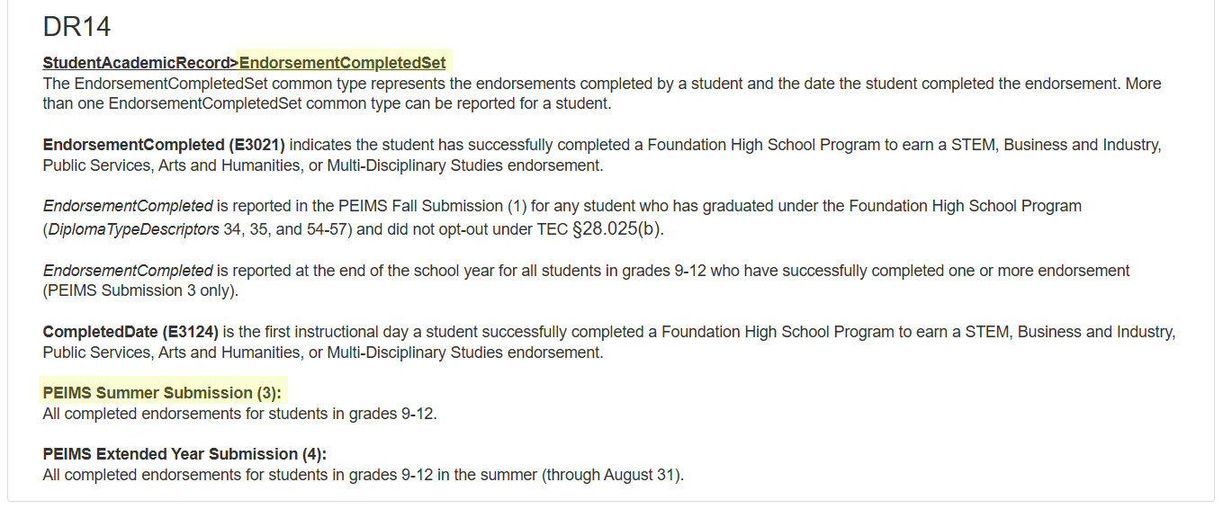
EndorsementCompletedSet
StudentAcademicRecord>EndorsementCompletedSet Common Type:

Slide 22
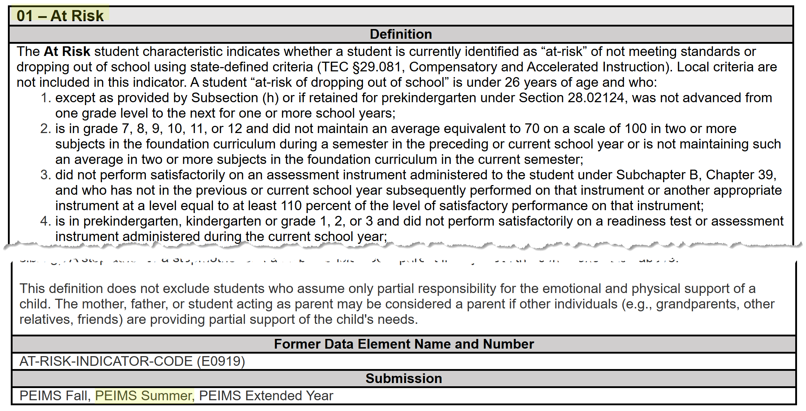
StudentCharacteristic – At Risk Summer
The StudentCharacteristic (C344) “01” At Risk will be added to the PEIMS Summer Submission:

Slide 23
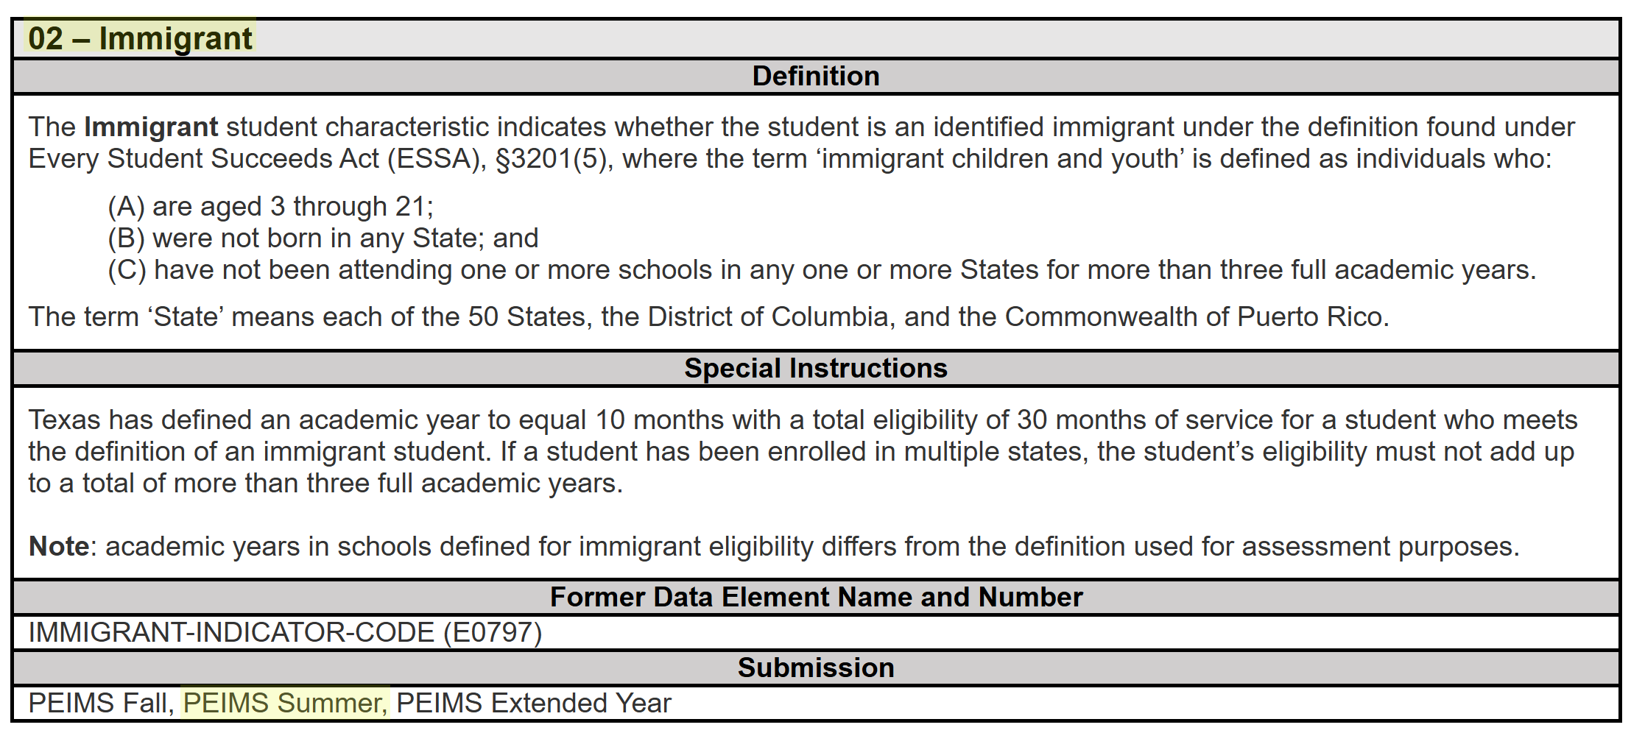
StudentCharacteristic – Immigrant Summer
The StudentCharacteristic (C344) “02” Immigrant will be added to the PEIMS Summer Submission:

Slide 24
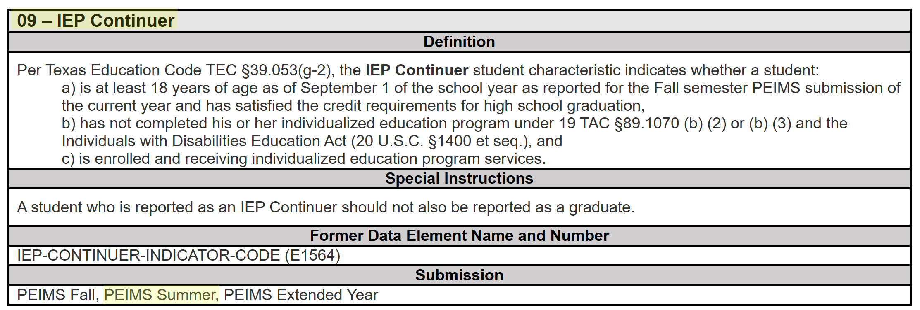
StudentCharacteristic – IEP Continuer Sum
The StudentCharacteristic (C344) “09” IEP Continuer will be added to the PEIMS Summer Submission:

Slide 25
TITLE SLIDE: PEIMS Extended Year
PEIMS EXTENDED YEAR
NAME OF COMPONENT (ALL CAPS) MARCH 19-21, 2024

Slide 26
PEIMS Extended Year Submission
2025-2026 Leavers and Graduates:
Applies to students in grades 7-12 who:
Were enrolled on the final day (C323 = “H”) but did not return during the 2026-2027 school-start window.
Graduated during the summer (up to August 31).
Note: The close of the 2026-2027 School-Start Window is September 25, 2026.

Slide 27
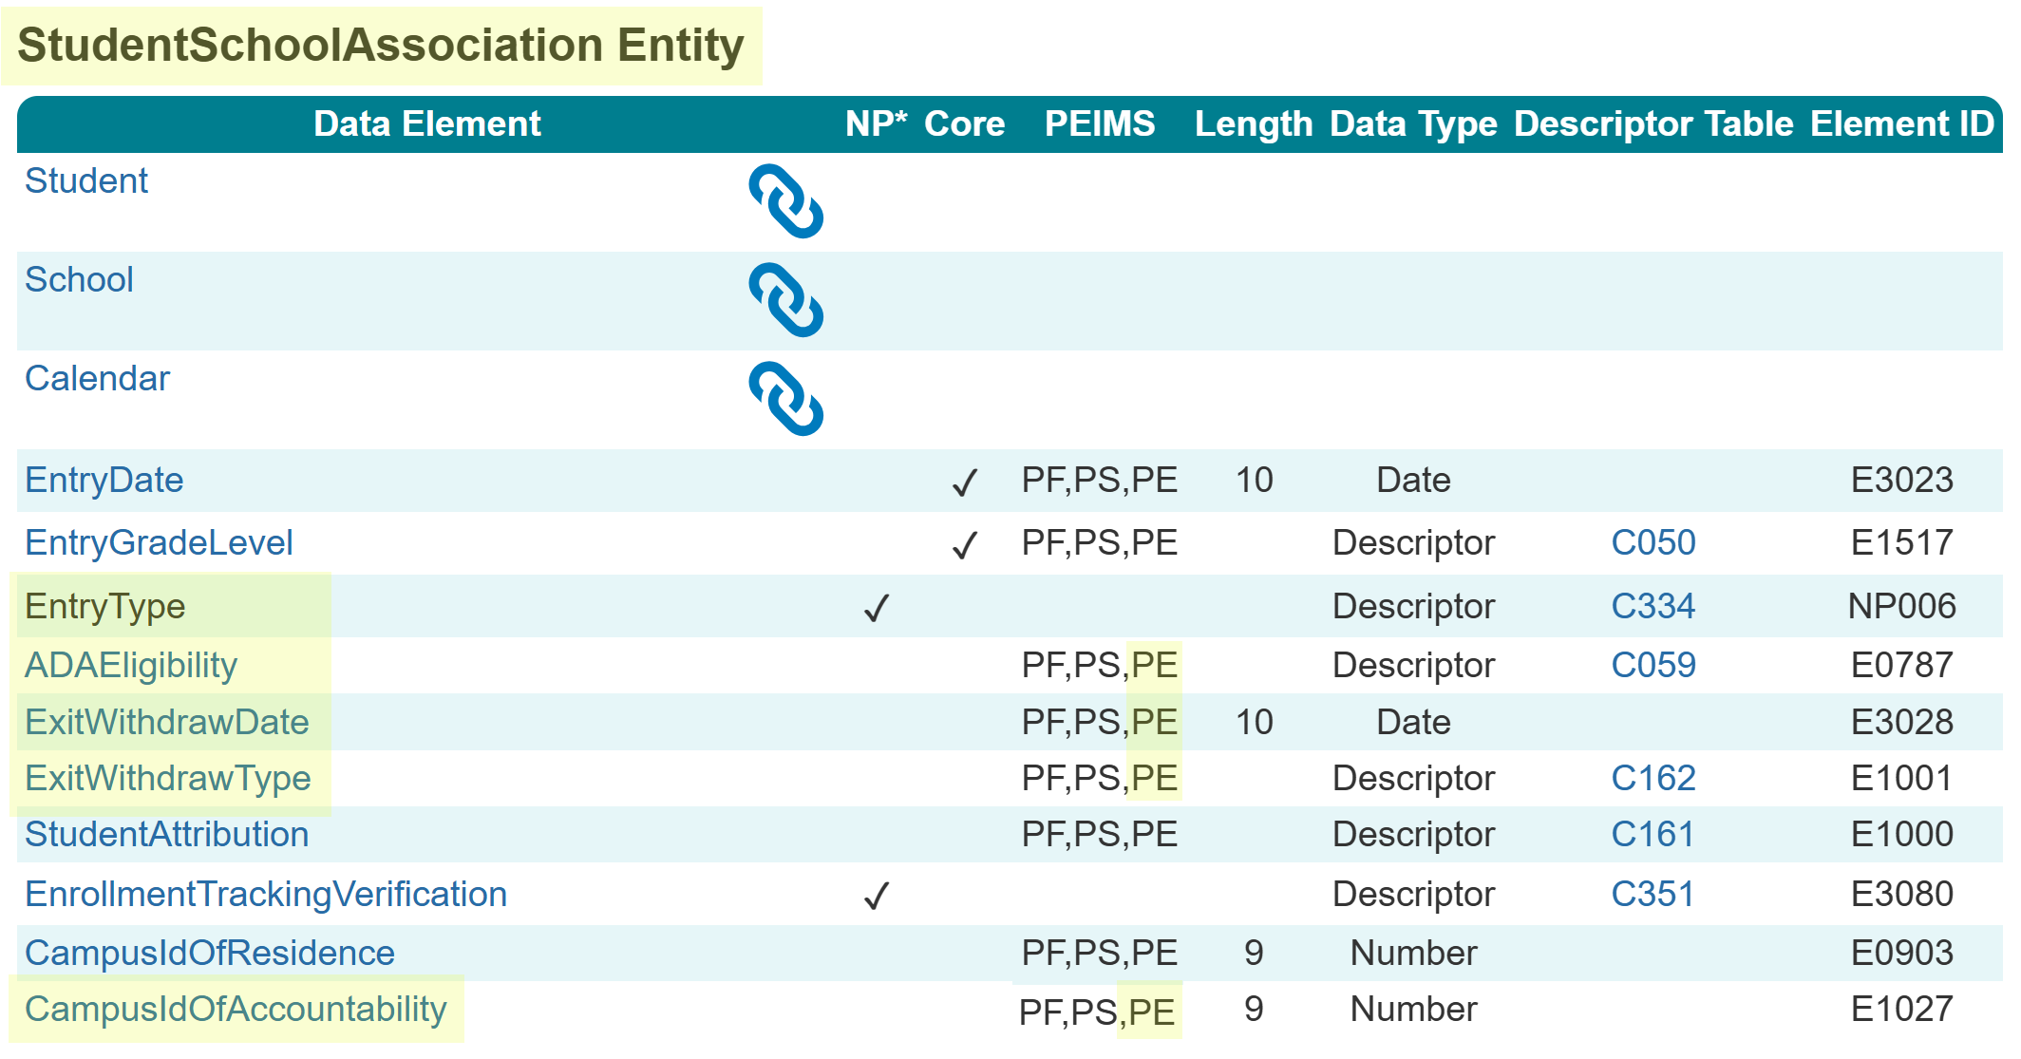
StudentSchoolAssociation Entity Extended
The following is added to the PEIMS Extended Year Submission:
Data Elements:
EntryType (NP006)
ADAEligibility (E0787)
ExitWithdrawDate (E3028)
ExitWithdrawType (E1001)
CampusIdOfAccountability (E1027)

Slide 28
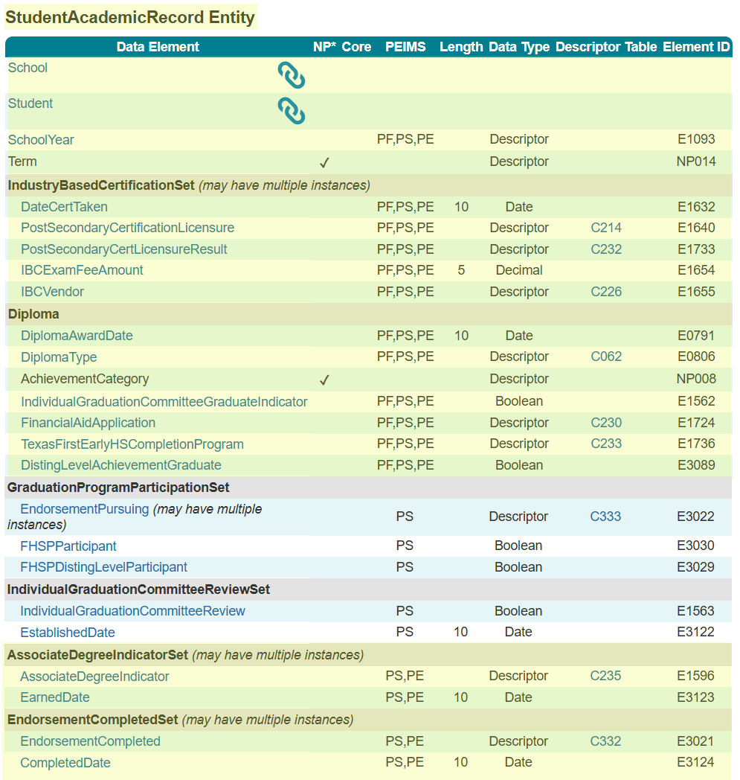
StudentAcademicRecord (SAR) Entity Extended
The following is added to the PEIMS Extended Year Submission:
Common Types:
IndustryBasedCertificationSet
Diploma
AssociateDegreeIndicatorSet
EndorsementCompletedSet
Data Elements:
DateCertTaken (E1632)
PostSecondaryCertificationLicensure (E1640)
PostSecondaryCertLicensureResult (E1733)
IBCExamFeeAmount (E1654)
IBCVendor (E1655)

Slide 29
StudentAcademicRecord (SAR) Entity Continued
Data Elements Continued:
DiplomaAwardDate (E0791)
DiplomaType (E0806)
AchievementCategory (NP008)
IndividualGraduationCommitteeGraduate Indicator (E1562)
FinancialAidApplication (E1724)
TexasFirstEarlyHSCompletionProgram (E1736)
DistingLevelAchievementGraduate (E3089)
AssociateDegreeIndicator (E1596)
EarnedDate (E3123)
EndorsementCompleted (E3021)
CompletedDate (E3124)

Slide 30
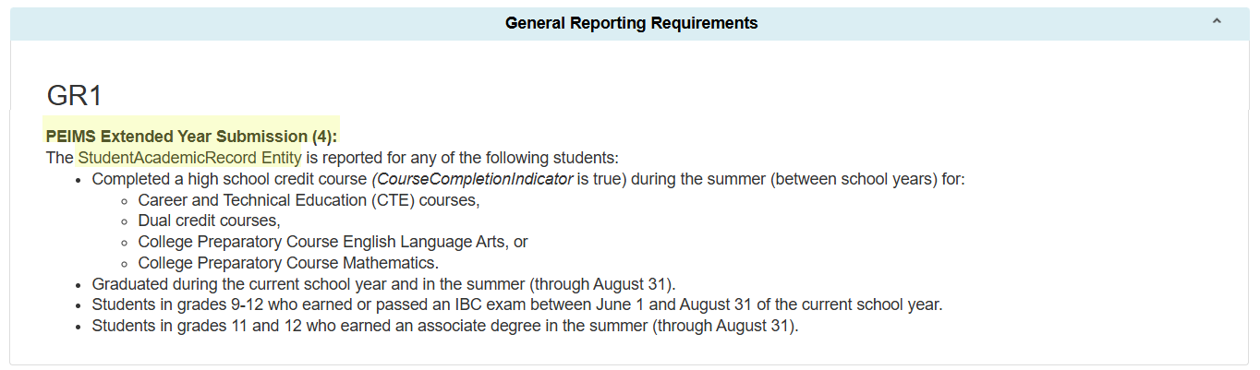
SAR Entity PEIMS Extended Year Submission Guidance
Students reported in the StudentAcademicRecord Entity:

Slide 31
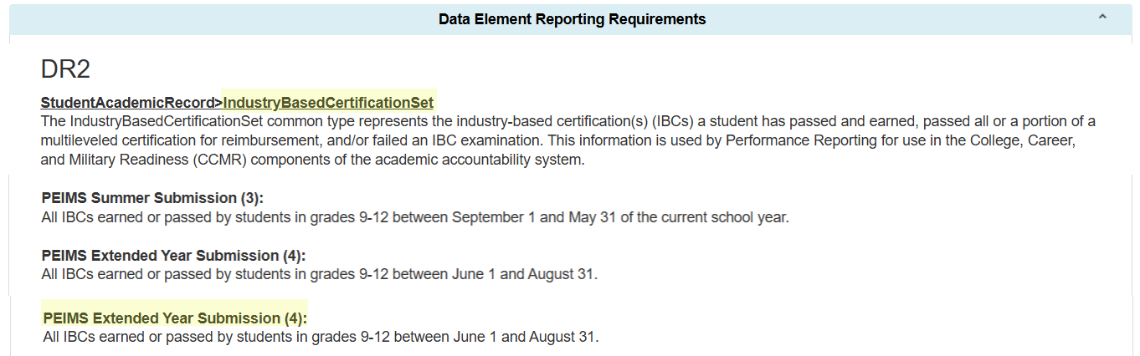
IndustryBasedCertificationSet 1
StudentAcademicRecord>IndustryBasedCertificationSet Common Type:

Slide 32
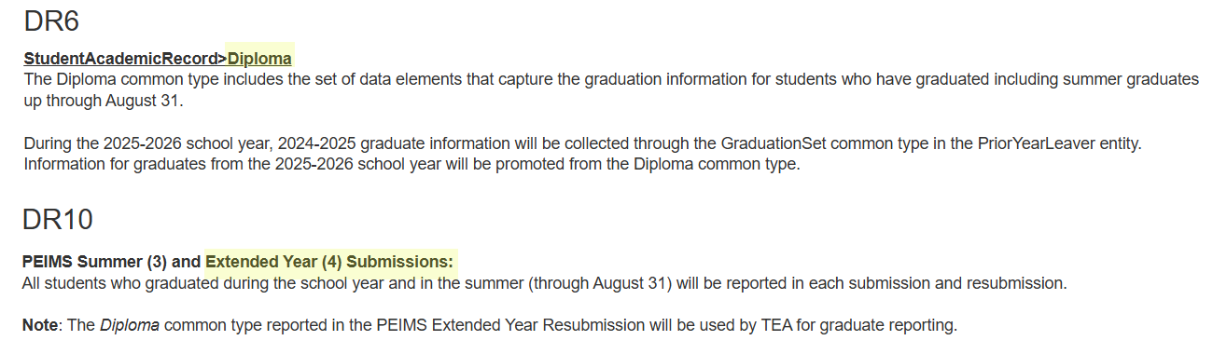
Diploma 4
StudentAcademicRecord>Diploma Common Type:

Slide 33
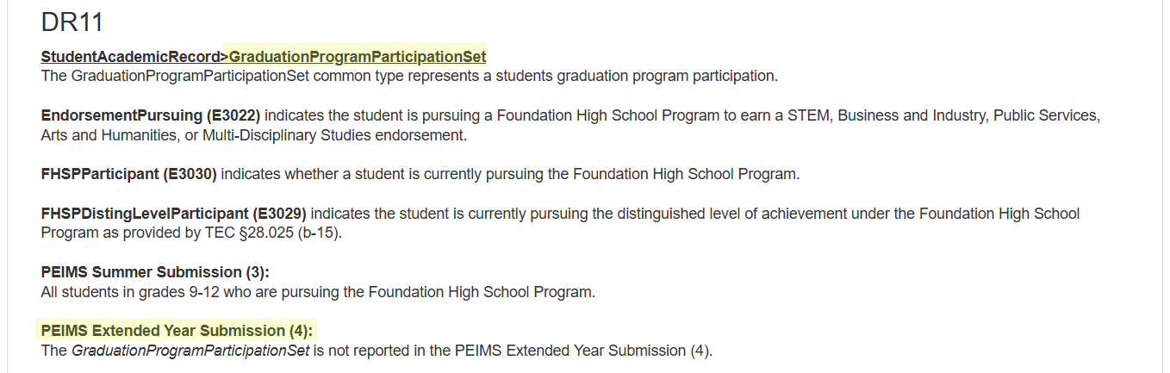
GraduationProgramParticipationSet 2
StudentAcademicRecord>GraduationProgramParticipationSet Common Type:

Slide 34
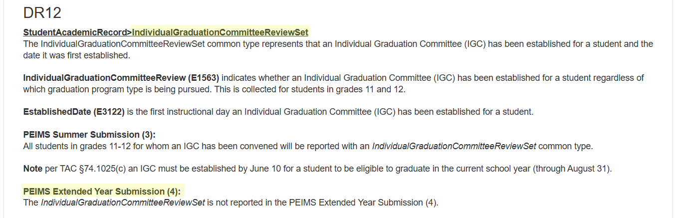
IndividualGraduationCommitteeReviewSet 32
StudentAcademicRecord>IndividualGraduationCommitteeReviewSet Common Type:

Slide 35
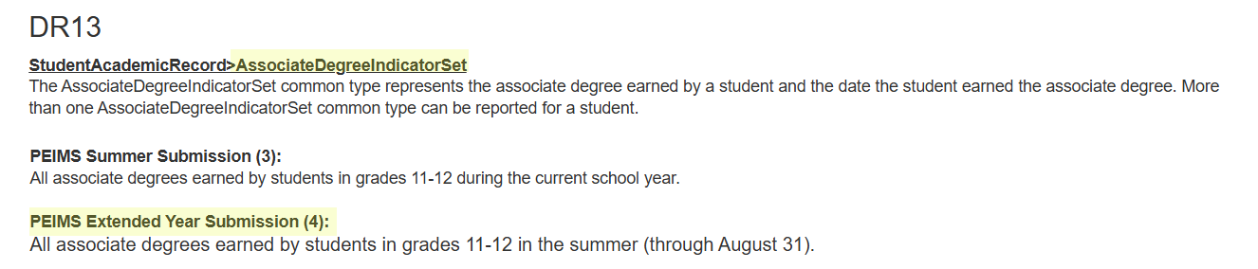
AssociateDegreeIndicatorSet 3
StudentAcademicRecord>AssociateDegreeIndicatorSet Common Type:

Slide 36
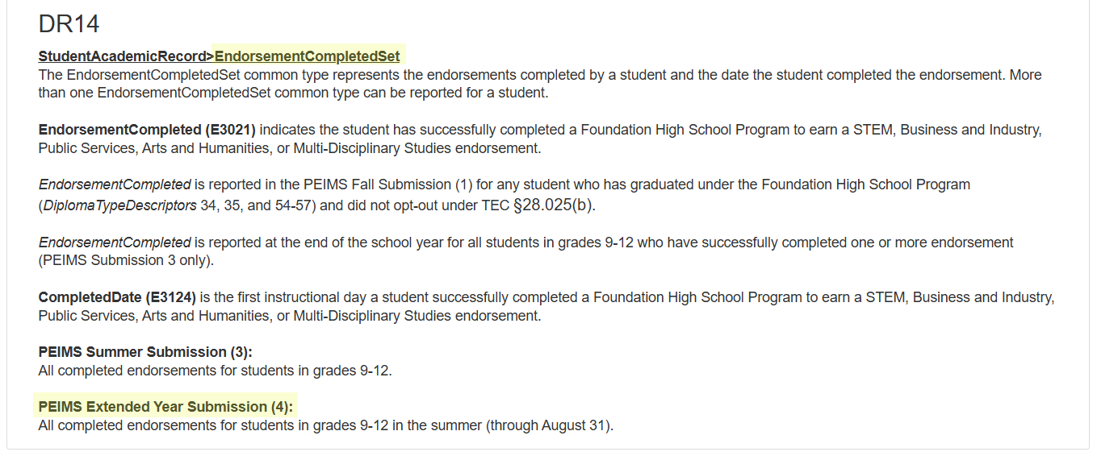
EndorsementCompletedSet 2
StudentAcademicRecord>EndorsementCompletedSet Common Type:

Slide 37
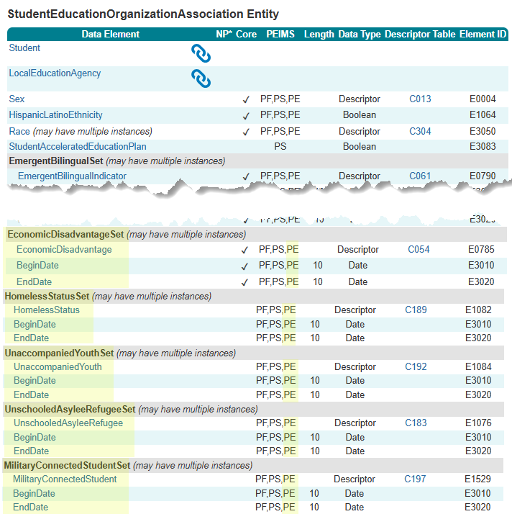
StudentEducationOrganizationAssociation Entity
The following is added to the PEIMS Extended Year Submission:
Common Types:
EconomicDisadvantageSet
HomelessStatusSet
UnaccompaniedYouthSet
UnschooledAsyleeRefugeeSet
MilitaryConnectedStudentSet
Data Elements:
EconomicDisadvantage (E0785)
HomelessStatus (E1082)
UnaccompaniedYouth (E1084)
UnschooledAsyleeRefugee (E1076)
MilitaryConnectedStudent (E1529)

Slide 38
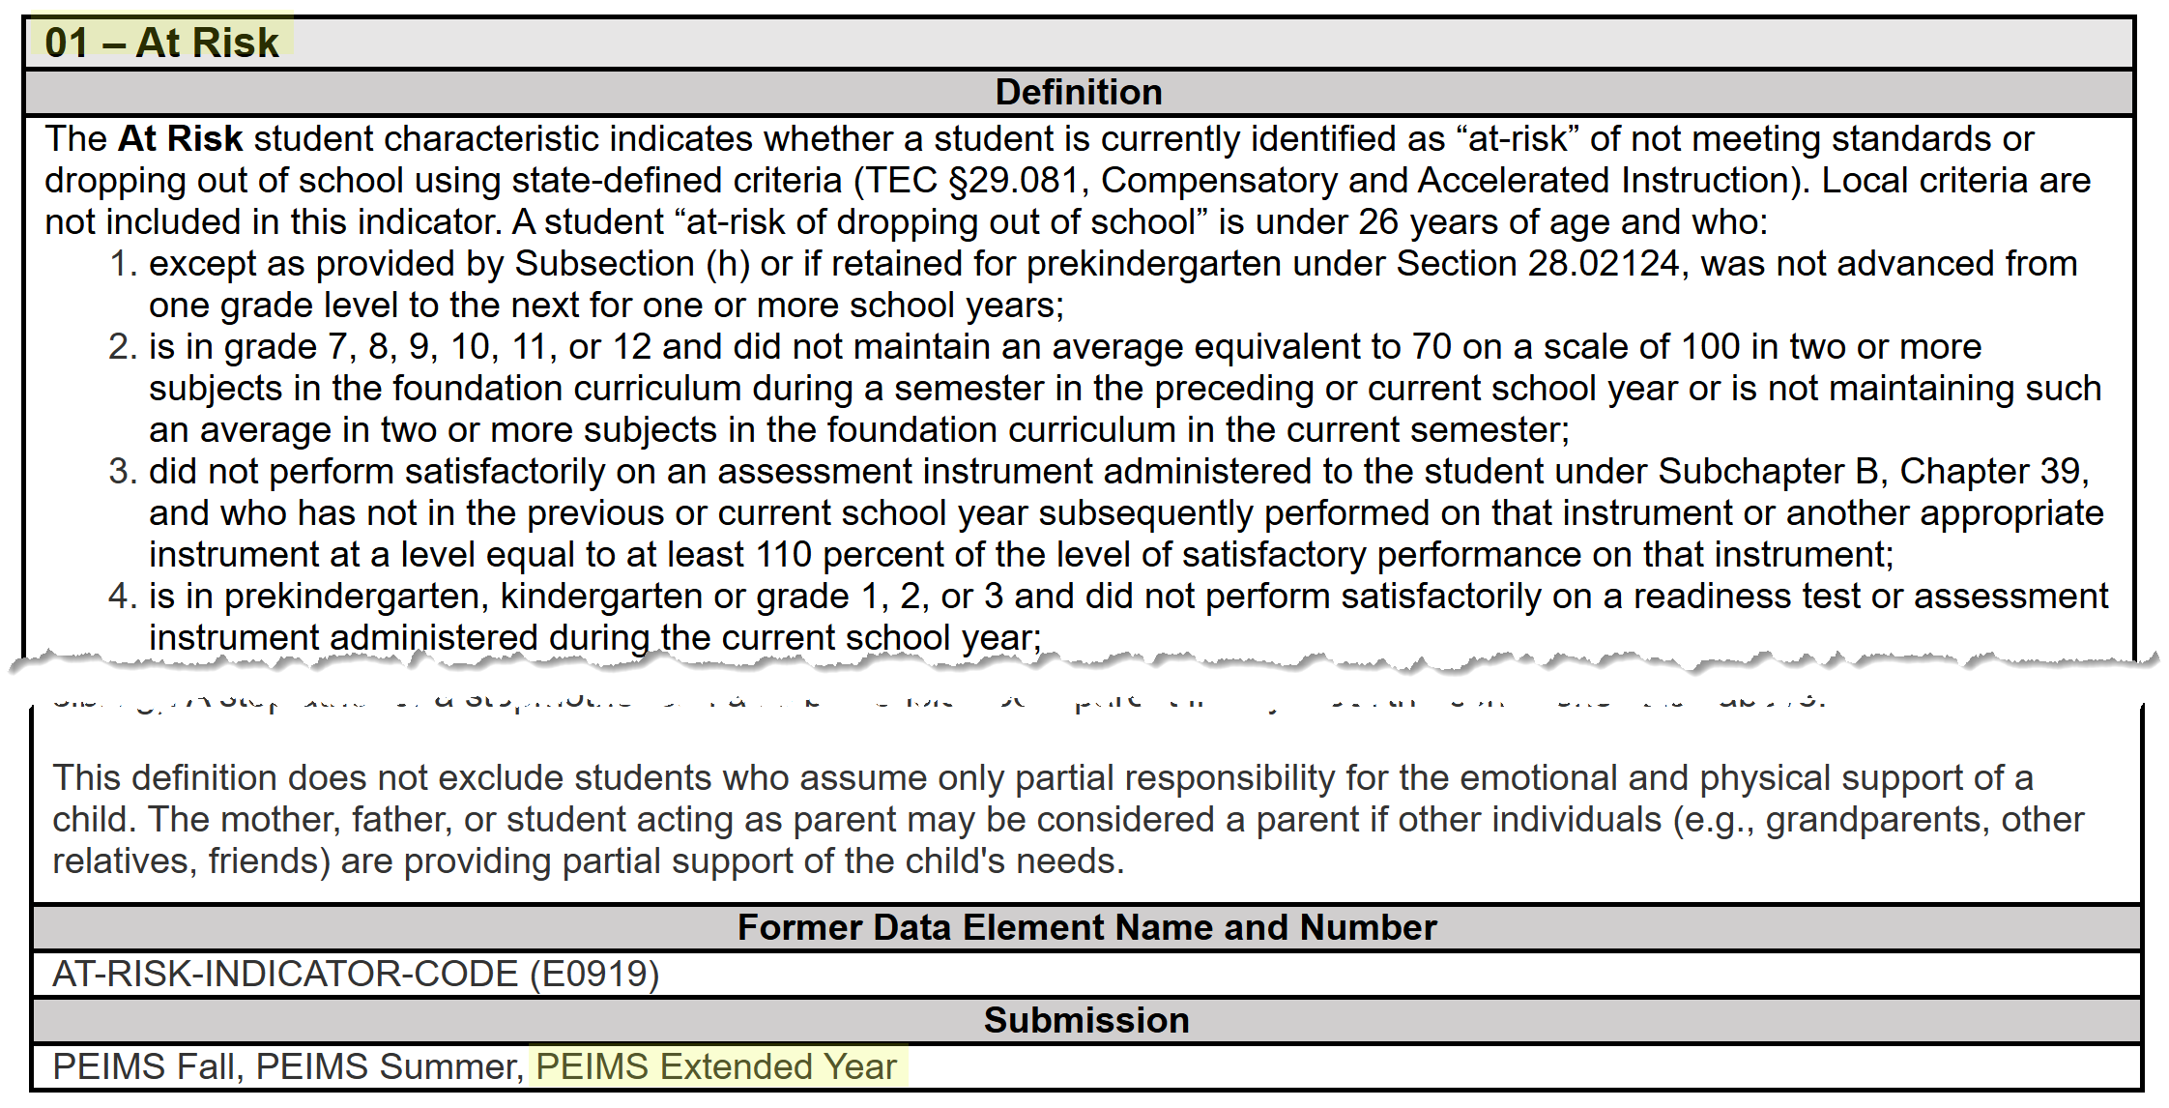
StudentCharacteristic – At Risk Extended
The StudentCharacteristic (C344) “01” At Risk will be added to the PEIMS Extended Year Submission:

Slide 39
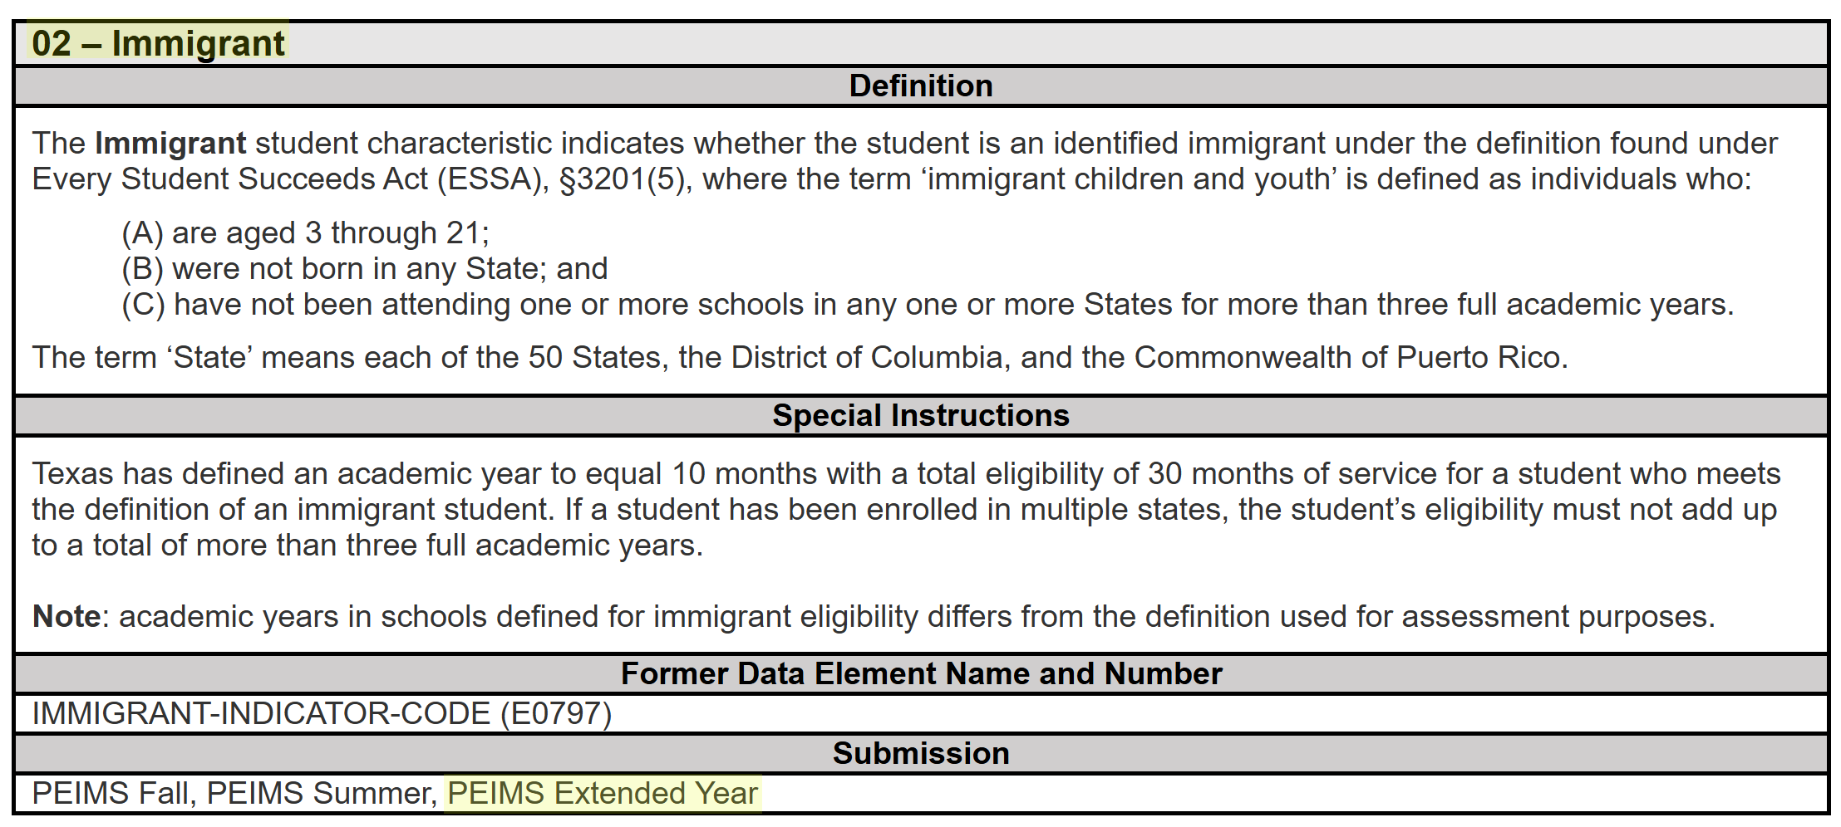
StudentCharacteristic – Immigrant Extended
The StudentCharacteristic (C344) “02” Immigrant will be added to the PEIMS Extended Year Submission:

Slide 40
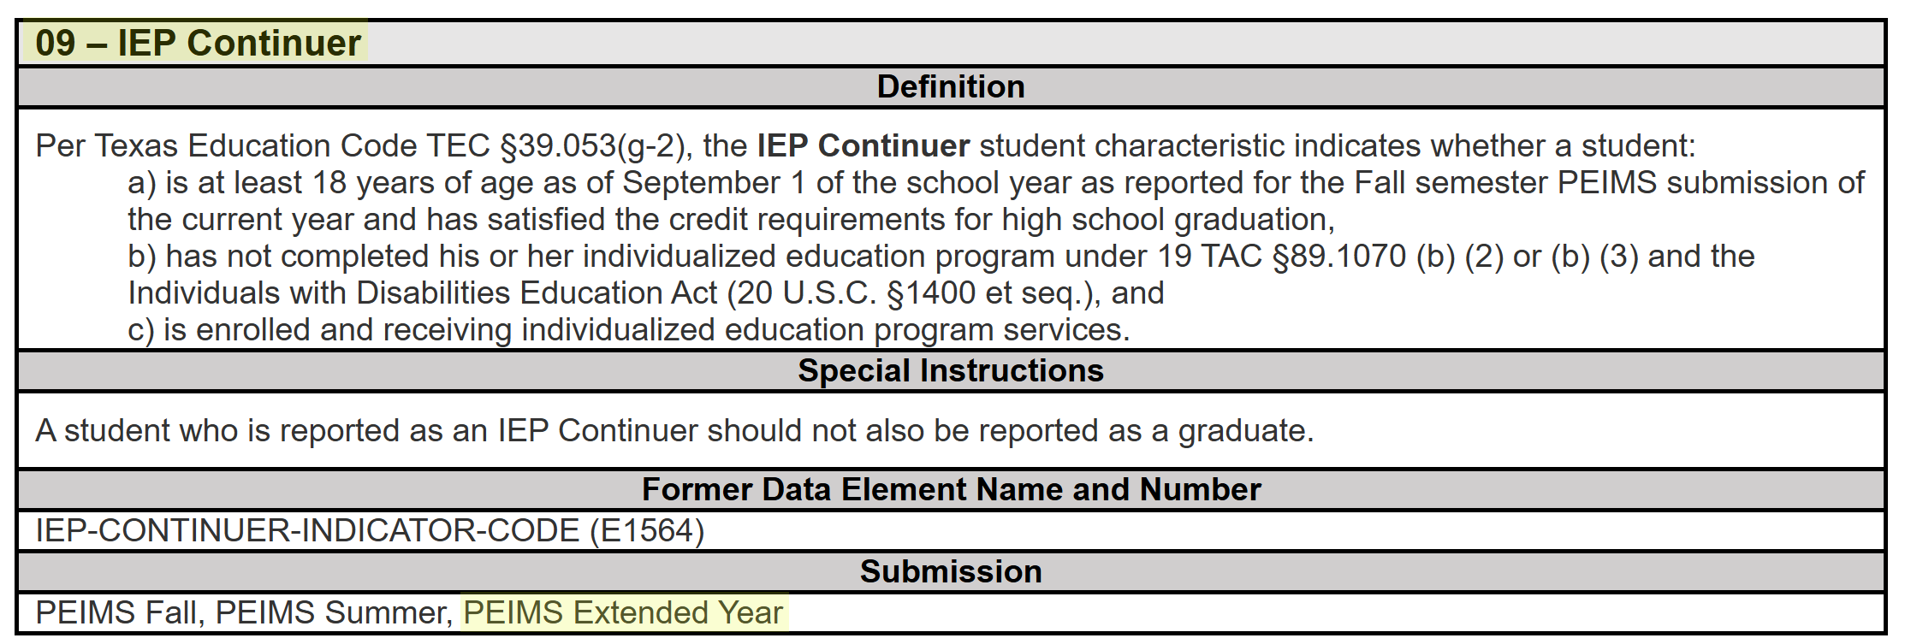
StudentCharacteristic – IEP Continuer Ext
The StudentCharacteristic (C344) “09” IEP Continuer will be added to the PEIMS Extended Year Submission:

Slide 41

QUESTIONS
QUESTIONS?

