Slide 1

TITLE SLIDE: Data Standards Changes
2025-2026 TEDS CHANGES FOLLOWING YEAR ONE OF THE TSDS UPGRADE July 29, 2025 and July 31, 2025
<NAME OF COMPONENT> (ALL CAPS) MARCH 19-21, 2024

Slide 2

Agenda – 2025-2026 TEDS Changes Following Year One TSDS Upgrade
Shared Service Arrangements
CourseTranscriptExt Entity
StudentAcademicRecord Entity
Adult Previous Attendance
SSSP Team Review
PriorYearLeaver Entity
EmploymentPeriod Guidance Update
PayrollExt Entity
Staff Entity
Questions

Slide 3

TITLE SLIDE: Middle School Advanced Mathematics
Shared Service Arrangements
NAME OF COMPONENT (ALL CAPS) MARCH 19-21, 2024

Slide 4
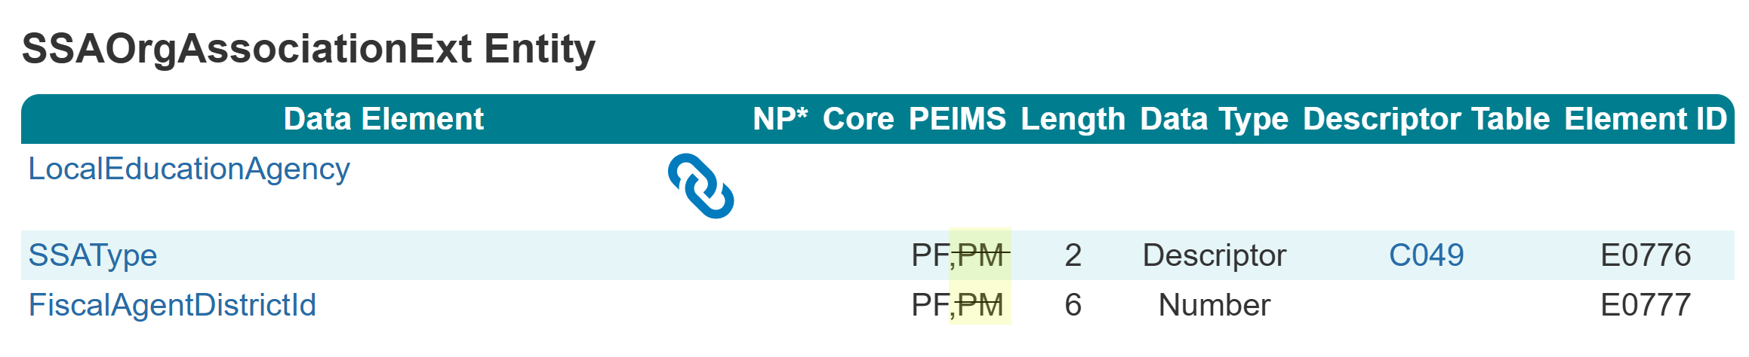
SSAOrgAssociationExt Entity
During the 2024-2025 PEIMS Fall Submission, it was determined that the shared service arrangement type could differ for the PEIMS Fall or PEIMS Mid-Year Submissions in certain circumstances.
For the 2025-2026 school year, the SSAOrgAssociationExt Entity will be used for the PEIMS Fall Submission only.

Slide 5
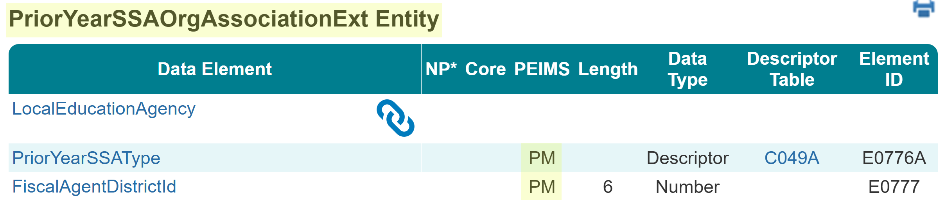
PriorYearSSAOrgAssociationExt Entity
For the 2025-2026 school year, the PriorYearSSAOrgAssociationExt Entity will be used for the PEIMS Mid-Year Submission.

Slide 6
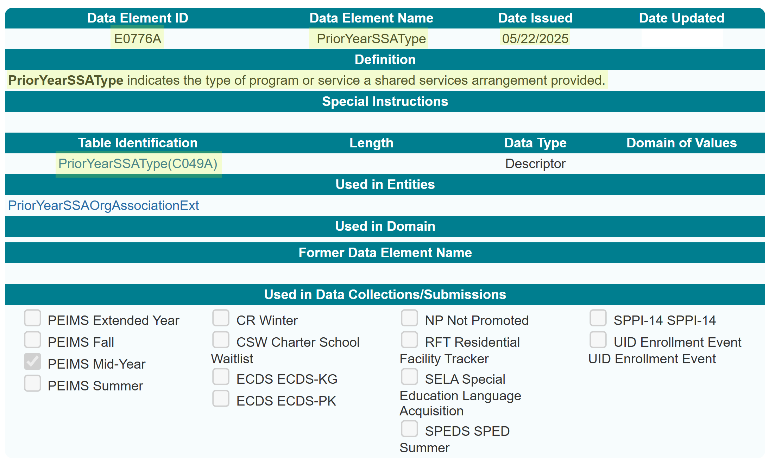
PriorYearSSAType (E0776A)
New PriorYearSSAType (E0776A) data element:

Slide 7
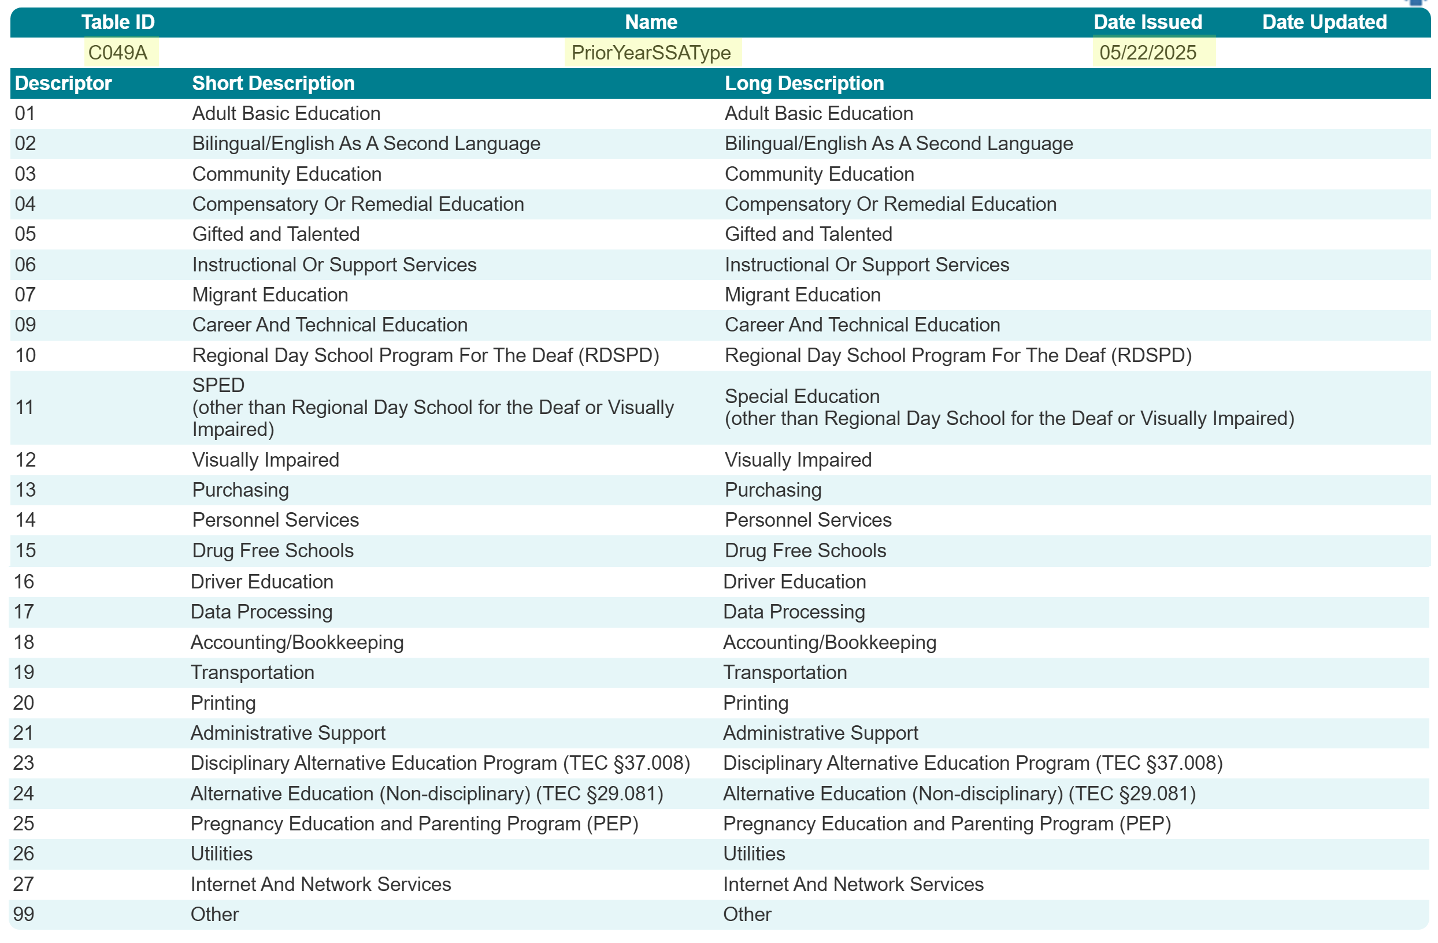
PriorYearSSAType (C049A)
New PriorYearSSAType (C049A) descriptor table:

Slide 8
TSDS PEIMS Mid-Year Reports
Three reports reflect data collected through the new PriorYearSSAType Entity:
PDM2-100-015
PDM2-100-017
PDM2-100-018
Promotion logic will pull from the new entity for the EdOrg > SSA Organization Association subcategory.
No updates to reports will be needed.

Slide 9
TITLE SLIDE: CourseTranscriptExt Entity Title Slide
CourseTranscriptExt
Entity
NAME OF COMPONENT (ALL CAPS) MARCH 19-21, 2024

Slide 10
CourseTranscriptExt Entity
The Ed-Fi CourseTranscript Entity has the following as the key:
CourseAttemptResult
Course
StudentAcademicRecord
Using the Ed-Fi CourseTranscript Entity would not allow TEA to accurately promote the completed courses.
On Friday, May 16, 2025, the CourseTranscriptExt Entity was released for the 2025.2.2 version of TEDS. The CourseTranscriptExt Entity was also added to the 2026.1.1 version of TEDS.

Slide 11
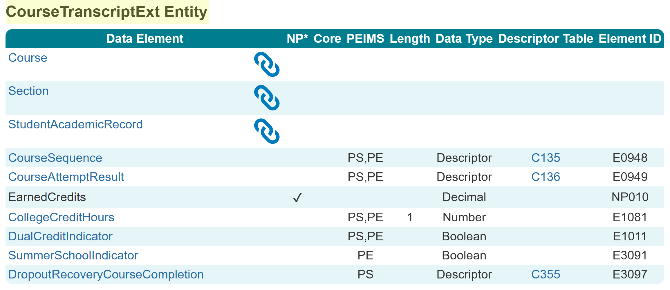
CourseTranscriptExt Entity
The new CourseTranscriptExt Entity has the following as the key:
CourseAttemptResult
Course
StudentAcademicRecord
Section
CourseSequence

Slide 12
Course Completion Promotions
Course Completion records for students will be promoted when…
The CourseTranscriptExt Entity record published has a UID matching …
A StudentAcademicRecord Entity record published matching School Year/Term…
To a published Session Entity record.
Additionally,
The CourseTranscriptExt Entity record published has a matching CourseSequence…
To a published Section Entity record with matching SectionSet > CourseSequence.
Finally,
The CourseTranscriptExt Entity record published has a matching SectionIdentifier…
To a StudentSectionAssociation Entity record published with CourseCompletionIndicator “True” that matches 1-to-1 a…
Published Section Entity record.

Slide 13
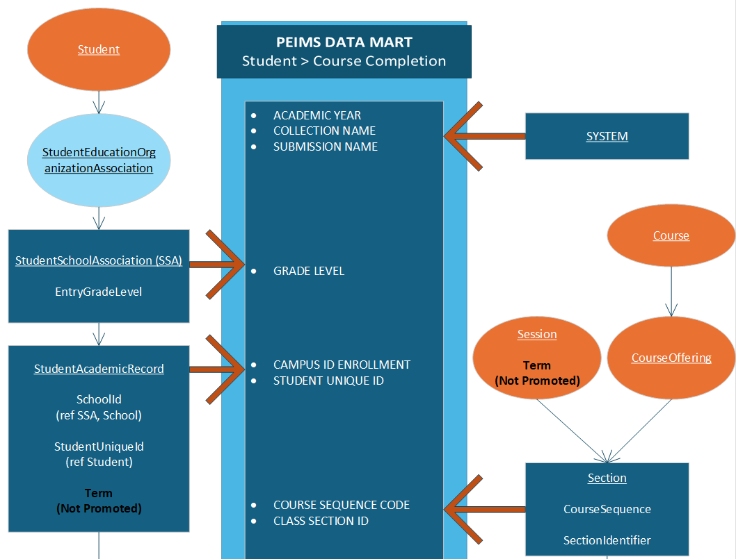
Course Completion Promotions

Slide 14
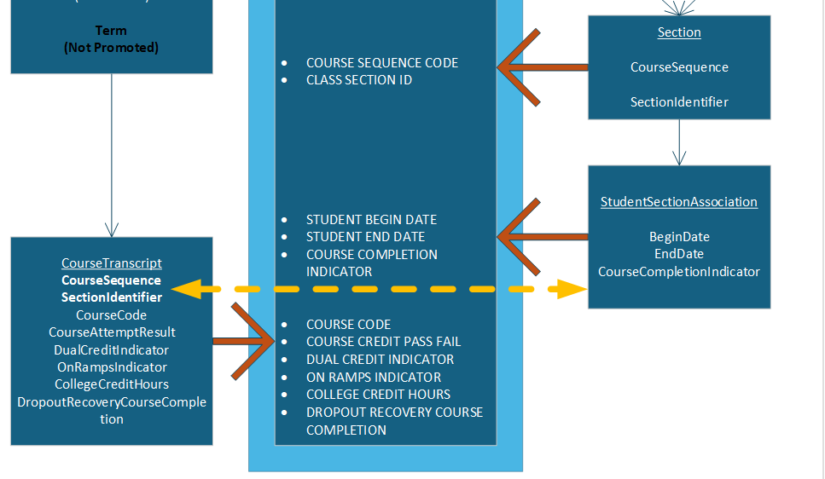
Course Completion Promotions

Slide 15
TITLE SLIDE: StudentAcademicRecord Entity
StudentAcademicRecord Entity
NAME OF COMPONENT (ALL CAPS) MARCH 19-21, 2024

Slide 16
StudentAcademicRecord (SAR) Entity
The StudentAcademicRecord Entity has TEA extended data elements:
EndorsementPursuing (E3022)
IndividualGraduationCommitteeReview (E1563)
AssociateDegreeIndicator (E1596)
FHSPParticipant (E3030)
FHSPDistingLevelParticipant (E3029)
EndorsementCompleted (E3021)
The data element Term is part of the key, so vendors sent multiple StudentAcademicRecord entities with different Terms for an individual student, and TEA had to determine which StudentAcademicRecord set of data to promote.

Slide 17
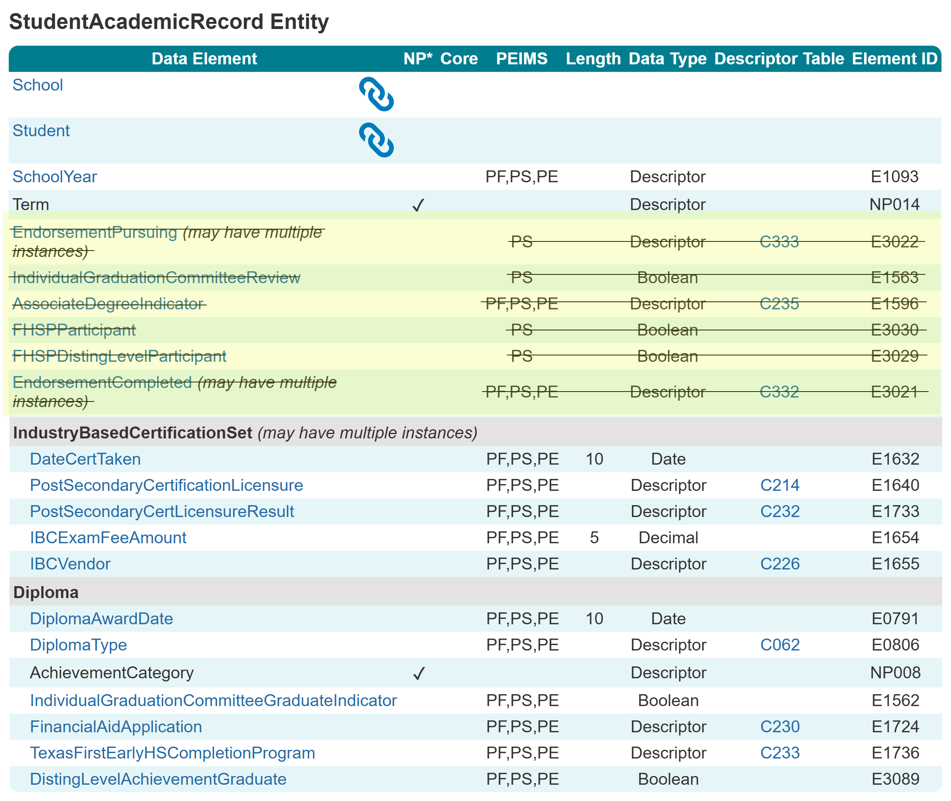
StudentAcademicRecord (SAR) Entity
The following data elements were moved to separate common types in the StudentAcademicRecord Entity:
EndorsementPursuing
IndividualGraduationCommitteeReview
AssociateDegreeIndicator
FHSPParticipant
FHSPDistingLevelParticipant
EndorsementCompleted

Slide 18
SAR Entity
New dates within the new Common Types are used for promotion logic purposes; they will not promote into the data mart.
Students should only have current-year SAR Entity records in the current-year IODS.
Students may have more than one SAR Entity record published:
Term (NP014) is part of the primary key to publish and reflects the LEA’s course scheduling setup.
If the LEA is publishing multiple SARs for a student, the data within the JSON should promote into the data mart correctly with these new common types.

Slide 19
SAR New Common Types
Four new common types were added to the StudentAcademicRecord Entity:
GraduationProgramParticipationSet
IndividualGraduationCommitteeReviewSet
AssociateDegreeIndicatorSet
EndorsementCompletedSet

Slide 20
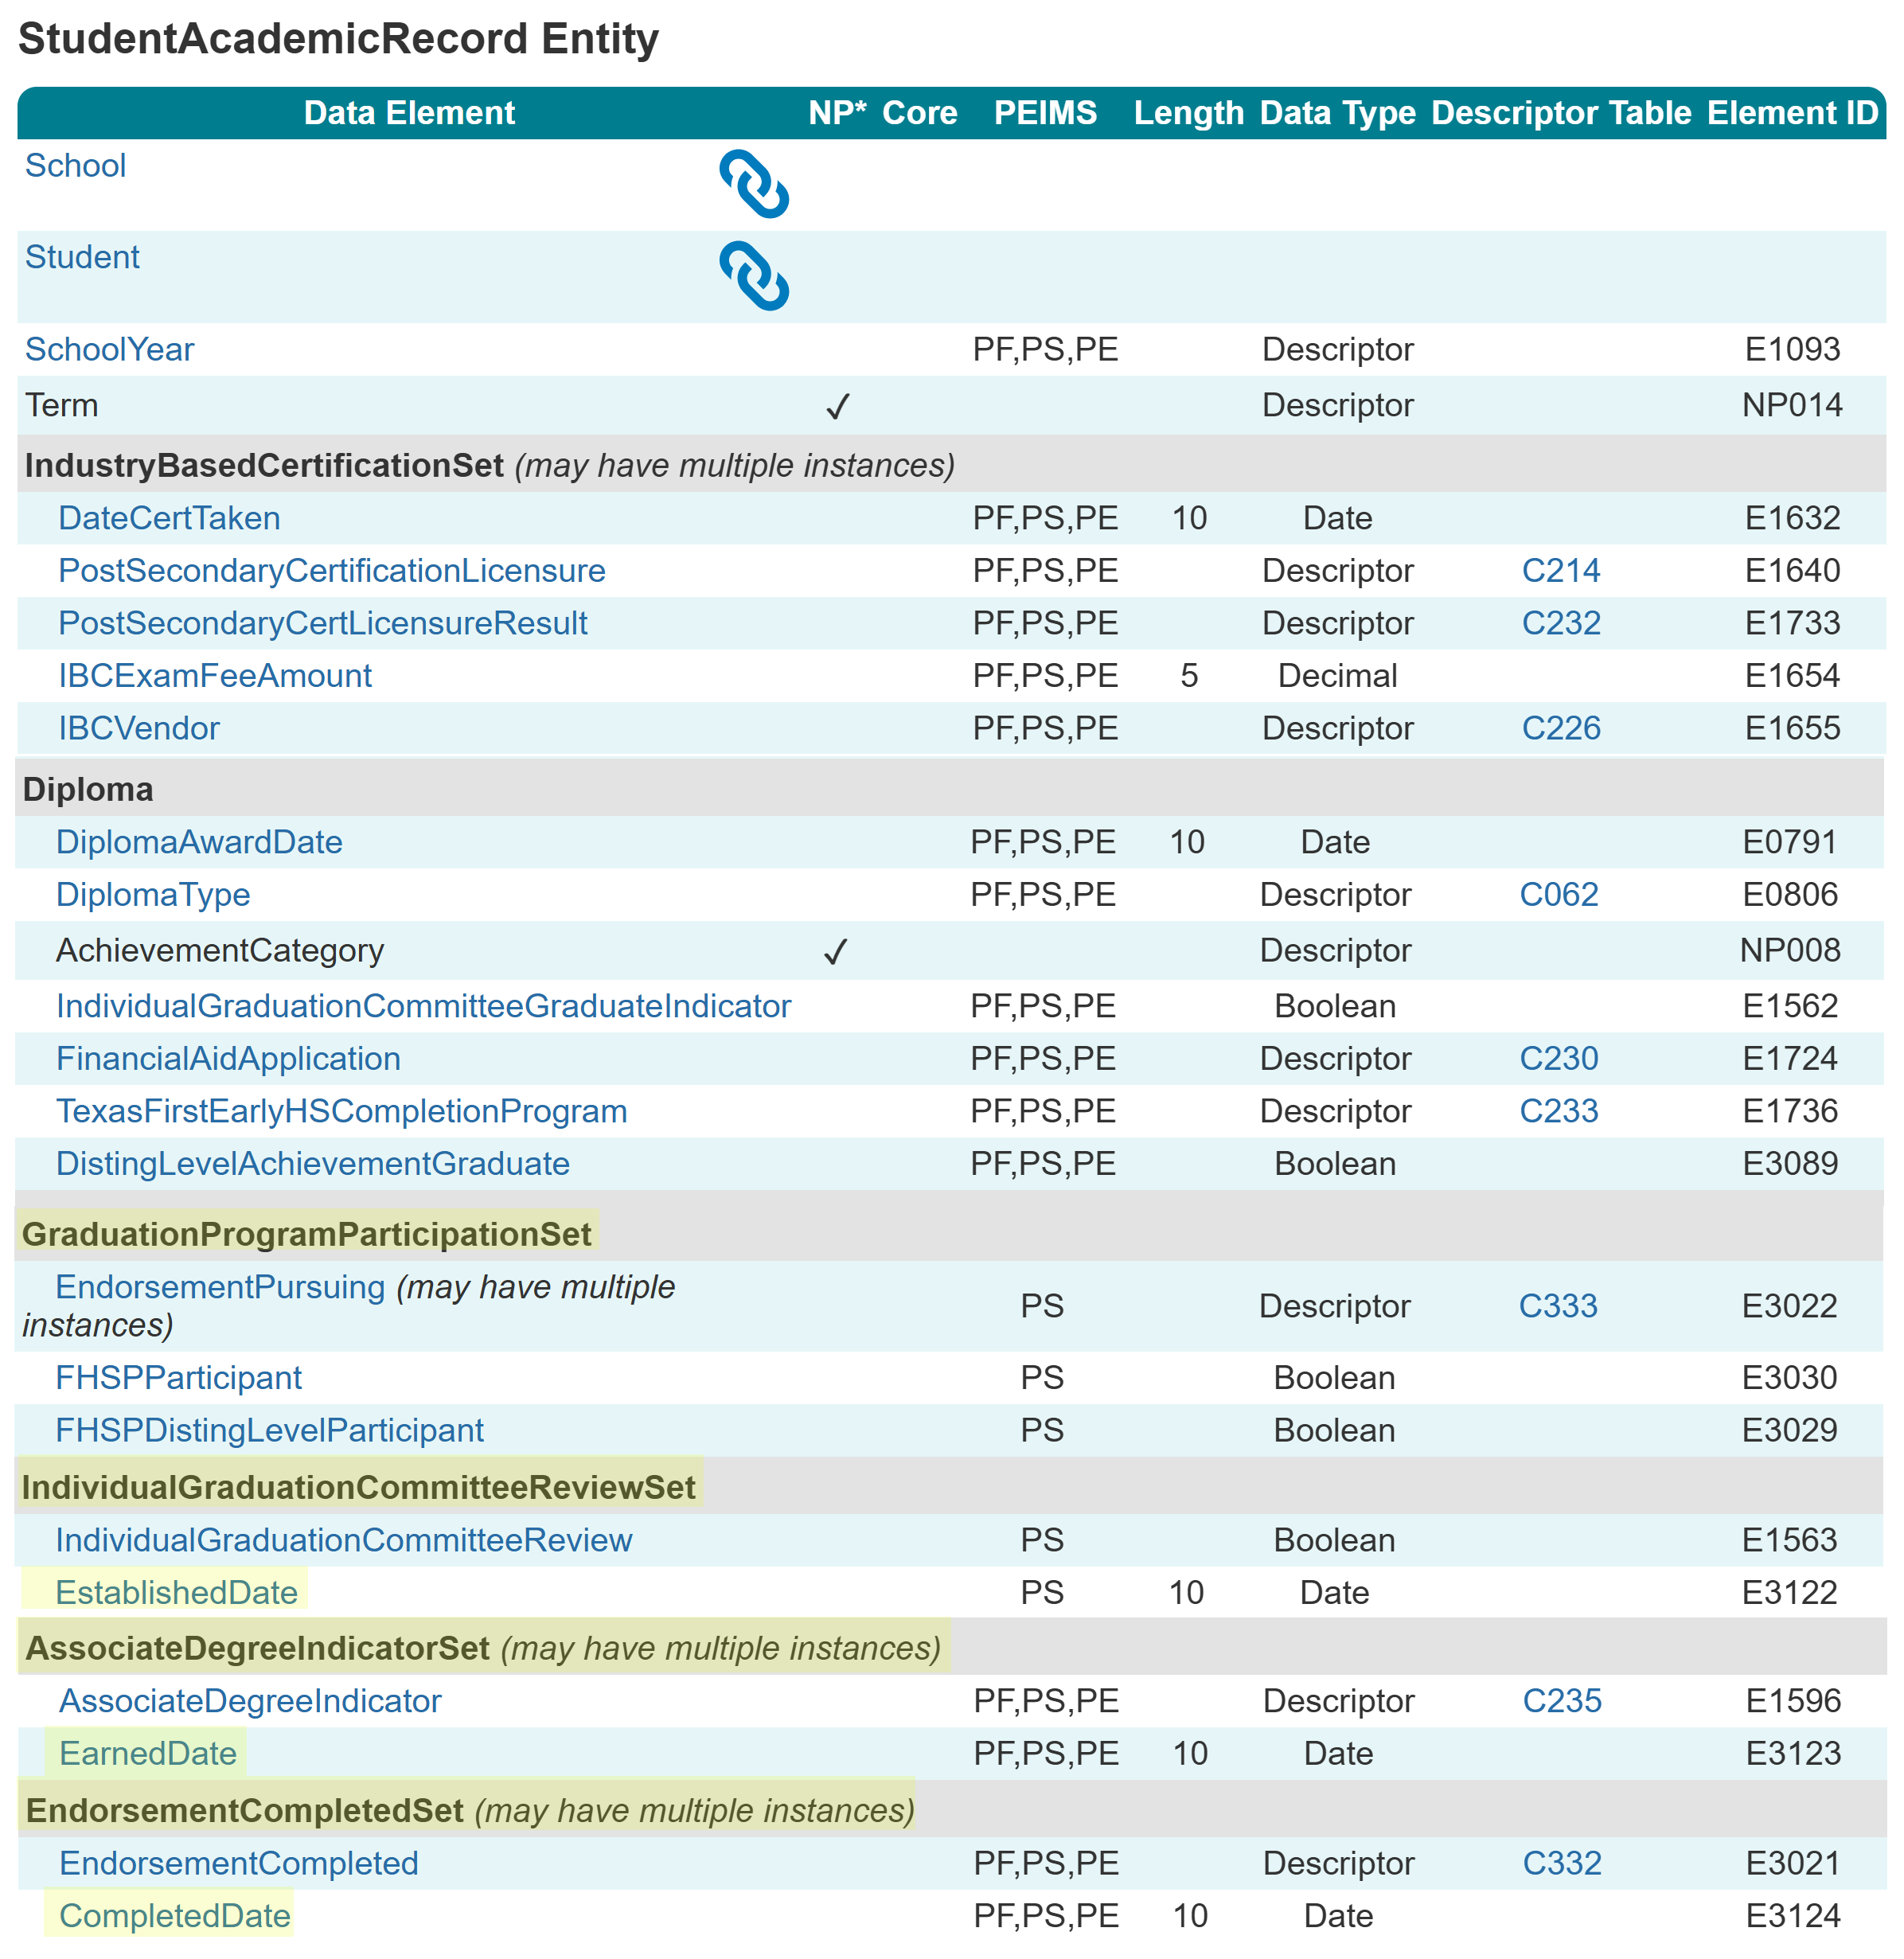
SAR New Common Types

Slide 21
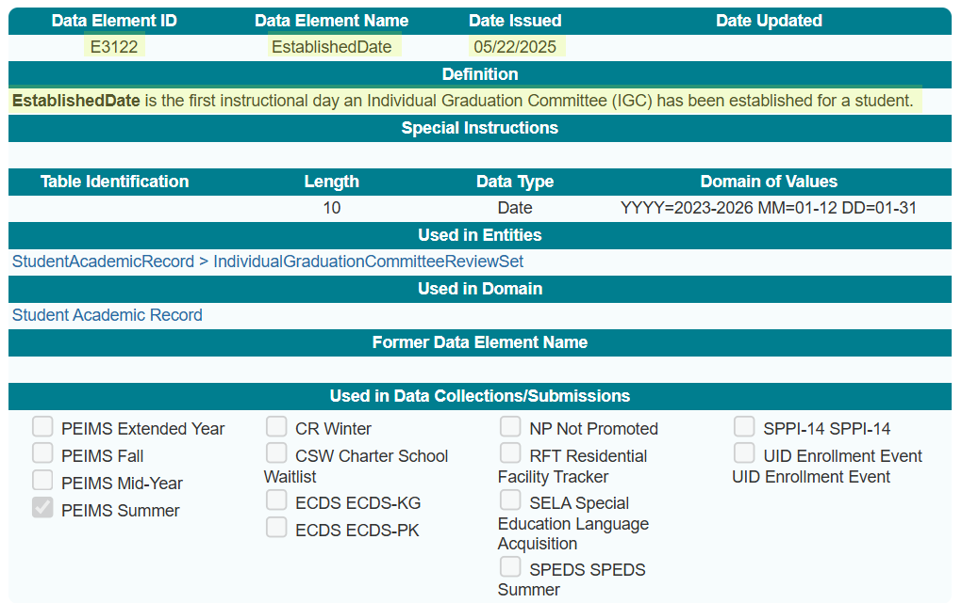
EstablishedDate (E3122)

Slide 22
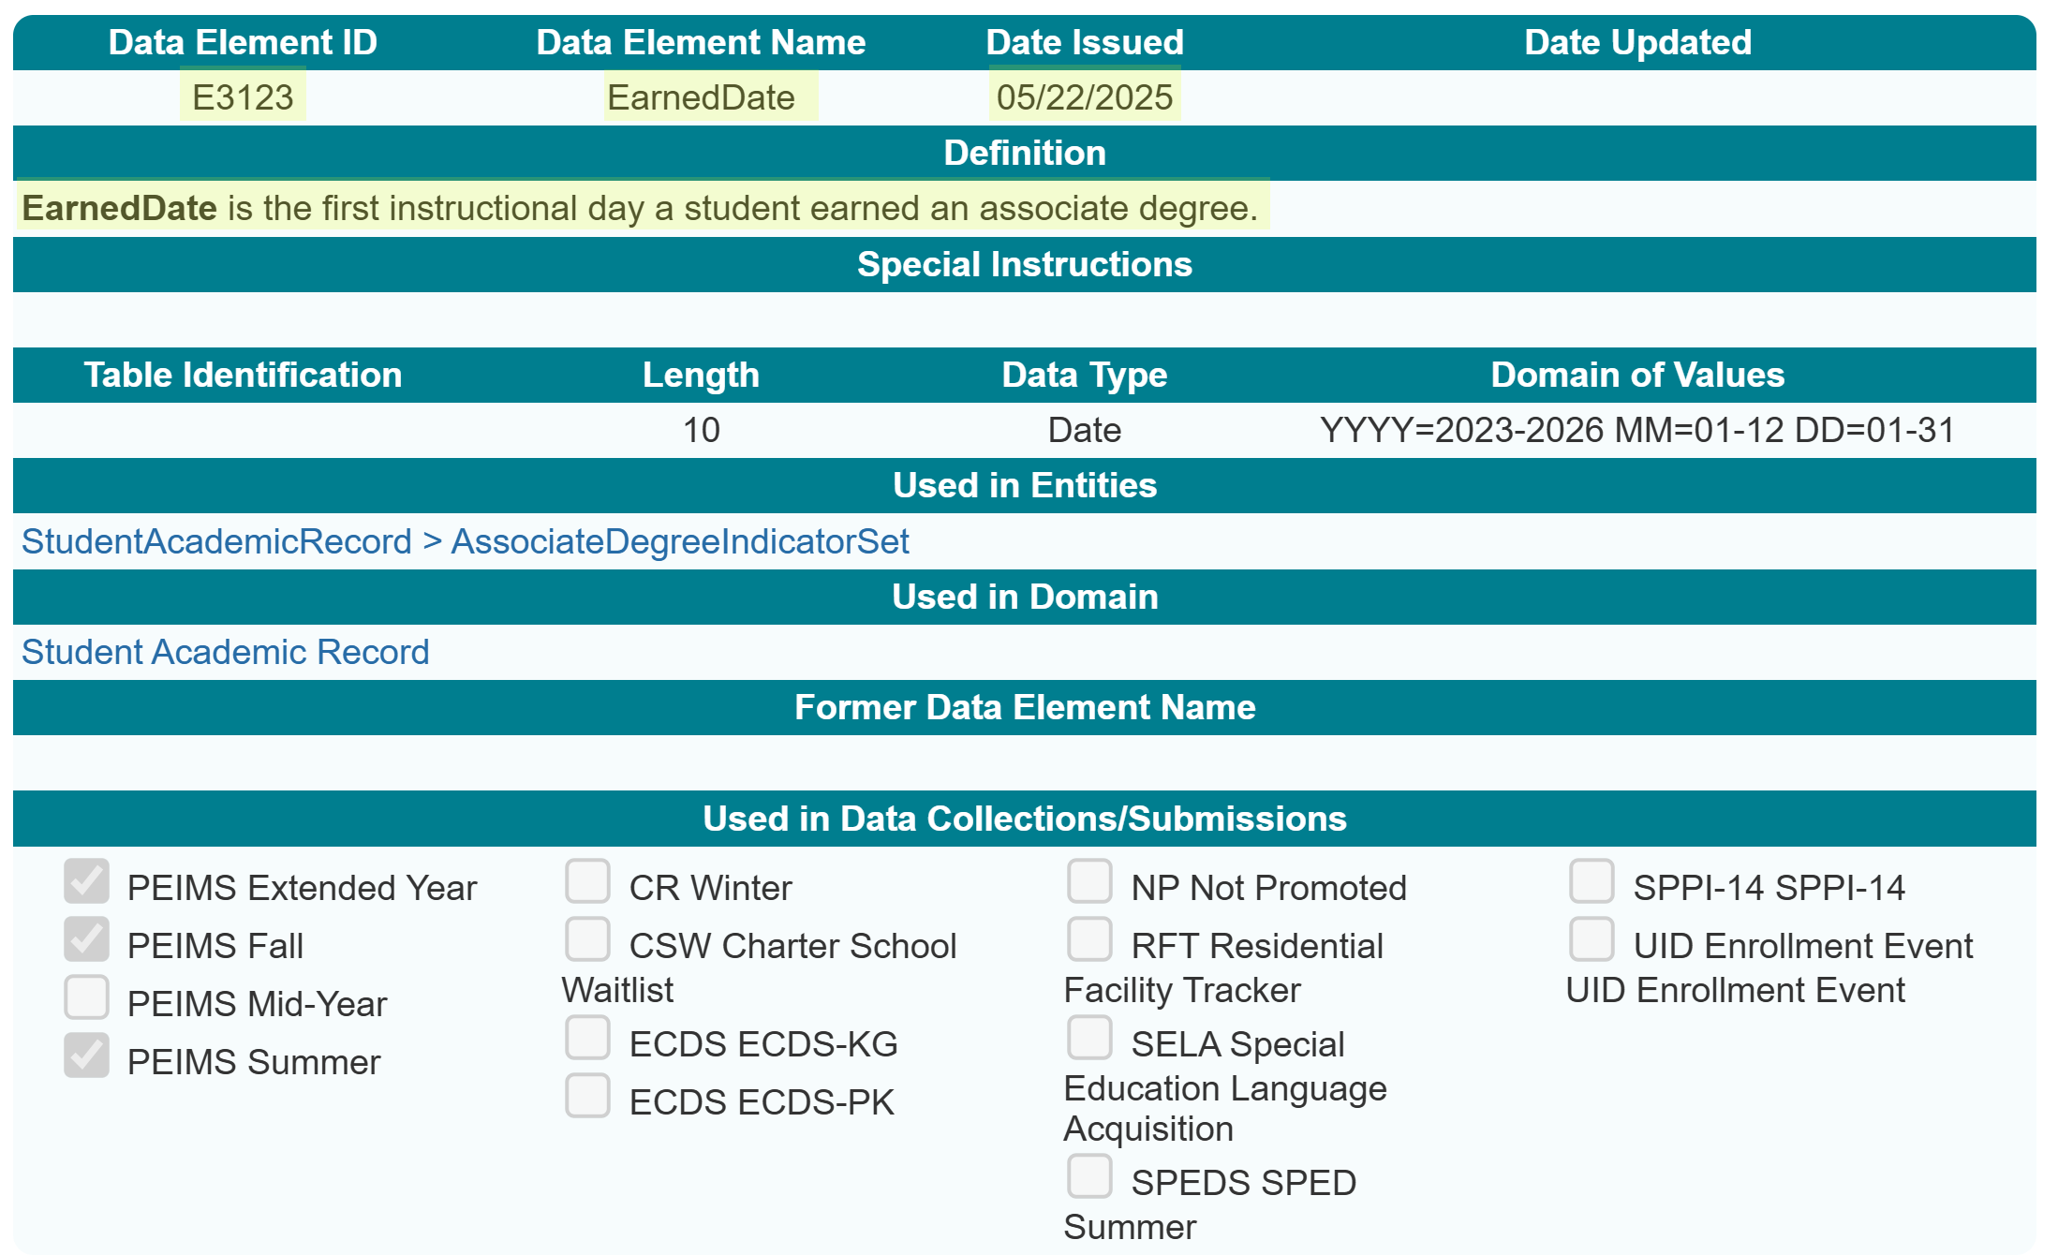
EarnedDate (E3123)

Slide 23
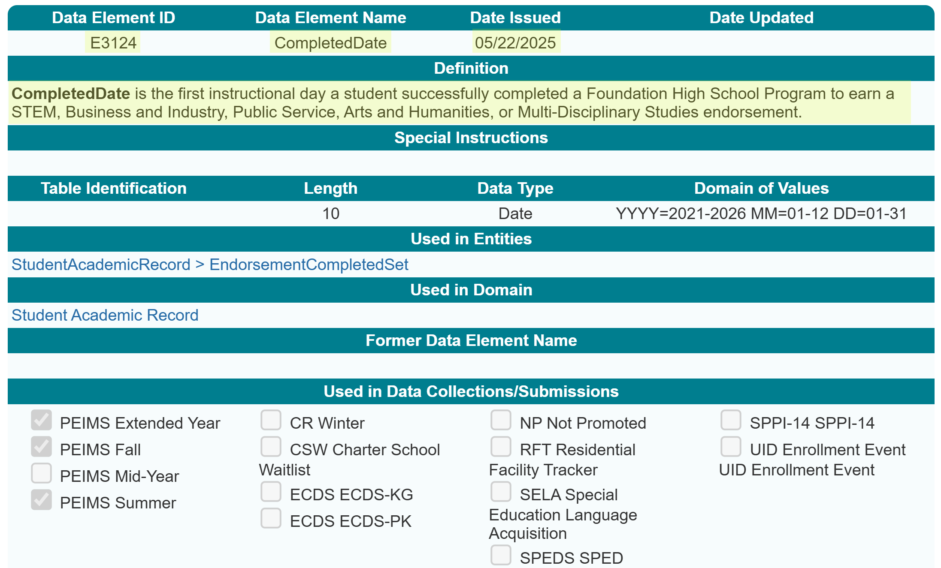
CompletedDate (E3124)

Slide 24
TITLE SLIDE: Adult Previous Attendance
Adult Previous Attendance
NAME OF COMPONENT (ALL CAPS) MARCH 19-21, 2024

Slide 25
2023-2024 Adult Previous Attendance
In the 2023-2024 school year, the ADULT-PREVIOUS-ATTENDANCE-INDICATOR-CODE (E1660) was used to report an adult student (age 18-25) who is currently in a high school equivalency program, dropout recovery school, or other adult education program, has or has not attended school in the previous nine months prior to enrolling.
ADULT-PREVIOUS-ATTENDANCE-INDICATOR-CODE = “1” meant the student attended school in the previous nine months.
ADULT-PREVIOUS-ATTENDANCE-INDICATOR-CODE = “0” meant the student had NOT attended school in the previous nine months.

Slide 26
2024-2025 Adult Previous Attendance
In the 2024-2025 school year, Adult Previous Attendance was reported in the PEIMS Fall and PEIMS Summer Submissions using a StudentCharacteristic (C344).
There was no way for an LEA to report that a student did not attend school in the previous nine months before enrolling using a “0.”
For the 2025-2026 school year, the StudentCharacteristic “16” will be removed and replaced with a new common type to collect the information.

Slide 27
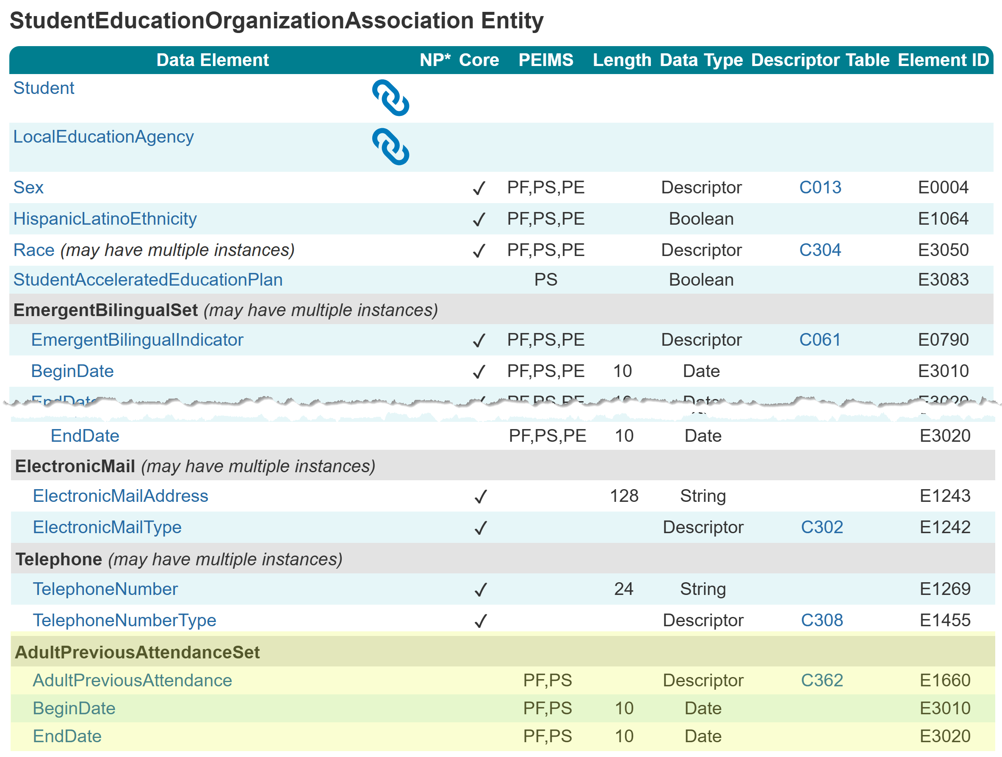
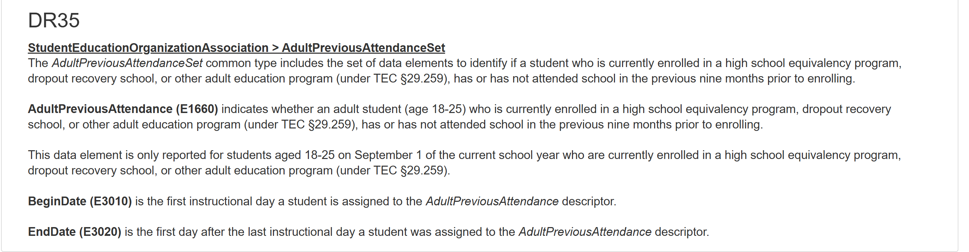
AdultPreviousAttendanceSet

Slide 28
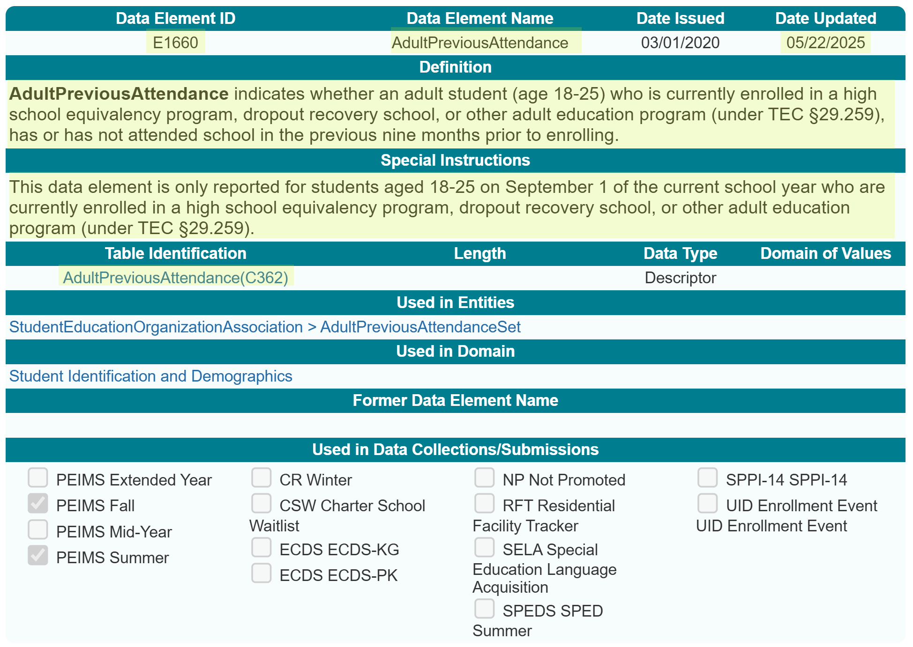
AdultPreviousAttendance (E1660)

Slide 29
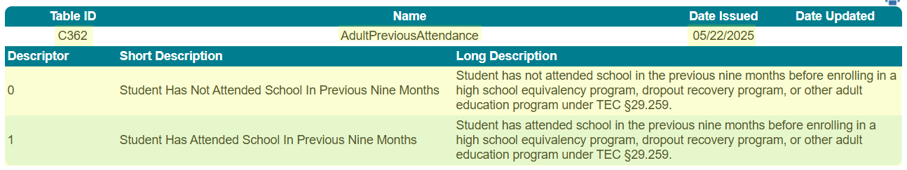
AdultPreviousAttendance (C362)

Slide 30
TITLE SLIDE: SSSP Team Review
SSSP Team Review
NAME OF COMPONENT (ALL CAPS) MARCH 19-21, 2024

Slide 31
SafeSupportiveSchoolProgramTeamReview (E1734)
In the 2023-2024 school year, the SAFE-SUPPORTIVE-SCHOOL-PROGRAM-TEAM-REVIEW (E1734) was reported in the StudentDisciplineIncidentAssociationExtension complex type.
In the 2024-2025 school year, the SafeSupportiveSchoolProgramTeamReview (E1734) was reported in the DisciplineIncident Entity. This meant that any student associated with a discipline incident would be reported as showing that the SSSP team reviewed the student incident.
It was determined that the data should be associated with the individual student and not the incident.

Slide 32
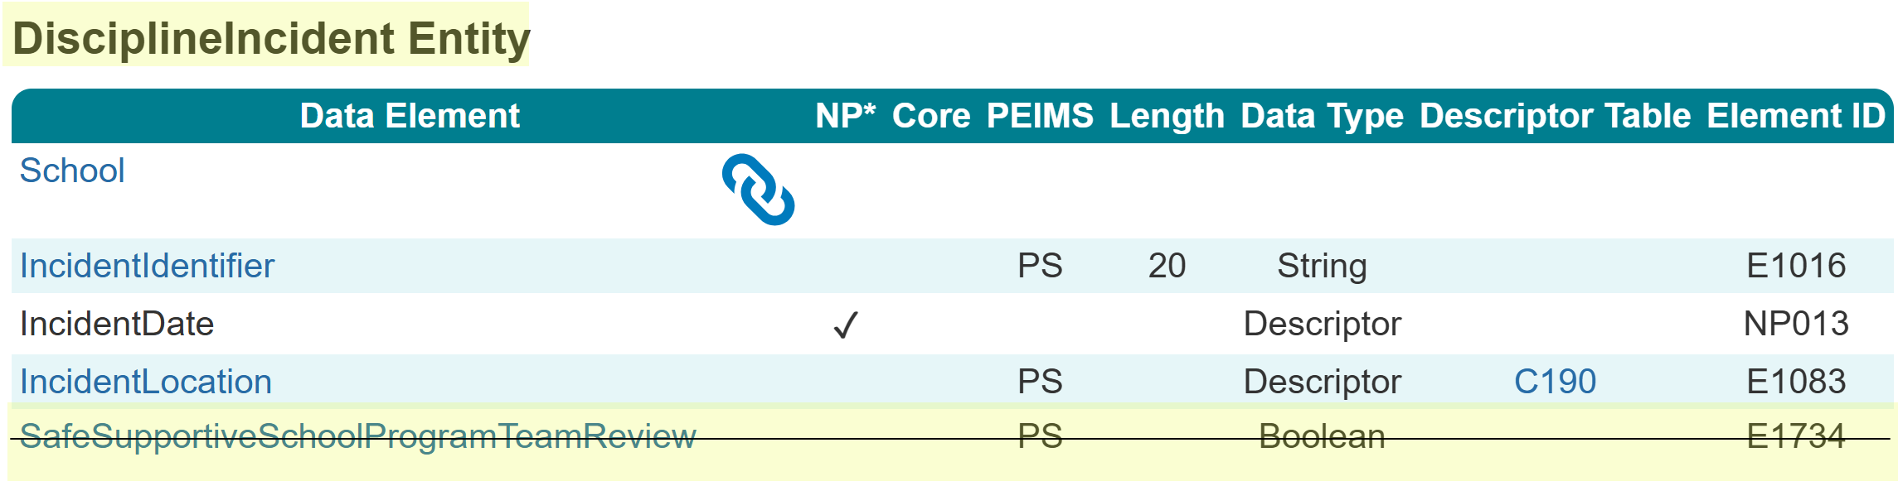
SafeSupportiveSchoolProgramTeamReview (E1734)
The SafeSupportiveSchoolProgramTeamReview (E1734) data element was removed from the DisciplineIncident Entity.
Resources

Slide 33
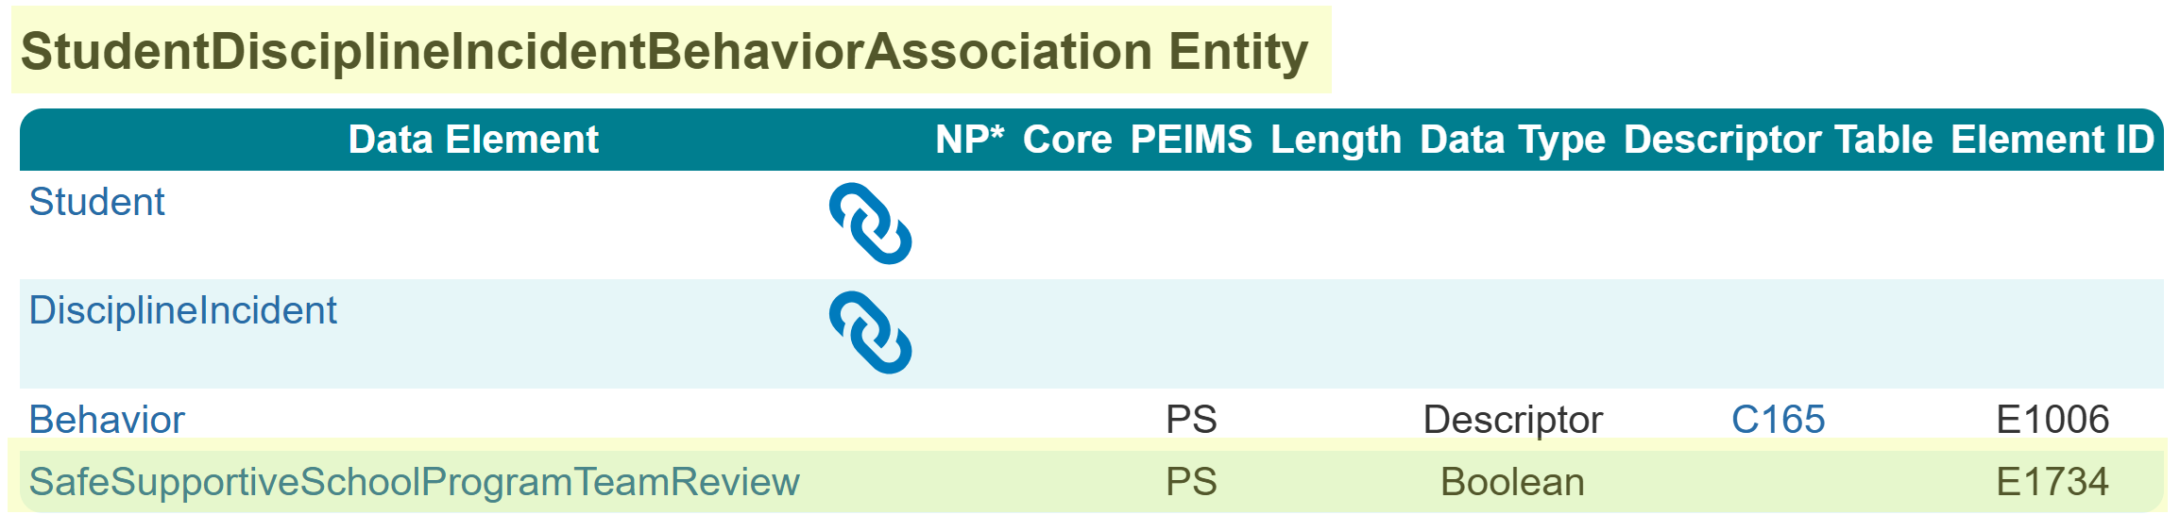
SafeSupportiveSchoolProgramTeamReview (E1734)
The SafeSupportiveSchoolProgramTeamReview (E1734) data element was added to the StudentDisciplineIncidentBehaviorAssociation Entity.
Resources

Slide 34
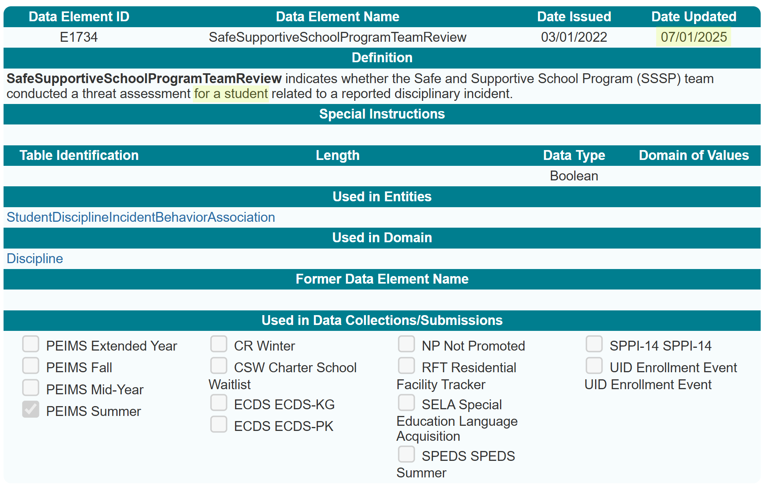
Data Element Definition Update

Slide 35
TITLE SLIDE: PriorYearLeaver Entity
PriorYearLeaver Entity
NAME OF COMPONENT (ALL CAPS) MARCH 19-21, 2024

Slide 36
PriorYearLeaver Entity Data Element Removed
During the 2024-2025 school year, TEA began using the PriorYearLeaver Entity to collect data on all students they served in grades 7-12 during the prior school year. The program information reported reflects the information for the student as of the last day of the prior school year or the last day of the student’s enrollment in that year. It was determined that TEA uses the data reported in the prior year’s PEIMS Fall and Summer Submission for the information reported in the TEA Completion, Graduation, and Dropout Reports.
https://tea.texas.gov/reports-and-data/school-performance/accountability-research/completion-graduation-and-dropout/completion-graduation-and-dropout-reports

Slide 37
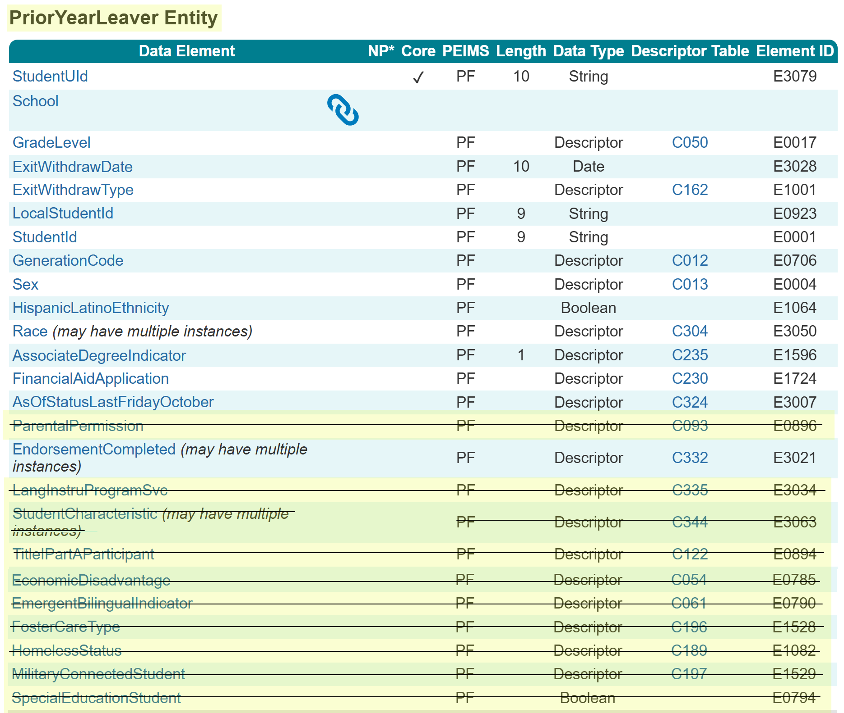
PriorYearLeaver Entity Data Element Removed
The following data elements were removed from the PriorYearLeaver Entity:
ParentalPermission (E0896)
LangInstruProgramSvc (E3034)
StudentCharacteristic (E3063)
TitleIPartAParticipant (E0894)
EconomicDisadvantage (E0785)
EmergentBilingualIndicator (E0790)
FosterCareType (E1528)
HomelessStatus (E1082)
MilitaryConnectedStudent (E1529)
SpecialEducationStudent (E0794)
In the 2025-2026 PEIMS Fall Submission, TEA will use the data reported in the 2024-2025 PEIMS Fall and Summer Submission for these data elements.

Slide 38
PriorYearLeaver Entity PEIMS Fall 2025-2026
Program Area uses data from…
ParentalPermission
Program Area uses data from…
EconomicDisadvantage
LangInstruProgSvc
StudentCharacteristics:
At Risk (01)
Immigrant (02)
EmergentBilingualIndicator
FosterCareType
HomelessStatus
MilitaryConnectedStudent
SpecialEducationStudent
TitleIPartAParticipant
StudentCharacteristics:
Migrant (03)
Section 504 (12)
Gifted & Talented (15)
Dyslexia (04)

Slide 39
TITLE SLIDE: EmploymentPeriod Guidance Update
EmploymentPeriod Guidance Update
NAME OF COMPONENT (ALL CAPS) MARCH 19-21, 2024

Slide 40
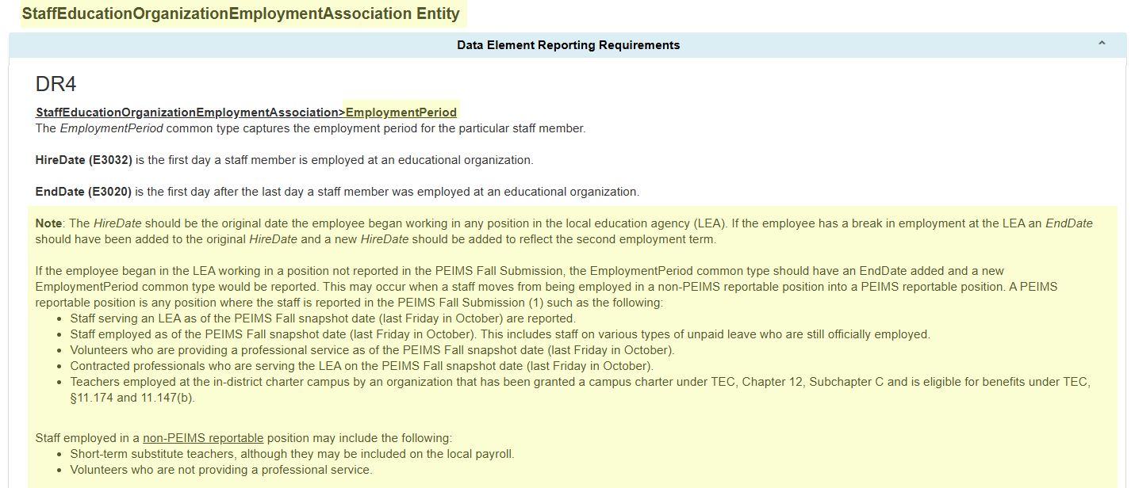
EmploymentPeriod Common Type Guidance
During the 2024-2025 school year, TEA received questions about reporting the HireDate.

Slide 41
TITLE SLIDE: PayrollExt Entity Title Slide
PayrollExt Entity
NAME OF COMPONENT (ALL CAPS) MARCH 19-21, 2024

Slide 42
PayrollExt Entity
During the 2024-2025 school year, TEA received questions about reporting payroll information for staff on paid and unpaid leave.
Additionally, questions were received about what the BeginDate in the PayrollExt Entity should be when a staff member is hired or changes positions close to the PEIMS Fall Snapshot date and has not yet received a payroll record reflecting the changes.

Slide 43
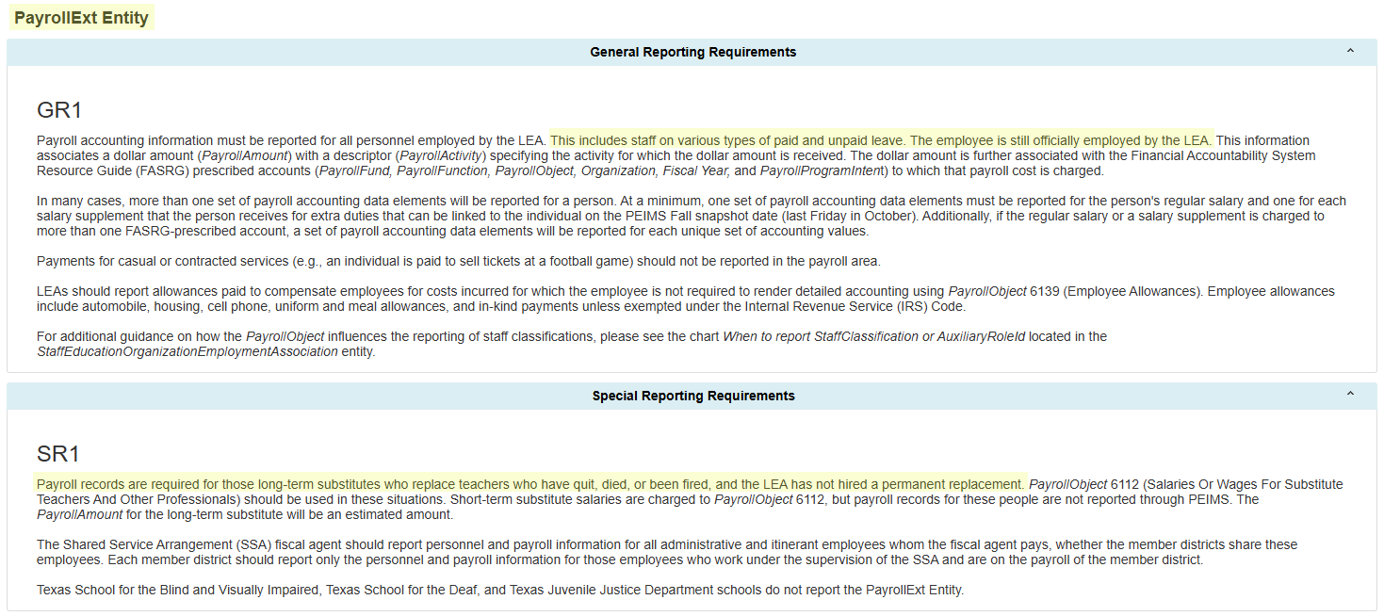
PayrollExt Entity Guidance
The General Reporting Requirements and the Special Reporting Requirements in the PayrollExt Entity have been updated to reflect that staff on paid or unpaid leave would still have the PayrollExt Entity reported. All staff still employed by the LEA should report a PayrollExt Entity.

Slide 44
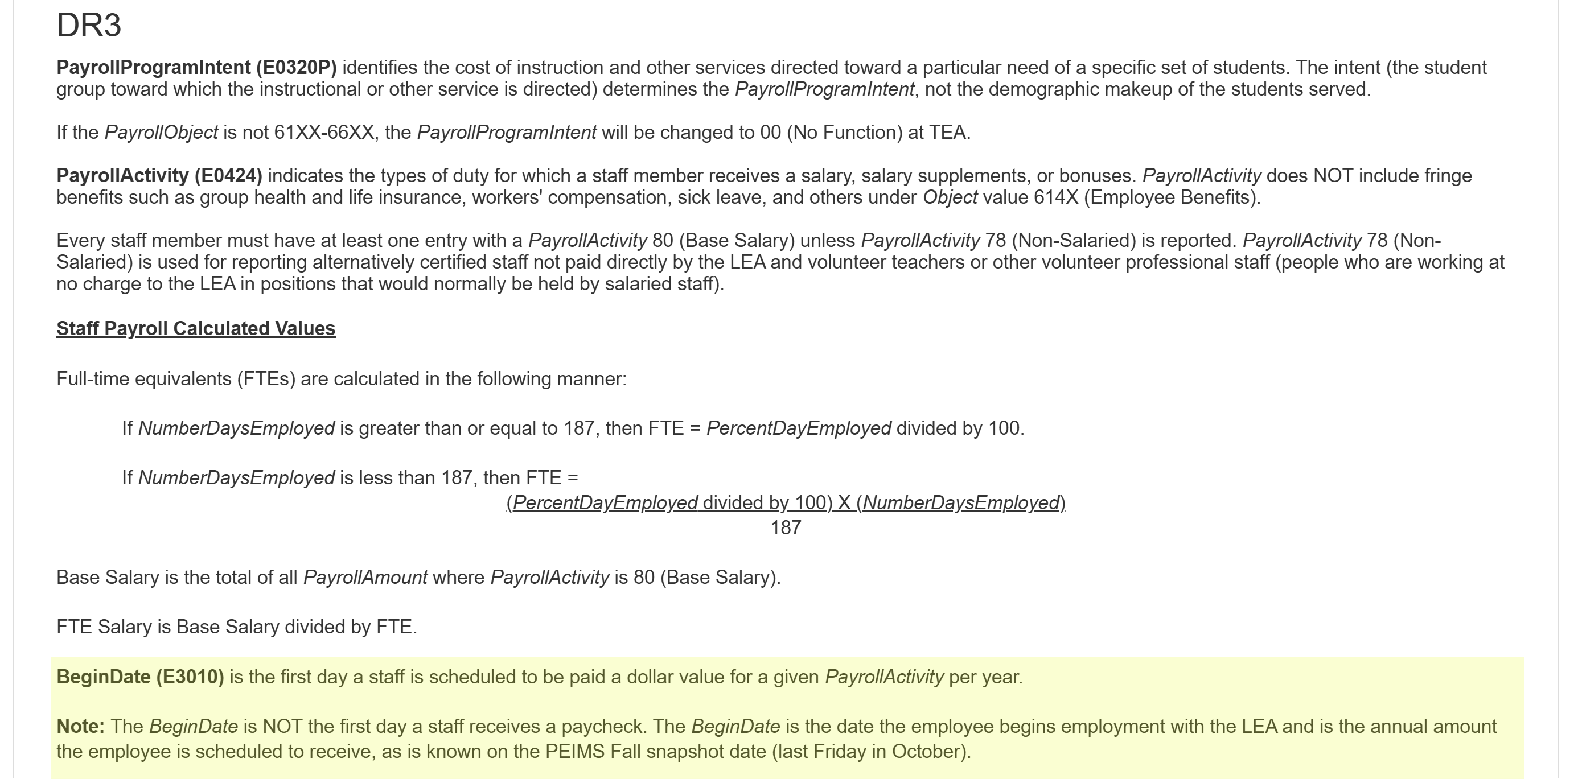
PayrollExt Entity BeginDate
The BeginDate (E3010) in the PayrollExt Entity has been updated and a note added to clarify the PayrollAmount reported.

Slide 45
TITLE SLIDE: Staff Entity
Staff Entity
NAME OF COMPONENT (ALL CAPS) MARCH 19-21, 2024

Slide 46
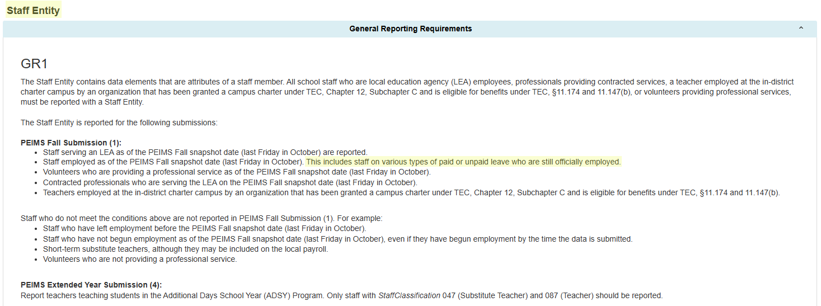
Staff Entity Changes
During the 2024-2025 school year, TEA received questions about reporting staff information for staff on paid and unpaid leave. General Reporting Requirements were updated to show that these staff are reported in the PEIMS Fall Submission.

Slide 47

TITLE SLIDE: Questions
QUESTIONS?
NAME OF COMPONENT (ALL CAPS) MARCH 19-21, 2024

