Slide 1

TITLE SLIDE: Data Standards Changes
2025-2026 DATA STANDARDS CHANGES July 31, 2025
<NAME OF COMPONENT> (ALL CAPS) MARCH 19-21, 2024

Slide 2

Agenda – 2025-2026 Data Standards Changes
Middle School Advanced Mathematics
Advanced Technical Credit
OnRamps Dual Enrollment Indicator
Accelerated Instruction Changes
Discipline Changes
New Classroom Position
Special Education Changes
Begin and End Date for Homeless Identification
Questions
Resources

Slide 3

TITLE SLIDE: Middle School Advanced Mathematics
Middle School Advanced Mathematics
NAME OF COMPONENT (ALL CAPS) MARCH 19-21, 2024

Slide 4
Middle School Advanced Mathematics
During the 88th legislative session, SB 2124 was passed, which added that each school district and open-enrollment charter school should develop an advanced mathematics program for middle school students that is designed to enable those students to enroll in Algebra I in eighth grade. (Texas Administrative Code (TAC) §74.2101)
One new descriptor will be added to the StudentCharacteristic (C344) descriptor table to collect in the PEIMS Fall Submission if a student is enrolled in an advanced mathematics program.
A student should remain coded with the StudentCharacteristic “24” until they are no longer enrolled in a Middle School Advanced Mathematics course and upon enrolling in the ninth grade.
Resources

Slide 5
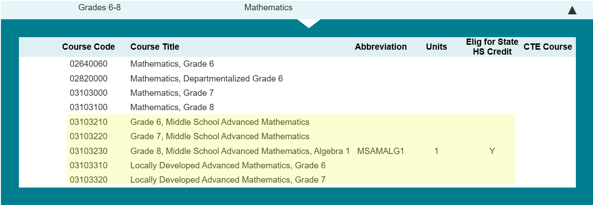
MS Advanced Math CourseCodes
The following CourseCodes have been added for a student participating in the Middle School Advanced Math program:
Resources

Slide 6
TITLE SLIDE: Advanced Technical Credit
Advanced Technical Credit
NAME OF COMPONENT (ALL CAPS) MARCH 19-21, 2024

Slide 7
Sunset – Advanced Technical Credit
The Career and Technical Education program area has requested that the Texas Education Agency (TEA) sunset the ATCIndicator (E1058). Perkins V removed funding for the Advanced Technical Credit (ATC) program. The last ATC course was offered during the 2018-2019 school year. The ATCIndicator was collected in the PEIMS Summer and Extended Year Submissions.
Resources

Slide 8
TITLE SLIDE: OnRamps Dual Enrollment Indicator
OnRamps Dual Enrollment Indicator
NAME OF COMPONENT (ALL CAPS) MARCH 19-21, 2024

Slide 9
OnRamps Dual Enrollment Background
The TEA Performance Reporting Division receives student-level information about OnRamps college course completion, course credit, and credit hours directly from the University of Texas at Austin. TEA cannot determine the secondary course credit given to a student by the local education agency (LEA).
One new data element, OnRampsDualEnrollmentIndicator (E3120), will be added to the CourseTranscript Entity and collected in the PEIMS Summer and Extended Year Submissions for TEA to determine which secondary courses align with specific OnRamps courses.
Resources

Slide 10
TITLE SLIDE: Accelerated Instruction Changes
Accelerated Instruction Changes
NAME OF COMPONENT (ALL CAPS) MARCH 19-21, 2024

Slide 11
Accelerated Instruction
In the 2024-2025 PEIMS Summer Submission, TEA began collecting data to identify the accelerated instruction provided by an LEA to a particular student.
Texas Administrative Code, Section 104.1001, was adopted, which approved Ratio Waiver List (RWL) products. These products use automated, computerized, or other augmented methods of instruction, which LEAs can use in place of some or all of the required individual or group instruction.
The Texas Tutoring Supports Division has determined that it is necessary to know which students use a product from the RWL for their accelerated instruction.
One new data element, RatioWaiverListProductUsed (E3121), will be added to the AcceleratedInstructionSet common type in the StudentEducationOrganizationAssociation Entity and collected beginning in the 2025-2026 PEIMS Summer Submission.
Resources

Slide 12
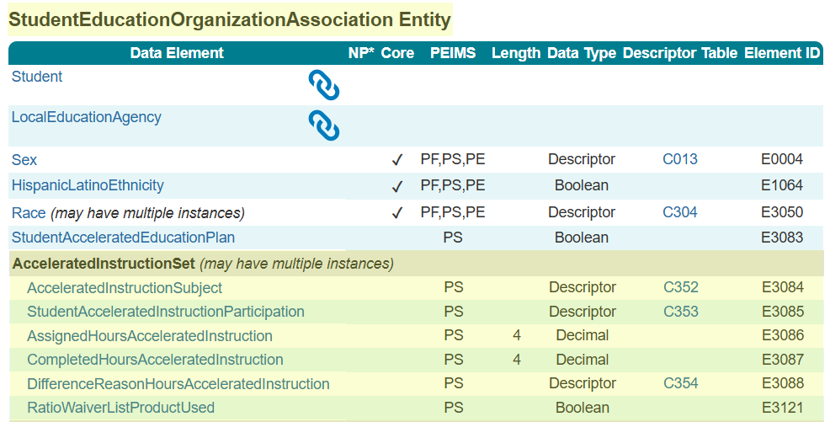
AcceleratedInstructionSet Common Type Reminder
AcceleratedInstructionSet common type is reported for each Subject where a student did not meet standard on the assessment. A student with an AcceleratedInstructionSet reported does NOT automatically mean a student is reported with a StudentAcceleratedEducationPlan (E3083).
Resources

Slide 13
Accel Instruction Data Element Updates
AssignedHoursAcceleratedInstruction (E3086): revised the domain of values from 00.00-60.00 to 00.00-90.00.
CompletedHoursAcceleratedInstruction (E3087): revised the domain of values from 00.00-60.00 to 00.00-90.00.
RatioWaiverListProductUsed (E3121): revised from required to optional.
Resources

Slide 14
TITLE SLIDE: Discipline Changes
Discipline Changes
NAME OF COMPONENT (ALL CAPS) MARCH 19-21, 2024

Slide 15
Discipline Changes
The Student Discipline Program Specialist audited all discipline-related data components and guidance in the Texas Education Data Standards (TEDS) and the Texas Records Exchange (TREx) Data Standards for accuracy and alignment with Chapter 37 of the Texas Education Code.
The changes reviewed during the Spring training are the results of this audit.
Additional changes may occur as a result of House Bill 6 from the 89th Regular Legislative Session. TEA will provide those changes in the September 2, 2025, post-addendum publication of the Texas Education Data Standards.
Resources

Slide 16
TITLE SLIDE: New Classroom Position
New ClassroomPosition
NAME OF COMPONENT (ALL CAPS) MARCH 19-21, 2024

Slide 17
New Classroom Position
TEA developed the Teacher Residency initiative to address the scale of, access to, and sustainability of high-quality teacher preparation through incentives and support to LEAs and Education Preparation Program (EPP) Partnerships to implement paid teacher residency programs.
The Educator Quality Department has requested that a new ClassroomPosition (C309) descriptor be added to help identify individuals serving as teacher residents. ClassroomPosition (E1454) is reported in the PEIMS Fall Submission, Class Roster Winter Submission, and the Early Childhood Data System Prekindergarten and Kindergarten Submissions.
Resources

Slide 18
TITLE SLIDE: Special Education Changes
Special Education Changes
NAME OF COMPONENT (ALL CAPS) MARCH 19-21, 2024

Slide 19
Special Education (SPED) Changes
The Special Population Policy, Integration, and Technical Assistance Department audited all special education-related data components in the Texas Education Data Standards (TEDS) and the Texas Records Exchange (TREx) Data Standards for accuracy and alignment with TAC §89.1040 adopted on July 26, 2024. and TAC §89.1070 adopted on November 1, 2024.
As a result of this audit, the program area requested the following language changes:
Preschool Program for Children with Disabilities (PPCD) to Early Childhood Special Education (ECSE)
Special Education Students to Students Receiving Special Education Services
Individualized Education Plan to Individualized Education Program
Reference to aged 3 through 5 changed to aged 3 through 5 (not in kindergarten)
Resources

Slide 20
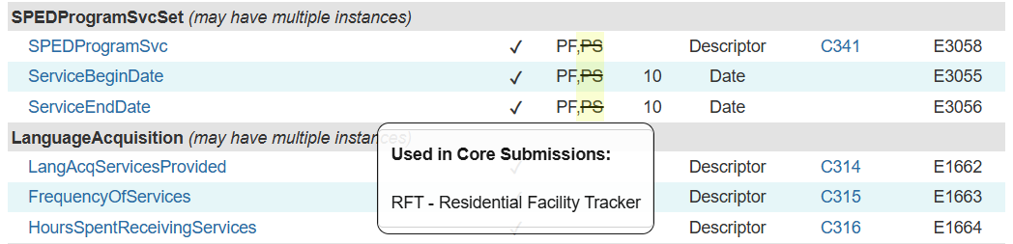
SPEDProgramSvc (E3083)
In XML, LEAs reported the SPEDProgramSvc (E3083) in the PEIMS Summer Submission files. The SPEDProgramSvc was not promoted to the PEIMS Summer Submission but was promoted for RF Tracker. When the upgrade data standard was developed, SPEDProgramSvc still showed that the data element was promoted to the PEIMS Summer Submission. This has been changed.
Resources

Slide 21
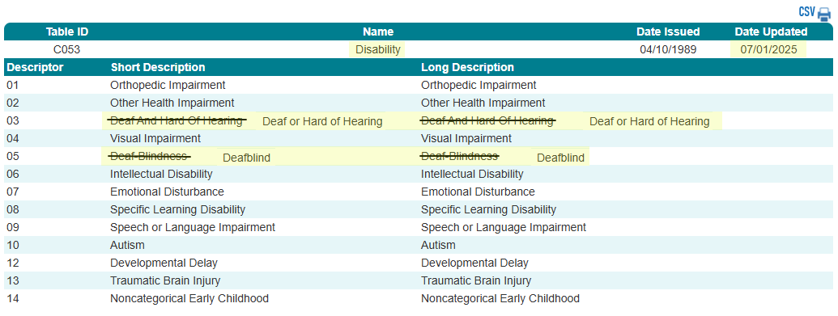
Disability (C053)
Resources

Slide 22
TITLE SLIDE: Homeless Identification
Begin and End Date for Homeless Identification
NAME OF COMPONENT (ALL CAPS) MARCH 19-21, 2024

Slide 23
Begin and End Date for Homeless Identification
TEA’s Self-Reported Data Unit (SRDU) conducts compliance reviews related to potential discrepancies in data reported to TEA by school systems, including reviews of school system compliance requirements related to the identification of and disciplinary decisions for students experiencing homelessness.
Per Texas Education Code (TEC), Section 37.001, student disciplinary decisions must consider “(4)(F) a student’s status as a student who is homeless” as a factor, “regardless of whether the decision concerns a mandatory or discretionary action” and whether it is “concerning suspension, removal to Disciplinary Alternative Education Program (DAEP), expulsion or placement in Juvenile Justice Alternative Education Program (JJAEP).”
Beginning in the 2025-2026 PEIMS Summer Submission, TEA will promote the BeginDate (E3010) and EndDate (E3020) for the HomelessStatus (E1082).

Slide 24
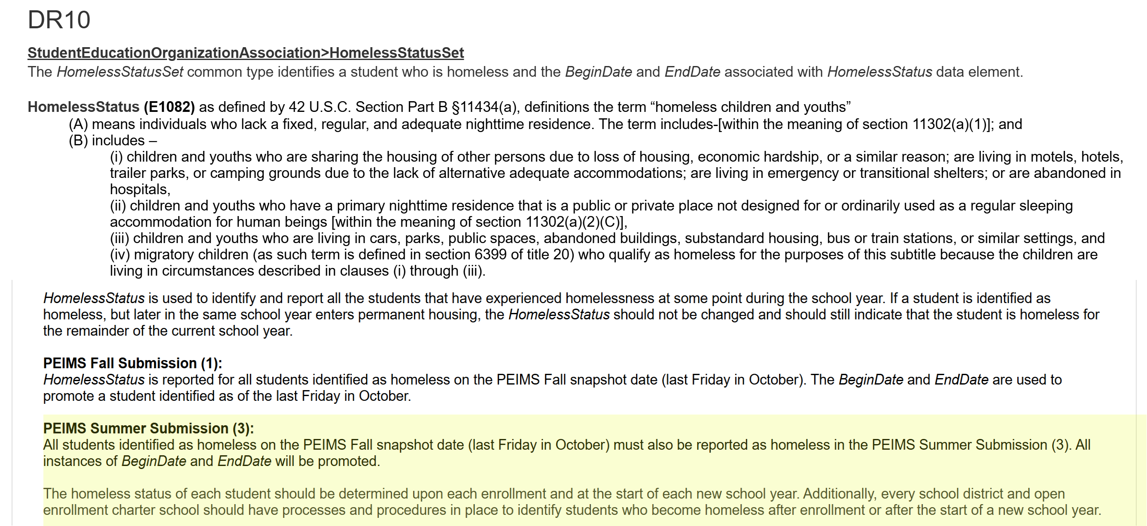
Homeless Indicator in PEIMS Summer Submission

Slide 25

QUESTIONS
QUESTIONS?

Slide 26
TITLE SLIDE: Resources
Resources
NAME OF COMPONENT (ALL CAPS) MARCH 19-21, 2024

Slide 27

TITLE SLIDE: Middle School Advanced Mathematics Resources
The following slides were presented during the 2025 Spring TSDS ESC Coordinators Training for Middle School Advanced Mathematics:
NAME OF COMPONENT (ALL CAPS) MARCH 19-21, 2024

Slide 28
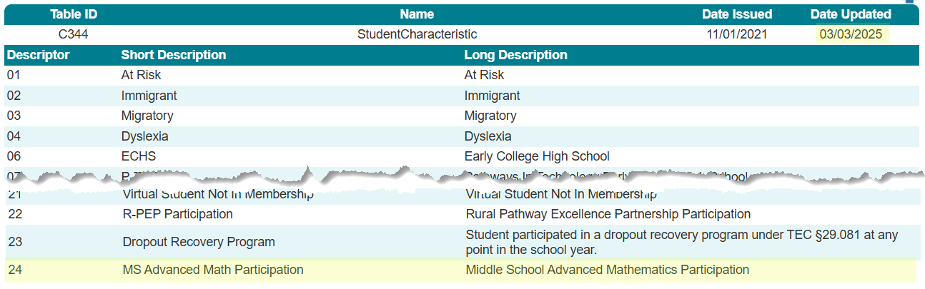
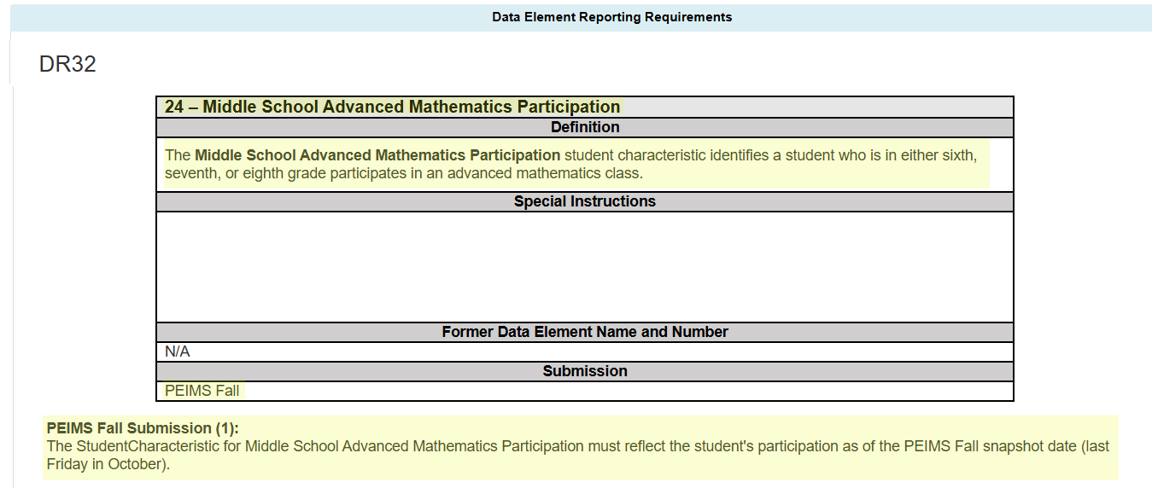
StudentCharacteristic (C344)

Slide 29
MS Advanced Math Data Validation
The following data validation will be added to the PEIMS Fall Submission to only allow the new StudentCharacteristic to be reported for a student in grades sixth, seventh, or eighth:

Slide 30
TITLE SLIDE: Advanced Technical Credit Resources
The following slides were presented during the 2025 Spring TSDS ESC Coordinators Training for Advanced Technical Credit:
NAME OF COMPONENT (ALL CAPS) MARCH 19-21, 2024

Slide 31
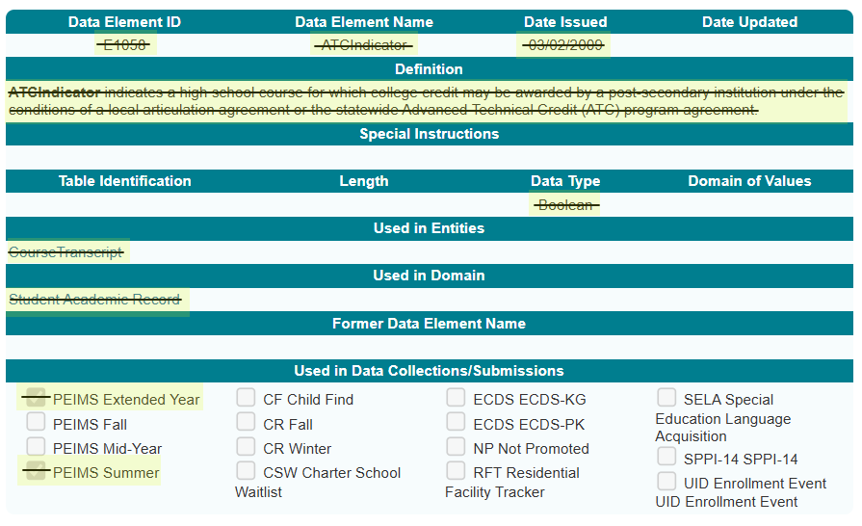
Sunset – Advanced Technical Credit

Slide 32
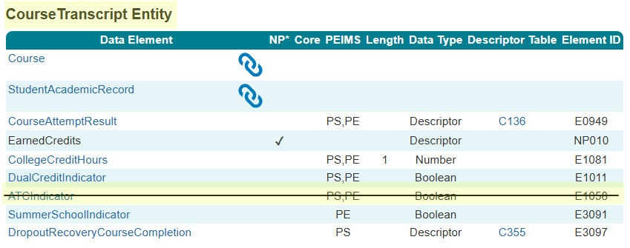
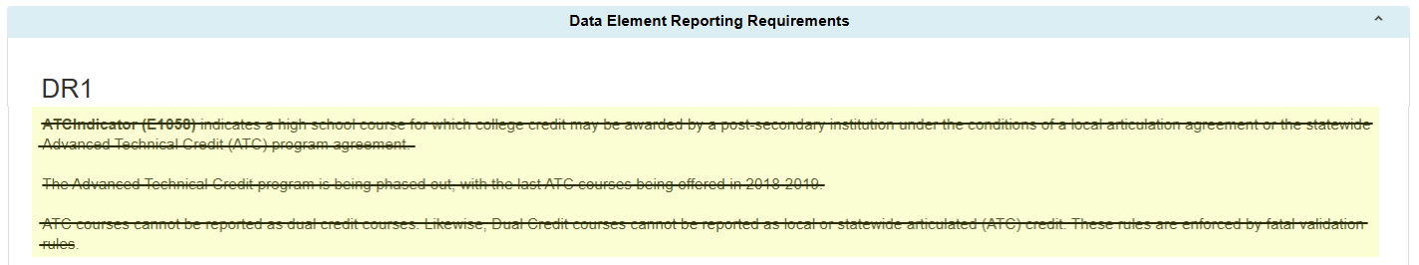
ATC Data Element

Slide 33
ATC Data Validations
The following data validations will be removed from the PEIMS Summer and Extended Year Submissions:

Slide 34
TITLE SLIDE: OnRamps Dual Enrollment Indicator Resources
The following slides were presented during the 2025 Spring TSDS ESC Coordinators Training for OnRamps Dual Enrollment Indicator:
NAME OF COMPONENT (ALL CAPS) MARCH 19-21, 2024

Slide 35
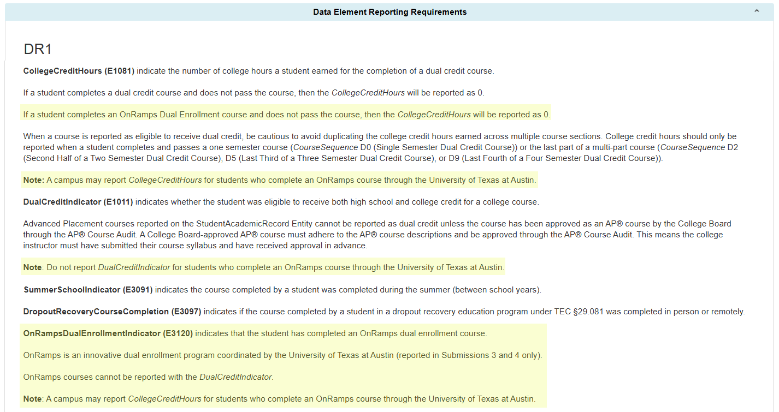
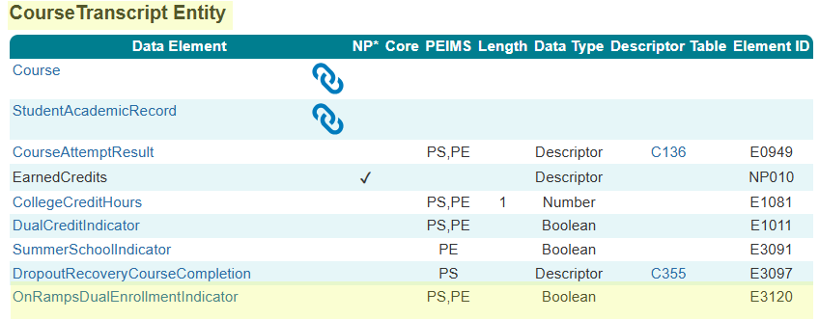
OnRampsDualEnrollmentIndicator

Slide 36
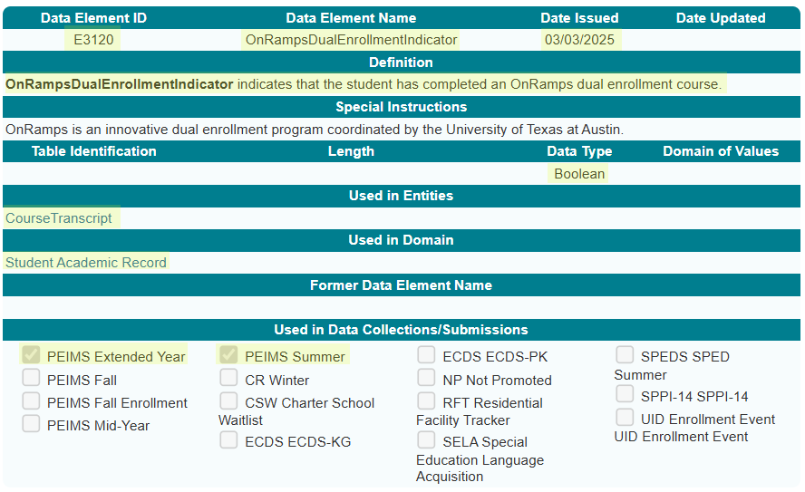
OnRampsDualEnrollmentIndicator Data Element

Slide 37
OnRamps Data Validation
The following data validations will be revised in the PEIMS Summer and Extended Year Submissions:
43415-0037
43415-0050
43415-0051
43415-0052
43415-0057

Slide 38
OnRamps Data Validation 1
The following data validations will be added to the PEIMS Summer and Extended Year Submissions:

Slide 39
TITLE SLIDE: Accelerated Instruction Changes Resources
The following slides were presented during the 2025 Spring TSDS ESC Coordinators Training for Accelerated Instruction Changes:
NAME OF COMPONENT (ALL CAPS) MARCH 19-21, 2024

Slide 40
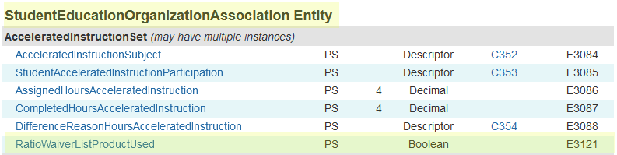
AcceleratedInstructionSet Common Type
One new data element, RatioWaiverListProductUsed (E3121), will be added to the AcceleratedInstructionSet common type in the StudentEducationOrganizationAssociation Entity and collected beginning in the 2025-2026 PEIMS Summer Submission.

Slide 41
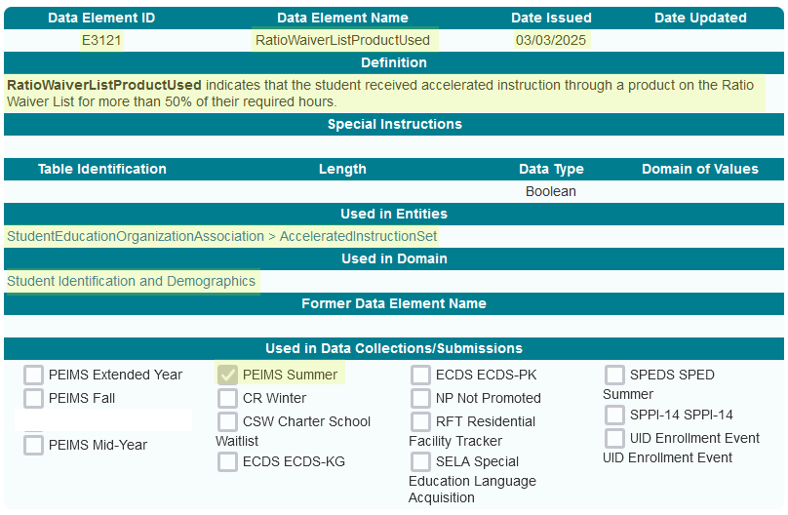
RatioWaiverListProductUsed Data Element

Slide 42
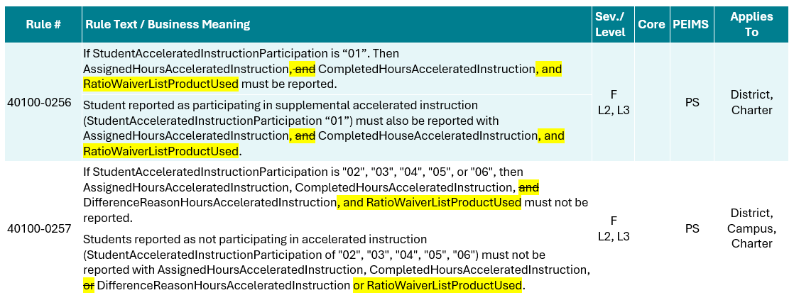
RatioWaiverListProductUsed Data Validation
The following PEIMS Summer Submission data validations will be revised:

Slide 43
TITLE SLIDE: Discipline Changes Resources
The following slides were presented during the 2025 Spring TSDS ESC Coordinators Training for Discipline Changes:
NAME OF COMPONENT (ALL CAPS) MARCH 19-21, 2024

Slide 44
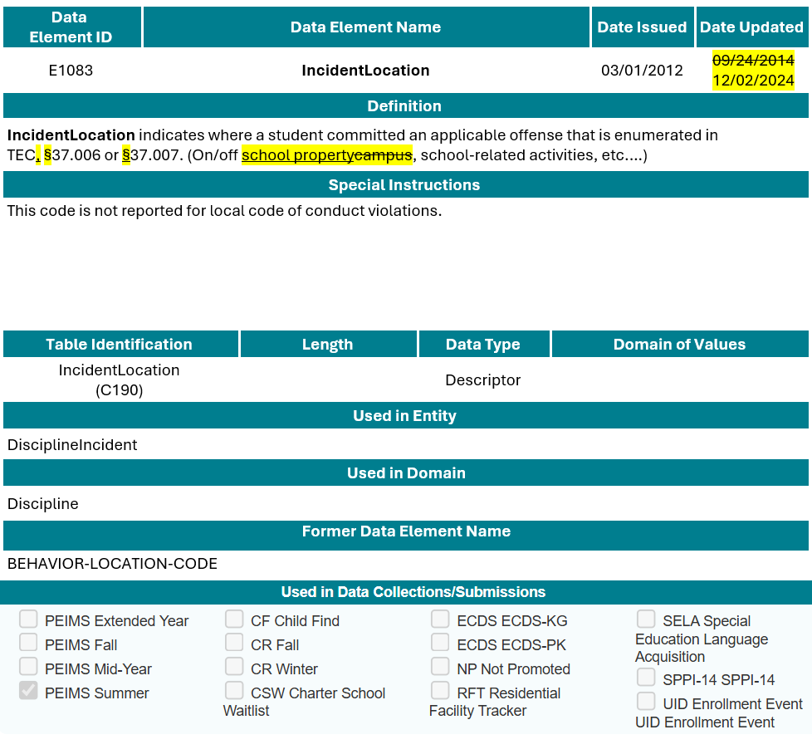
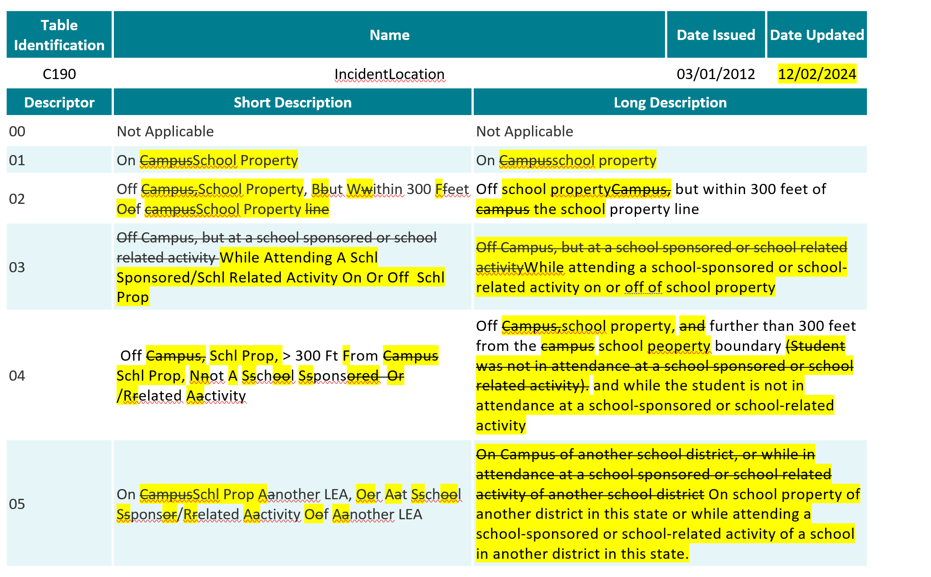
IncidentLocation (E1083)

Slide 45
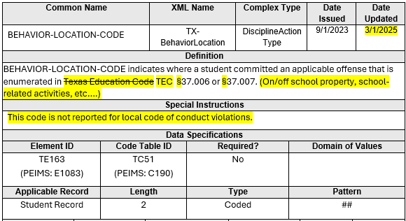
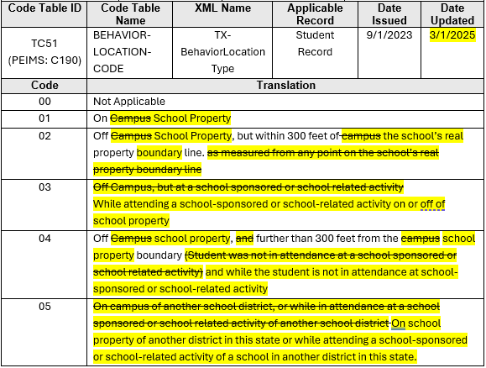
BEHAVIOR-LOCATION-CODE (TE163)

Slide 46
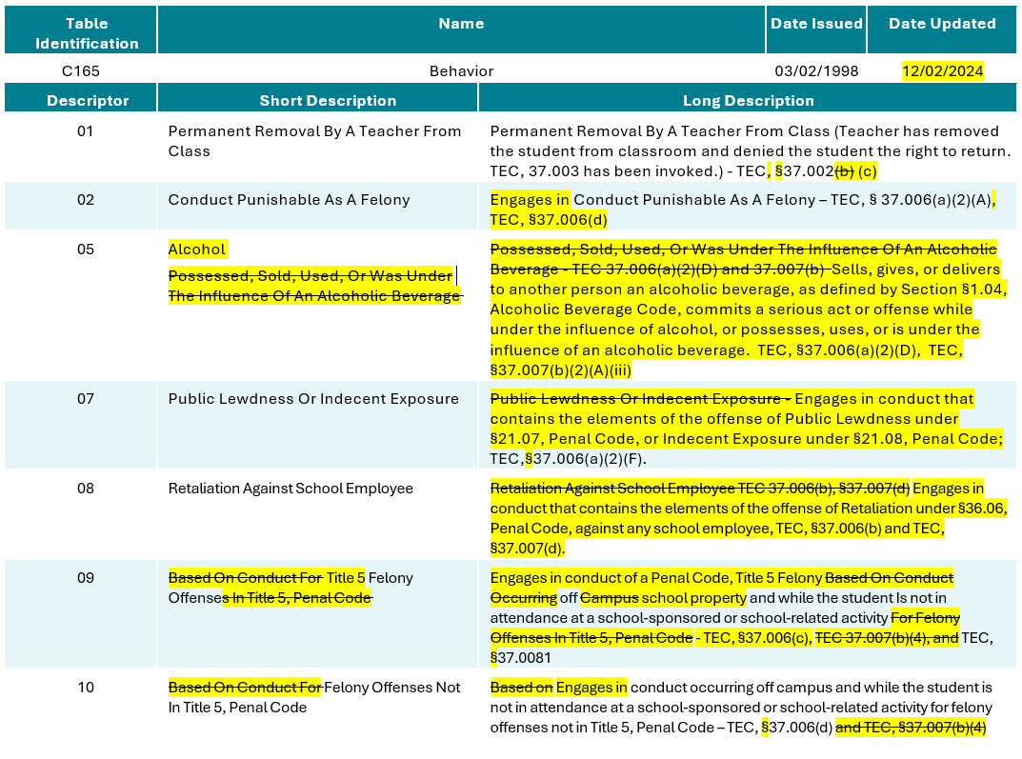
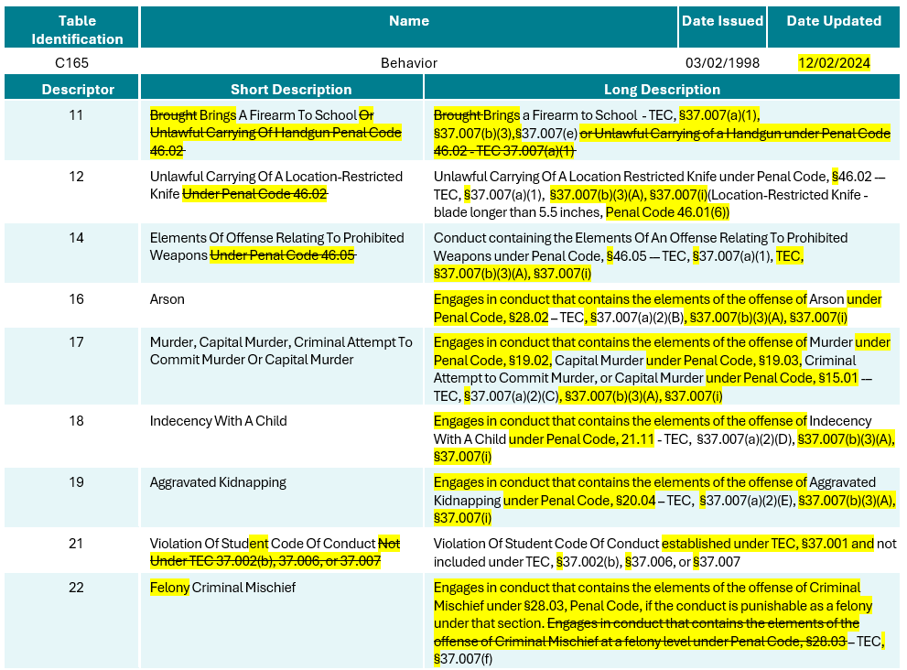
Behavior (C165)

Slide 47
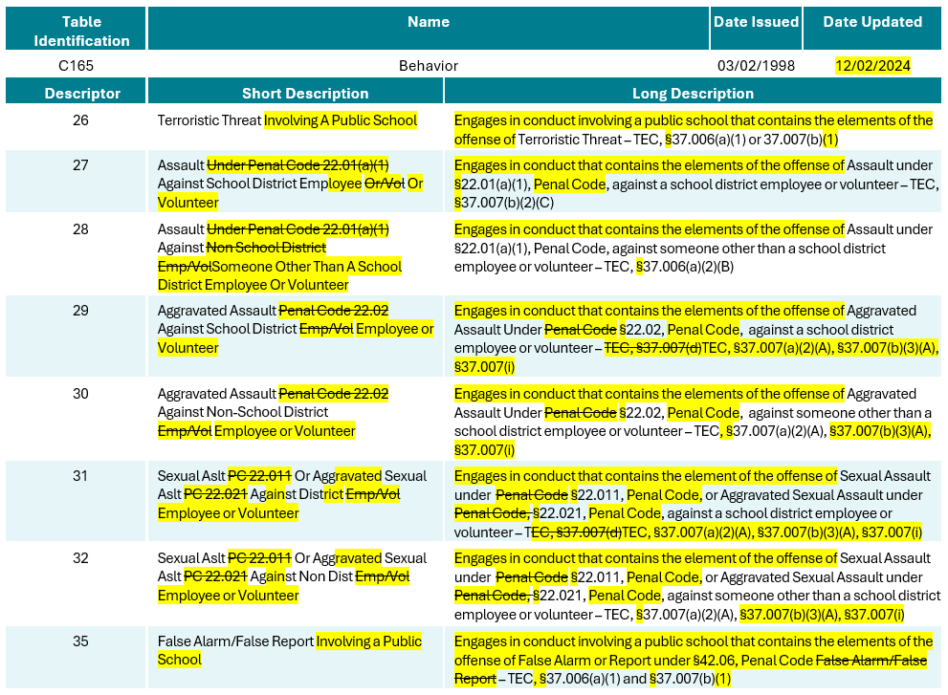
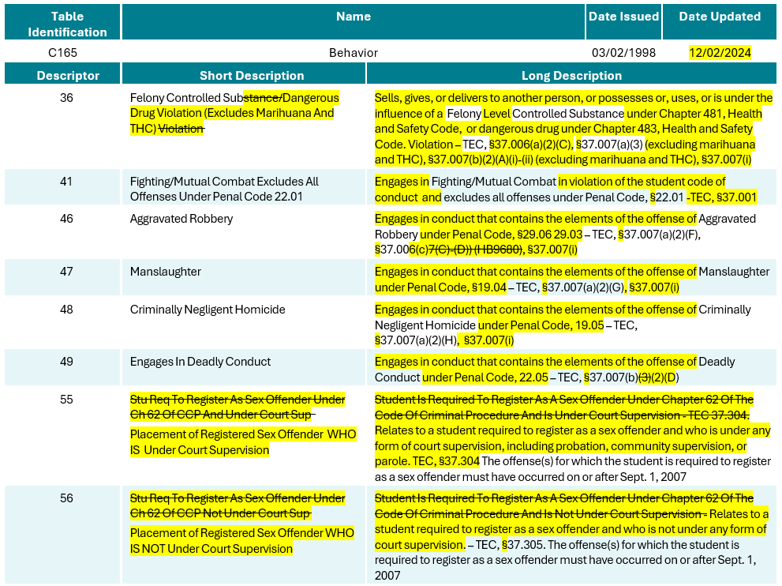
Behavior (C165) 1

Slide 48
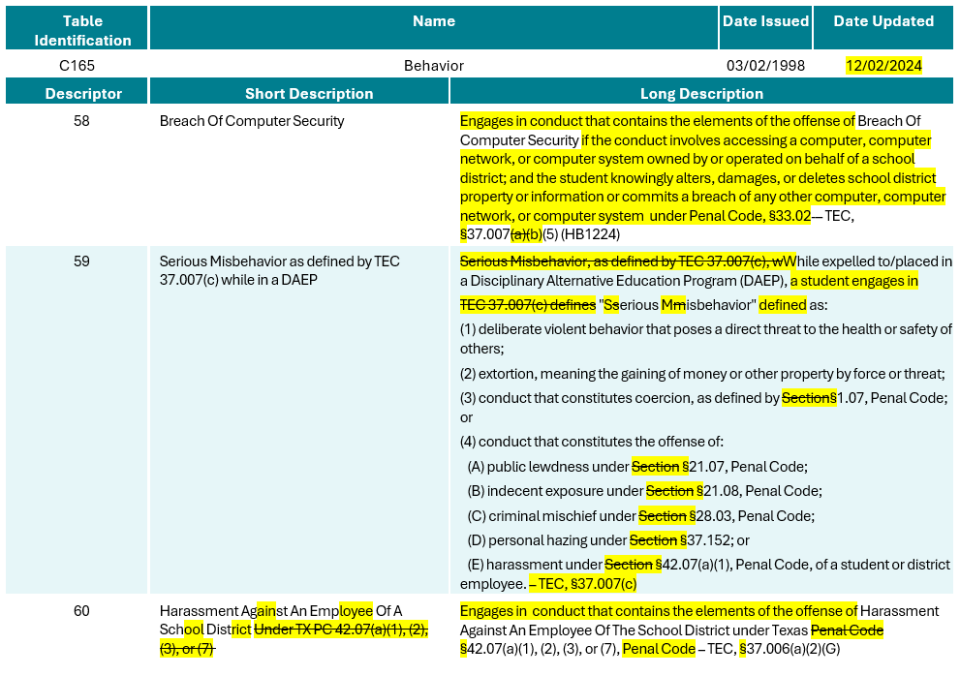
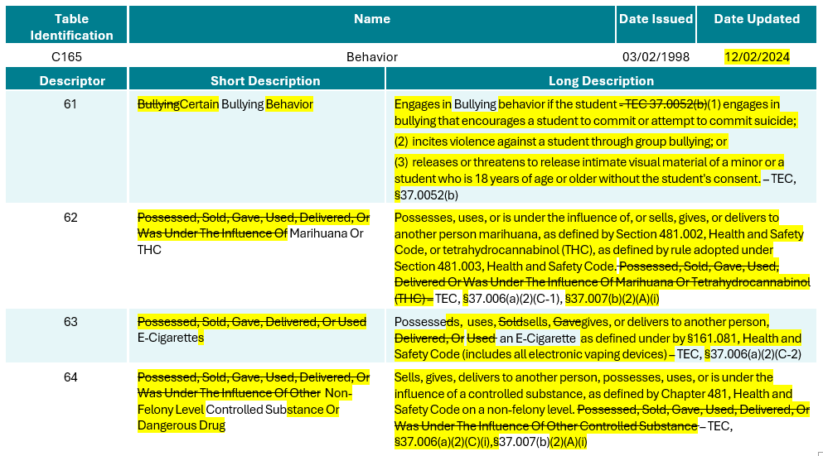
Behavior (C165) 2

Slide 49
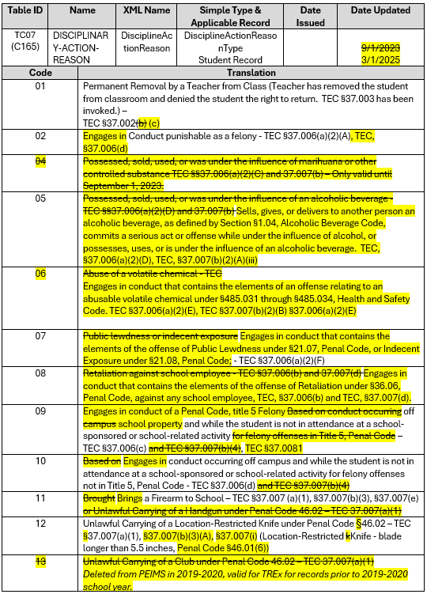
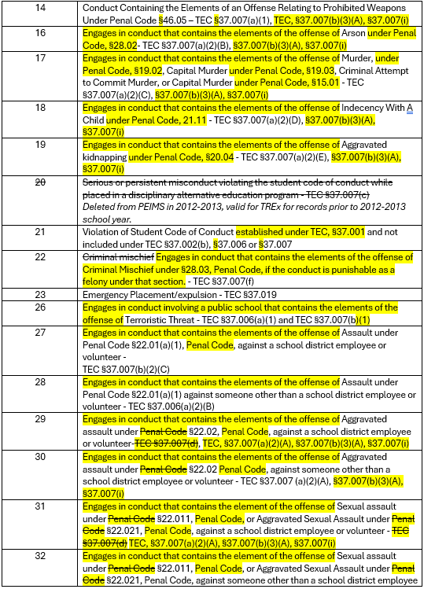
DISCIPLINARY-ACTION-REASON (TC07)

Slide 50
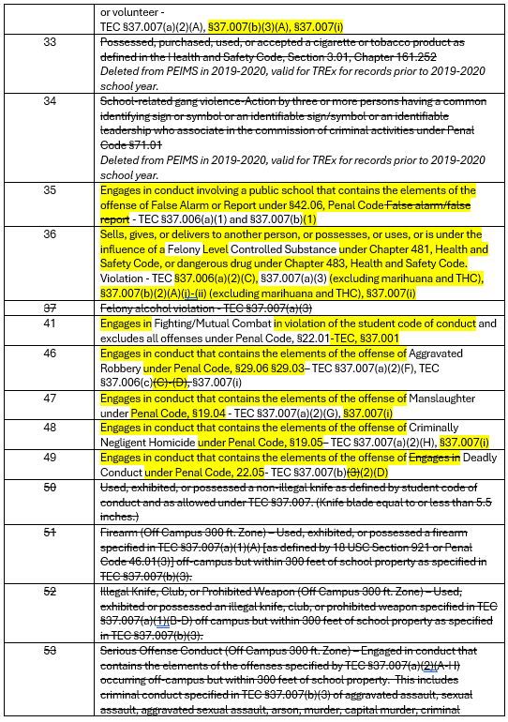
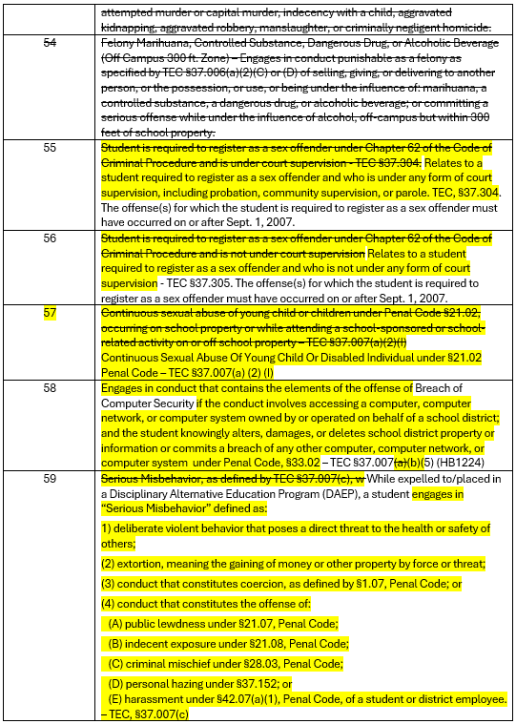
DISCIPLINARY-ACTION-REASON (TC07) 1

Slide 51
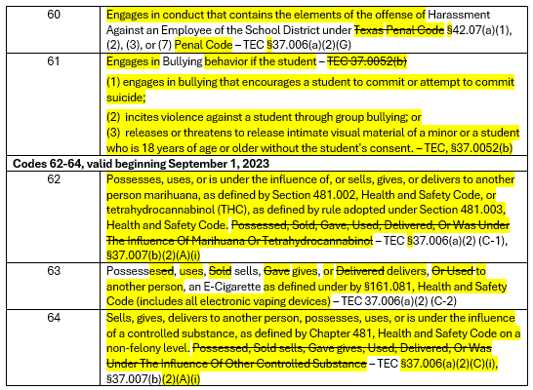
DISCIPLINARY-ACTION-REASON (TC07) 2

Slide 52
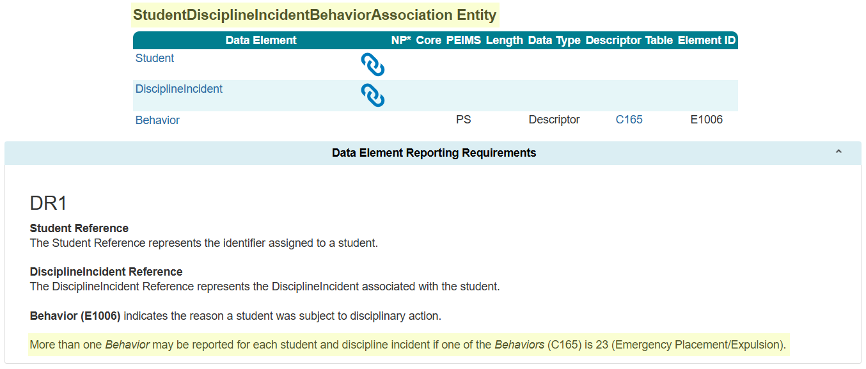
StudentDisciplineIncidentBehaviorAssociation Entity

Slide 53
Discipline Data Validation Changes
The business meanings in the following data validations will be revised in the PEIMS Summer Submission:
44425-0030
44425-0051
44425-0056
44425-0057
44425-0058
44425-0059
44425-0060
44425-0079

Slide 54
TITLE SLIDE: Classroom Position Resources
The following slides were presented during the 2025 Spring TSDS ESC Coordinators Training for New ClassroomPosition:
NAME OF COMPONENT (ALL CAPS) MARCH 19-21, 2024

Slide 55
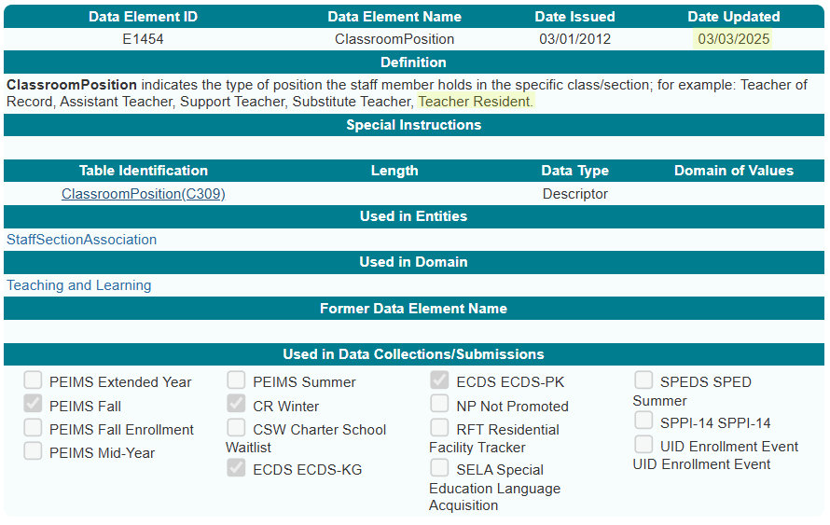
ClassroomPosition Data Element

Slide 56
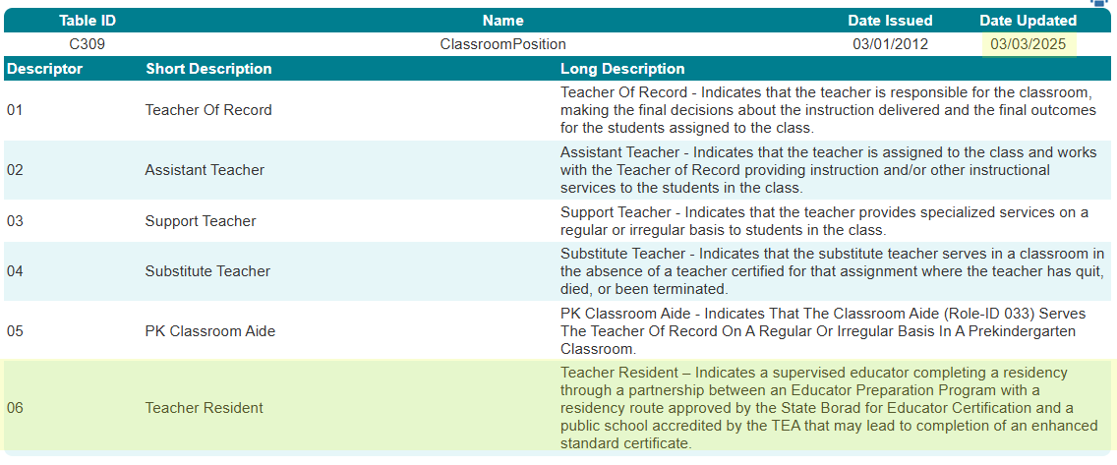
ClassroomPosition Descriptor Table

Slide 57
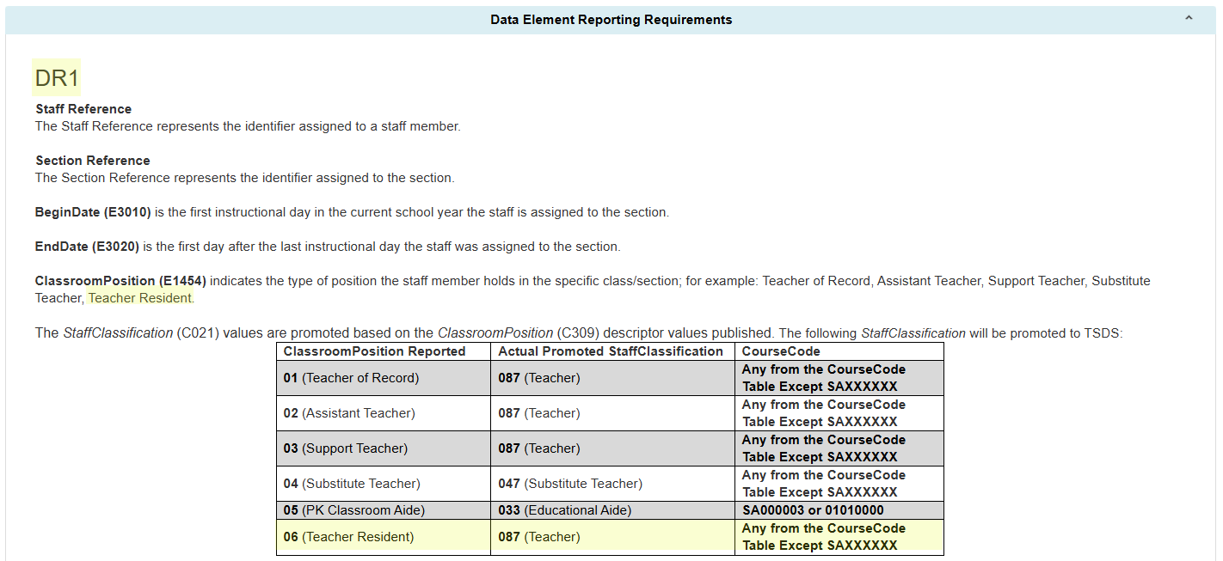
StaffSectionAssociation PEIMS Fall Reporting

Slide 58
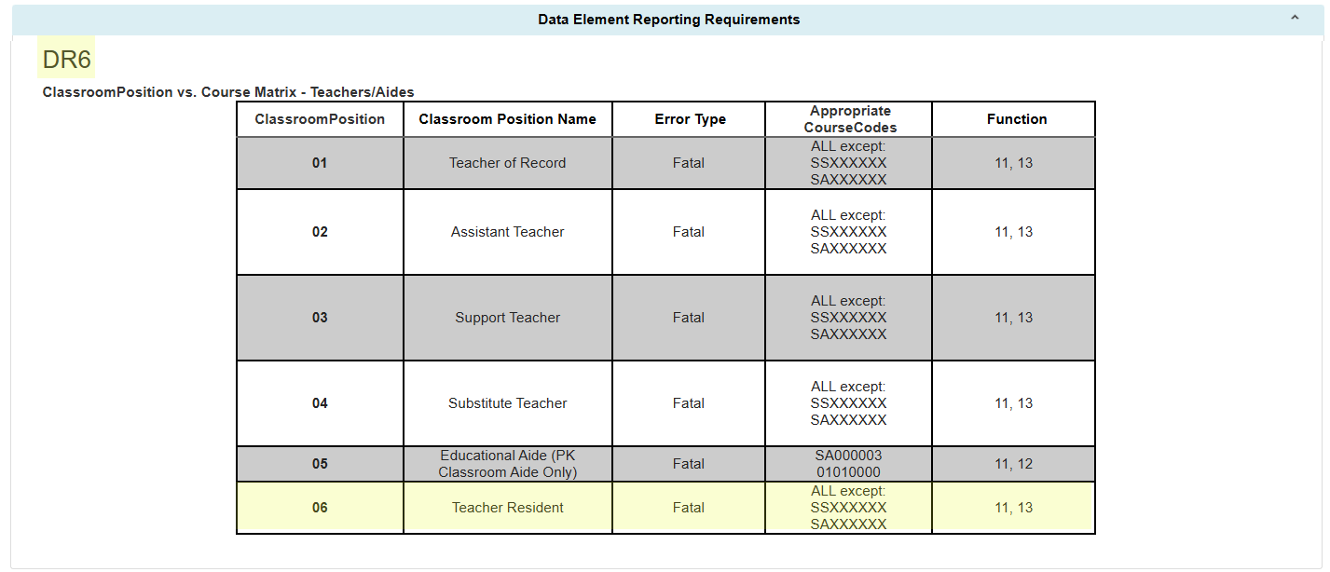
ClassroomPosition vs. Course Matrix

Slide 59
ClassroomPosition Data Validations
The following data validations will be revised in the PEIMS Fall and Class Roster Winter Submissions:
30090-0007
30090-0052
30090-0086
30090-0122
40110-0052
40110-0067
TEA may need to add additional rules to the Early Childhood Data System for the new ClassroomPosition.

Slide 60
TITLE SLIDE: Special Education Changes Resources
The following slides were presented during the 2025 Spring TSDS ESC Coordinators Training for Special Education Changes:
NAME OF COMPONENT (ALL CAPS) MARCH 19-21, 2024

Slide 61
SPED Data Element Changes
PPCDServiceLocation (E1077)
Data Element Name (ECSEServiceLocation)
Definition
SPEDStudentAgeRange (E3059)
Definition
EligibilityDeterminationDate (E1716)
Definition
ResidentialFacilityStudentSchoolDayLength (E1637)
Definition

Slide 62
SPED Descriptor Table Changes
SPEDProgramSvc (C341)
Short and Long Description – 23-25
PPCDServiceLocation (C184)
Descriptor Table Name (ECSEServiceLocation)
Short and Long Description – 1, 3-8
DiplomaType (C062)
Short and Long Description – 35
PopulationServed (C030)
Short and Long Description – 06
SPEDStudentAgeRange (C342)
Short and Long Description – 00, 01, 02

Slide 63
SPED Reporting Requirement Changes
In addition to the specific changes made to the data elements and descriptors, changes were made to the TEDS General Reporting Requirements (GR) and Data Element Reporting Requirements (DR).
StudentSpecialEducationProgramAssociation Entity
GR1, DR2, DR4, DR7, DR12
StudentSpecialEducationProgramEligibilityAssociation Entity
DR3
Section Entity
DR3

Slide 64
SPED Reporting Requirement Changes, Cont.
StudentAcademicRecord
DR7, DR8, DR9
StaffEducationOrganizationAssignmentAssociation Entity
DR2
StudentEducationOrganizationAssociation Entity
DR28

Slide 65
SPED Data Validation Changes
The following data validations will be revised:
30090-0022
30090-0047
30090-0052
30090-0060
30090-0083
30090-0120
30090-0121
40100-0151
40110-0006
40110-0176
41163-0029
41163-0036
42401-0010
42400-0021
45435-0003
45435-0005
50300-0012

