Slide 1

TITLE SLIDE: Data Standards Changes
2025-2026 DATA STANDARDS CHANGES
April 3, 2025
<NAME OF COMPONENT> (ALL CAPS)
MARCH 19-21, 2024

Slide 2

Agenda – 2025-2026 Data Standards Changes
Middle School Advanced Mathematics
Advanced Technical Credit
OnRamps Dual Enrollment Indicator
Accelerated Instruction Changes
Discipline Changes
New Classroom Position
Special Education Changes
Questions

Slide 3

TITLE SLIDE: Middle School Advanced Mathematics
Middle School Advanced Mathematics
NAME OF COMPONENT (ALL CAPS)
MARCH 19-21, 2024

Slide 4
Middle School Advanced Mathematics
During the 88th legislative session, SB 2124 was passed, which added that each school district and open-enrollment charter school should develop an advanced mathematics program for middle school students that is designed to enable those students to enroll in Algebra I in eighth grade. (Texas Administrative Code (TAC) §74.2101)
One new descriptor will be added to the StudentCharacteristic (C344) descriptor table to collect in the PEIMS Fall Submission if a student is enrolled in an advanced mathematics program.

Slide 5
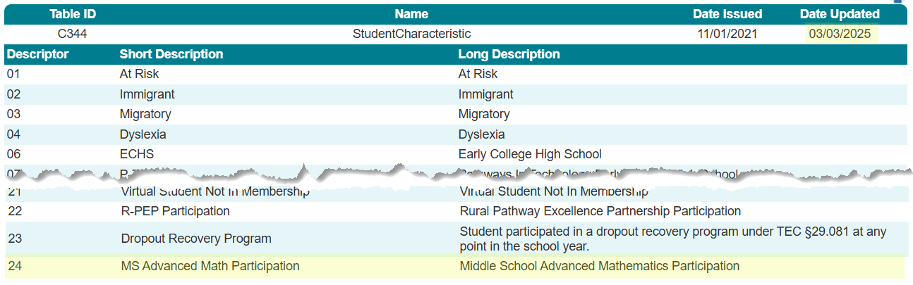
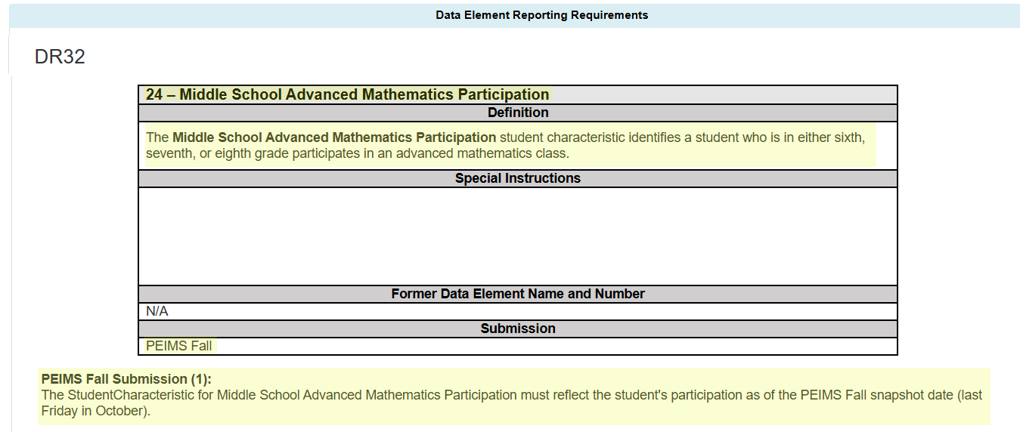
StudentCharacteristic (C344)

Slide 6
MS Advanced Math Data Validation
The following data validation will be added to the PEIMS Fall Submission to only allow the new StudentCharacteristic to be reported for a student in grades sixth, seventh, or eighth:

Slide 7
MS Advanced Math Reports
The following PEIMS Fall Submission reports will be updated to include the new StudentCharacteristic:
PDM1-120-003 – Student Program Roster
This report provides a listing of enrolled students, arranged alphabetically by last name, and indicates participation in special programs.
PDM1-120-005 – Student Data Review
This report summarizes student counts by grade, ethnicity, graduates, dropouts, economically disadvantaged, emergent bilingual (EB), and special programs.

Slide 8
MS Advanced Math Reports Cont.
PDM1-120-009 – Disaggregation of PEIMS Student Data
This report provides student enrollment counts and percentages from the Fall submission.
PDM1-120-003 – Student Indicator Report by Grade
This report lists students within various demographics and program enrollment information.
PDM1-230-001 –Data Element Summary Report
This report summarizes all data reported for TSDS PEIMS.

Slide 9
TITLE SLIDE: Advanced Technical Credit
Advanced Technical Credit
NAME OF COMPONENT (ALL CAPS)
MARCH 19-21, 2024

Slide 10
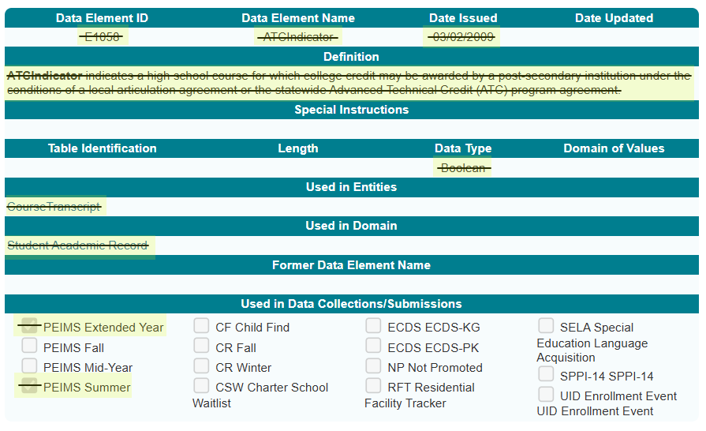
Sunset – Advanced Technical Credit
The Career and Technical Education program area has requested that the Texas Education Agency (TEA) sunset the ATCIndicator (E1058). Perkins V removed funding for the Advanced Technical Credit (ATC) program. The last ATC course was offered during the 2018-2019 school year. The ATCIndicator was collected in the PEIMS Summer and Extended Year Submissions.

Slide 11
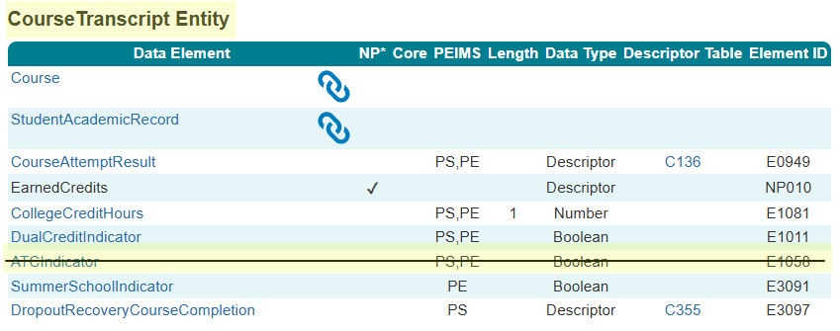
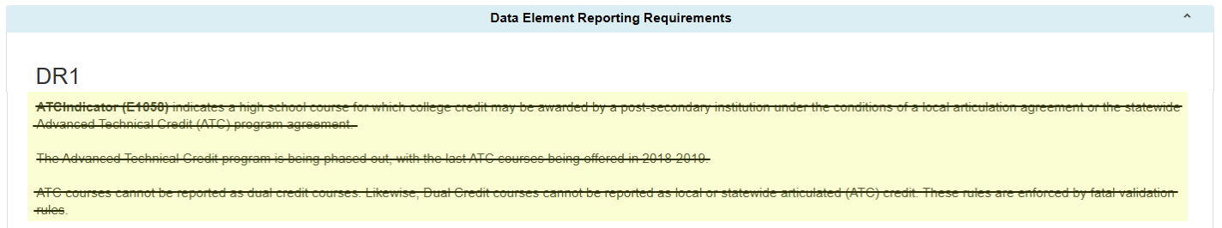
ATC Data Element

Slide 12
ATC Data Validations
The following data validations will be removed from the PEIMS Summer and Extended Year Submissions:

Slide 13
ATC Reports – Summer Submission
The ATCIndicator will be removed from the following PEIMS Summer Submission report:
PDM3-133-002 – Students Completing Courses with Advanced/Dual Credit/Enrollment
This report summarizes the count of students completing courses that were eligible for dual credit or advanced technical credit.
PDM3-230-001 – Data Element Summary Report
This report summarizes all data reported for TSDS PEIMS.

Slide 14
ATC Report – Extended Year Submission
The ATCIndicator will be removed from the following PEIMS Extended Year Submission report:
PDM4-230-001 – Data Element Summary Report
This report summarizes all data reported for TSDS PEIMS.

Slide 15
TITLE SLIDE: OnRamps Dual Enrollment Indicator
OnRamps Dual Enrollment Indicator
NAME OF COMPONENT (ALL CAPS)
MARCH 19-21, 2024

Slide 16
OnRamps Dual Enrollment Background
The TEA Performance Reporting Division receives student-level information about OnRamps college course completion, course credit, and credit hours directly from the University of Texas at Austin. TEA cannot determine the secondary course credit given to a student by the local education agency (LEA).
One new data element, OnRampsDualEnrollmentIndicator (E3120), will be added to the CourseTranscript Entity and collected in the PEIMS Summer and Extended Year Submissions for TEA to determine which secondary courses align with specific OnRamps courses.

Slide 17
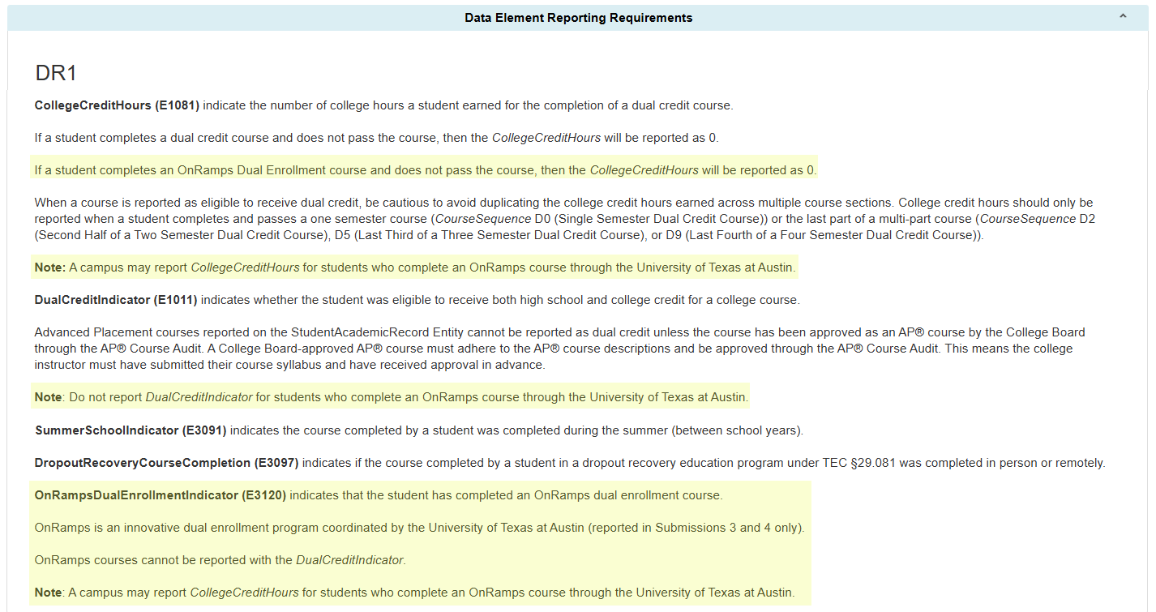
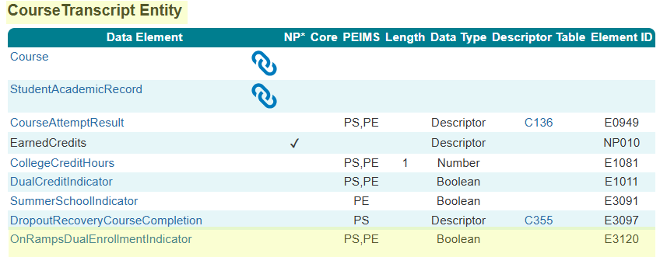
OnRampsDualEnrollmentIndicator

Slide 18
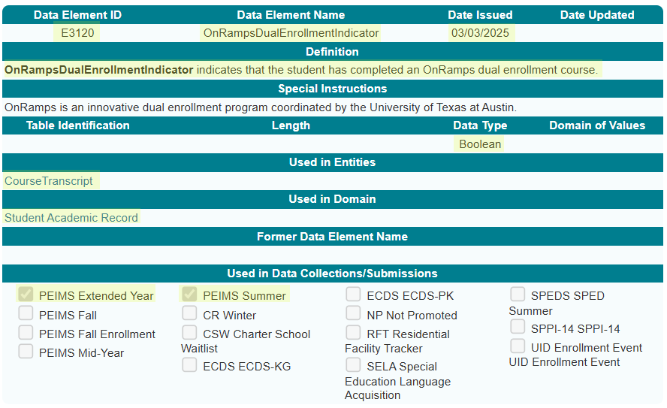
OnRampsDualEnrollmentIndicator Data Element

Slide 19
OnRamps Data Validation
The following data validations will be revised in the PEIMS Summer and Extended Year Submissions:
43415-0037
43415-0050
43415-0051
43415-0052
43415-0057

Slide 20
OnRamps Data Validation 1
The following data validations will be added to the PEIMS Summer and Extended Year Submissions:

Slide 21
OnRamps Reports – Summer Submission
The OnRampsDualEnrollmentIndicator will be added to the following PEIMS Summer Submission report:
PDM3-133-002 – Students Completing Courses with Advanced/Dual Credit/Enrollment
This report summarizes the count of students completing courses that were eligible for dual credit or advanced technical credit.
PDM3-230-001 – Data Element Summary Report
This report summarizes all data reported for TSDS PEIMS.

Slide 22
OnRamps Reports – Extended Year Submission
The OnRampsDualEnrollmentIndicator will be added to the following PEIMS Extended Year Submission reports:
PDM4-133-002 – Students Completing Courses with Dual Credit
This report summarizes the count of students completing courses that were eligible for dual credit.
PDM4-230-001 – Data Element Summary Report
This report summarizes all data reported for TSDS PEIMS.

Slide 23
TITLE SLIDE: Accelerated Instruction Changes
Accelerated Instruction Changes
NAME OF COMPONENT (ALL CAPS)
MARCH 19-21, 2024

Slide 24
Accelerated Instruction Background
In the 2024-2025 PEIMS Summer Submission, TEA will begin collecting data to identify the accelerated instruction provided by an LEA to a particular student.
Texas Administrative Code, Section 104.1001, was adopted, which approved Ratio Waiver List (RWL) products. These products use automated, computerized, or other augmented methods of instruction, which LEAs can use in place of some or all of the required individual or group instruction.
The Texas Tutoring Supports Division has determined that it is necessary to know which students use a product from the RWL for their accelerated instruction.

Slide 25
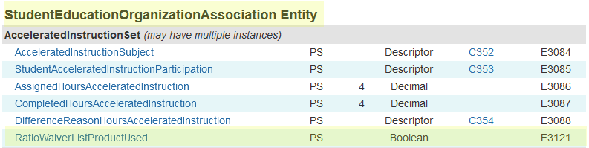
AcceleratedInstructionSet Common Type
One new data element, RatioWaiverListProductUsed (E3121), will be added to the AcceleratedInstructionSet common type in the StudentEducationOrganizationAssociation Entity and collected beginning in the 2025-2026 PEIMS Summer Submission.

Slide 26
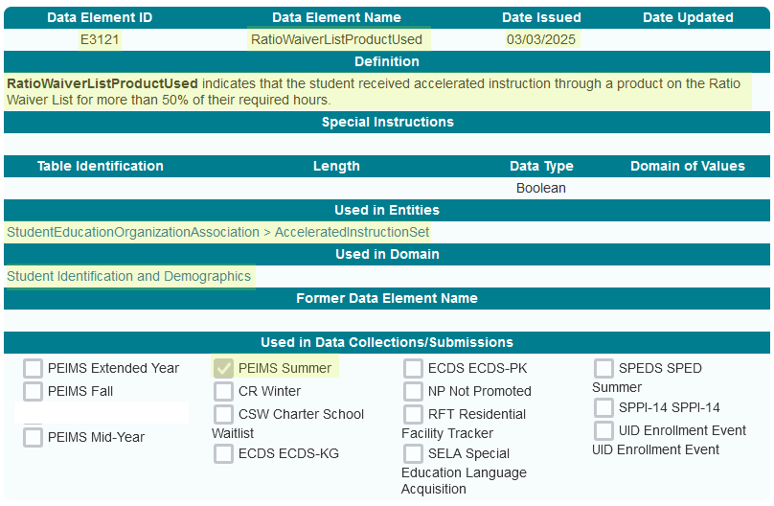
RatioWaiverListProductUsed Data Element

Slide 27
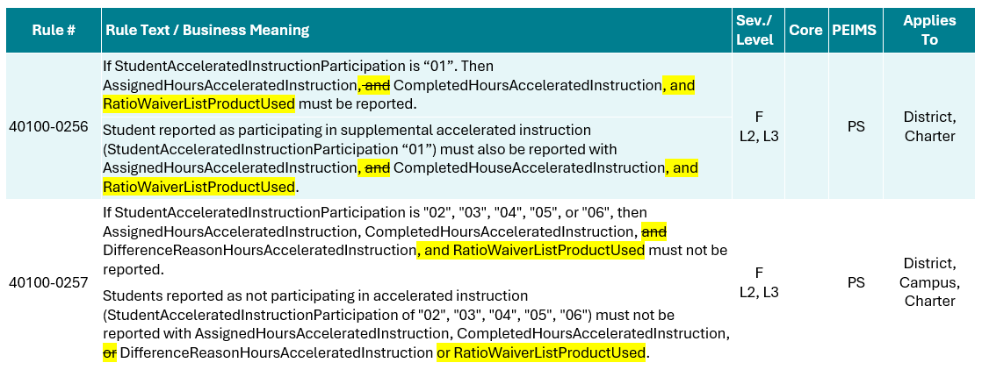
RatioWaiverListProductUsed Data Validation
The following PEIMS Summer Submission data validations will be revised:

Slide 28
Accelerated Instruction Report
The RatioWaiverListProductUsed data element will be added to the following PEIMS Summer Submission reports:
PDM3-120-025 – Accelerated Instruction Student Roster
This report will include students who have a student accelerated education plan and shall display the accelerated instruction subject, accelerated participation, assigned hours, completed hours, and difference reason hours for each subject submitted.
PDM3-120-026 – Accelerated Instruction Summary Report
This report summarizes the accelerated instruction totals by subject, participation, difference hours reason and grade.
PDM3-230-001 – Data Element Summary Report
This report summarizes all data reported for TSDS PEIMS.

Slide 29
TITLE SLIDE: Discipline Changes
Discipline Changes
NAME OF COMPONENT (ALL CAPS)
MARCH 19-21, 2024

Slide 30
Discipline Changes
The Student Discipline Program Specialist audited all discipline-related data components and guidance in the Texas Education Data Standards (TEDS) and the Texas Records Exchange (TREx) Data Standards for accuracy and alignment with Chapter 37 of the Texas Education Code.
The changes on the following slides are the result of the audit.

Slide 31
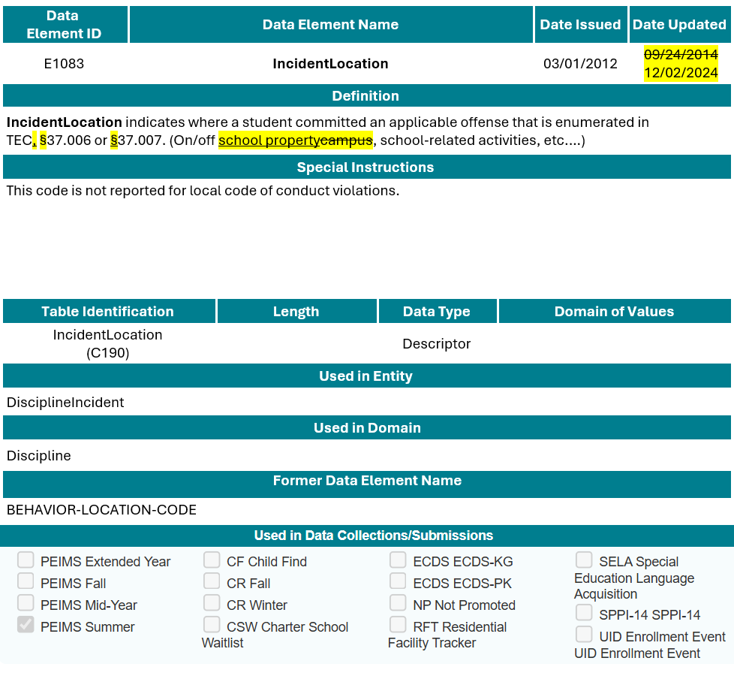
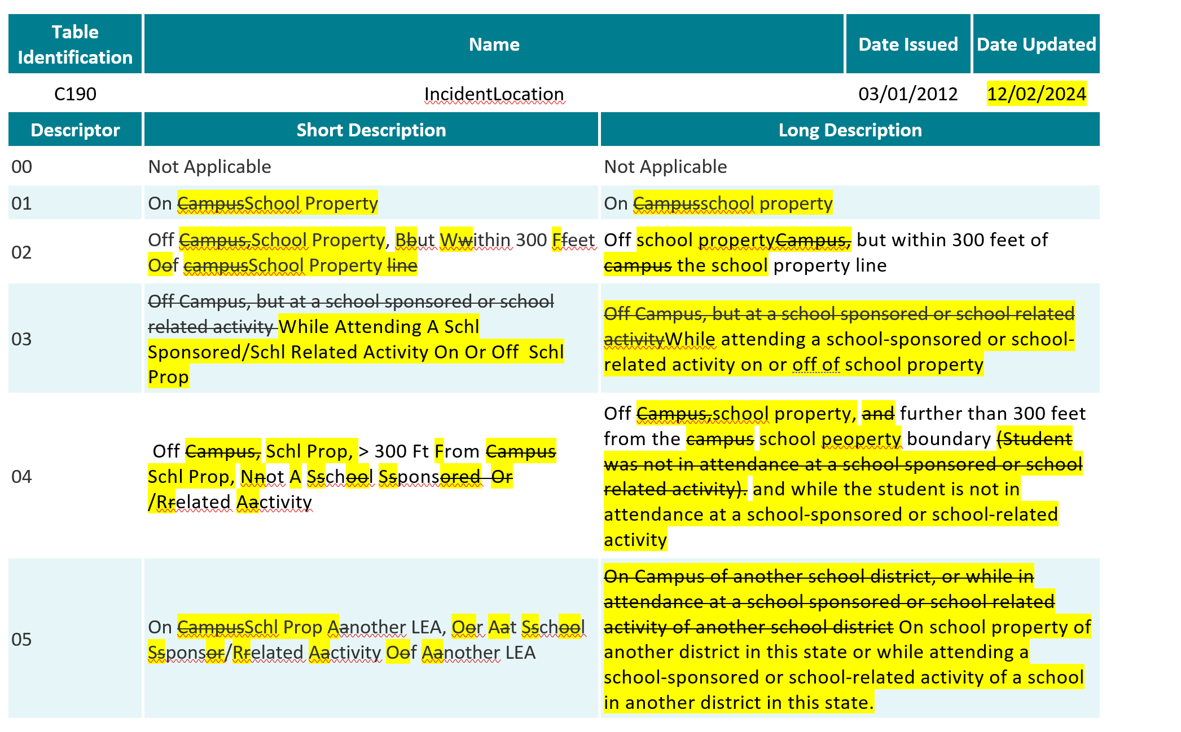
IncidentLocation (E1083)

Slide 32
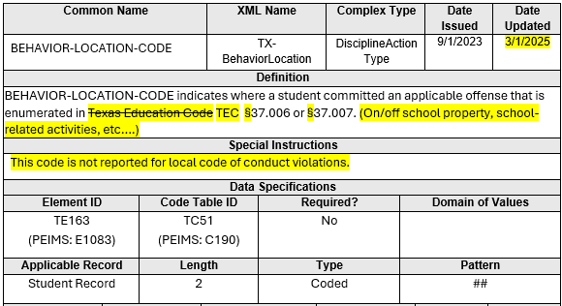
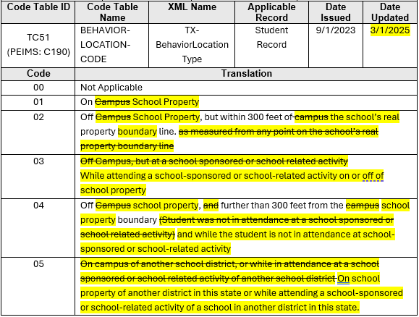
BEHAVIOR-LOCATION-CODE (TE163)

Slide 33
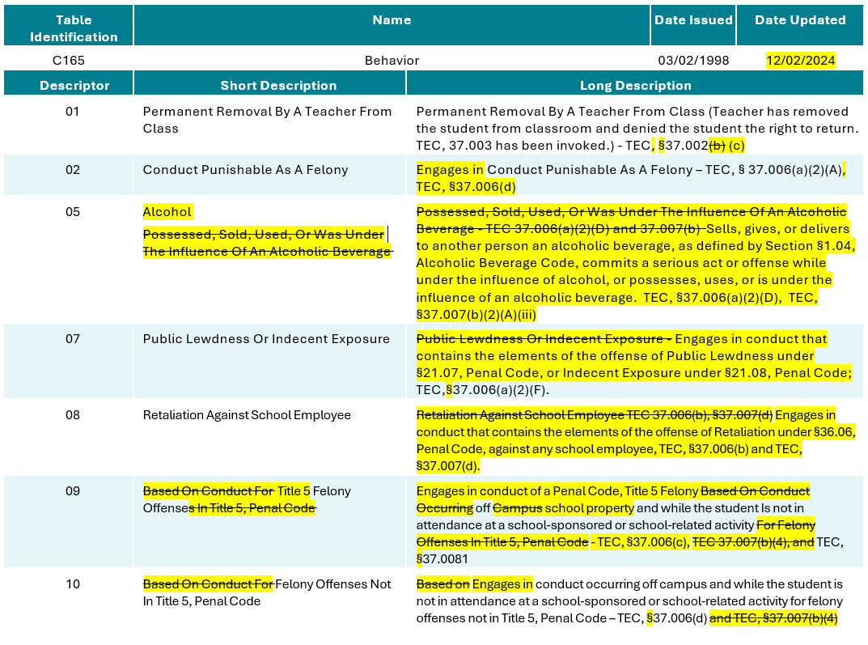
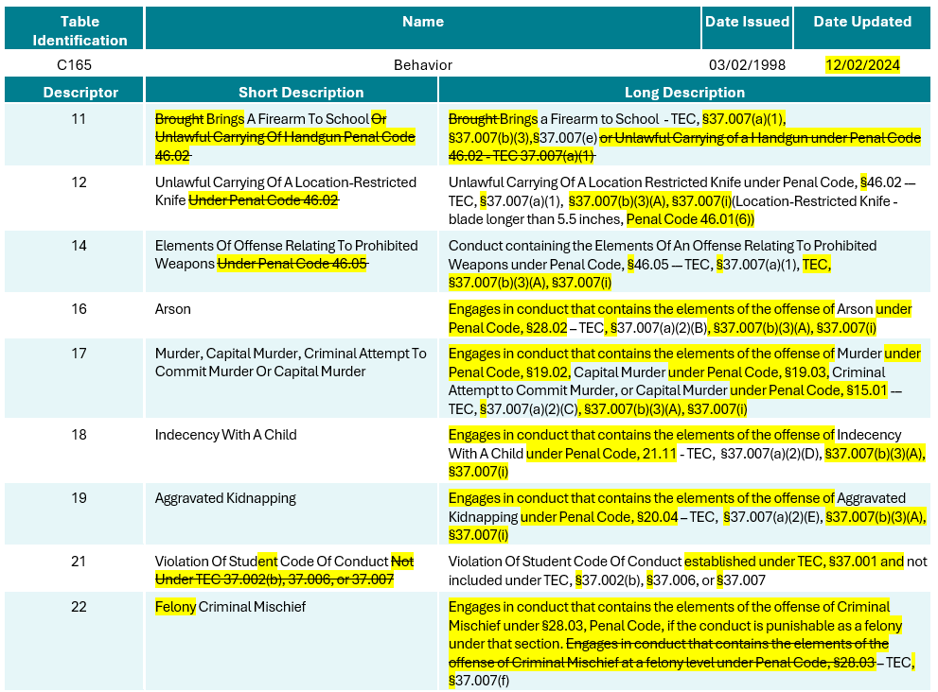
Behavior (C165)

Slide 34
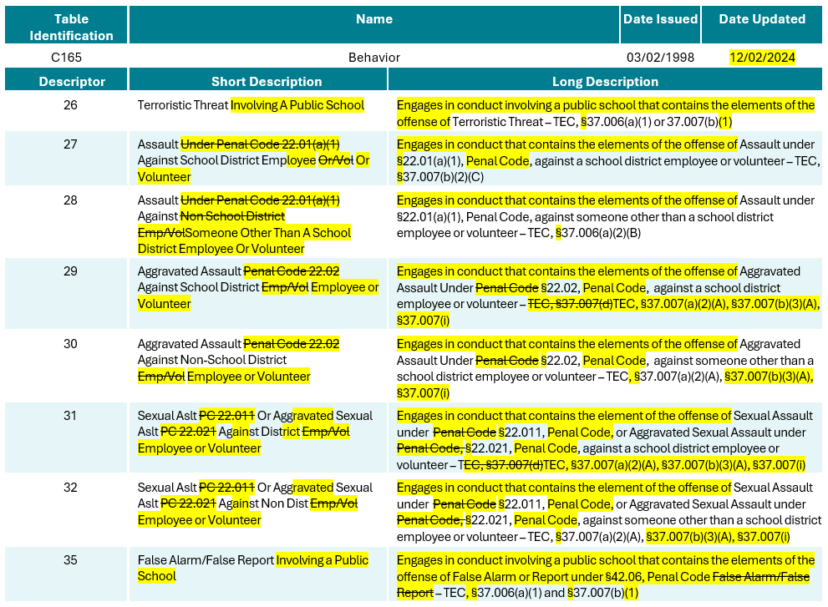
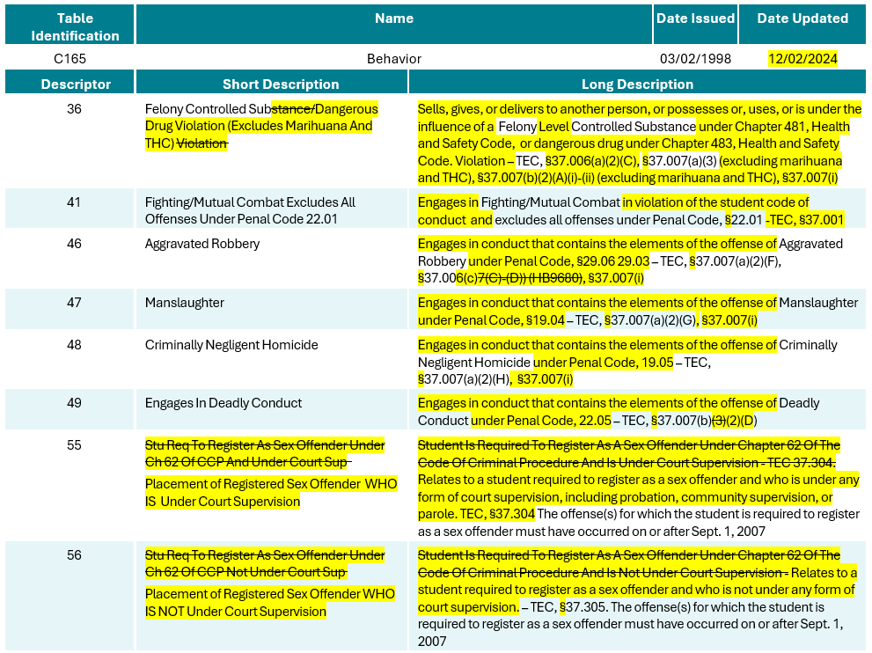
Behavior (C165) 1

Slide 35
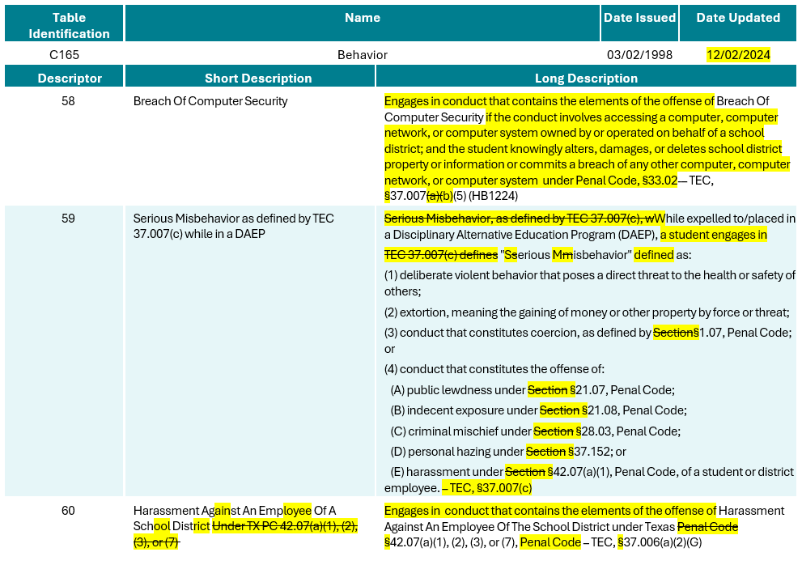
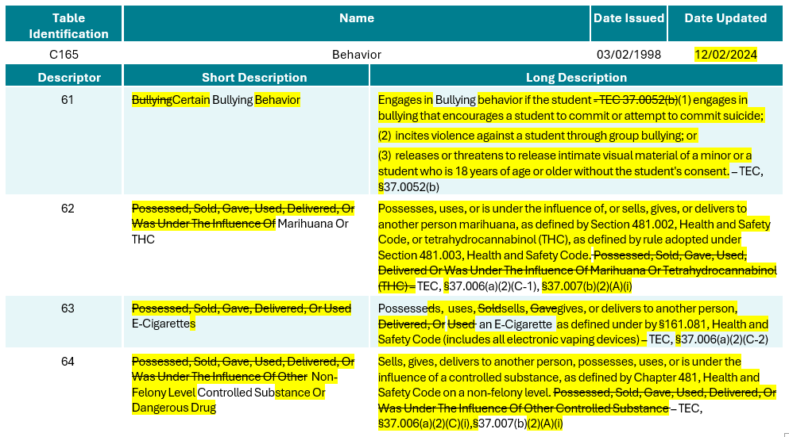
Behavior (C165) 2

Slide 36
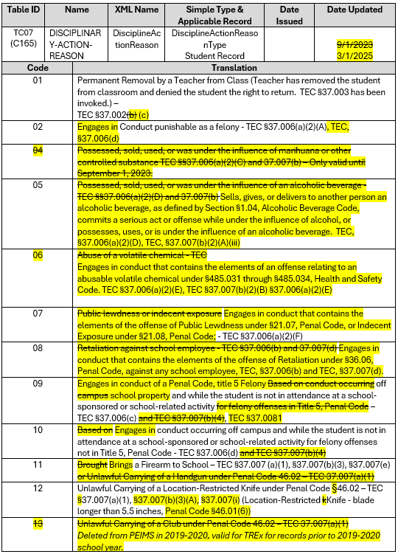
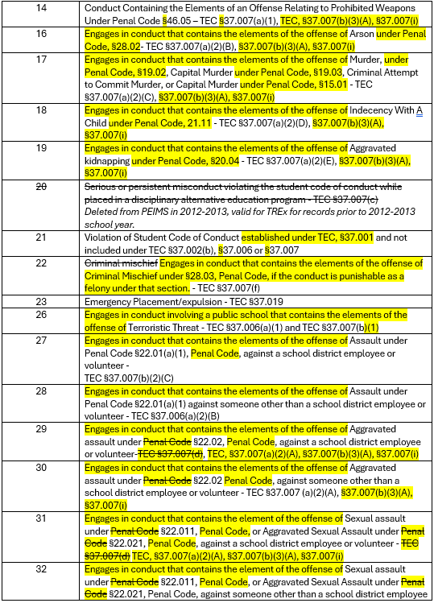
DISCIPLINARY-ACTION-REASON (TC07)

Slide 37
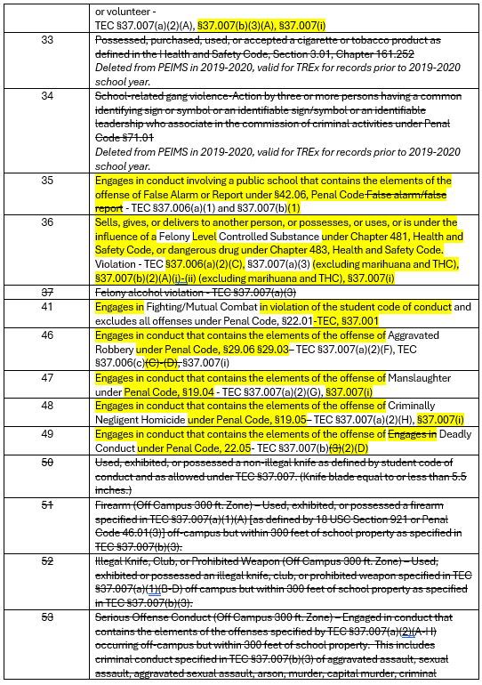
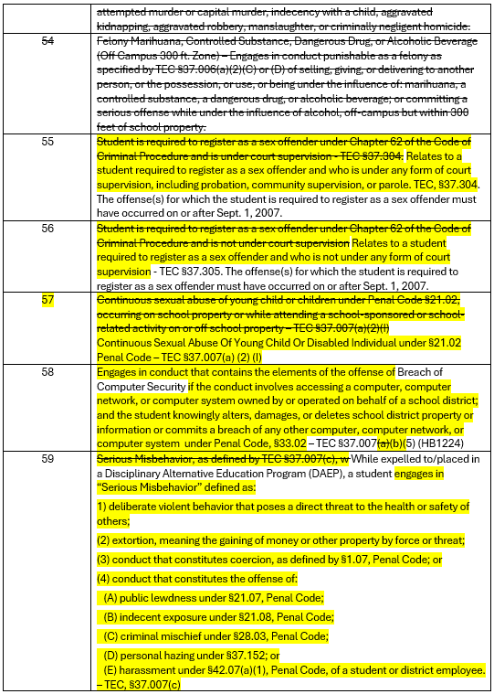
DISCIPLINARY-ACTION-REASON (TC07) 1

Slide 38
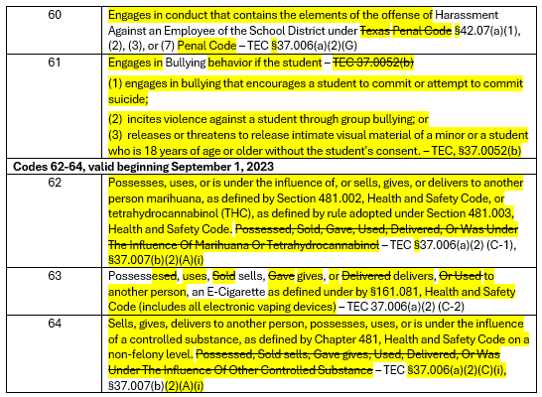
DISCIPLINARY-ACTION-REASON (TC07) 2

Slide 39
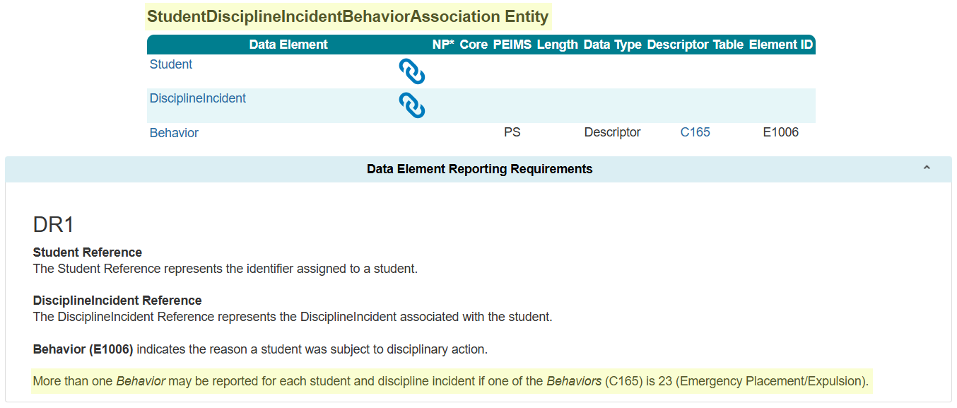
StudentDisciplineIncidentBehaviorAssociation Entity

Slide 40
Discipline Data Validation Changes
The business meanings in the following data validations will be revised in the PEIMS Summer Submission:
44425-0030
44425-0051
44425-0056
44425-0057
44425-0058
44425-0059
44425-0060
44425-0079

Slide 41
Discipline Report Changes
The following PEIMS Summer Submission reports will be revised to reflect the discipline changes made:
PDM3-132-003 – Student Disciplinary Action Summary
PDM3-132-006 – Student Disciplinary Action Incident Counts by Reason Code

Slide 42
TITLE SLIDE: New Classroom Position
New ClassroomPosition
NAME OF COMPONENT (ALL CAPS)
MARCH 19-21, 2024

Slide 43
New Classroom Position
TEA developed the Teacher Residency initiative to address the scale of, access to, and sustainability of high-quality teacher preparation through incentives and support to LEAs and Education Preparation Program (EPP) Partnerships to implement paid teacher residency programs.
The Educator Quality Department has requested that a new ClassroomPosition (C309) descriptor be added to help identify individuals serving as teacher residents. ClassroomPosition (E1454) is reported in the PEIMS Fall Submission, Class Roster Winter Submission, and the Early Childhood Data System Prekindergarten and Kindergarten Submissions.

Slide 44
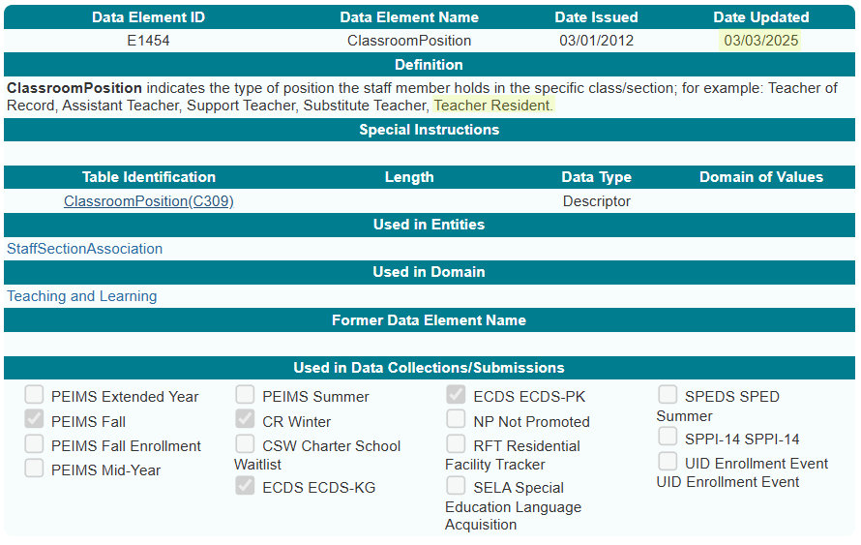
ClassroomPosition Data Element

Slide 45
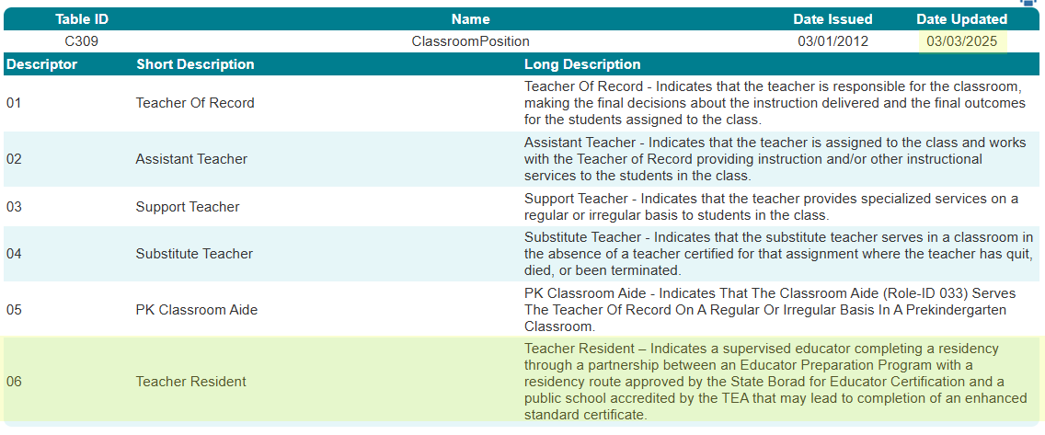
ClassroomPosition Descriptor Table

Slide 46
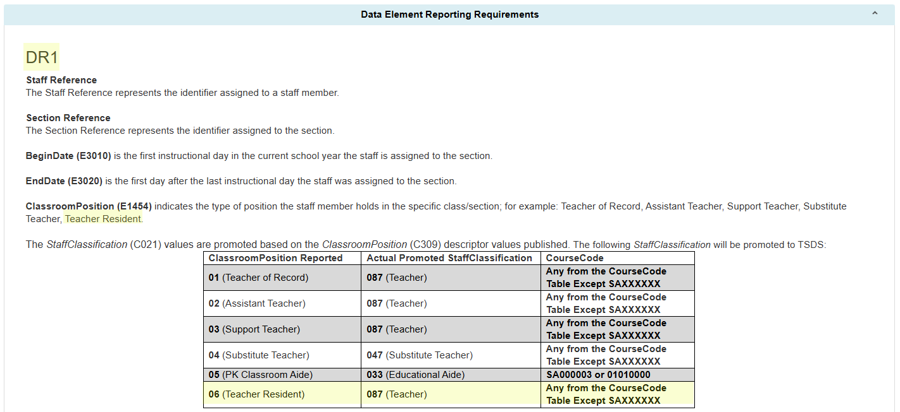
StaffSectionAssociation PEIMS Fall Reporting

Slide 47
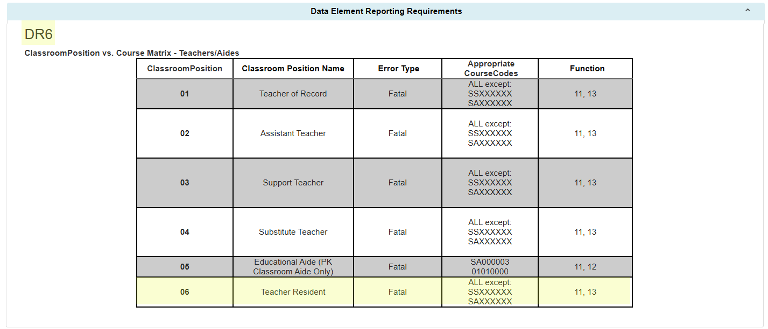
ClassroomPosition vs. Course Matrix

Slide 48
ClassroomPosition Data Validations
The following data validations will be revised in the PEIMS Fall and Class Roster Winter Submissions:
30090-0007
30090-0052
30090-0086
30090-0122
40110-0052
40110-0067
TEA may need to add additional rules to the Early Childhood Data System for the new ClassroomPosition.

Slide 49
ClassroomPosition Reports
The following Class Roster Winter Submission reports will be updated to include the new ClassroomPosition 06 (Teacher Resident):
CLS2-100-001 – Student Class Roster – Winter Submission
This report provides a Class Roster Winter Submission listing of each course, including basic information about each class and a roster of the students in that class.
CLS2-100-003 – Staff Class Assignment Report – Winter Submission
This report provides a Class Roster Winter Submission listing of staff, arranged alphabetically by staff name then class course code, along with classroom attributes.
CLS2-100-004 – Student Class Roster – Winter Submission
This report provides a Class Roster Winter Submission listing and summarizes teacher and class information, including student counts for grades 1-12.
CLS2-100-006 – Submission Summary Report – Winter Submission
This report displays the row count for the Class Roster Winter Submission by category and subcategory.

Slide 50
ClassroomPosition Reports Cont.
The following Early Childhood Data System Prekindergarten and Kindergarten Submissions reports will be updated to include the new ClassroomPosition 06 (Teacher Resident):
ECD0-000-003 – Early Childhood Assessment PK Sources
This statewide report identifies the prekindergarten (PK) programs associated with kindergarten students and their kindergarten ready or not kindergarten ready status.
ECD0-000-001 – TSDS Early Childhood Assessment Completion
This report provides the overall status of the current ECDS collection for all kindergarten programs.
ECD0-000-002 – TSDS Early Childhood KG Assessment Summary
This report summarizes the results of kindergarten assessment, showing the number and percentage of students who are kindergarten ready or who are not kindergarten ready.
ECD0-000-004 – TSDS Early Childhood KG Data Submission
This report provides a detailed breakdown of data submissions for the kindergarten data collection.

Slide 51
TITLE SLIDE: Special Education Changes
Special Education Changes
NAME OF COMPONENT (ALL CAPS)
MARCH 19-21, 2024

Slide 52
Special Education (SPED) Changes
The Special Population Policy, Integration, and Technical Assistance Department audited all special education-related data components in the Texas Education Data Standards (TEDS) and the Texas Records Exchange (TREx) Data Standards for accuracy and alignment with TAC §89.1040 adopted on July 26, 2024. and TAC §89.1070 adopted on November 1, 2024.
As a result of this audit, the program area requested the following language changes:
  Preschool Program for Children with Disabilities (PPCD) to Early Childhood Special Education (ECSE)
  Special Education Students to Students Receiving Special Education Services
  Individualized Education Plan to Individualized Education Program
  Reference to aged 3 through 5 changed to aged 3 through 5 (not in kindergarten)

Slide 53
SPED Data Element Changes
PPCDServiceLocation (E1077)
  Data Element Name (ECSEServiceLocation)
  Definition
SPEDStudentAgeRange (E3059)
  Definition
EligibilityDeterminationDate (E1716)
  Definition
ResidentialFacilityStudentSchoolDayLength (E1637)
  Definition

Slide 54
SPED Descriptor Table Changes
SPEDProgramSvc (C341)
  Short and Long Description – 23-25
PPCDServiceLocation (C184)
  Descriptor Table Name (ECSEServiceLocation)
  Short and Long Description – 1, 3-8
DiplomaType (C062)
  Short and Long Description – 35
PopulationServed (C030)
  Short and Long Description – 06
SPEDStudentAgeRange (C342)
  Short and Long Description – 00, 01, 02

Slide 55
SPED Reporting Requirement Changes
In addition to the specific changes made to the data elements and descriptors, changes were made to the TEDS General Reporting Requirements (GR) and Data Element Reporting Requirements (DR).
StudentSpecialEducationProgramAssociation Entity
  GR1, DR2, DR4, DR7, DR12
StudentSpecialEducationProgramEligibilityAssociation Entity
  DR3
Section Entity
  DR3

Slide 56
SPED Reporting Requirement Changes, Cont.
StudentAcademicRecord
  DR7, DR8, DR9
StaffEducationOrganizationAssignmentAssociation Entity
  DR2
StudentEducationOrganizationAssociation Entity
  DR28

Slide 57
SPED Data Validation Changes
The following data validations will be revised:
30090-0022
30090-0047
30090-0052
30090-0060
30090-0083
30090-0120
30090-0121
40100-0151
40110-0006
40110-0176
41163-0029
41163-0036
42401-0010
42400-0021
45435-0003
45435-0005
50300-0012

Slide 58
SPED Report Changes
The following PEIMS Fall Submission reports will be updated to include the special education changes:
PDM1-121-006 – Special Education Roster by Grade
This report lists special education students, their disabilities, and their services by last name and grade.
PDM1-121-008 – Preschool Program for Children w/ Disabilities by Grade and Service Location*
This report summarizes special education students participating in the Preschool Program for Children with Disabilities (PPCD), grouped by campus with counts by grade and PPCD service location.
PDM1-121-009 – Special Education Student Data
This report contains data for Special Education students from the Fall Collection.
*Note: the report name and description of report will be changed to reflect the new terminology Early Childhood Special Education.

Slide 59
SPED Report Changes Cont.
The following Residential Facility Tracker report will be updated to include the special education changes:
RFT0-100-004 – Individual Student Detail Summary
This report provides a list of all students in residential facilities for a selected LEA.

Slide 60

QUESTIONS
QUESTIONS?

