Slide 1

TITLE SLIDE: Data Standards Changes
2025-2026 DATA STANDARDS CHANGES
April 1, 2025
<NAME OF COMPONENT> (ALL CAPS)
MARCH 19-21, 2024

Slide 2

Agenda – 2025-2026 Data Standards Changes
Middle School Advanced Mathematics
Advanced Technical Credit
OnRamps Dual Enrollment Indicator
Accelerated Instruction Changes
Discipline Changes
New Classroom Position
Special Education Changes
Questions

Slide 3

TITLE SLIDE: Middle School Advanced Mathematics
Middle School Advanced Mathematics
NAME OF COMPONENT (ALL CAPS)
MARCH 19-21, 2024

Slide 4
Middle School Advanced Mathematics
During the 88th legislative session, SB 2124 was passed, which added that each school district and open-enrollment charter school should develop an advanced mathematics program for middle school students that is designed to enable those students to enroll in Algebra I in eighth grade. (Texas Administrative Code (TAC) §74.2101)
One new descriptor will be added to the StudentCharacteristic (C344) descriptor table to collect in the PEIMS Fall Submission if a student is enrolled in an advanced mathematics program.

Slide 5
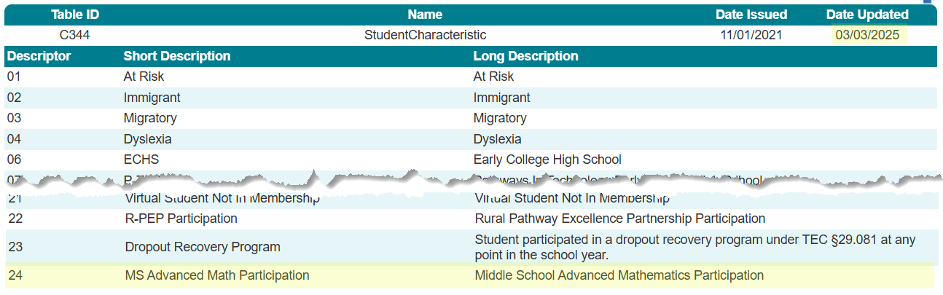
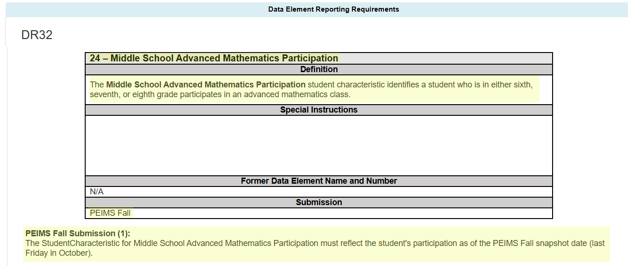
StudentCharacteristic (C344)

Slide 6
MS Advanced Math Data Validation
The following data validation will be added to the PEIMS Fall Submission to only allow the new StudentCharacteristic to be reported for a student in grades sixth, seventh, or eighth:

Slide 7
TITLE SLIDE: Advanced Technical Credit
Advanced Technical Credit
NAME OF COMPONENT (ALL CAPS)
MARCH 19-21, 2024

Slide 8
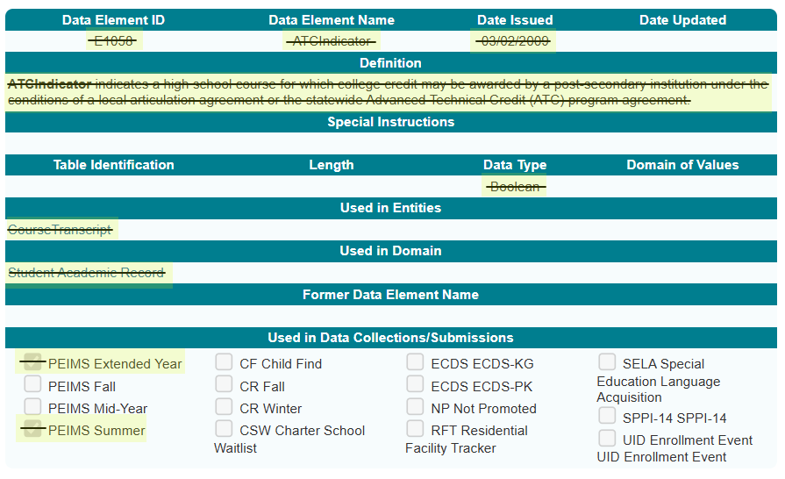
Sunset – Advanced Technical Credit
The Career and Technical Education program area has requested that the Texas Education Agency (TEA) sunset the ATCIndicator (E1058). Perkins V removed funding for the Advanced Technical Credit (ATC) program. The last ATC course was offered during the 2018-2019 school year. The ATCIndicator was collected in the PEIMS Summer and Extended Year Submissions.

Slide 9
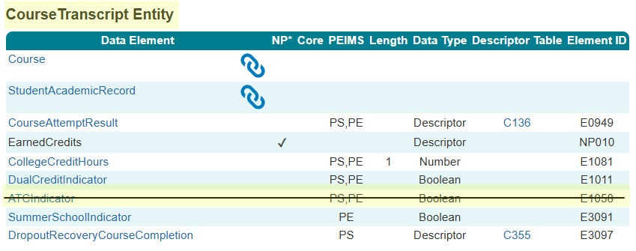
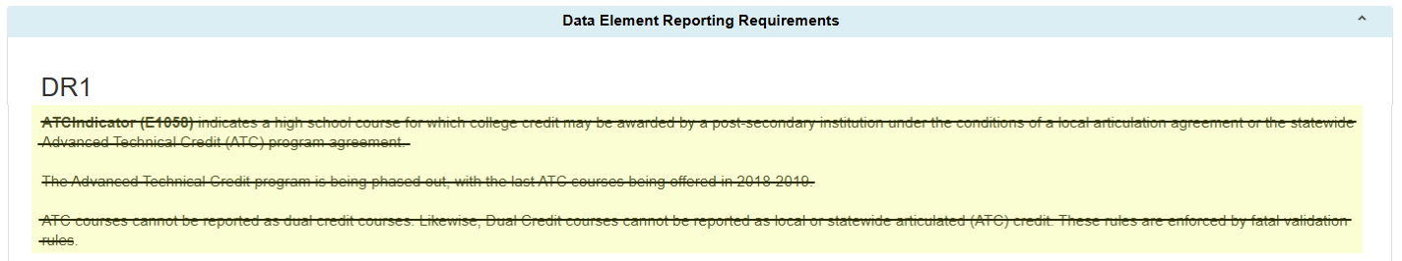
ATC Data Element

Slide 10
ATC Data Validations
The following data validations will be removed from the PEIMS Summer and Extended Year Submissions:

Slide 11
TITLE SLIDE: OnRamps Dual Enrollment Indicator
OnRamps Dual Enrollment Indicator
NAME OF COMPONENT (ALL CAPS)
MARCH 19-21, 2024

Slide 12
OnRamps Dual Enrollment Background
The TEA Performance Reporting Division receives student-level information about OnRamps college course completion, course credit, and credit hours directly from the University of Texas at Austin. TEA cannot determine the secondary course credit given to a student by the local education agency (LEA).
One new data element, OnRampsDualEnrollmentIndicator (E3120), will be added to the CourseTranscript Entity and collected in the PEIMS Summer and Extended Year Submissions for TEA to determine which secondary courses align with specific OnRamps courses.

Slide 13
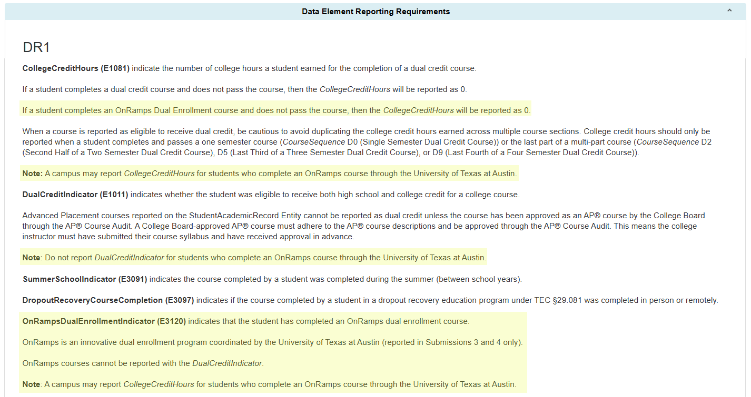
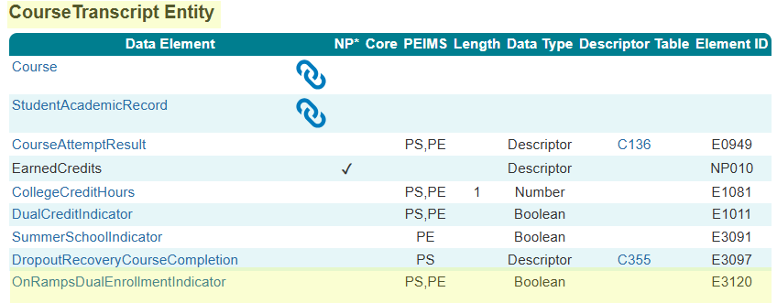
OnRampsDualEnrollmentIndicator

Slide 14
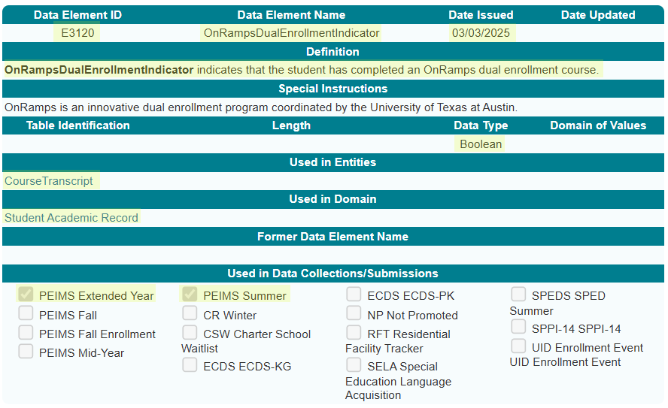
OnRampsDualEnrollmentIndicator Data Element

Slide 15
OnRamps Data Validation
The following data validations will be revised in the PEIMS Summer and Extended Year Submissions:
43415-0037
43415-0050
43415-0051
43415-0052
43415-0057

Slide 16
OnRamps Data Validation 1
The following data validations will be added to the PEIMS Summer and Extended Year Submissions:

Slide 17
TITLE SLIDE: Accelerated Instruction Changes
Accelerated Instruction Changes
NAME OF COMPONENT (ALL CAPS)
MARCH 19-21, 2024

Slide 18
Accelerated Instruction Background
In the 2024-2025 PEIMS Summer Submission, TEA will begin collecting data to identify the accelerated instruction provided by an LEA to a particular student.
Texas Administrative Code, Section 104.1001, was adopted, which approved Ratio Waiver List (RWL) products. These products use automated, computerized, or other augmented methods of instruction, which LEAs can use in place of some or all of the required individual or group instruction.
The Texas Tutoring Supports Division has determined that it is necessary to know which students use a product from the RWL for their accelerated instruction.

Slide 19
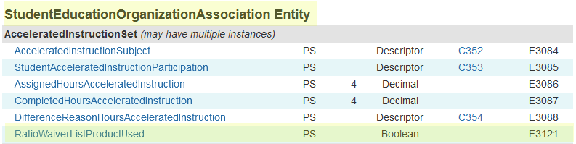
AcceleratedInstructionSet Common Type
One new data element, RatioWaiverListProductUsed (E3121), will be added to the AcceleratedInstructionSet common type in the StudentEducationOrganizationAssociation Entity and collected beginning in the 2025-2026 PEIMS Summer Submission.

Slide 20
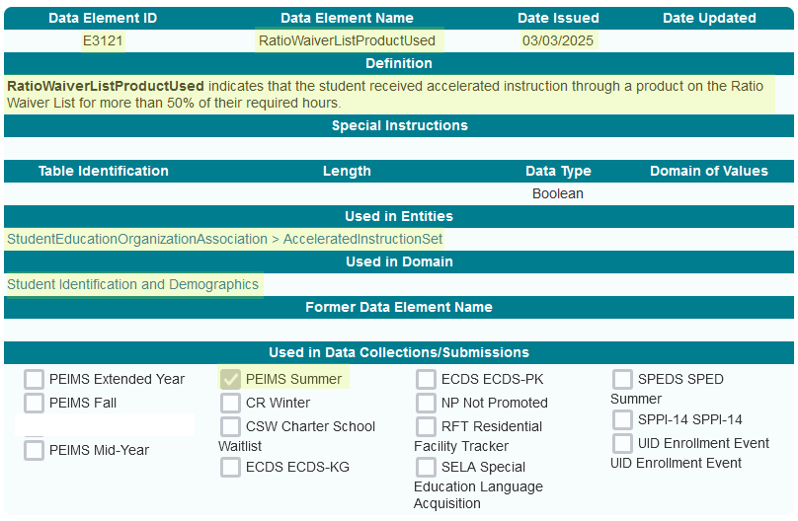
RatioWaiverListProductUsed Data Element

Slide 21
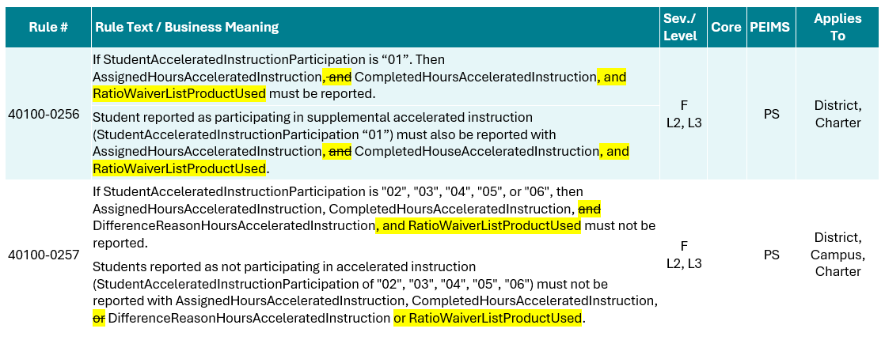
RatioWaiverListProductUsed Data Validation
The following PEIMS Summer Submission data validations will be revised:

Slide 22
TITLE SLIDE: Discipline Changes
Discipline Changes
NAME OF COMPONENT (ALL CAPS)
MARCH 19-21, 2024

Slide 23
Discipline Changes
The Student Discipline Program Specialist audited all discipline-related data components and guidance in the Texas Education Data Standards (TEDS) and the Texas Records Exchange (TREx) Data Standards for accuracy and alignment with Chapter 37 of the Texas Education Code.
The changes on the following slides are the result of the audit.

Slide 24
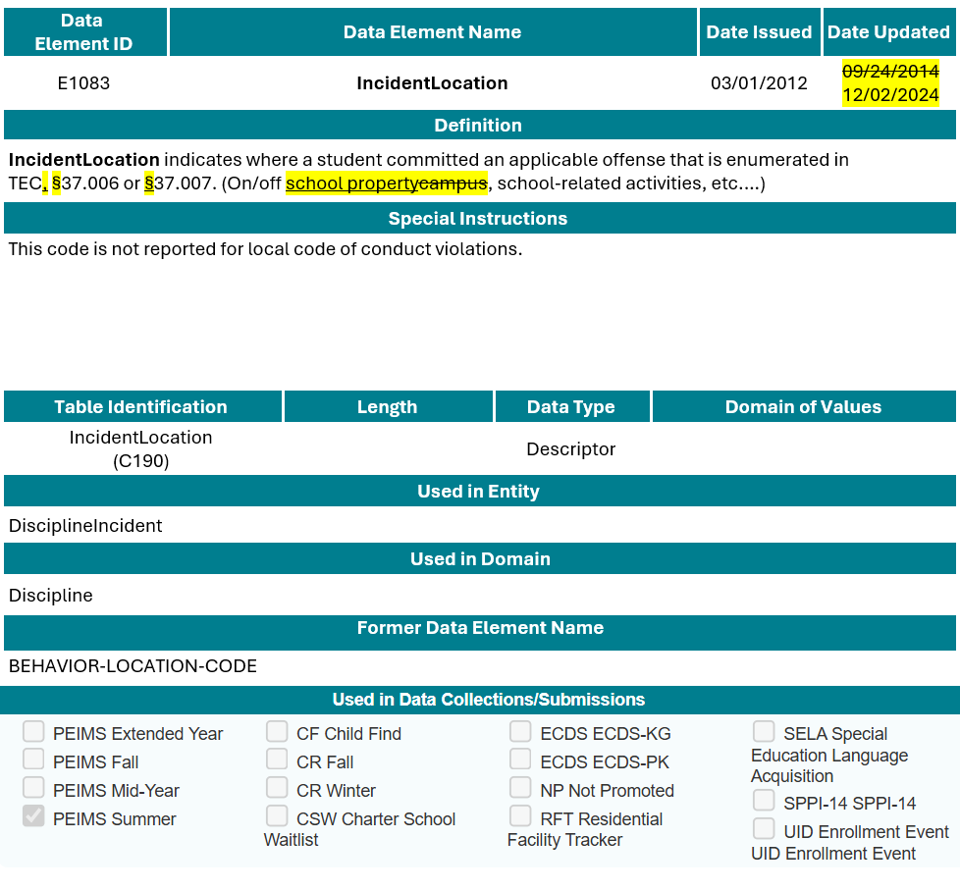
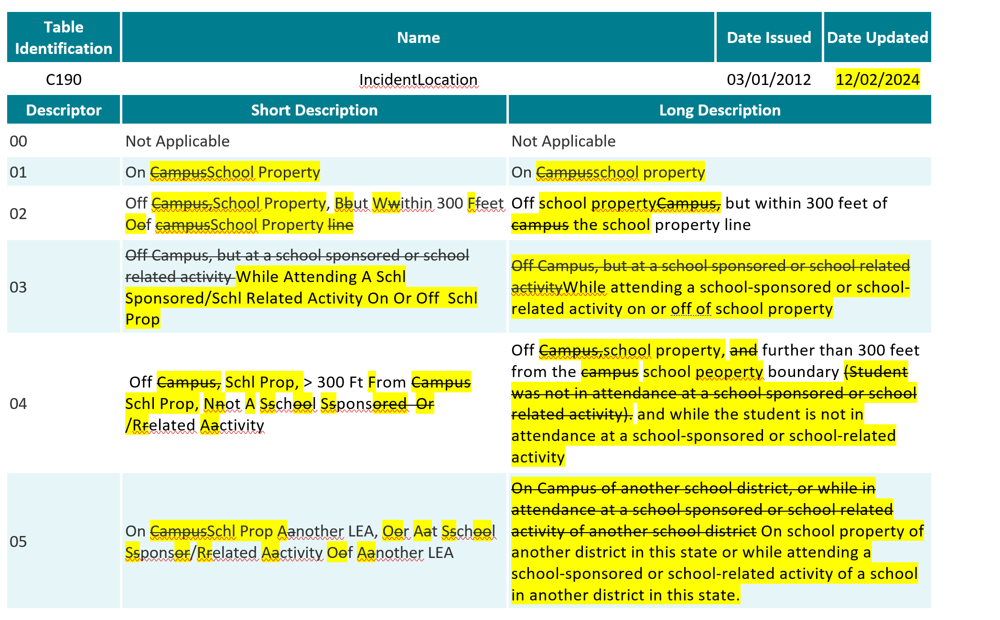
IncidentLocation (E1083)

Slide 25
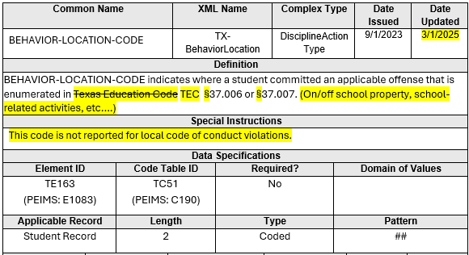
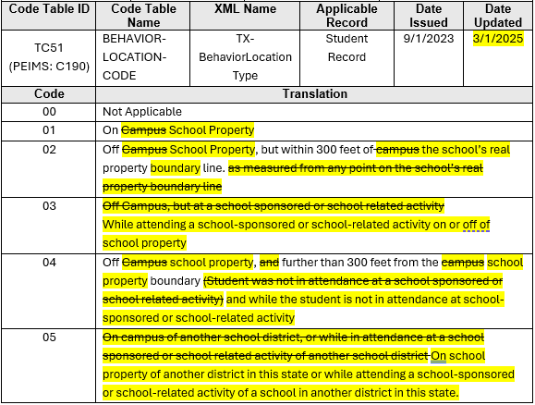
BEHAVIOR-LOCATION-CODE (TE163)

Slide 26
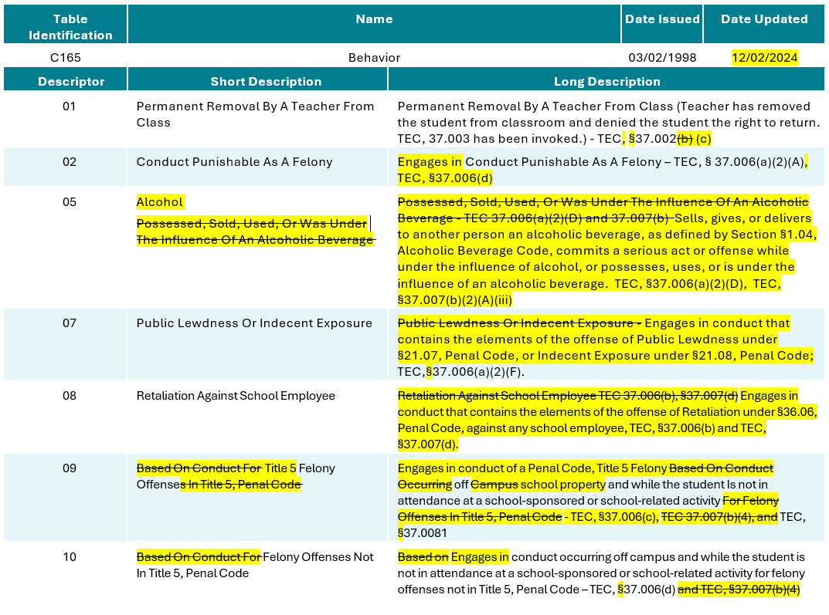
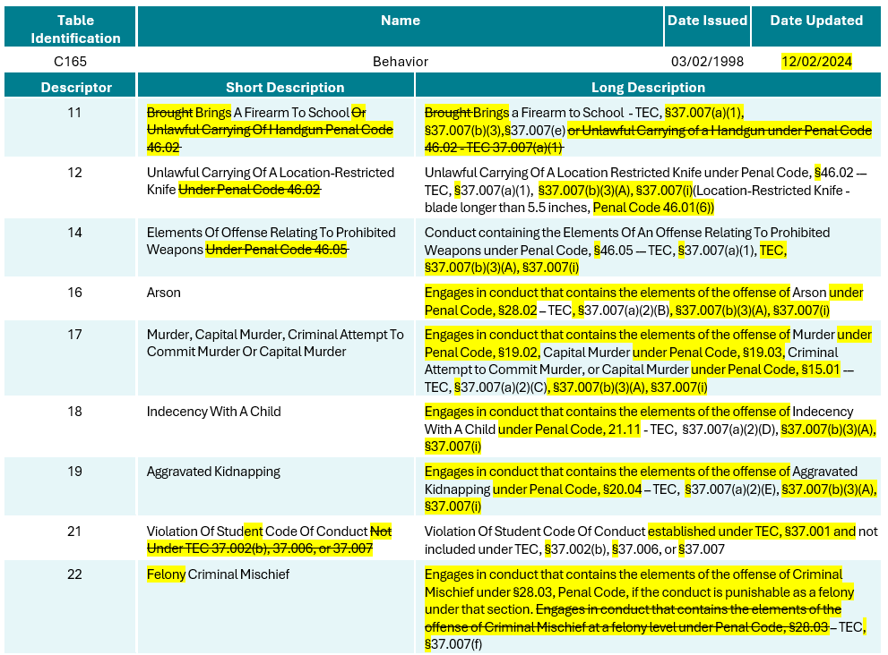
Behavior (C165)

Slide 27
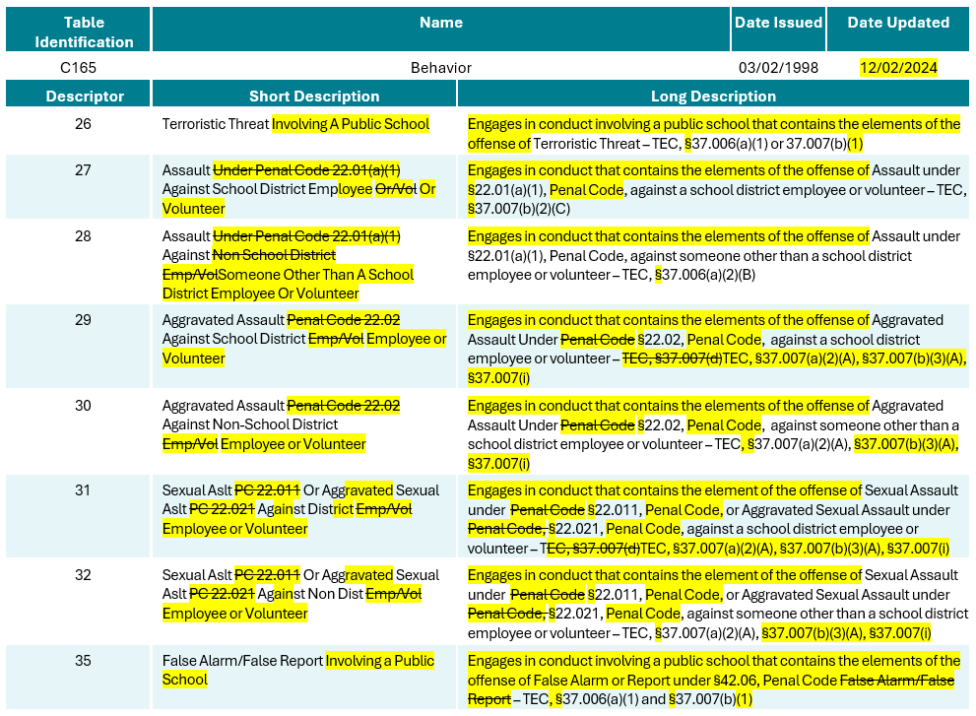
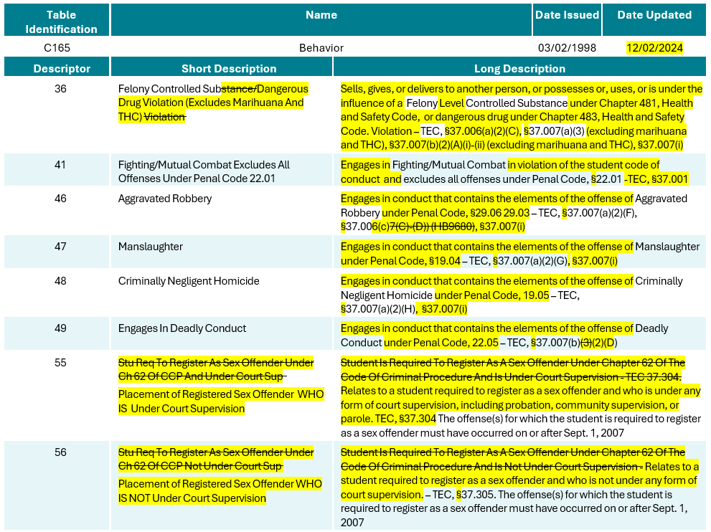
Behavior (C165) 1

Slide 28
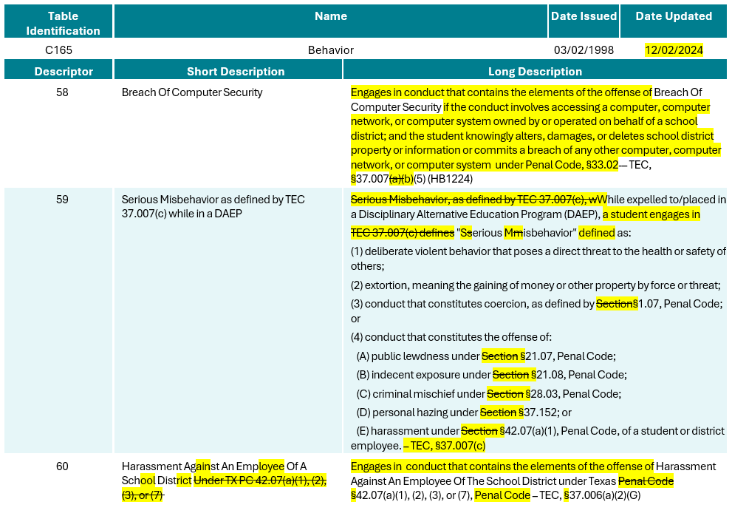
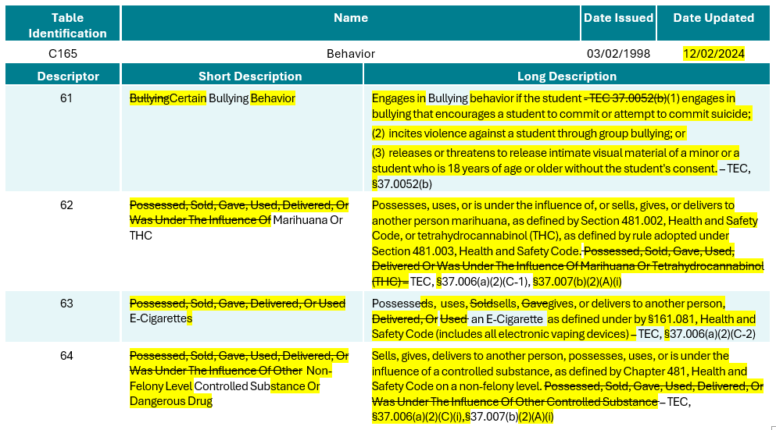
Behavior (C165) 2

Slide 29
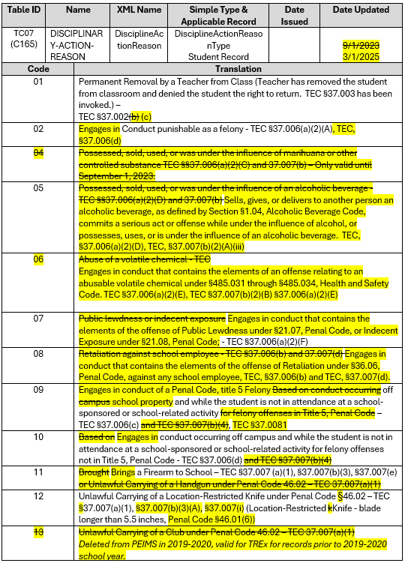
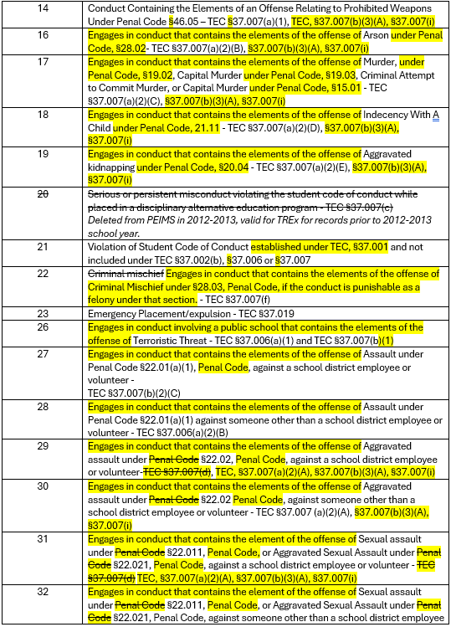
DISCIPLINARY-ACTION-REASON (TC07)

Slide 30
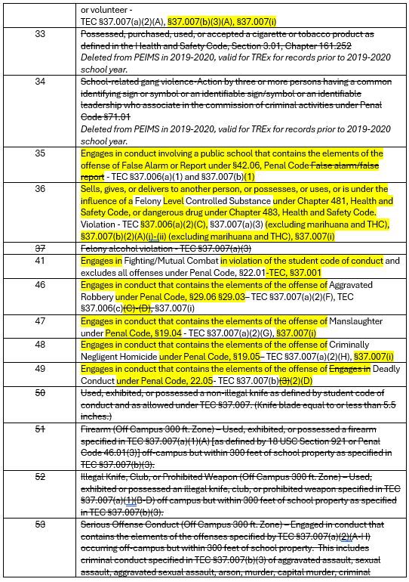
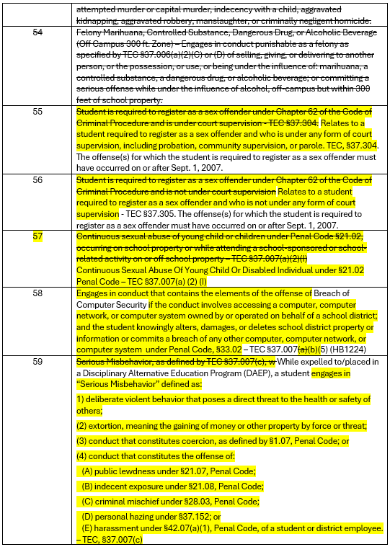
DISCIPLINARY-ACTION-REASON (TC07) 1

Slide 31
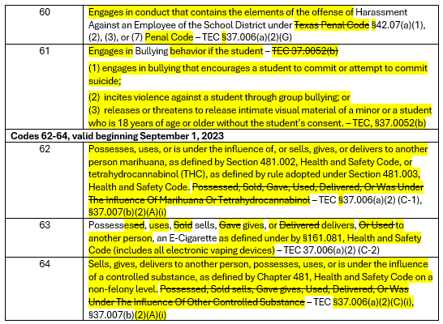
DISCIPLINARY-ACTION-REASON (TC07) 2

Slide 32
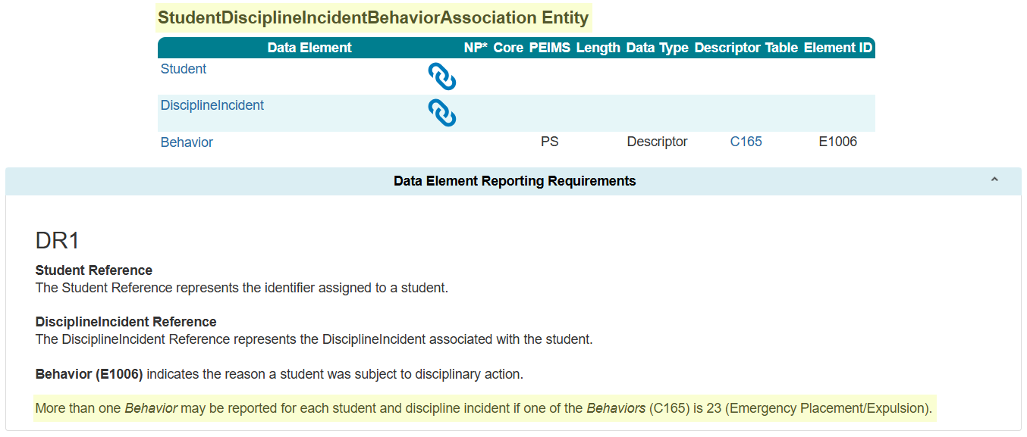
StudentDisciplineIncidentBehaviorAssociation Entity

Slide 33
Discipline Data Validation Changes
The business meanings in the following data validations will be revised in the PEIMS Summer Submission:
44425-0030
44425-0051
44425-0056
44425-0057
44425-0058
44425-0059
44425-0060
44425-0079

Slide 34
TITLE SLIDE: New Classroom Position
New ClassroomPosition
NAME OF COMPONENT (ALL CAPS)
MARCH 19-21, 2024

Slide 35
New Classroom Position
TEA developed the Teacher Residency initiative to address the scale of, access to, and sustainability of high-quality teacher preparation through incentives and support to LEAs and Education Preparation Program (EPP) Partnerships to implement paid teacher residency programs.
The Educator Quality Department has requested that a new ClassroomPosition (C309) descriptor be added to help identify individuals serving as teacher residents. ClassroomPosition (E1454) is reported in the PEIMS Fall Submission, Class Roster Winter Submission, and the Early Childhood Data System Prekindergarten and Kindergarten Submissions.

Slide 36
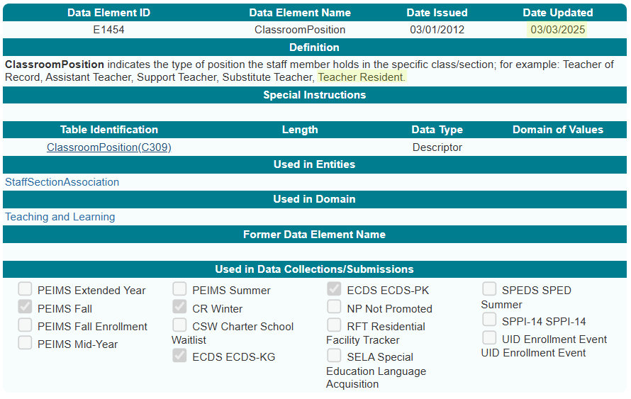
ClassroomPosition Data Element

Slide 37
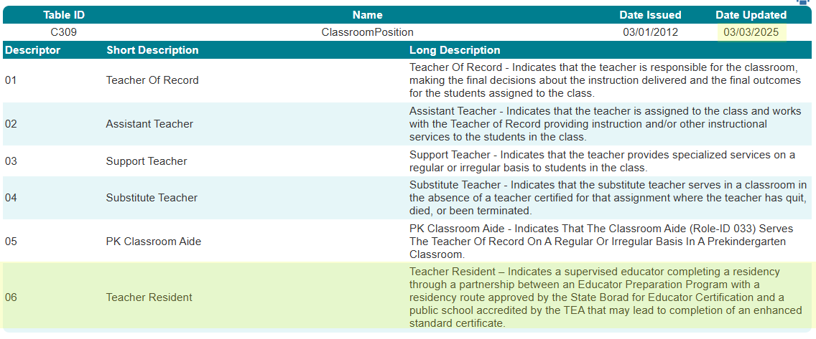
ClassroomPosition Descriptor Table

Slide 38
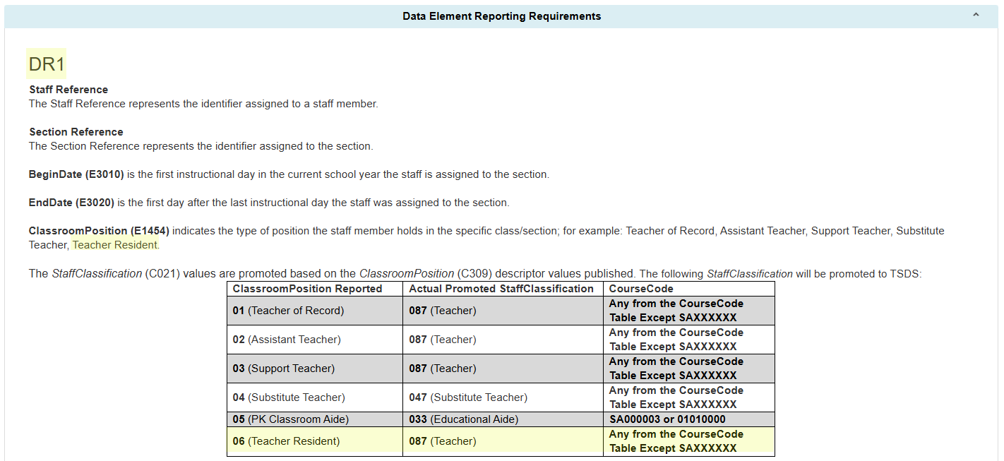
StaffSectionAssociation PEIMS Fall Reporting

Slide 39
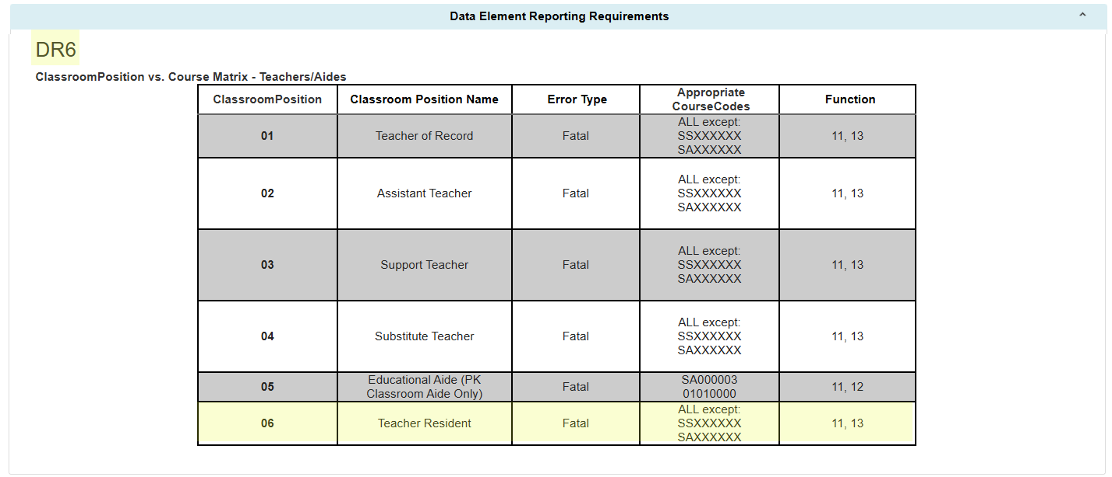
ClassroomPosition vs. Course Matrix

Slide 40
ClassroomPosition Data Validations
The following data validations will be revised in the PEIMS Fall and Class Roster Winter Submissions:
30090-0007
30090-0052
30090-0086
30090-0122
40110-0052
40110-0067
TEA may need to add additional rules to the Early Childhood Data System for the new ClassroomPosition.

Slide 41
TITLE SLIDE: Special Education Changes
Special Education Changes
NAME OF COMPONENT (ALL CAPS)
MARCH 19-21, 2024

Slide 42
Special Education (SPED) Changes
The Special Population Policy, Integration, and Technical Assistance Department audited all special education-related data components in the Texas Education Data Standards (TEDS) and the Texas Records Exchange (TREx) Data Standards for accuracy and alignment with TAC §89.1040 adopted on July 26, 2024. and TAC §89.1070 adopted on November 1, 2024.
As a result of this audit, the program area requested the following language changes:
  Preschool Program for Children with Disabilities (PPCD) to Early Childhood Special Education (ECSE)
  Special Education Students to Students Receiving Special Education Services
  Individualized Education Plan to Individualized Education Program
  Reference to aged 3 through 5 changed to aged 3 through 5 (not in kindergarten)

Slide 43
SPED Data Element Changes
PPCDServiceLocation (E1077)
  Data Element Name (ECSEServiceLocation)
  Definition
SPEDStudentAgeRange (E3059)
  Definition
EligibilityDeterminationDate (E1716)
  Definition
ResidentialFacilityStudentSchoolDayLength (E1637)
  Definition

Slide 44
SPED Descriptor Table Changes
SPEDProgramSvc (C341)
  Short and Long Description – 23-25
PPCDServiceLocation (C184)
  Descriptor Table Name (ECSEServiceLocation)
  Short and Long Description – 1, 3-8
DiplomaType (C062)
  Short and Long Description – 35
PopulationServed (C030)
  Short and Long Description – 06
SPEDStudentAgeRange (C342)
  Short and Long Description – 00, 01, 02

Slide 45
SPED Reporting Requirement Changes
In addition to the specific changes made to the data elements and descriptors, changes were made to the TEDS General Reporting Requirements (GR) and Data Element Reporting Requirements (DR).
StudentSpecialEducationProgramAssociation Entity
  GR1, DR2, DR4, DR7, DR12
StudentSpecialEducationProgramEligibilityAssociation Entity
  DR3
Section Entity
  DR3

Slide 46
SPED Reporting Requirement Changes, Cont.
StudentAcademicRecord
  DR7, DR8, DR9
StaffEducationOrganizationAssignmentAssociation Entity
  DR2
StudentEducationOrganizationAssociation Entity
  DR28

Slide 47
SPED Data Validation Changes
The following data validations will be revised:
30090-0022
30090-0047
30090-0052
30090-0060
30090-0083
30090-0120
30090-0121
40100-0151
40110-0006
40110-0176
41163-0029
41163-0036
42401-0010
42400-0021
45435-0003
45435-0005
50300-0012

Slide 48

QUESTIONS
QUESTIONS?

