Slide 1

TSDS IMPACT:
REPORTING LEAVERS AND GRADUATES July 29-July 31, 2025

Slide 2

Agenda – TSDS Impact: Reporting Leavers and Graduates
Promotion Logic
Data Validation
Reports – Local Education Agency
Reports – Statewide
Next Steps
Questions

Slide 3

Promotion Logic

Slide 4
Every Leaver, Every Time
LEA enters withdraw and graduation data into their SIS
SIS publishes the data to the IODS
TSDS promotes the data into the PEIMS data mart
TEA uses the last submitted data set
Reports reflect the set of data in the data mart

Slide 5

EveryLeaver 2
*and did not re-enroll in the Next School Year
Bolded=Expected Data in Submission

Slide 6
ExitWithdrawType vs AsOfStatusLastDayEnrollment
Non-Graduates
Students who leave during the school year:
Require an ExitWithdrawDate (E3028) and an ExitWithdrawType (E1001).
Typically reported with AsOfStatusLastDayEnrollment (E3006) ‘I’.
Students who do not return in the next school year:
Are considered ‘No Shows’ in the next year and should be determined to be a mover or a leaver.
Typically reported with AsOfStatusLastDayEnrollment (E3006) ‘H’.
Require an ExitWithdrawDate (E3028) and an ExitWithdrawType (E1001) reported in their prior year enrollment data.
Student ends the year with the LEA in the 2025-2026 school year yet does not return in the 2026-2027 school year. E3028 and E1001 should be included in the student’s 2025-2026 school year StudentSchoolAssociation Entity record.

Slide 7

ExitWithdrawType vs AsOfStatusLastDayEnrollment 1
How does your Student Information System (SIS) complete ‘end-of-year’ processes?
When do you assign an ExitWithdrawDate to your AsOfStatusLastDayEnrollment ‘H’ students?
Does your SIS crosswalk a ‘Year End’ local ExitWithdrawType descriptor to a PEIMS reportable (C162) descriptor?
When will those students report as Leavers for the LEA?

Slide 8
Diploma vs GraduationParticipationSet
Graduates
Students who graduate during the year:
Require a Diploma set of data.
The DiplomaAwardDate (E0791) will prompt the system to promote all included data elements.
May have one or more EndorsementCompletedSet to report.
If a student has completed a specific endorsement (C332) and also reports pursuing the same endorsement (C333), the completed will overwrite the pursuing data in the data mart.
Students who graduate after the last day of school:
Require the same data as above, however, the day the data is entered into the system will determine into which submission the data will promote in the PEIMS data mart.

Slide 9
PEIMS Resubmission Protocol
Resubmission eligibility relies on completion of the First Submission
PEIMS SUMR
Leavers
Graduates
PEIMS SUMR Resubmission
Leavers
Leavers
PEIMS EXYR
Graduates
PEIMS EXYR Resubmission
Leavers
Graduates
Graduates

Slide 10
Data Validation

Slide 11
Business Rules & Data Validation
Data Analysis
Update Current Rules
Create New Rules

Slide 12
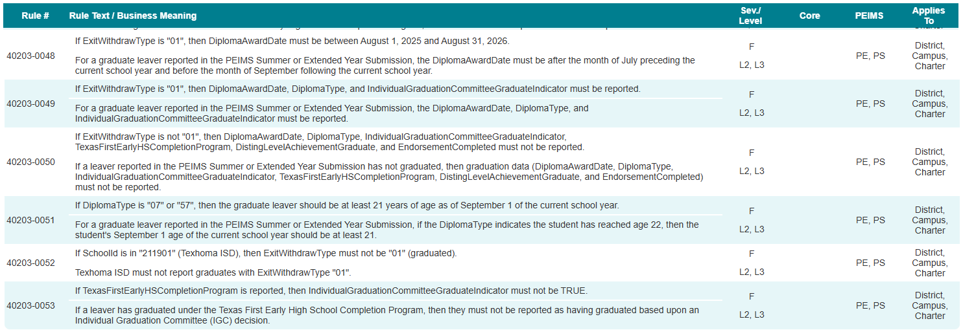
School Leaver Category
New rules added to the PEIMS Summer and Extended Year Submissions:

Slide 13
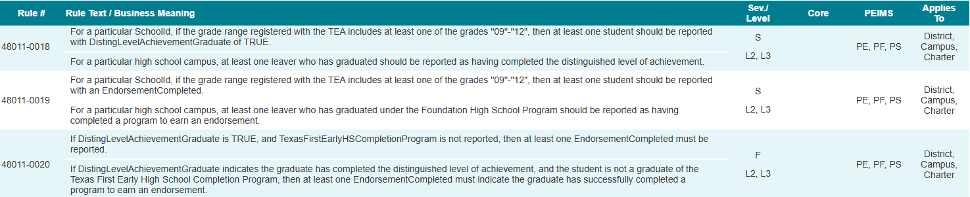
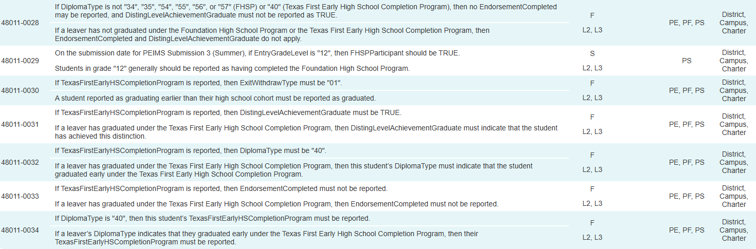
Student Graduation Program Category
PEIMS Fall Submission rules added to the PEIMS Summer and Extended Year Submissions:

Slide 14
Rule Summary
Rules added to the PEIMS Summer and Extended Year Submissions:
40203-0048 (New)
40203-0049 (New)
40203-0050 (New)
40203-0051 (New)
40203-0052 (New)
40203-0053 (New)
48011-0018 (PEIMS Fall)
48011-0019 (PEIMS Fall)
48011-0020 (PEIMS Fall)
48011-0026 (PEIMS Fall)
48011-0030 (PEIMS Fall)
48011-0031 (PEIMS Fall)
48011-0032 (PEIMS Fall)
48011-0033 (PEIMS Fall)
48011-0034 (PEIMS Fall)

Slide 15
Reports – Local Education Agency

Slide 16
Summer Submission Report Changes
The following PEIMS Summer Submission reports will be updated to include the new data collected:
PDM3-120-007 – Student Indicator Report by Grade
The Student Indicator Report by Grade lists students according to various demographics and program enrollment.
PDM3-230-001 – Data Element Summary Report
This report summarizes all data reported. This report provides an analysis of data submitted, including elements, descriptor tables, subcategories, and record counts.

Slide 17
Extended Year Submission Report Changes
The following PEIMS Extended Year Submission reports will be updated to include the new data collected:
PDM4-120-003 – Student Indicator Report by Grade
The Student Indicator Report by Grade lists students according to various demographics and program enrollment.
PDM4-230-001 – Data Element Summary Report
This report summarizes all data reported. The report provides an analysis of data submitted, including elements, descriptor tables, subcategories, and record counts.

Slide 18
Extended Year Submission New Reports
The following PEIMS Summer Submission reports will be added to the PEIMS Extended Year Submission:
PDM3-120-003 – Campus ID of Accountability Roster
This report lists students with a campus ID in the Campus ID of Accountability.
PDM3-120-009 – Student Foundation High School Program Roster by Grade
This report lists students who are in the Foundation High School Program (FHSP) and have a participating code of 1 (pursuing) or 2 (completed).
PDM3-120-019 – Industry-Based Certification Roster
The Industry-Based Certification Roster report displays a student's post-secondary industry certification and licensure information reported.

Slide 19

Fall Reports (Non-Leaver Category) to Summer and Extended Year
Report conversion from Fall to Summer & Extended Year does not equal 1 to 1.
Reports must be analyzed closely to determine applicable leaver/graduate data.
NEW Reports are already in development, and additional new reports are expected to be introduced.

Slide 20
Fall Reports to Summer and Extended Year
The following PEIMS Fall Submission report will be added to the PEIMS Summer and Extended Year Submissions:
PDM1-120-018 – Student Foundation High School Program Graduate Roster
This report lists students who have graduated from the Foundation High School Program (FHSP) under the FHSP graduation plan.

Slide 21
Leaver Reports to Summer and Extended Year
The following leaver reports from the PEIMS Fall Submission will be added to the PEIMS Summer and Extended Year Submissions:
PDM1-124-001 – Dropout Students by Gender, Ethnicity and Grade
This report summarizes dropout students by gender, ethnicity, and grade.
PDM1-124-002 – Dropout Roster
This report lists demographic and program information for dropout students alphabetically by last name and sorted by grade.
PDM1-124-003 – Graduates by Gender, Ethnicity and Graduation Type
This report summarizes graduated students according to sex and ethnicity.

Slide 22
Leaver Reports to Summer and Extended Continued 1
PDM1-124-004 – School Leaver Roster
This report provides a list of all school leavers, arranged alphabetically by name, along with basic information on each student.
PDM1-124-005 – School Leaver Summary
This report summarizes all school leavers in grades 7-12 by leaver reason code.
PDM1-124-006 – Non-Dropout Non-Graduates Leaver Roster
This report lists school leavers, arranged alphabetically by last name, who are not dropouts or graduates.
PDM1-124-007 – Graduate Roster by Graduation Type
This report lists basic information about students who have graduated, arranged alphabetically by last name.
PDM1-220-001 – Graduates Already Reported in Previous Year
This report lists all students who were reported as graduates this year but were also reported last year by any local education agency.

Slide 23

Reports to Compare and Validate
Compare data between submissions.
SUMR 1, SUMR 2, EXYR 1, EXYR2
Validate data at each submission.
Ensure accuracy in the final data set used by TEA divisions.

Slide 24
Reports - Statewide

Slide 25

Underreported Reports
Further analysis is underway:
PDM1-320-001
Interim List to Assist LEAs in Leaver Record Submission
PDM1-320-002
Preliminary Presumed Underreported Students List
PDM1-321-001
Presumed Underreported Students List

Slide 26
Leaver Status Hierarchy*
Status: | Determined by:
Graduate | Leaver records (reason code = 01)
Previous graduate | TSDS PEIMS graduate database
Not a leaver | Enrollment records (enrolled in school-start window in fall)
Mover | Attendance and enrollment records
Other leaver | Leaver records (reason code = 03, 16, 24 through 87, 90)
TxCHSE recipient | TxCHSE database
Dropout^{b} | Leaver records (reason code = 08, 20, 88, 89, 98)
Underreported^{c} | Record required but not submitted
*Slide from Spring Training Leaver Reconciliation (Step 4) by Division of Research and Analysis
^{b}Student becomes a dropout in annual dropout rate and possibly in longitudinal rate.
^{c}Student becomes underreported in annual rate and possibly in longitudinal rate.

Slide 27
TEA Reconciliation

Slide 28
Duplicate Student Reports
PDM1-403-001 – Duplicate Student Report for Enrollment and Graduates
This report lists all students submitted on an enrollment or graduate record by more than one LEA in the state.
Duplicate Graduate Under Analysis

Slide 29
Next Steps

Slide 30

Where Do We Go from Here?
New TEDS Guidance
Review thoroughly
C162 Descriptor Code ‘98’ = Other
Did not re-enroll within the school-start window
Leaver Legwork
Start early, look often
Work 12th grade down to 7th
AsOfStatusLastDayEnrollment ‘H’ = the LEA is the steward
Feedback on areas with further questions
Reason for leaving is unknown
Final ‘98’s are considered dropouts

Slide 31

Questions on the Horizon
Underreported student validation
‘No Show’ recovery
Migrant student tracking and recovery
“At Risk” students when reported at submission as ‘98-other’
Enrollment Tracking
via API process
reports to help in leaver legwork
Orphaned records when leaver is recovered to mover

Slide 32

QUESTIONS
QUESTIONS?

