Slide 1

TITLE SLIDE: Data Standards Changes
TECHNICAL SESSION July 31, 2025
<NAME OF COMPONENT> (ALL CAPS) MARCH 19-21, 2024

Slide 2

Agenda – Technical Session
2025-2026 Guidance
Helpful Reminders
Technical Resources
TSDS Compatible Designation
2024-2025 Accomplishments
2025-2026 Process Changes
Next Steps
Close Out
Tiered Support
Technical Forum

Slide 3

2025-2026 Guidance
2025-2026
Guidance

Slide 4
IODS: Multi-Year Availability
Reminder from Previous Guidance
For LEAs that will be submitting for the PEIMS Extended Year Submission, there will be an overlap with the opening of the 2025-2026 school year.
Due to this overlap, vendors should expect to publish data to multiple IODSs during the crossover summer months. Refer to the dates below for additional guidance:
August 4, 2025
The IODS/API for the 2025-2026 school year is available.
August 28, 2025
PEIMS Extended Year Submission is due.
September 18, 2025
PEIMS Extended Year Resubmission is due.

Slide 5
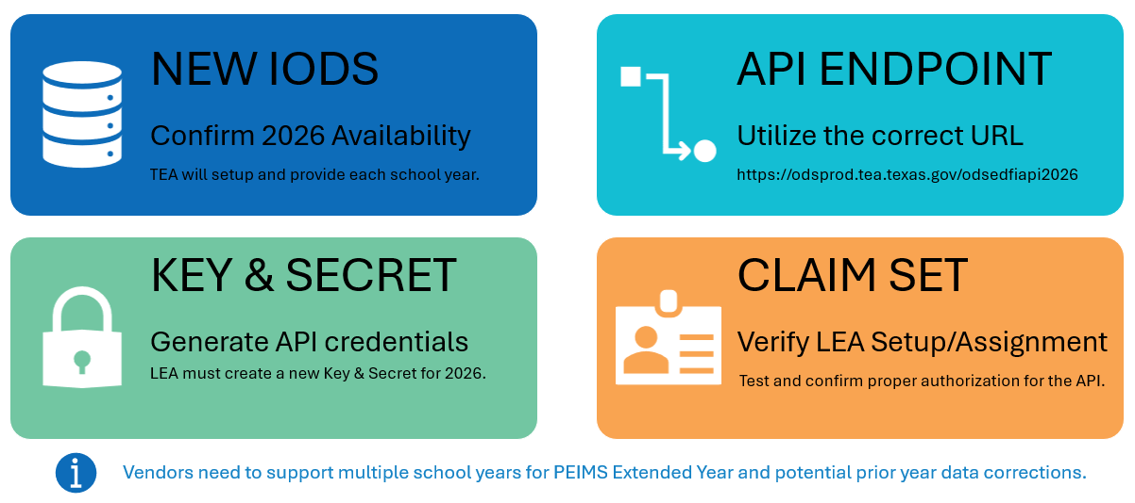
2025-2026: Reminders

Slide 6
2025-2026: Claim Set Updates
Full CRUD permissions added unless otherwise noted
PriorYearSSAOrgAssociationExt
PriorYearSSATypeDescriptor
Finance Vendor
HR/Finance Vendor
AdultPreviousAttendanceDescriptor
SIS/HR/Finance Vendor
SIS Vendor
SIS Vendor with Staff Profiles
SIS/HR/Finance Vendor
EntrySkillsRatingDescriptor
Read-Only All Resources (read access)
SIS Vendor
SIS Vendor with Staff Profiles
SIS/HR/Finance Vendor
ECSEServiceExitReasonDescriptor
Read-Only All Resources (read access)
SIS Vendor
SIS Vendor with Staff Profiles
SIS/HR/Finance Vendor
ExitSkillsRatingDescriptor
Read-Only All Resources (read access)
SIS Vendor
SIS Vendor with Staff Profiles
SIS/HR/Finance Vendor
ARDInvitedRepresentativeDescriptor
Read-Only All Resources (read access)
SIS Vendor
SIS Vendor with Staff Profiles
SIS/HR/Finance Vendor
Read-Only All Resources (read access)
Read-Only All Resources (read access)

Slide 7

2025-2026: Rate Limiting
No Changes Expected
Five tokens per 30 minutes will remain in effect for this school year.
Error 429 “Too many requests” will continue to be thrown when more than five tokens are requested within the allowed time.
There continues to be no limit on how many requests can be sent with the same token.

Slide 8


2025-2026 Software Development Kit (SDK)
Version 2026.2.0
Will be based upon:
TEDS 2026.2.0 published on July 1, 2025.
Will include updates to:
TEA Ed-Fi Handbook
TSDS MetaEd resources
Tentatively scheduled for:
August 8, 2025
Future 2025-2026 updates to the SDK may be released

Slide 9

2025-2026: Sandbox Environment
Tentatively Scheduled for August 4, 2025
Sandbox environment for vendors to test their product updates with a limited set of LEAs.
It will be in sync with the Production environment in terms of API, validations, and downstream apps.
Vendors should continue to utilize the SDK resource for development purposes.
TEAL ACCESS
The vendor applies for the necessary access to TSDS applications through TEAL with a specific LEA organization.
KEY & SECRET
The vendor generates the key and secret via the DMC application to utilize for all transactions into the Sandbox IODS.
PRODUCTION DATA
The vendor is responsible for the publication, deletion, and management of all data sent to the Sandbox IODS.
TSDS APPLICATIONS
The vendor can access the DMC, PEIMS, and Core applications to view validations and verify data promotions for all submissions.
Need Help: TSDS Vendor Support Portal

Slide 10
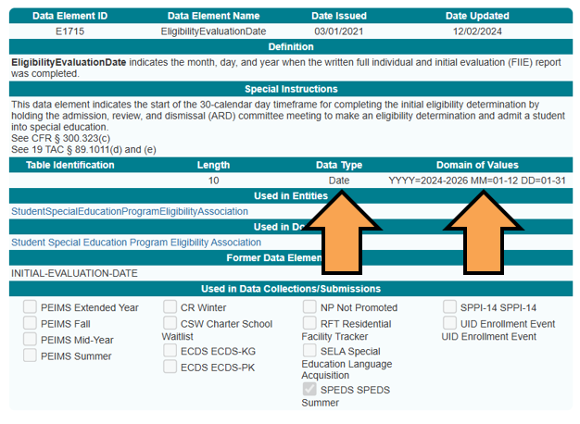
2025-2026: Level 1 Date Range Validations
Domain of Values
Starting with the 2025-2026 school year, the API will enforce the Domain of Values for Entities with Data Type = “Date”.
Any date published outside of the stated Domain of Values will result in a Level 1 (API) error.
Valid Entry: “2024-01-30”
Invalid Entry: “2028-01-30”
Need Help: TSDS Vendor Support Portal

Slide 11
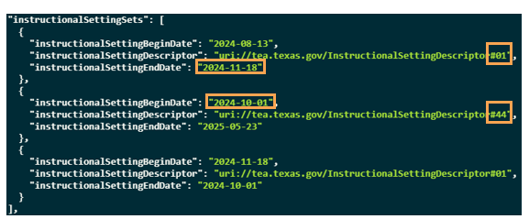
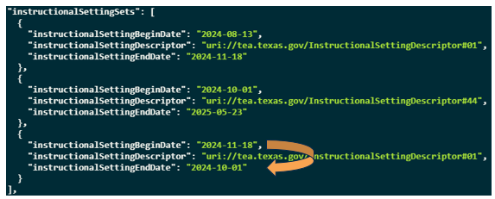
2025-2026: Begin & End Dates Within Sets
Example: StudentSpecialEducationProgramAssociation
Issue 1: Overlapping and Conflicting Date Ranges:
There is an overlapping date range, so it is unclear whether the student was in instructional setting #01 or #44 on the snapshot date (October 25, 2024). In this example, #44 is promoted due to having the ‘latest’ Begin Date.
Issue 2: Incorrect Date Range:
The end date comes before the begin date, which is invalid.
Vendors should be aware of these types of potential data scenarios and strive to address them within their product solutions whenever feasible. Failure to do so may necessitate complex changes to promotion logic in TSDS, which can degrade system performance and increase the time required to support or guide end users.
Need Help: TSDS Vendor Support Portal

Slide 12

TSDS Compatible Designation
TSDS Compatible
Designation

Slide 13

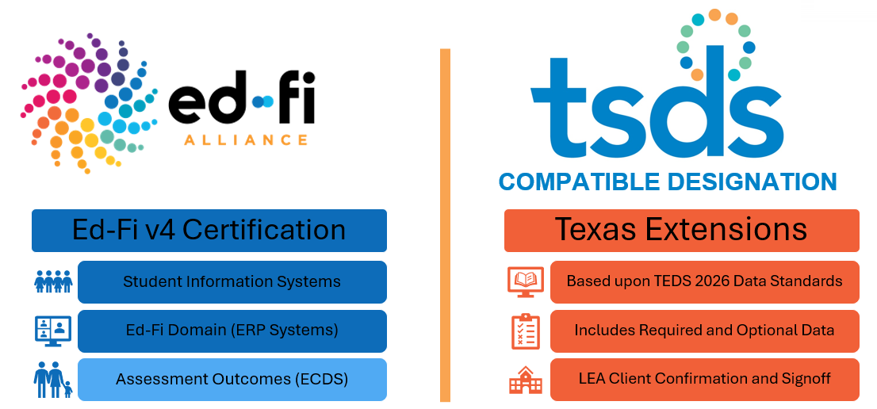
Vendor Certification & Designation

Slide 14
TSDS Compatible Designation Deferment
Previously Announced on May 22, 2025
Upon consulting with the Vendor Compatible Designation Council (VCDC), TEA has made the decision to defer the official designation of vendor products until the 2025-2026 school year.
TEA greatly appreciates the commitments of our VCDC members during this Go-Live year. Their efforts have been vital to identifying potential issues and serving as a liaison between TEA and their vendor partners.

Slide 15
Vendor Compatible Designation Council (VCDC)
DATA VERIFICATION
Participants assisted in confirming data was appropriately landing in the IODS and promoting to PEIMS and Core Data Marts as expected.
ISSUE RESOLUTION
Participants worked closely with vendors to resolve issues, assisting all users of their product.
Participants collaborated with TEA staff to ensure TSDS validations were correctly firing and reports accurately reflected their data.
TEA CONFIRMATION
Remaining Activities
PEIMS Extended Year Sub-committee
Decommission
Meetings & TEAMS Channels
Open Data Use Agreements

Slide 16

Shout Out to All Participants Involved
Assisted with early detection of:
HR record dates that impacted snapshot data
Accelerated hours assigned to students who will not be completing
Calendar & ReportingPeriodExt dependencies
Extended Year services promotion gaps
Issue reporting and enhancements:
TIMS Type | # Reported
Enhancement Requests | 21
Problem | 542
Question | 59
User Request | 431
Grand Total | 1053

Slide 17
2025-2026 Expectations for TSDS Designation
Vendor Driven
Ed-Fi Certification
Technical Best Practices
LEA and TEA Signoff
TSDS
Submission & Product Based
Each applicable TSDS data submission will be verified by LEA partners and TEA throughout the year.
Diverse
LEA Partners & Implementations
Vendors will be responsible for the selection of LEA partners to effectively represent their client base and implementations.
Continuous
Verification & Renewal
Vendors will be responsible for submitting all required LEA confirmation form(s) to be awarded a TSDS Compatible Designation. TEA may require vendor renewal in the future.

Slide 18

Next Steps for Vendors
TEA will provide a dedicated webinar with more information and details on requirements:
Expected to be scheduled in September or October 2025
Begin to identify your LEA partnerships for submissions.
Ensure your product(s) have obtained an Ed-Fi v4 Certification.

Slide 19

Closeout
Closeout

Slide 20
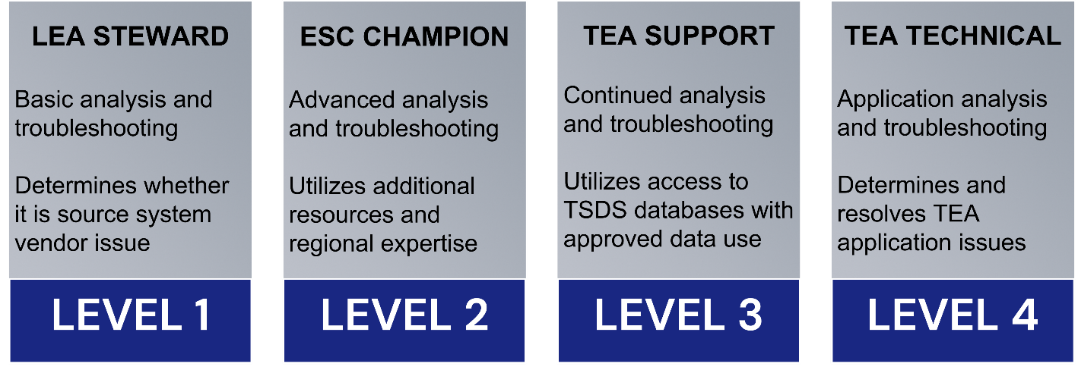
Supporting LEAs in 2025-2026
Tiered Support Model
To ensure a successful 2024-2025 Go-Live school year, TEA provided direct support and interaction with LEAs across the state, as needed.
Starting with the 2025-2026 school year, TEA will return to our official Tiered Support Model and all issues be routed through TIMS.
Vendors are encouraged to utilize:
TSDS Vendor Support Portal
TSDSCustomerSupport mailbox

Slide 21

We Need Your Feedback…
Based upon your experience in the 2024-2025 Go-Live year:
What is one thing that TEA should consider to ensure a successful 2025-2026 year?

Slide 22
Technical Resources
What additional technical resources or support is needed by your development or support teams?

Slide 23
Technical Communication
What additional communications should TEA consider to best support you and/or your LEAs?

Slide 24

QUESTIONS
QUESTIONS?

