Slide 1

SPECIAL EDUCATION DATA SYSTEM
SUMMER SUBMISSION
July 29 – July 31, 2025

Slide 2


AGENDA – SPECIAL EDUCATION DATA SYSTEM
New Collection
SPPI-7
SPPI-11 & SPPI-12
SPPI-13
Data Validation
Access Data
Wrap Up
Questions
Reference Slides
SPEDS

Slide 3

THE NEW COLLECTION

Slide 4
BACKGROUND ON THE NEW COLLECTION 3
Federal Mandate
SPP/APR
Indicators
Individuals with Disabilities Act (IDEA) ensures students with disabilities receive a free appropriate public education (FAPE) in the least restrictive environment (LRE).
IDEA Part B requires states to develop a State Performance Plan (SPP) with an Annual Performance Report (APR).
IDEA requires states to develop a State Performance Plan (SPP) and annually report on 18 indicators in the Annual Performance Report (APR).
Some indicators measure compliance with IDEA requirements and others measure child and family outcomes.
SPEDS data is submitted by local education agencies (LEAs).

Slide 5

PROGRAM AREA CONTACTS
Donna Holmes
Jeremy McCaig
  SPP@tea.texas.gov

Slide 6
DATA COLLECTION - OVERVIEW
The following students will be collected in the new SPEDS Summer Submission:
  SPPI-7: children aged 3-5 (not in kindergarten) who receive ECSE services for six months or more during the school year. Collected at exit from ECSE services.
  SPPI-11/12: previously collected through the TSDS Child Find Submission;
    11a: children aged 3-21 initial evaluation for special education services,
    11b: the resulting eligibility determination leading to development of an IEP, or
    12: children who have an IEP developed and implemented by their third birthday.
  SPPI-13: all children with an IEP aged 16 up to age 21.
The annual data collection period occurs from July 1 to June 30.
Resources

Slide 7
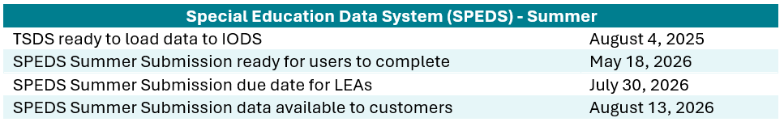
TIMELINE – 2025-2026 SCHOOL YEAR
TSDS Core Application will be available for running Level 2 Validations, Promotion, and Validation of data starting on September 15, 2025.

Slide 8

TEAL ROLES AND PRIVILEGES CONT.
Each of the TSDS Core roles listed above currently have a “Child Find Access” privilege.
Renaming to "SPEDS Summer Access"
Targeting Mid-August
Current access will transfer automatically – no need to reapply

Slide 9
Promotion Logic SPEDS Summer
SPEDS will consist of Students
  Ages 3 to 21
  AND
    With an Eligibility Determination date between 7/1 – 6/30 (SPPI-11/12)
  OR
    Students served in Special Education
    AND
      Exited from Early Childhood Special Education (ECSE) between 7/1 – 6/30 (SPPI-7)
    OR
      At least 16 years old by 6/30 of the current school year (SPPI-13)

Slide 10
Promotion Logic SPEDS Summer 2

Slide 11
LEA-Level NEW Data Elements
PreschoolOutcomesReporting (E3098)
TimelyInitialEvaluationReporting (E3126)
EarlyChildhoodTransitionReporting (E3127)
SecondaryTransitionReporting (E3128)
SPEDS Summer will be submitted by ALL LEAs.
PreschoolOutcomesReporting was formerly found on the School Entity as a descriptor. (2026.1.1 TEDS Update)
These four Boolean data elements will allow the LEA to verify when they do NOT have data for a particular collection.
Resources

Slide 12
SPPI-7

Slide 13
SPPI-7 Data Elements
StudentEarlyChildhoodOutcomesEntrySet
ECSESocialEmotionalEntrySkillsRating
ECSEKnowledgeEntrySkillsRating
ECSEAppropriateFunctioningEntrySkillsRating
StudentEarlyChildhoodOutcomesExitSet
ECSEServiceExitReason
ECSESocialEmotionalExitSkillsRating
ECSEExitSocialEmotionalNewSkills
ECSEKnowledgeExitSkillsRating
ECSEExitKnowledgeNewSkills
ECSEAppropriateFunctioningExitSkillsRating
ECSEExitAppropriateFunctioningNewSkills
Resources

Slide 14
Promotion Logic SPPI-7

Slide 15
REPORTS
SPD0-107-001 Preschool Outcomes Student Roster
SPD0-107-002 Student Progress Measure Summary
SPD0-111-001 SPPI-11 Student Compliance Report (formerly CHF0-100-001)
SPD0-111-002 SPPI-11 Aggregate Report (formerly CHF0-100-003)
SPD0-111-003 SPPI-11 Calculations Report (formerly CHF0-100-005)
SPD0-112-001 SPPI-12 Student Compliance Report (formerly CHF0-100-002)
SPD0-112-002 SPPI-12 Aggregate Report (formerly CHF0-100-004)
SPD0-113-001 Secondary Transition Student Roster and Compliance
SPD0-113-002 Secondary Transition Compliance Data

Slide 16
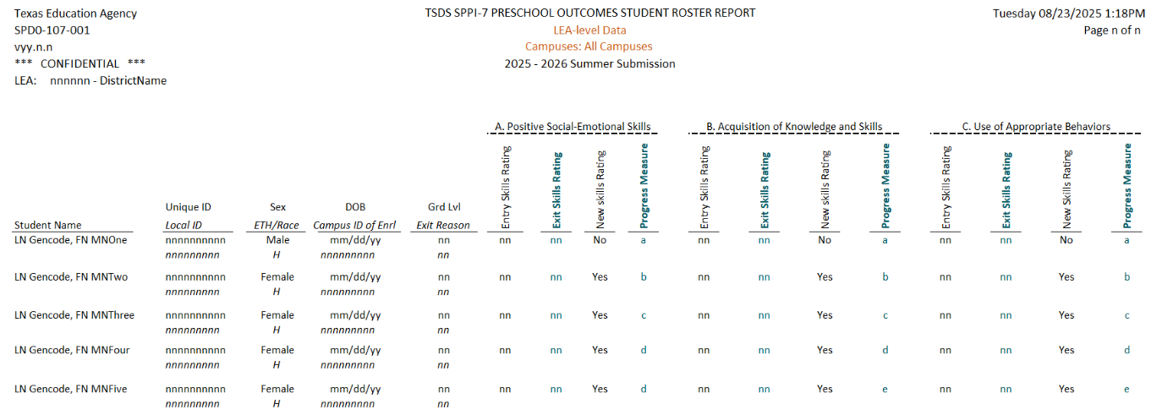
SPD0-107-001 Preschool Outcomes Student Roster

Slide 17
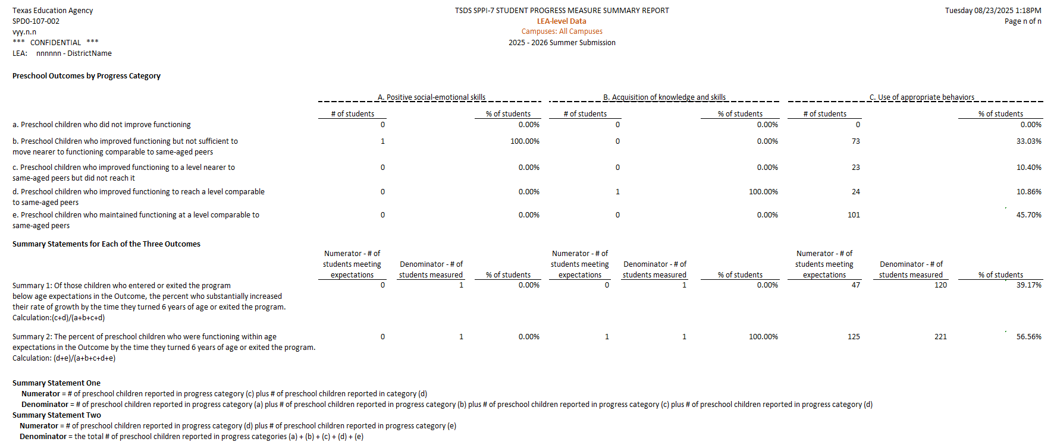
SPD0-107-002 Student Progress Measure Summary
Section 1

Slide 18
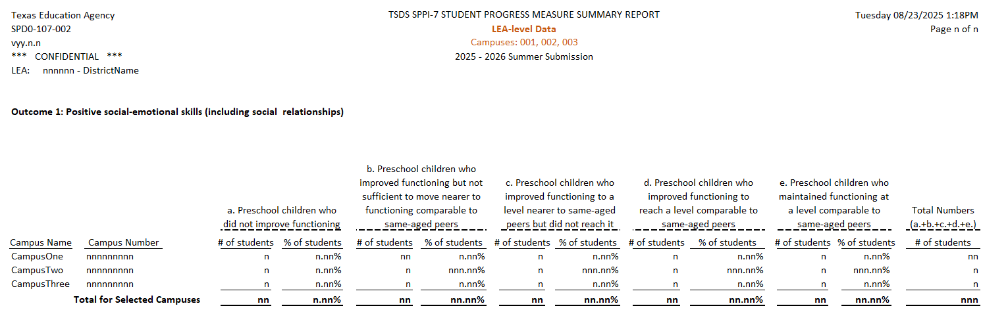
SPD0-107-002 Student Progress Measure Summary b
Section 2

Slide 19
SPPI-11 & SPPI-12

Slide 20
SPPI-11 & SPPI-12
StudentSpecialEducationProgramEligibilityAssociation
ConsentToEvaluationReceivedDate
EligibilityEvaluationDate
EvaluationDelayDays
EvaluationDelayReason
EligibilityDeterminationDate
IDEAIndicator
EligibilityDelayReason
OriginalECIServicesDate
TransitionNotificationDate
TransitionConferenceDate
StudentEducationOrganizationResponsibilityAssociation
Resources

Slide 21
PROMOTION LOGIC SPPI-11 / SPPI-12

Slide 22
REPORTS 2
SPD0-107-001 Preschool Outcomes Student Roster
SPD0-107-002 Student Progress Measure Summary
SPD0-111-001 SPPI-11 Student Compliance Report (formerly CHF0-100-001)
SPD0-111-002 SPPI-11 Aggregate Report (formerly CHF0-100-003)
SPD0-111-003 SPPI-11 Calculations Report (formerly CHF0-100-005)
SPD0-112-001 SPPI-12 Student Compliance Report (formerly CHF0-100-002)
SPD0-112-002 SPPI-12 Aggregate Report (formerly CHF0-100-004)
SPD0-113-001 Secondary Transition Student Roster and Compliance
SPD0-113-002 Secondary Transition Compliance Data

Slide 23
SPPI-13

Slide 24
SPPI-13 Data Elements
StudentSecondaryTransitionSet
SecondaryTransitionIEPReviewDate
MeasureableSecondaryGoals
UpdatedSecondaryGoals
TransitionAssessment
IEPTransitionServices
CoursesStudySecondaryGoals
TransitionServiceNeeds
ARDInvitedStudent
ARDInvitedRepresentative
SecondaryTransitionARDMeetingDate

Slide 25
PROMOTION LOGIC SPPI-13

Slide 26
REPORTS3
SPD0-107-001 Preschool Outcomes Student Roster
SPD0-107-002 Student Progress Measure Summary
SPD0-111-001 SPPI-11 Student Compliance Report (formerly CHF0-100-001)
SPD0-111-002 SPPI-11 Aggregate Report (formerly CHF0-100-003)
SPD0-111-003 SPPI-11 Calculations Report (formerly CHF0-100-005)
SPD0-112-001 SPPI-12 Student Compliance Report (formerly CHF0-100-002)
SPD0-112-002 SPPI-12 Aggregate Report (formerly CHF0-100-004)
SPD0-113-001 Secondary Transition Student Roster and Compliance
SPD0-113-002 Secondary Transition Compliance Data

Slide 27
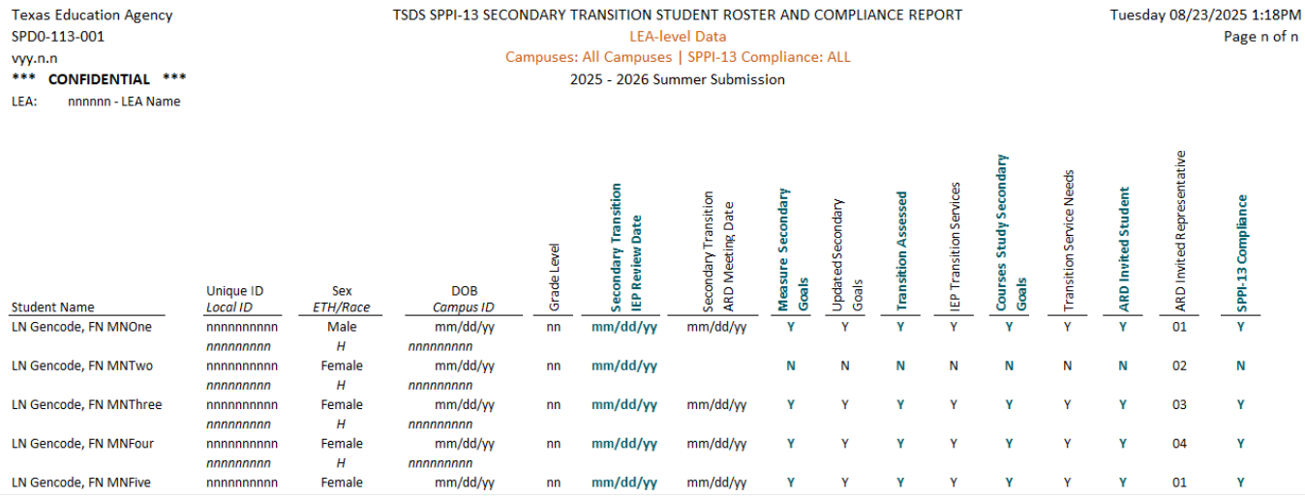
SPD0-113-001
Secondary Transition Student Roster and Compliance Report

Slide 28
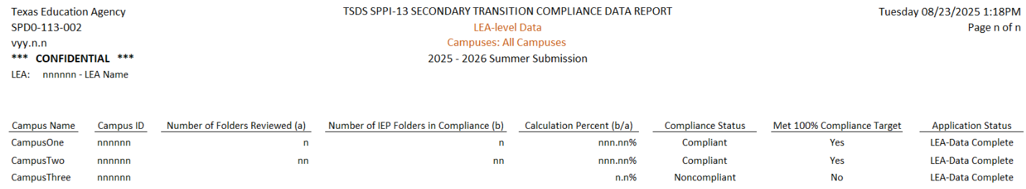
SPD0-113-002
Secondary Transition Compliance Data Report
Notes:
ASK ProgArea about redundant Compliance Status and Met 100% comp target columns

Slide 29
DATA VALIDATION

Slide 30
DATA VALIDATION – NEW
FATALS
LEA Level | 10010-0025 10010-0026 10010-0027 10010-0028 | 10010-0029 10010-0030 10010-0031 10010-0032
Student Level | None
SPECIAL WARNINGS
LEA Level | None
Student Level | 41163-0104 41163-0106
LEA-Level fatals refer to reporting TRUE or FALSE for the four new LEA data elements (E3098, E3126, E3127, E3128).
  IMPORTANT: Reporting TRUE for these elements is the LEA’s way to verify that they will NOT be submitting data for that specific SPP Indicator.
Resources

Slide 31
DATA VALIDATION - CHANGED/UPDATED
FATALS
Student Level | 40100-0221
SPECIAL WARNINGS
Student Level | 40100-0223
The majority of the rules updates for 2025-2026 are updating ‘Child Find’ to ‘SPEDS’ and moving the rule into the SPEDS Summer Submission.
Resources

Slide 32
ACCESS DATA

Slide 33
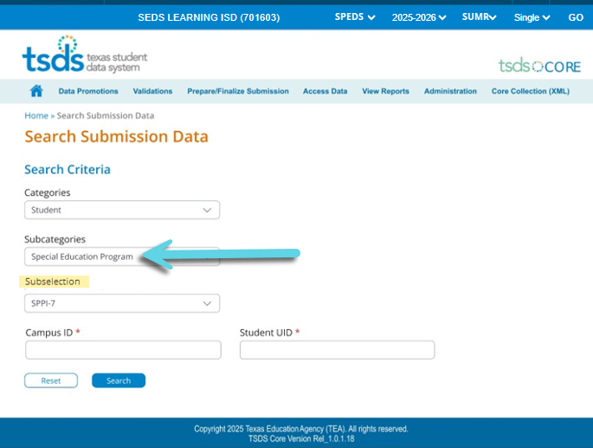
Access Data>Search Submission Data
Subcategories available for Subselection:
Student Enrollment (School Association)
Student Basic
Special Education Program

Slide 34
THE WRAP UP

Slide 35
PLAN TO BE SUCCESSFUL
ESC
Vendor(s)
Attend Training
Stay Current
Actionable data throughout the year
Level 2 Validations
Many rules are data element based and will catch early errors.
Promote & Validate Data
Schedule monthly or each Six Weeks Reporting Period.
Data due in July
Program Area is able to run these to validate their data.

Slide 36
PREPARE FOR THE UNEXPECTED
Data Origin?
What is the Source of Truth?
Student Information System (SIS)
Missing Data?
Dates, Dates, & more Dates
SPPI-11/12 data requires calendar data and has many ‘date’ data elements
Not Compliant?
Students show Non-Compliance
Check all the dates and the calendars
SPED data vendor product
Import / Overwrites
Manual or Automatic data entry
SPPI-7 & SPPI-13 require full sets of data in the JSON, check Level 1 errors
SPPI-7 data looks at the date the student is exited from ECSE
Use the SPPI-11/12 decision flow chart (KB 650)

Slide 37
COLLABORATION IS KEY
SPED Dept
SPED Vendor
Data Human

Slide 38

TIMELINE FOR THE GO LIVE – SPEDS
Load to IODS
Go Live: Aug 4, 2025
Promote/Validate
Sept 15, 2025
Promote / Validate
Complete/Due Date
May 18, 2026
Due July 30, 2026
Level 2 Validations
LEA may complete

Slide 39


QUESTIONS
QUESTIONS?

Slide 40



REFERENCE SLIDES
Slides with the star are NEW TEDS updates since the Spring Training sessions.

Slide 41

TITLE SLIDE: BACKGROUND
BACKGROUND
NAME OF COMPONENT (ALL CAPS)
MARCH 19-21, 2024

Slide 42
BACKGROUND
The Special Education Data System Summer Submission will combine the following:
  Child Find Collection
  SPPI-7 – Preschool Outcomes
  SPPI-13 – Secondary Transition

Slide 43
BACKGROUND – CHILD FIND
Child Find (SPPI-11 and 12)
  SPPI-11 – Timely Initial Evaluation
    Refers to compliance with state-established timeframes (19 TAC §89.1011) for evaluating children, ages 3-21, for special education under Part B of the Individuals with Disabilities Education Act (IDEA).
  SPPI-12 – Early Childhood Transition
    Refers to compliance for children referred from Part C of IDEA before age three, found eligible for Part B, and have an individualized education program (IEP) developed and implemented by their third birthday to receive early childhood special education (ECSE) services.

Slide 44
BACKGROUND – SPPI-7
SPPI-7 – Preschool Outcomes
  Measures the demonstrated improvement for preschool children aged three through five with IEPs in the following areas:
    Positive social-emotional skills (including social relationships);
    Acquisition and use of knowledge and skills (including early language/communication and early literacy); and
    Use of appropriate behaviors to meet their needs.
  Local Education Agencies (LEA) utilize the Childhood Outcomes Summary Process to document children’s progress in the three outcomes. LEAs report these outcomes using a specific rating category on a seven-point scale at entry and exit for all students aged three through five (not in kindergarten) who receive early childhood special education (ECSE) services for six months or more during the school year.

Slide 45
BACKGROUND – SPPI-13
SPPI-13 – Secondary Transition
  Measures the percentage of youth with IEPs aged 16 up to age 21 with an IEP that includes:
    Appropriate measurable postsecondary goals that are annually updated and based upon an age-appropriate transition assessment;
    Transition services, including courses of study, that will reasonably enable the student to meet those postsecondary goals; and
    Annual IEP goals related to the student’s transition service needs.
  There must be documented evidence that the student was invited to the admission, review, and dismissal (ARD) committee meeting where transition services are to be discussed and evidence that, if appropriate, a representative of any participating agency that is likely to be responsible for providing or paying for transition services be invited to the ARD meeting with prior consent of the parent or student who has reached the age of majority.

Slide 46
BACKGROUND – CURRENT COLLECTION
SPPI-7 data are collected through the SPP 7 Early Childhood Outcomes application in TEAL.
SPPI-13 data are collected through the SPP 13 Secondary Transition application in TEAL. SPPI-13 is currently collected on only a select number of students. Once moved into TSDS, the data will be collected on all students aged 16 through 21 during the data collection year, which runs from July 1 to June 30.
Child Find (combination of SPPI-11 and 12) is currently collected in TSDS through the Child Find Collection.

Slide 47
TITLE SLIDE: TIMELINE
TIMELINE
NAME OF COMPONENT (ALL CAPS)
MARCH 19-21, 2024

Slide 48
TIMELINE – 2025-2026 SCHOOL YEAR 2

Slide 49
TITLE SLIDE: TEAL ROLES AND PRIVILEGES
TEAL ROLES AND
NAME OF COMPONENT (ALL CAPS)
MARCH 19-21, 2024
PRIVILEGES

Slide 50
TEAL ROLES AND PRIVILEGES
The existing TSDS Core roles will be used for the SPEDS Summer Submission.
  Core LEA Data Approver
  Core LEA Data Completer
  Core LEA Data Promoter
  Core LEA Data Viewer
  Core ESC Data Viewer
  Core TEA Data Viewer
No new TEAL roles will be added for the SPEDS Summer Submission.

Slide 51
TEAL ROLES AND PRIVILEGES cNT.
Each of the TSDS Core roles listed on the previous page currently have a “Child Find Access” privilege.
Current plan is to utilize this existing privilege but rename it “SPEDS Summer Access”.
  This will ensure users who currently have the “Child Find Access” privilege will not need to reapply for access to SPEDS Summer.
  By adding “Summer” to the privilege name, we are future-proofing the privileges in the event any additional submissions are added to the SPEDS data collection at a later date.

Slide 52
TITLE SLIDE: DATA COLLECTION
DATA
NAME OF COMPONENT (ALL CAPS)
MARCH 19-21, 2024
COLLECTION

Slide 53
DATA COLLECTION – OVERVIEW d
The following students will be collected in the new SPEDS Summer Submission:
  SPPI-7: children aged 3-5 (not in kindergarten) who receive ECSE services for six months or more during the school year. Collected at exit from ECSE services.
  SPPI-11/12: previously collected through the TSDS Child Find Submission;
    11a: children aged 3-21 initial evaluation for special education services, and
    11b: the resulting eligibility determination leading to development of an IEP, or
    12: children who have an IEP developed and implemented by their third birthday.
  SPPI-13: all children with an IEP aged 16 up to age 21.
The annual data collection period occurs from July 1 to June 30.
Resources

Slide 54
DATA COLLECTION - DOMAINS
Domains:
  Education Organization
  School Calendar
  Enrollment
  Student Identification and Demographics
  Alternative and Supplemental Services
  Student Special Education Program Eligibility Association

Slide 55

EDUCATION ORGANIZATION DOMAIN
EDUCATION ORGANIZATION DOMAIN
NAME OF COMPONENT (ALL CAPS)
MARCH 19-21, 2024

Slide 56
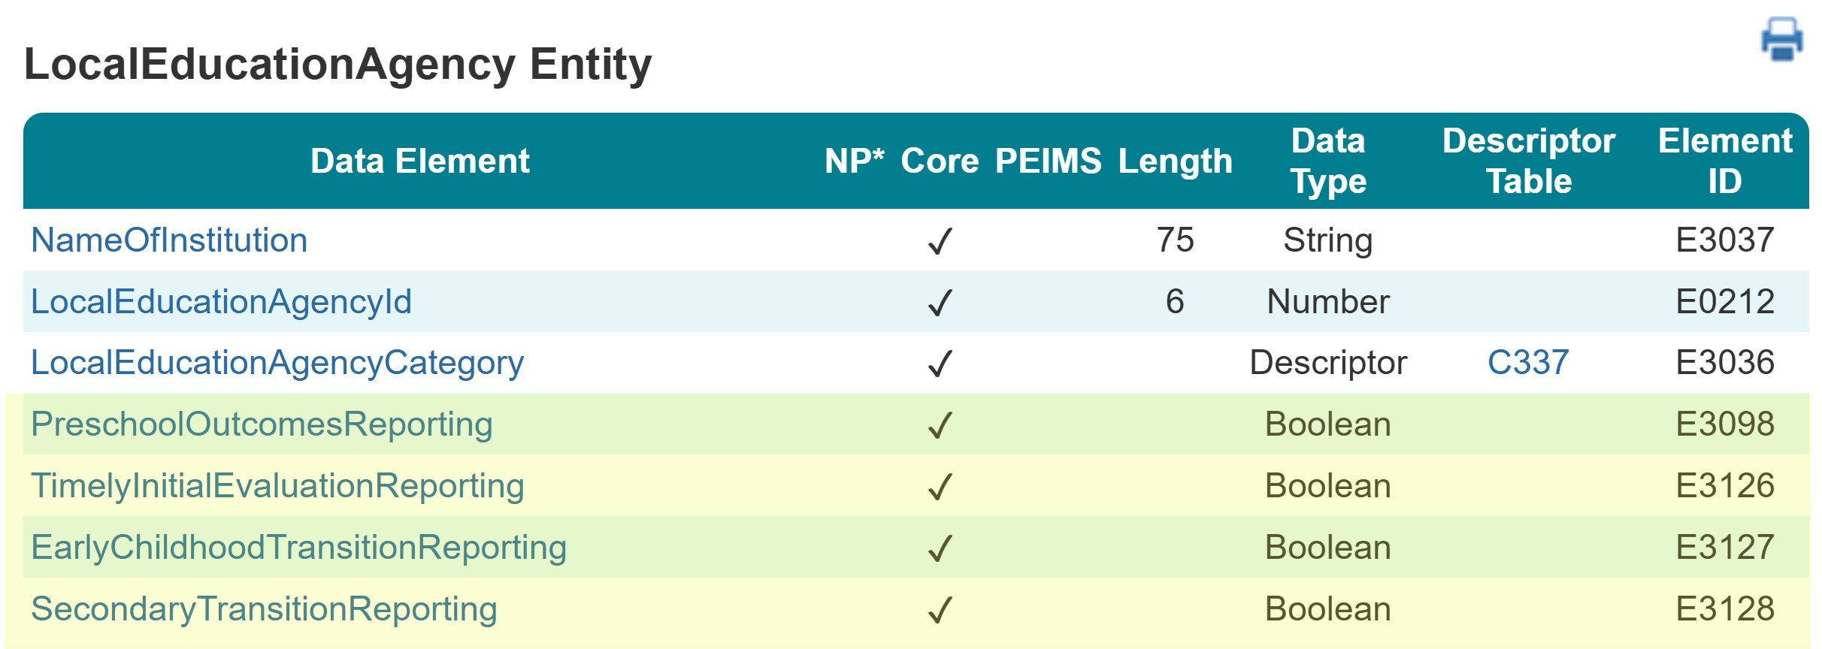

LocalEducationAgency 2

Slide 57
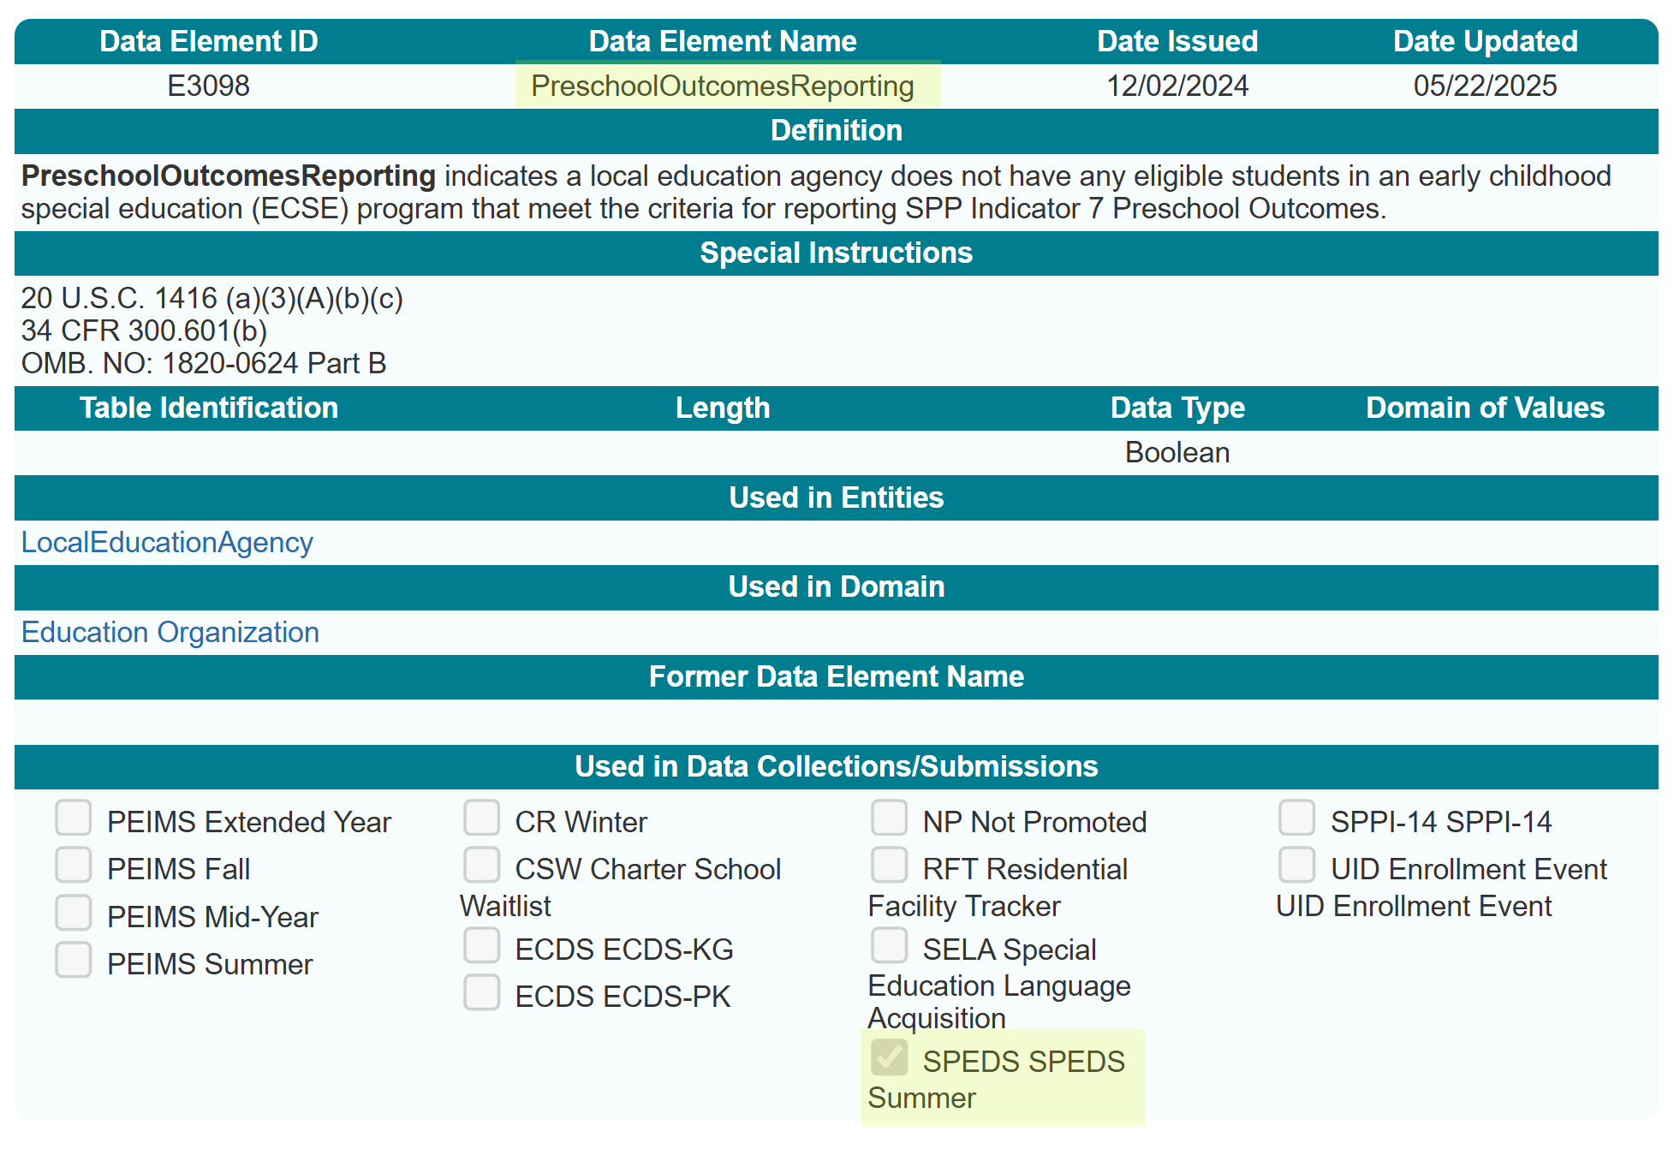
PreschoolOutcomesReporting
The PreschoolOutcomesReporting (E3098) data element was moved from the School Entity to the LocalEducationAgency Entity and changed from a descriptor to Boolean. The descriptor table will be removed.
  True: the LEA has no students to report for the SPP Indicator 7 Timely Initial Evaluation.
  False: the LEA will be reporting students for the SPP Indicator 7 Timely Initial Evaluation.

Slide 58
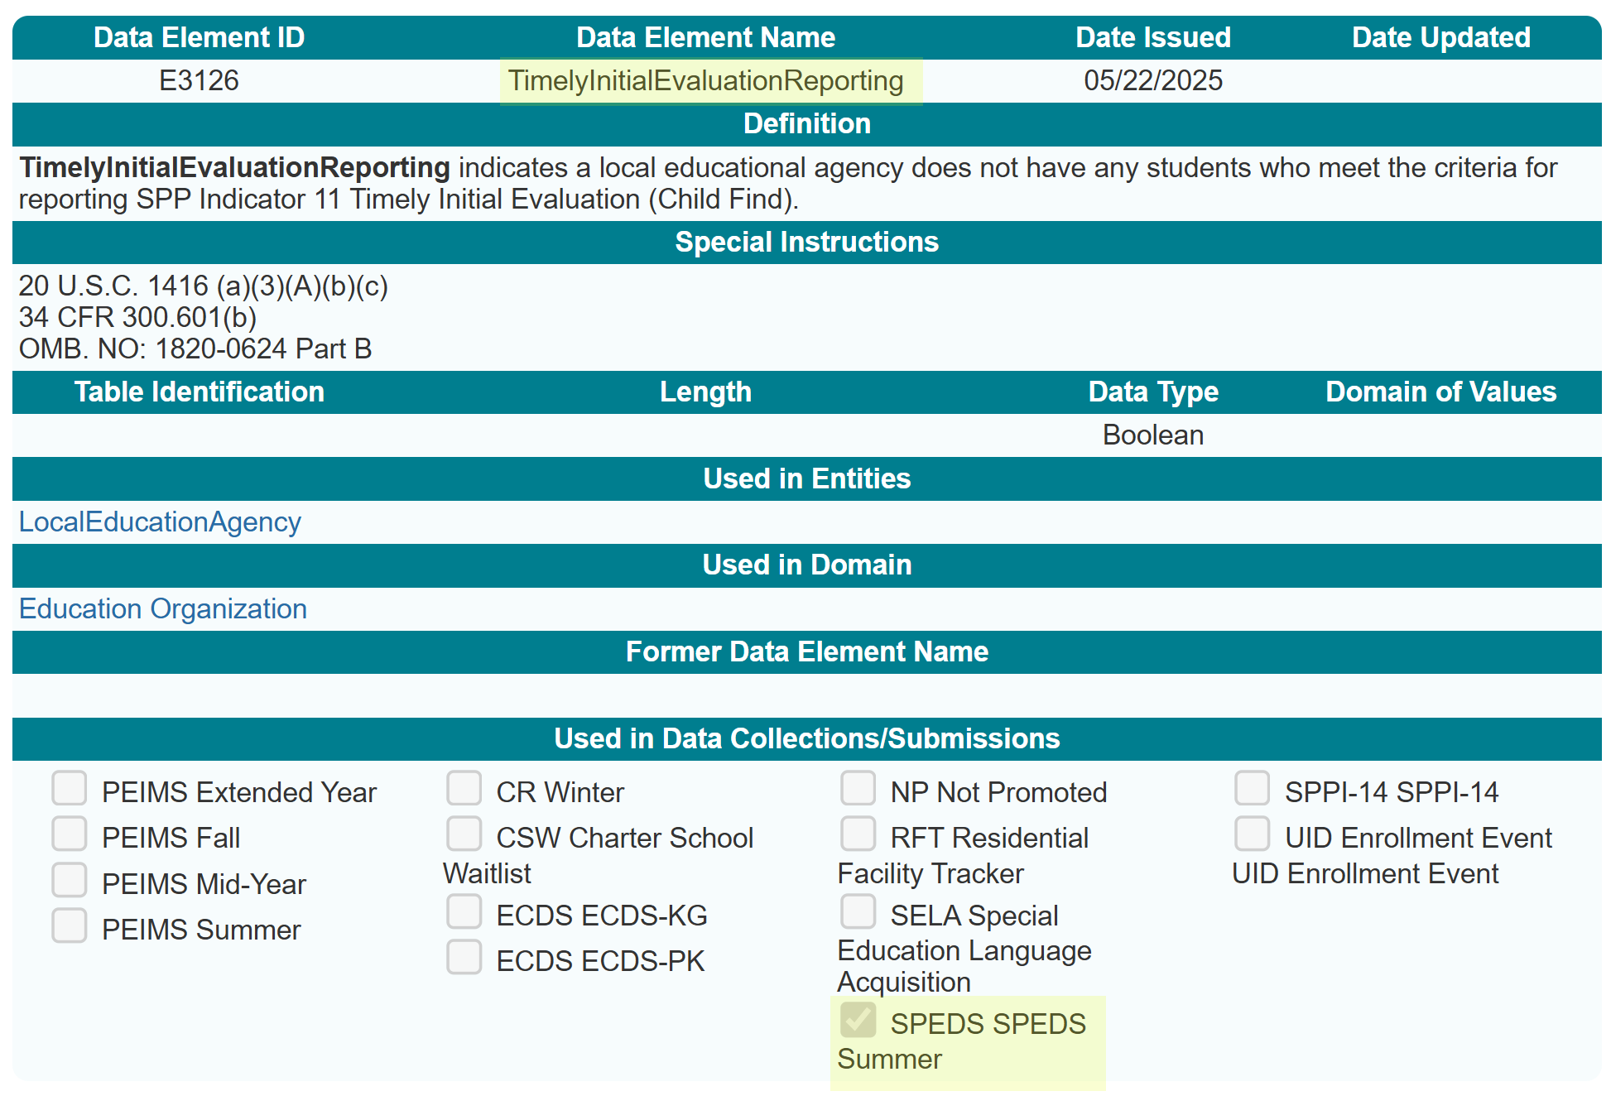
TimelyInitialEvaluationReporting
The TimelyInitialEvaluationReporting (E3126) data element is reported as follows for the SPEDS Summer Submission:
  True: the LEA has no students to report for the SPP Indicator 11 Timely Initial Evaluation.
  False: the LEA will be reporting students for the SPP Indicator 11 Timely Initial Evaluation.

Slide 59
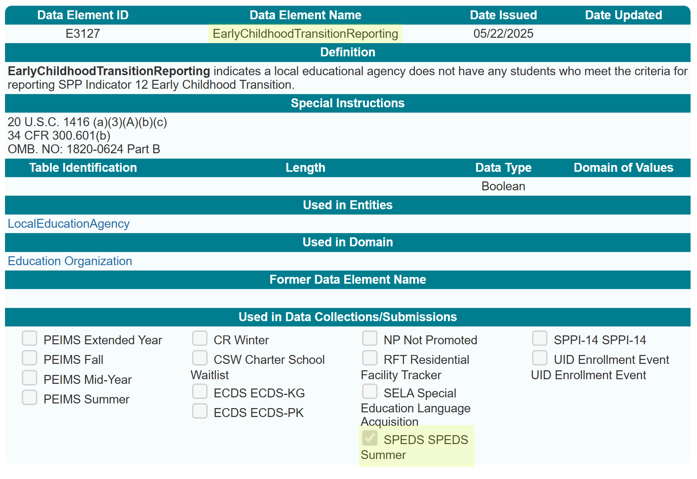
EarlyChildhoodTransitionReporting (E3127)
The EarlyChildhoodTransitionReporting (E3127) data element is reported as follows for the SPEDS Summer Submission:
  True: the LEA has no students to report for the SPP Indicator 12 Early Childhood Transition.
  False: the LEA will be reporting students for the SPP Indicator 12 Early Childhood Transition.

Slide 60
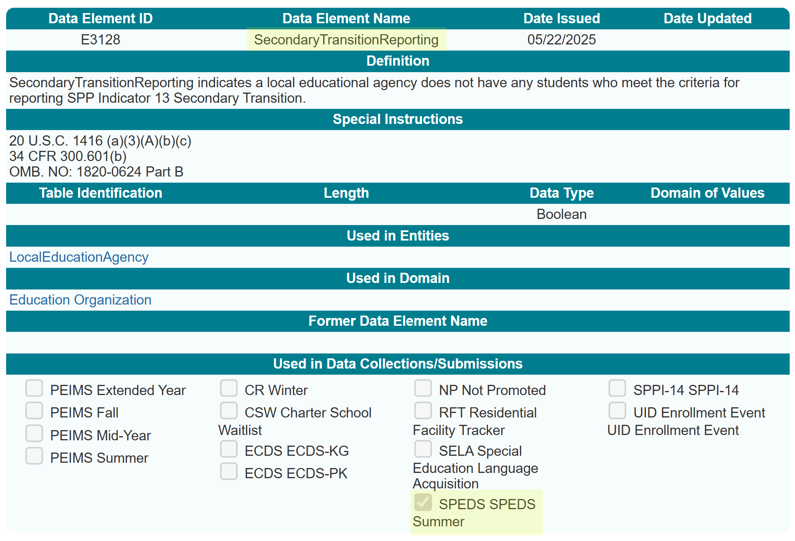
SecondaryTransitionReporting
The SecondaryTransitionReporting (E3128) data element is reported as follows for the SPEDS Summer Submission:
  True: the LEA has no students to report for the SPP Indicator 13 Secondary Transition.
  False: the LEA will be reporting students for the SPP Indicator 13 Secondary Transition.

Slide 61
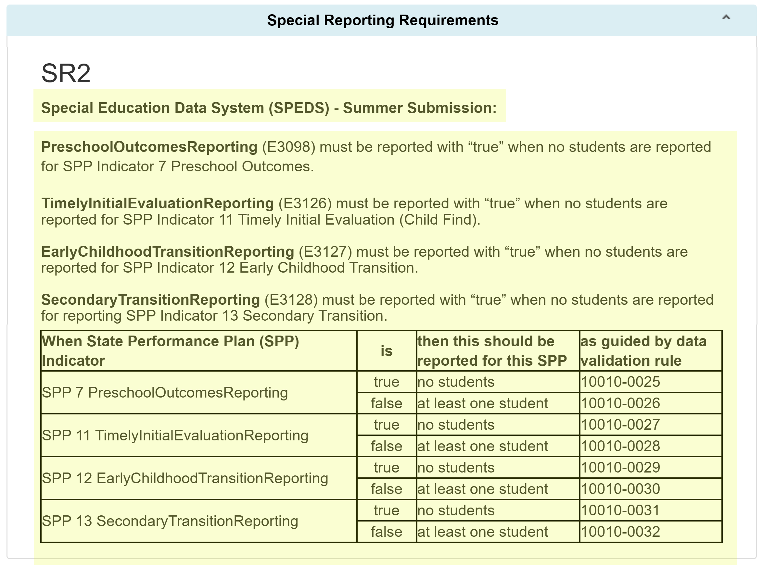
LocalEducationAgency Special Reporting Req

Slide 62
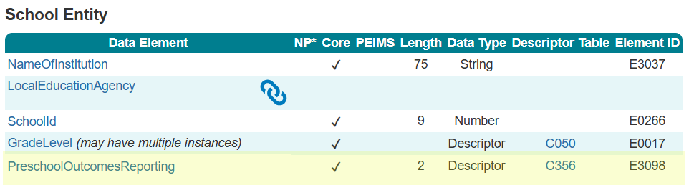
School 2
The data element PreschoolOutcomesReporting (E3098) was moved to the LocalEducationAgency Entity and changed from a descriptor to Boolean.

Slide 63
SCHOOL CALENDAR DOMAIN
SCHOOL CALENDAR DOMAIN
NAME OF COMPONENT (ALL CAPS)
MARCH 19-21, 2024

Slide 64
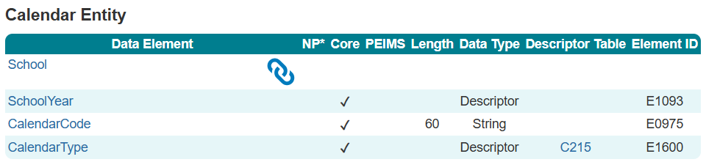
Calendar

Slide 65
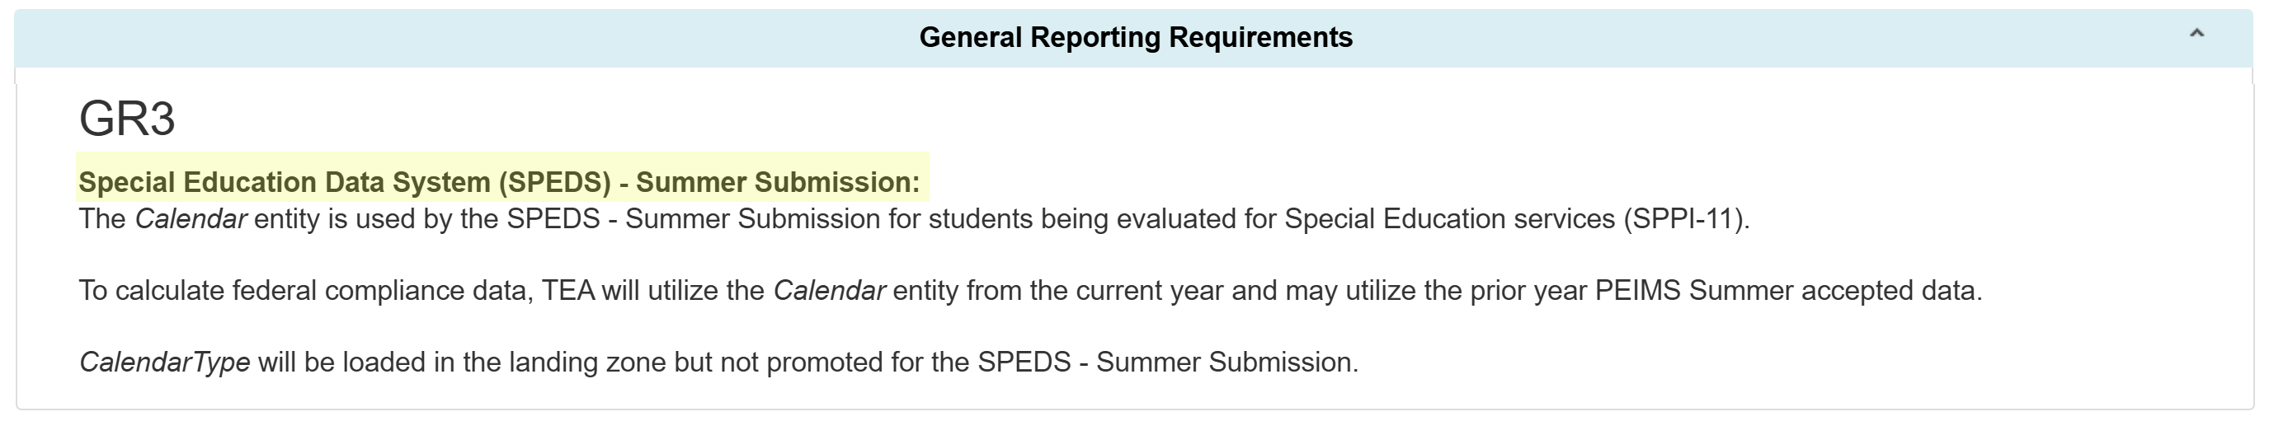
Calendar General Reporting Requirements

Slide 66
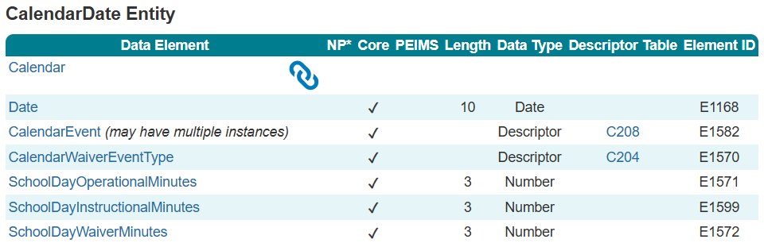
CalendarDate

Slide 67
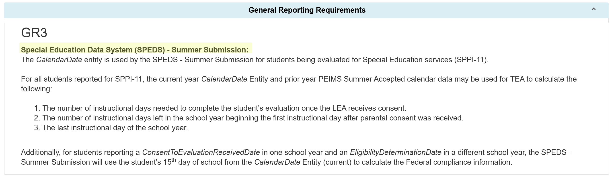
CalendarDate General Reporting Requirements

Slide 68
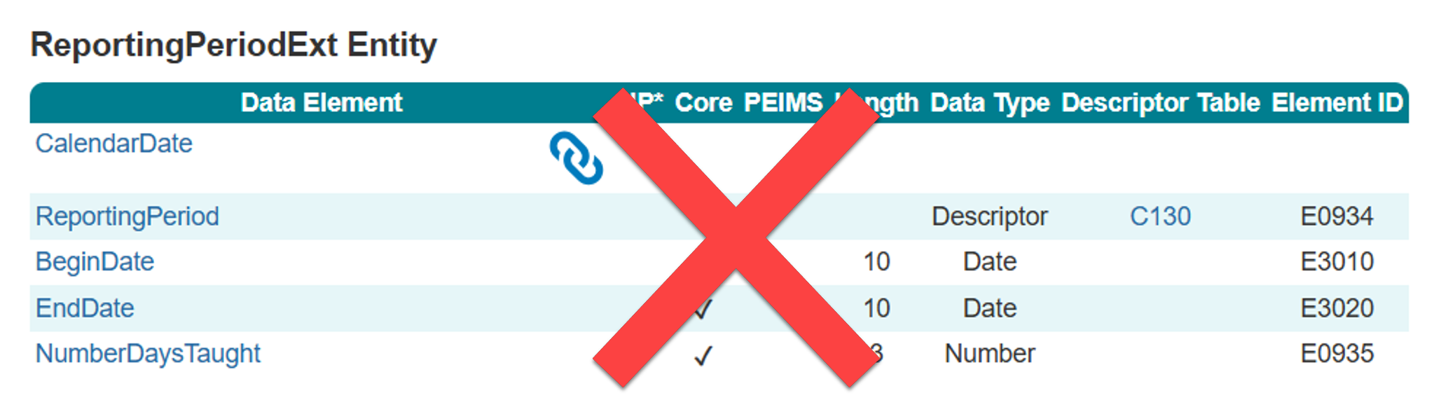
ReportingPeriodExt 2
The ReportingPeriodExt Entity will no longer be promoted for the Special Education Data System – Summer Submission.

Slide 69
ENROLLMENT DOMAIN
ENROLLMENT DOMAIN
NAME OF COMPONENT (ALL CAPS)
MARCH 19-21, 2024

Slide 70
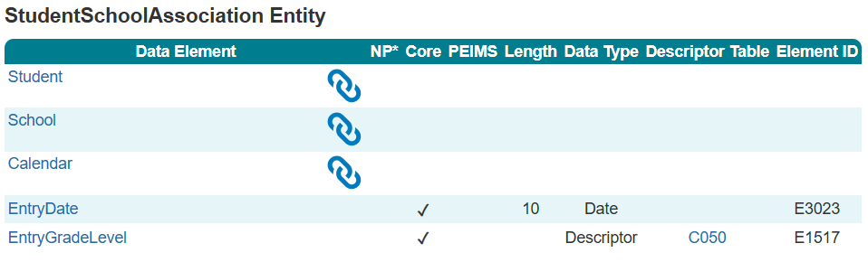
StudentSchoolAssociation

Slide 71
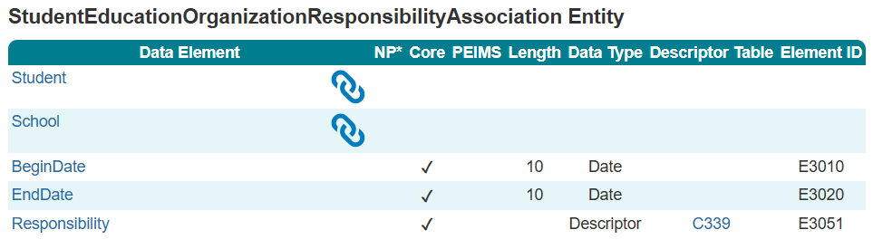
StudentEducationOrganizationResponsibility
Association

Slide 72
STUDENT IDENTIFICATION AND DEMOGRAPHICS DOMAIN
STUDENT IDENTIFICATION AND DEMOGRAPHICS DOMAIN
NAME OF COMPONENT (ALL CAPS)
MARCH 19-21, 2024

Slide 73
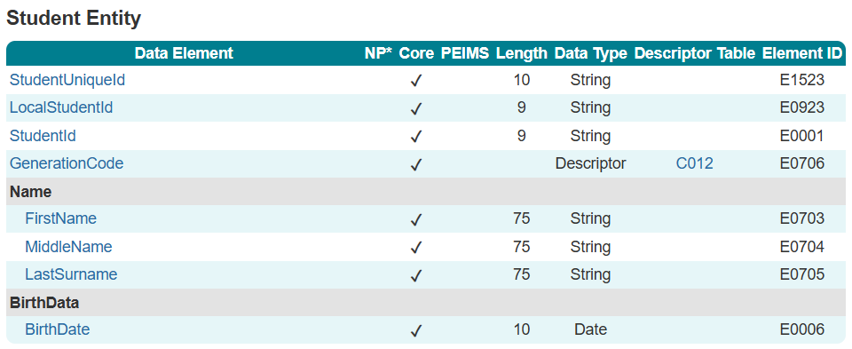
Student

Slide 74
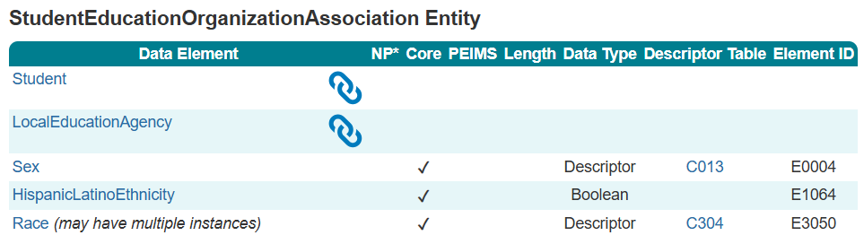
StudentEducationOrganizationAssociation

Slide 75
ALTERNATIVE AND SUPPLEMENTAL SERVICES DOMAIN
ALTERNATIVE AND SUPPLEMENTAL SERVICES DOMAIN
NAME OF COMPONENT (ALL CAPS)
MARCH 19-21, 2024

Slide 76
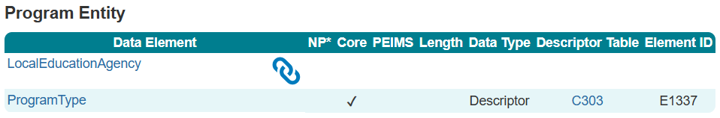
Program

Slide 77

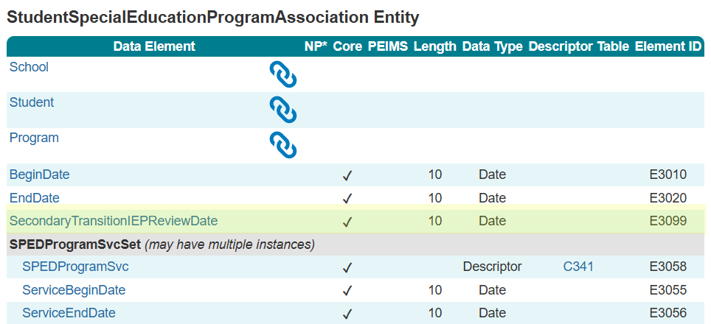
StudentSpecialEducationProgramAssociation
The data element SecondaryTransitionIEPReviewDate (E3099) is moved to the StudentSpecialEducationProgramAssociation.StudentSecondaryTransitionSet.

Slide 78
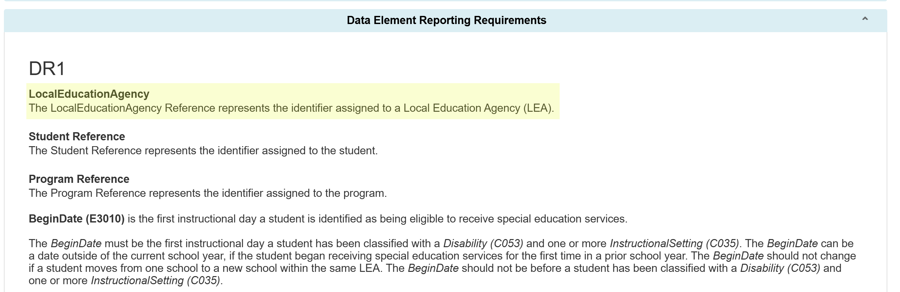
LocalEducationAgency Reference
The School Reference in the StudentSpecialEducationProgramAssociation Entity was replaced with a LocalEducationAgency Reference.

Slide 79
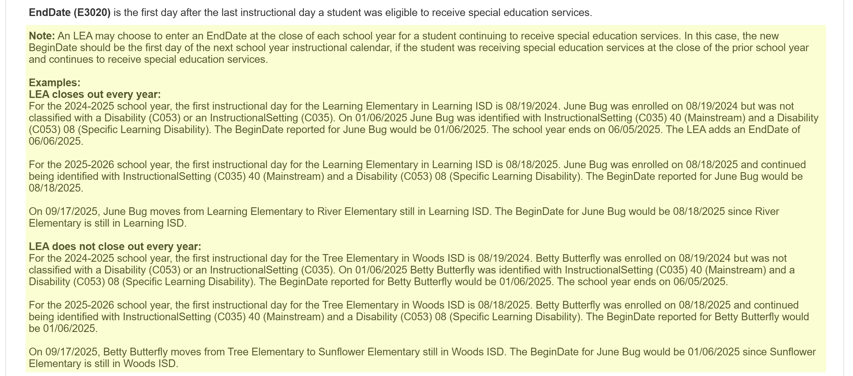
StudentSpecialEducationProgramAssociation
Additional guidance for the BeginDate (E3010) and EndDate (E3020) was added.

Slide 80
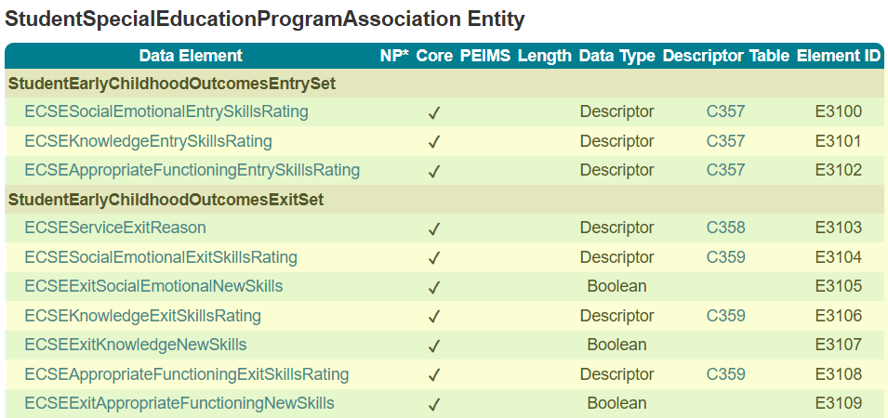
StudentSpecialEducationProgram
Association

Slide 81
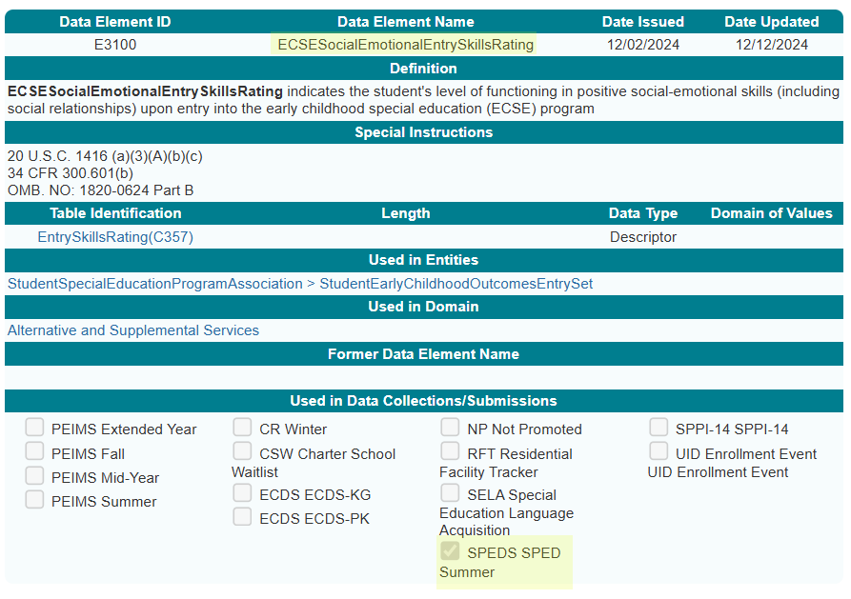
ECSESocialEmotionalEntrySkillsRating

Slide 82
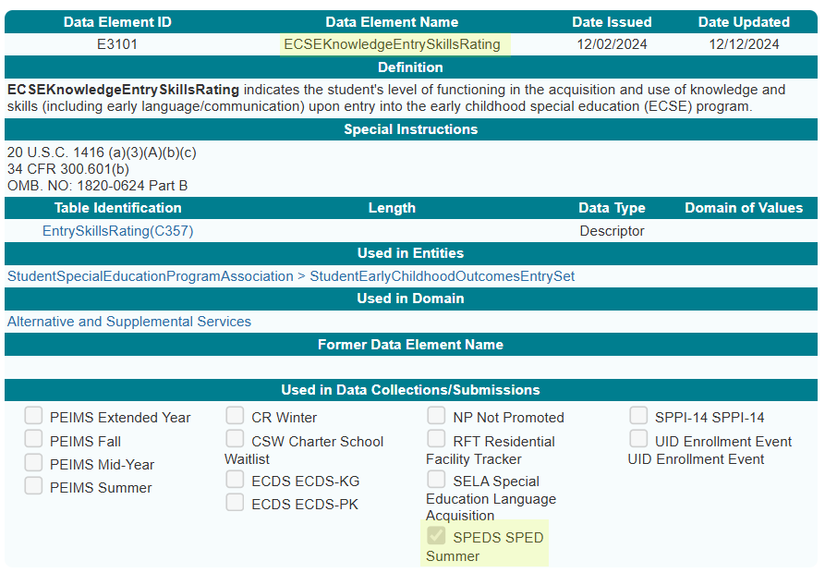
ECSEKnowledgeEntrySkillsRating

Slide 83
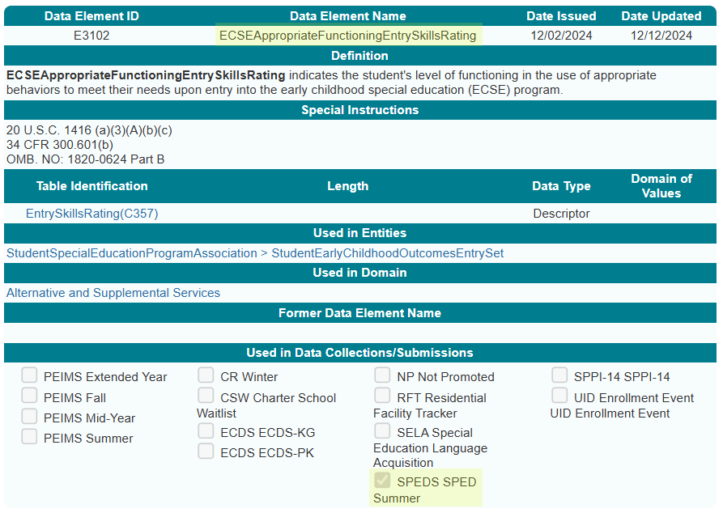
ECSEAppropriateFunctioningEntrySkillsRating

Slide 84
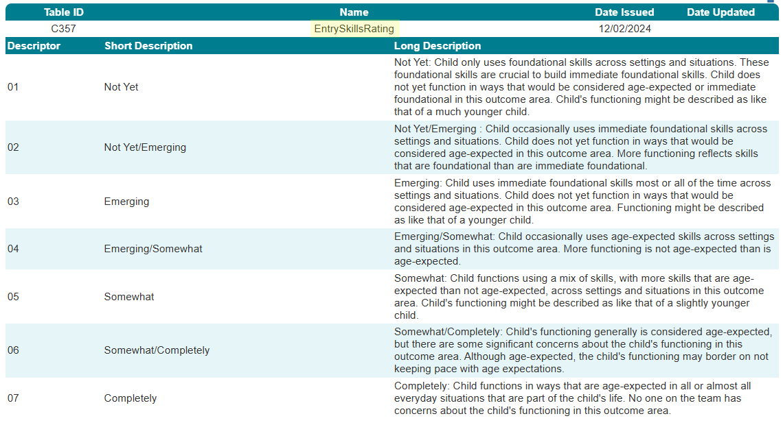
EntrySkillsRating Descriptor Table

Slide 85
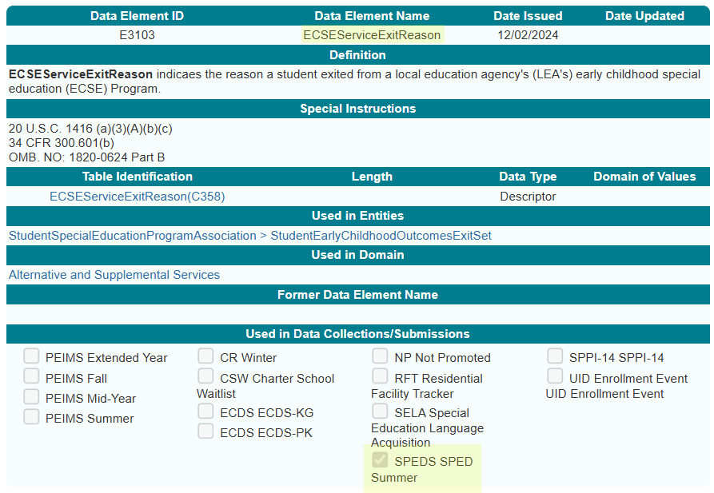
ECSEServiceExitReason

Slide 86
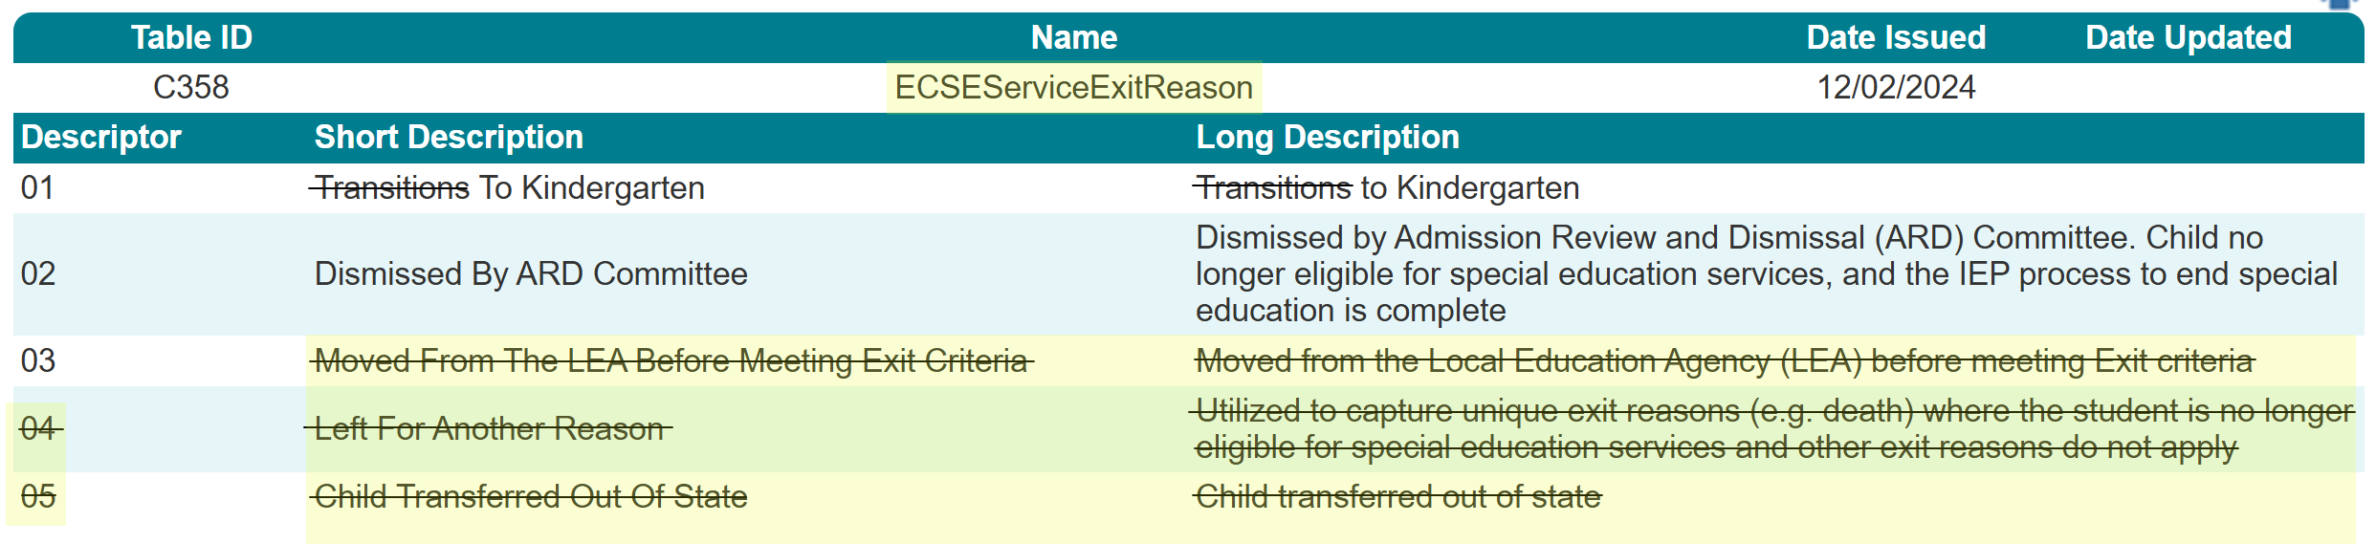
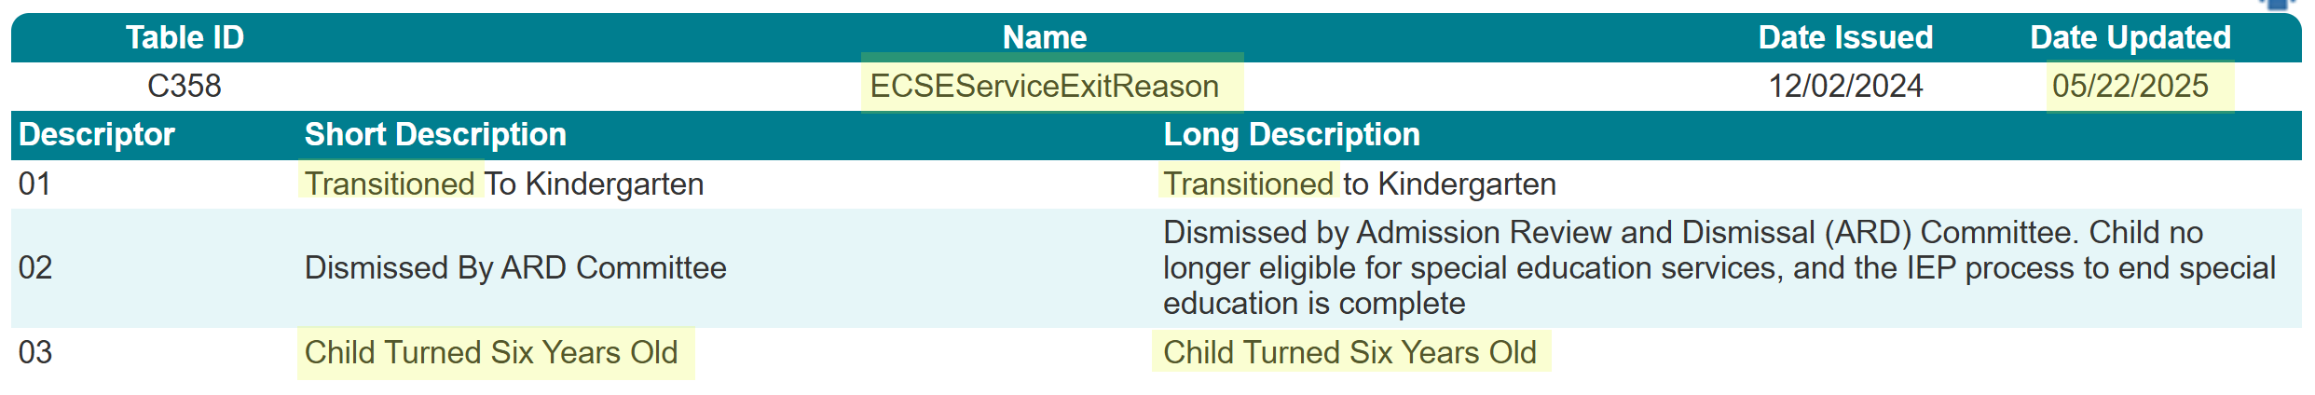
ECSEServiceExitReason (C358)

Slide 87
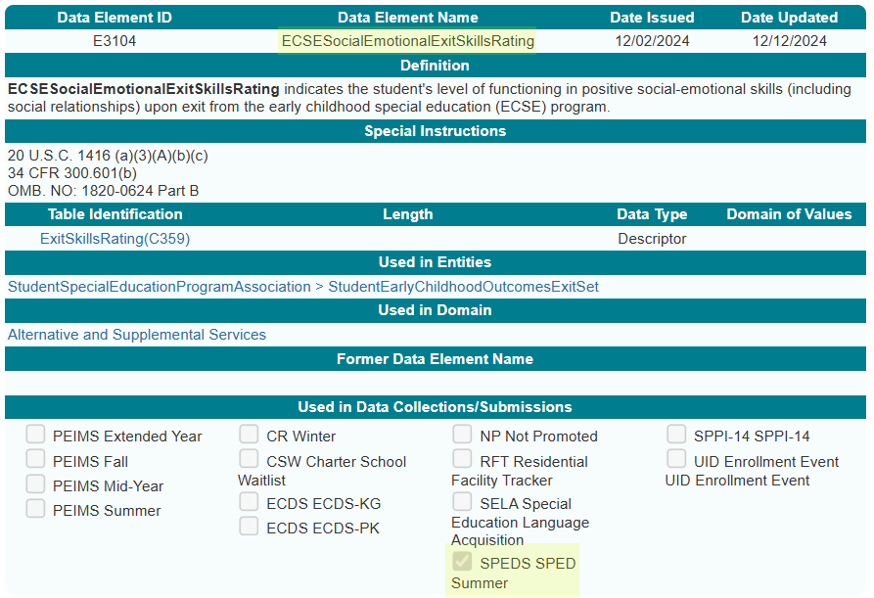
ECSESocialEmotionalExitSkillsRating

Slide 88
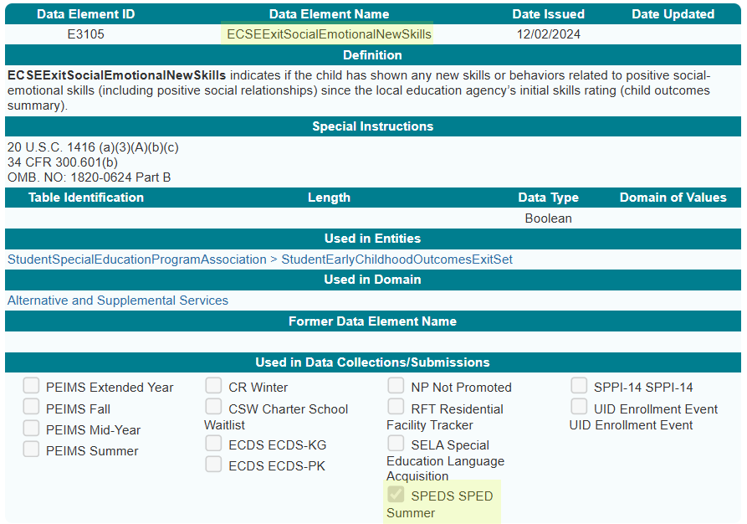
ECSEExitSocialEmotionalNewSkills

Slide 89
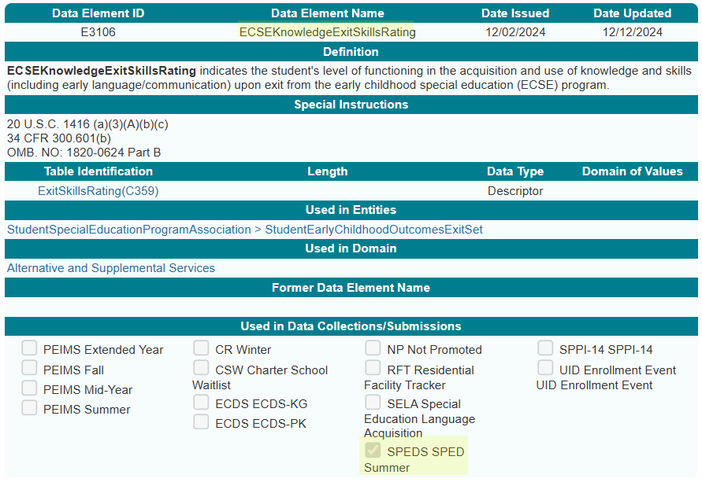
ECSEKnowledgeExitSkillsRating

Slide 90
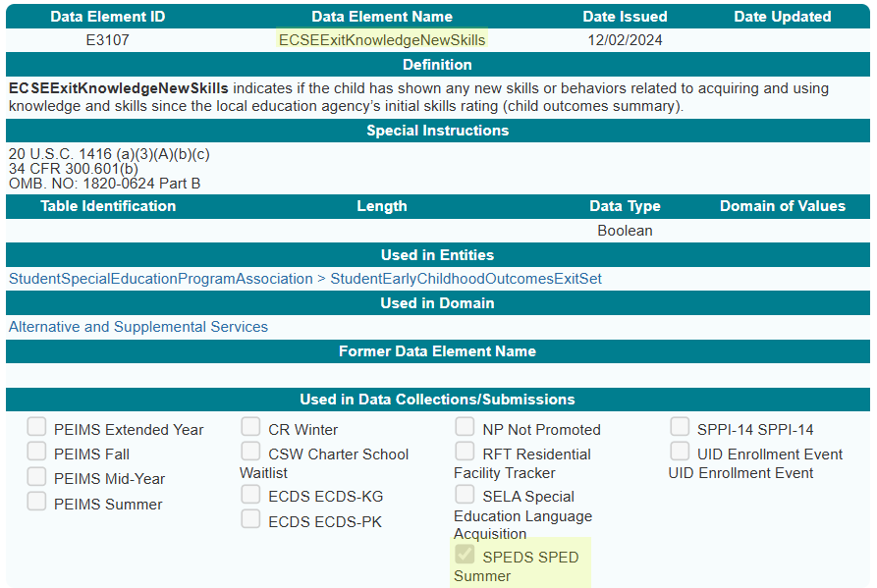
ECSEExitKnowledgeNewSkills

Slide 91
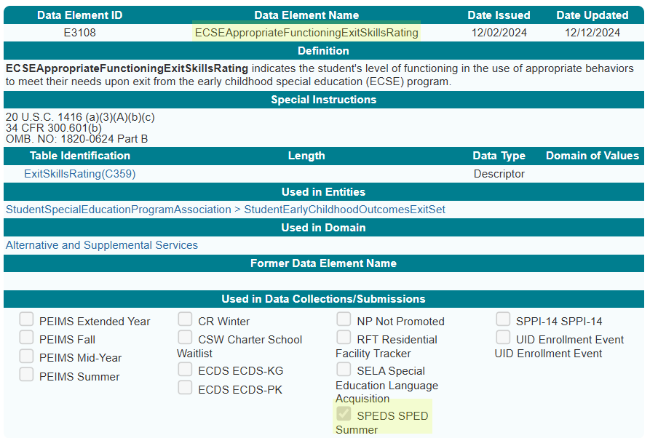
ECSEAppropriateFunctioningExitSkillsRating

Slide 92
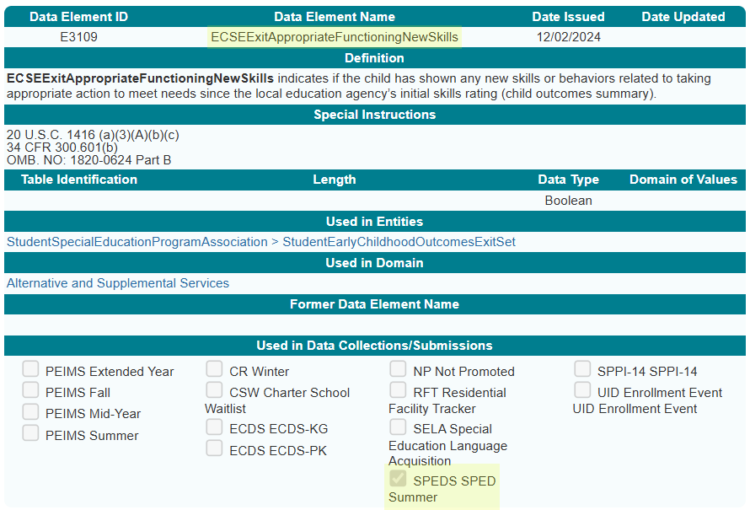
ECSEExitAppropriateFunctioningNewSkills

Slide 93
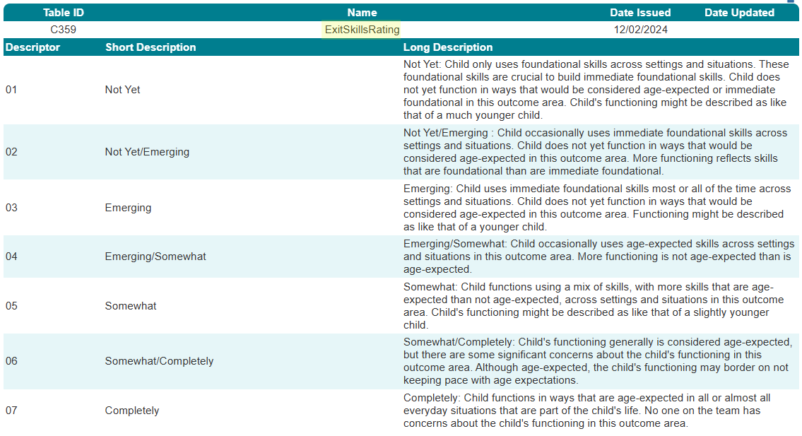
ExitSkillsRating Descriptor Table

Slide 94
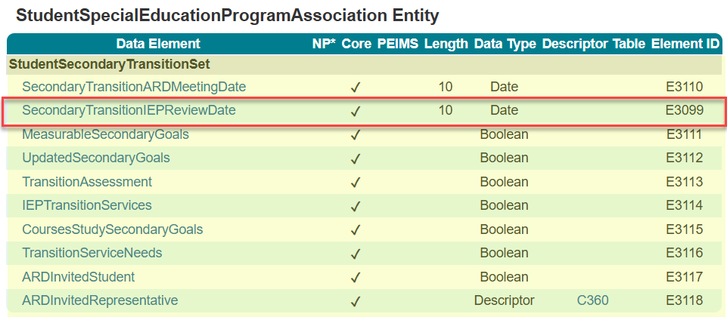
StudentSpecialEducationProgramAssociation 1

Slide 95
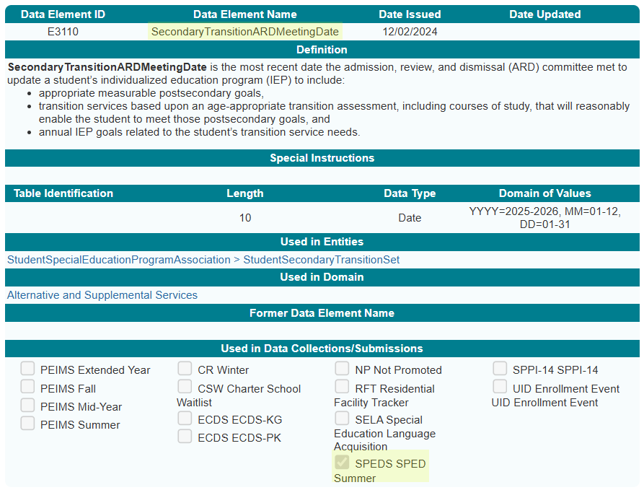
SecondaryTransitionARDMeetingDate

Slide 96
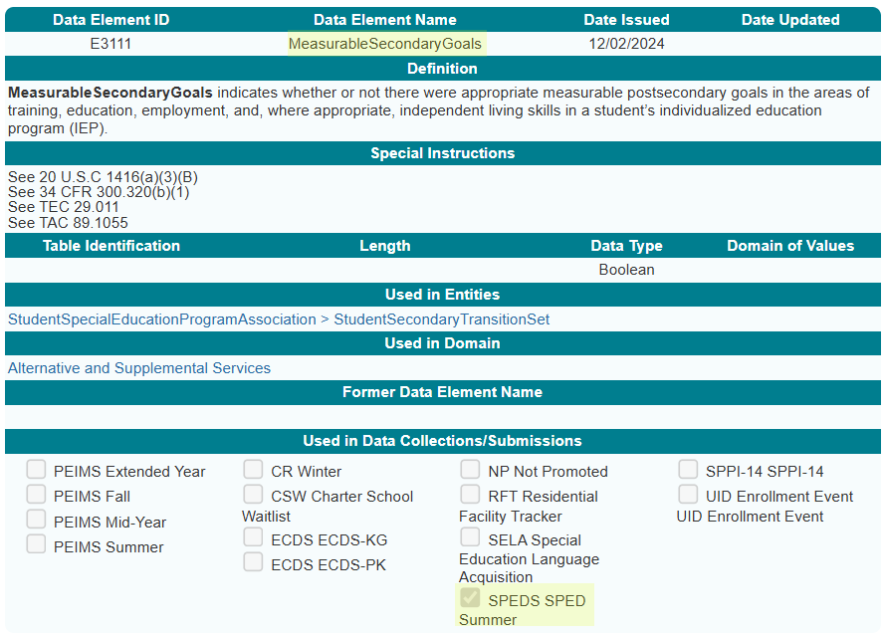
MeasurableSecondaryGoals

Slide 97
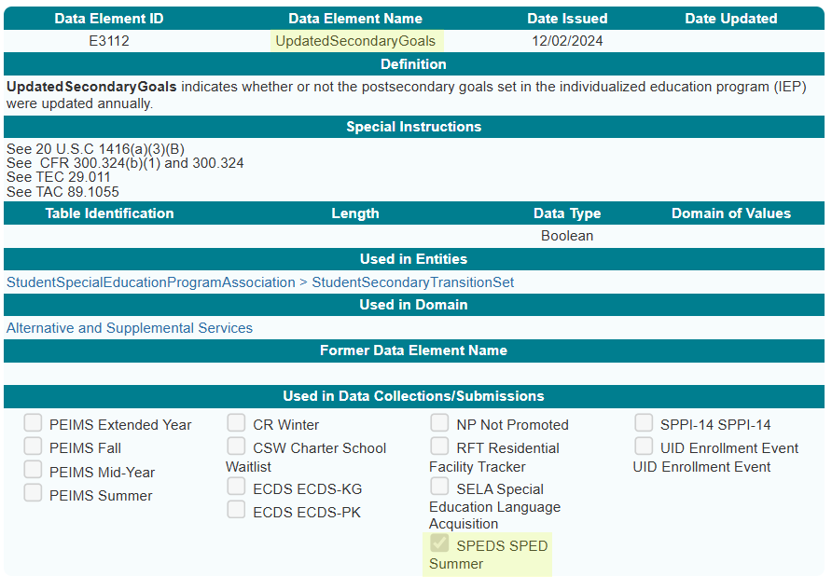
UpdatedSecondaryGoals

Slide 98
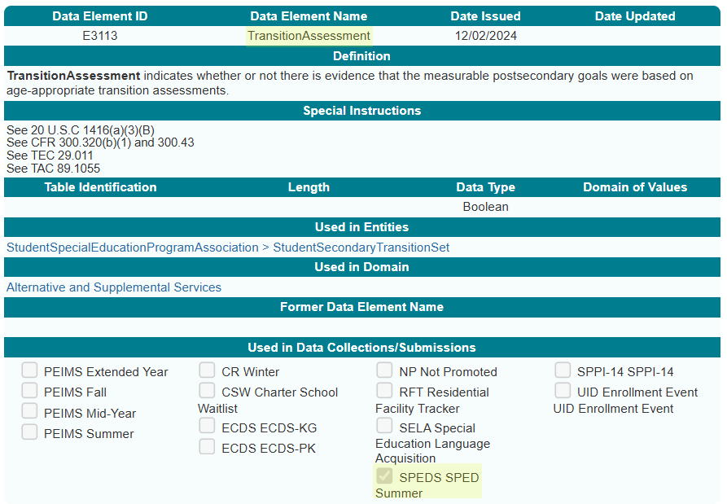
TransitionAssessment

Slide 99
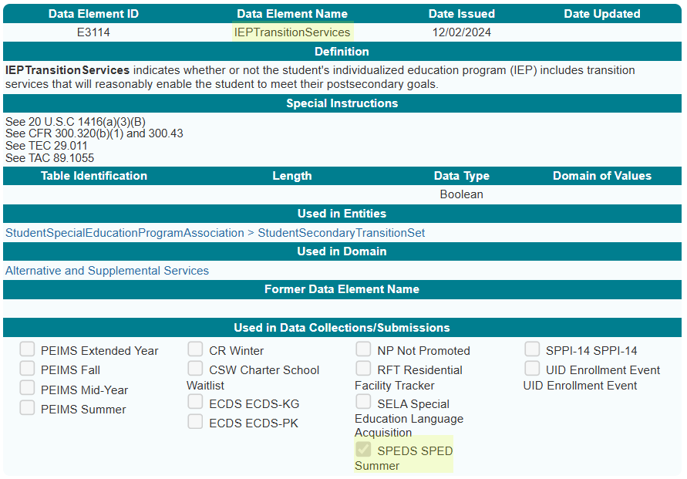
IEPTransitionServices

Slide 100
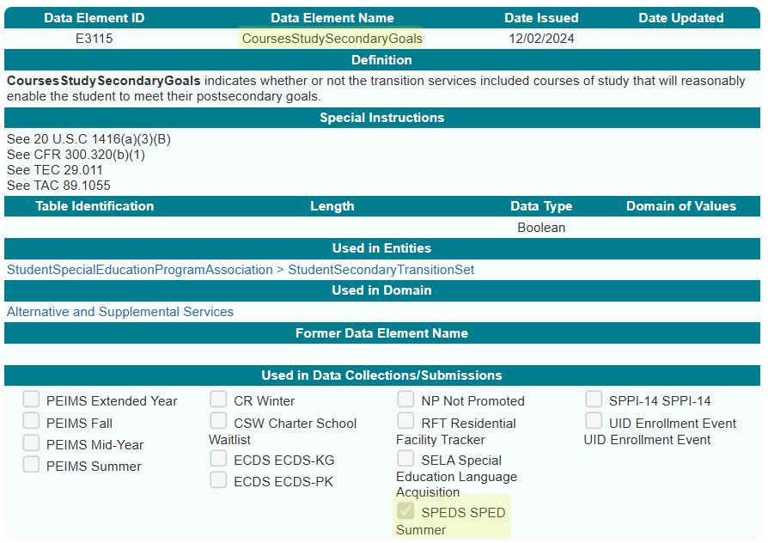
CoursesStudySecondaryGoals

Slide 101
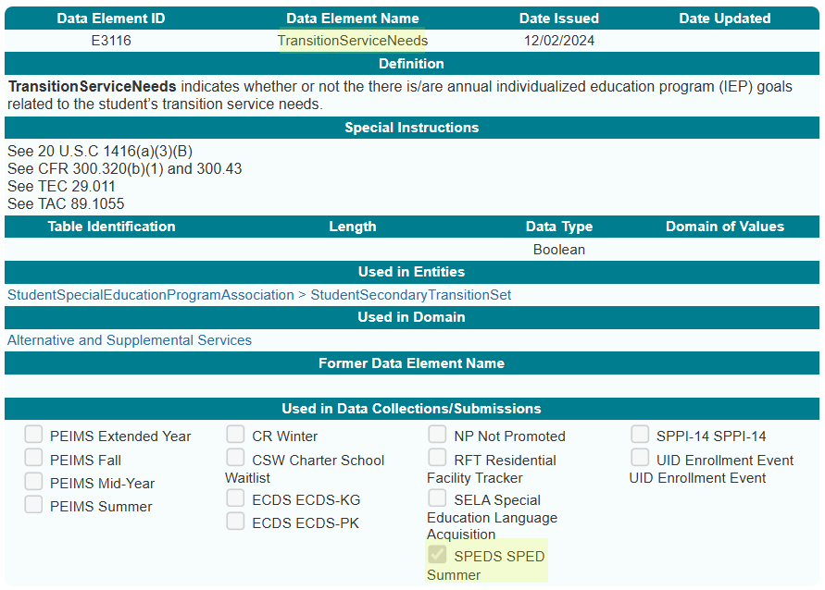
TransitionServiceNeeds

Slide 102

ARDInvitedStudent

Slide 103

ARDInvitedRepresentative

Slide 104

ARDInvitedRepresentative Descriptor Table

Slide 105
STUDENT SPECIAL EDDUCATION PROGRAM ELIGIBILITY ASSOCIATION DOMAIN
STUDENT SPECIAL EDUCATION PROGRAM ELIGIBILITY ASSOCIATION DOMAIN
NAME OF COMPONENT (ALL CAPS)
MARCH 19-21, 2024

Slide 106

StudentSpecialEducationProgramEligibility
Association

Slide 107
TITLE SLIDE: BUSINESS VALIDATIONS
BUSINESS
NAME OF COMPONENT (ALL CAPS)
MARCH 19-21, 2024
VALIDATIONS

Slide 108

LOCAL EDUCATION AGENCY CATEGORY

Slide 109

LOCAL EDUCATION AGENCY CATEGORY 1

Slide 110

LOCAL EDUCATION AGENCY CATEGORY 2

Slide 111

STUDENT BASIC CATEGORY

Slide 112
ENROLLMENT CATEGORY

Slide 113

SPECIAL EDUCATION PROGRAM CATEGORY 1

Slide 114

SPECIAL EDUCATION PROGRAM CATEGORY 2

Slide 115

SPECIAL EDUCATION PROGRAM CATEGORY 3

Slide 116

SPECIAL EDUCATION PROGRAM CATEGORY 2 4

Slide 117
TITLE SLIDE: REPORTS
REPORTS
NAME OF COMPONENT (ALL CAPS)
MARCH 19-21, 2024

Slide 118
REPORTS 4
The existing Child Find reports will be retained in the SPEDS Summer Submission.
  SPD0-111-001 SPPI-11 Student Compliance Report
  SPD0-112-001 SPPI-12 Student Compliance Report
  SPD0-111-002 SPPI-11 Aggregate Report
  SPD0-112-002 SPPI-12 Aggregate Report
  CHF0-100-005 SPPI-11 Calculations Report
The new SPPI-7 and SPPI-13 reports will be available at LEA and Campus levels.
  SPD0-107-001 Preschool Outcomes Student Roster
  SPD0-107-002 Student Progress Measure Summary
  SPD0-113-001 Secondary Transition Student Roster and Compliance
  SPD0-113-002 Secondary Transition Compliance Data

Slide 119
END OF RESOURCES

