Slide 1

PEIMS ATTENDANCE SUBMISSION
March 31, 2026

Slide 2

AGENDA
Submission Status
Lessons Learned
Report on Reports
Changes Now and Later
Timelines
FAQ
Resources

Slide 3


SUBMISSION STATUS

Slide 4
PEIMS ATTENDANCE SUBMISSION STATUS
Instances Complete for 2025-2026
1st Six Weeks
Instance Remaining for 2025-2026
5th Six Weeks
2nd Six Weeks
3rd Six Weeks
4th Six Weeks
Final Reconciliation for 2025-2026
PEIMS Summer Submission and Resubmission

Slide 5

LESSONS LEARNED

Slide 6
LESSONS LEARNED
Active students can promote with only reported absences for a single reporting period. Fatal business rule 42400-0035 was removed to allow this scenario.
For each Six Weeks instance, calendar dates and reporting period entity data for the entire school year must be promoted.
Students reclassified by LPAC from EB to non-EB occurs in the summer, and EB coding should reflect those changes/dates.
Special Warnings for longer than expected instructional day minutes (10200-0010).
Common for 4-day week LEAs
Common for an extended school day
TAA September 18, 2025: House Bill 2 (HB 2) Implementation: Six-week Attendance Reporting

Slide 7
WHEN THE CALENDAR CHANGES
When a campus closes unexpectedly or experiences a missed instructional day, the day must be immediately converted to a non‑school day in the student attendance accounting system. The LEA must promptly update campus calendar(s) to accurately reflect the missed school day.
If the LEA is seeking a TEA attendance waiver for the missed instructional day, the day should remain identified as a non‑school day while the waiver request is under consideration. The pursuit of a waiver does not delay the requirement to update calendars or attendance records to reflect the missed day.
Low-attendance days must remain identified as instructional days in the student attendance accounting system unless and until the LEA receives an approved attendance waiver from TEA. No calendar or attendance status changes may be made for a low-attendance day prior to waiver approval.
If the attendance waiver is granted in time for the applicable six‑weeks PEIMS Attendance submission instance, the LEA shall update its calendar to indicate a waiver day in that submission. If the waiver is granted after six‑weeks reporting, any ADA adjustments will be made during the near‑final settle‑up process using actual attendance data reported in the PEIMS Summer Submission and incorporated into the Summary of Finances.
For additional questions, contact State Funding at sfinance@tea.texas.gov.

Slide 8

REPORT ON REPORTS

Slide 9
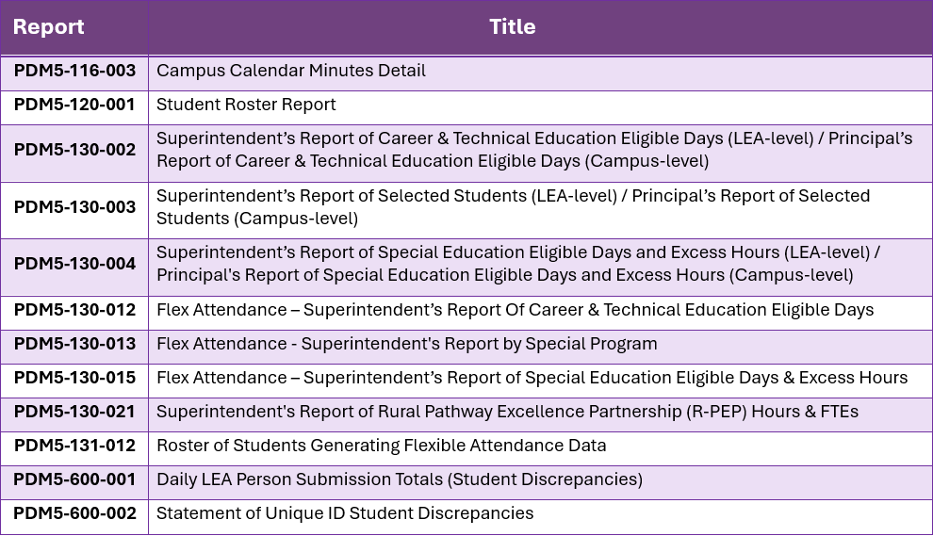
REPORTS STATUS UPDATE
These reports were released since the training provided on January 5, 2026.

Slide 10

CHANGES NOW AND LATER

Slide 11

OUTSTANDING IMPLEMENTATIONS 2025-2026
No further system or business rule changes are planned for the TSDS PEIMS ATND Submission for the 2025-2026 school year.

Slide 12
CHANGES COMING IN 2026-2027
Removing two StudentCharacteristic data elements from promotion:
Gifted and Talented
Dyslexia Indicator
Special Education funding updates:
Tiers of Intensity must be reported for students via:
SpecialEducationTierOfIntensityAttendance Entity
FlexibleSpecialEducationTierOfIntensityAttendance Entity
The StudentSpecialEducationProgramAssociation Entity will be added to promotion logic.
New rules will be developed to reflect the new TierOfIntensity funding changes.

Slide 13
CHANGES COMING IN 2026-2027 2
Rules to be reinstated:
42400-0001 (Basic Attendance)
42500-0001 (Flexible Attendance)
Updating rules and adding to PEIMS ATND:
42405-0002 (Basic Attendance-Special Education)
42505-0002 (Flexible Attendance-Special Education)
New rule:
42500-0065 (Flexible Attendance-Bil/ESL)
Until these business rules are implemented, data quality checks will be used to support LEAs in submitting accurate data. ESCs will be notified if data issues are identified for an LEA.
Refer to the Resources section of this slide deck for rule details.
Notes:
Rules to be reinstated:
42400-0001
Basic attend req student record required-
42500-0001
Flex att req student record demo
updating Rules & adding
42405-0002
Checking for student record-basic attend MATCH
42505-0002
Checking for student record-flex basic attend MATCH
New rules
42500-0065
Flexible bil esl-check for flex basic attend record

Slide 14

TIMELINES

Slide 15
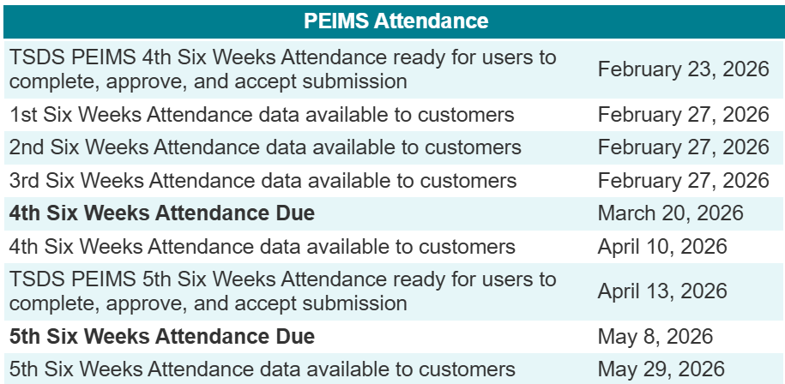
TIMELINES FOR 2025-2026

Slide 16

FREQUENTLY ASKED QUESTIONS

Slide 17
FREQUENTLY ASKED QUESTIONS
Question: What should I do if my district makes a retroactive change to calendars or attendance after a PEIMS Attendance (ATND) submission instance has already been completed? For example, a dropout recovery program begins during the first six weeks, but the program is not set up in our SIS until after the PEIMS Attendance 1st Six Weeks instance is complete.
Answer:
Once the calendar and attendance data is added/updated in the SIS, the data will be published to the IODS. The appropriate data will then be promoted for the current PEIMS Attendance submission instance.
If the added/updated data published impacts completed attendance PEIMS Attendance submission instances, these data will be promoted in the PEIMS Summer Submission and reconciled during the settle-up process.

Slide 18
FREQUENTLY ASKED QUESTIONS 2 2
Question: An LEA is receiving multiple Calendar duplicate promotion errors. After review, the LEA cannot identify any truly duplicate calendar r entities in the IODS data. What are their next steps?
Answer: A duplicate Calendar promotion error is not always caused by an actual duplicate CalendarDate Entity. In many cases, the error occurs when the number of ReportingPeriodExt Entities does not align with the number of instructional days published in the CalendarDate Entity.
Common causes include:
Extra ReportingPeriodExt Entities beyond the number of days taught (for example, 30 ReportingPeriodExt Entities published for only 29 instructional calendar dates).
BeginDate or EndDate mismatches in the ReportingPeriodExt Entities that cause the system to interpret an additional, unintended instructional day.
In these scenarios, the system attempts to reconcile an extra instructional day that does not exist in the calendar, resulting in a duplicate Calendar error.

Slide 19
FREQUENTLY ASKED QUESTIONS 32
Question: A student is reporting the Gifted & Talented (G/T) indicator in the PEIMS ATND 3rd Six Weeks instance, even though the student was not identified as G/T until the start of the 4th Six Weeks reporting period. This is inflating the G/T counts in the PEIMS ATND 3rd Six Weeks instance.
Answer: The system promotes student data that is active at the time of promotion. Because the 3rd Six Weeks instance is promoted during the LEA’s 4th Six Weeks reporting period, the student is reported as G/T in the 3rd Six Weeks instance. The program area is aware that this promotion logic may result in slightly inflated counts. Per the program area, G/T and Dyslexia services are funded based on the PEIMS Summer Submission. For the 2026-2027 school year these two data elements will not be promoted in the PEIMS Attendance Submissions.
Below are two State Funding resources
State Funding Data Elements, Sources, and Timelines for FSP SOF Reports (February 2026)
SY 2025-2026 Preliminary Summary of Finances Report Updates (February 2026)

Slide 20
KNOWN ISSUES
The hyperlinks to the error lists from the Prepare/Finalize Submission screen are not functioning as expected.
Users cannot open the subcategory error lists from this screen.
Users may access Monitor Validations to review the errors for all subcategories.
This fix will be deployed in the 2026-2027 school year.

Slide 21

QUESTIONS

Slide 22

RESOURCES

Slide 23
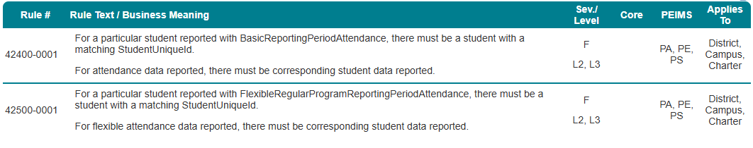
BUSINESS RULES DETAILS - REINSTATED

Slide 24
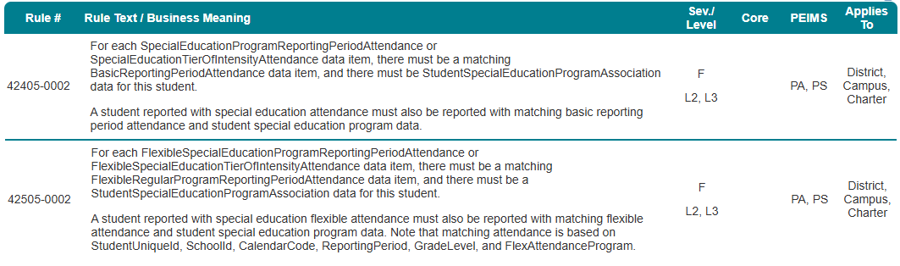
BUSINESS RULES DETAILS - UPDATED

Slide 25
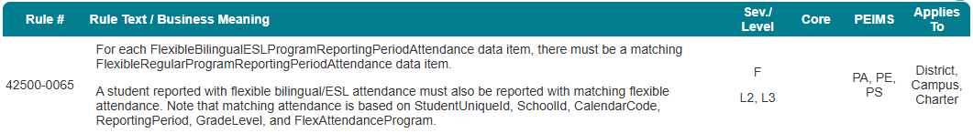
BUSINESS RULES DETAILS - NEW

