Slide 1

PEIMS FALL ENROLLMENT SUBMISSION
March 31, 2026

Slide 2

Agenda – 2026-2027 PEIMS Fall Enrollment Submission
PEIMS Fall Enrollment Submission
Timeline
Application and Promotion Logic
Business Rules
Reports
Training Plan
Questions

Slide 3

PEIMS FALL ENROLLMENT

Slide 4
2026-2027 PEIMS Fall Enrollment Submission
The PEIMS Fall Enrollment Submission will consist of:
  All students enrolled on the first Friday in October with their Special Education program determination and
  Students in grades 7-12 enrolled at any point during the school start window (first day of school through the last Friday in September).

Slide 5
Entities
The PEIMS Fall Enrollment Submission will consist of the following entities:
  LocalEducationAgency
  School
  Calendar
  Student
  StudentEducationOrganizationAssociation
  StudentSchoolAssociation
  Program
  StudentSpecialEducationProgramAssociation

Slide 6
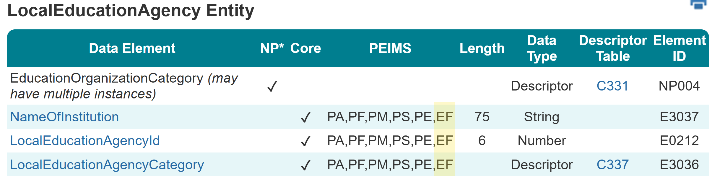
LocalEducationAgency Entity Summer
The following is added to the PEIMS Fall Enrollment Submission:
  Data Elements:
    EducationOrganizationCategory (NP004)
    NameOfInstitution (E3037)
    LocalEducationAgencyId (E0212)
    LocalEducationAgencyCategory (E3036)

Slide 7
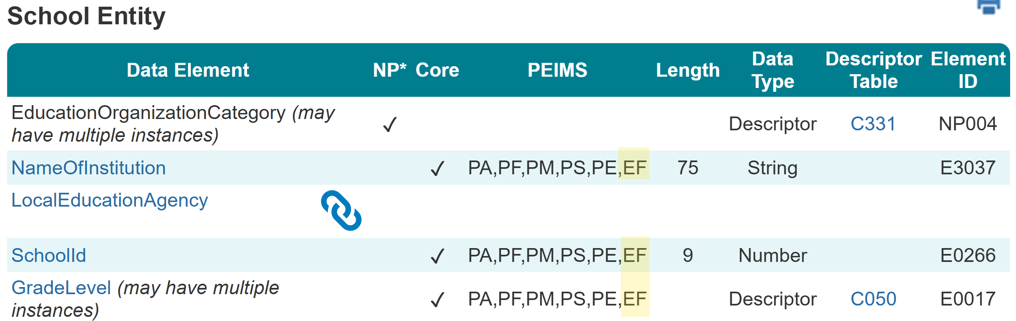
School Entity Summer
The following is added to the PEIMS Fall Enrollment Submission:
  Data Elements:
    EducationOrganizationCategory (NP004)
    NameOfInstitution (E3037)
    LocalEducationAgency (Reference)
    SchoolId (E0266)
    GradeLevel (E0017)

Slide 8
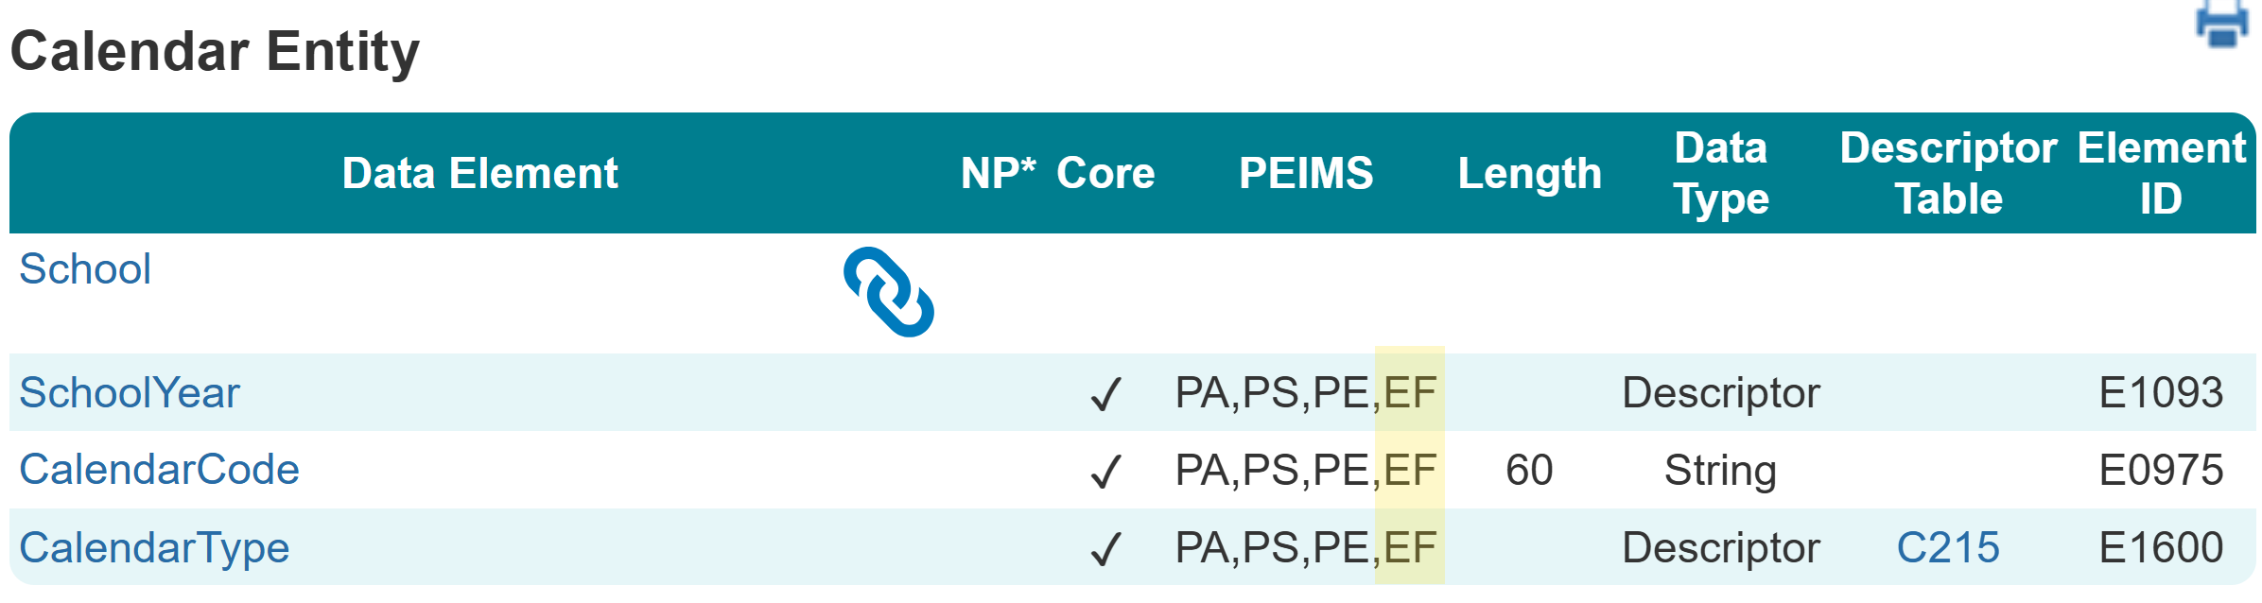
Calendar Entity Summer
The following is added to the PEIMS Fall Enrollment Submission:
  Data Elements:
    School (Reference)
    SchoolYear (E1093)
    CalendarCode (E0975)
    CalendarType (E1600)

Slide 9
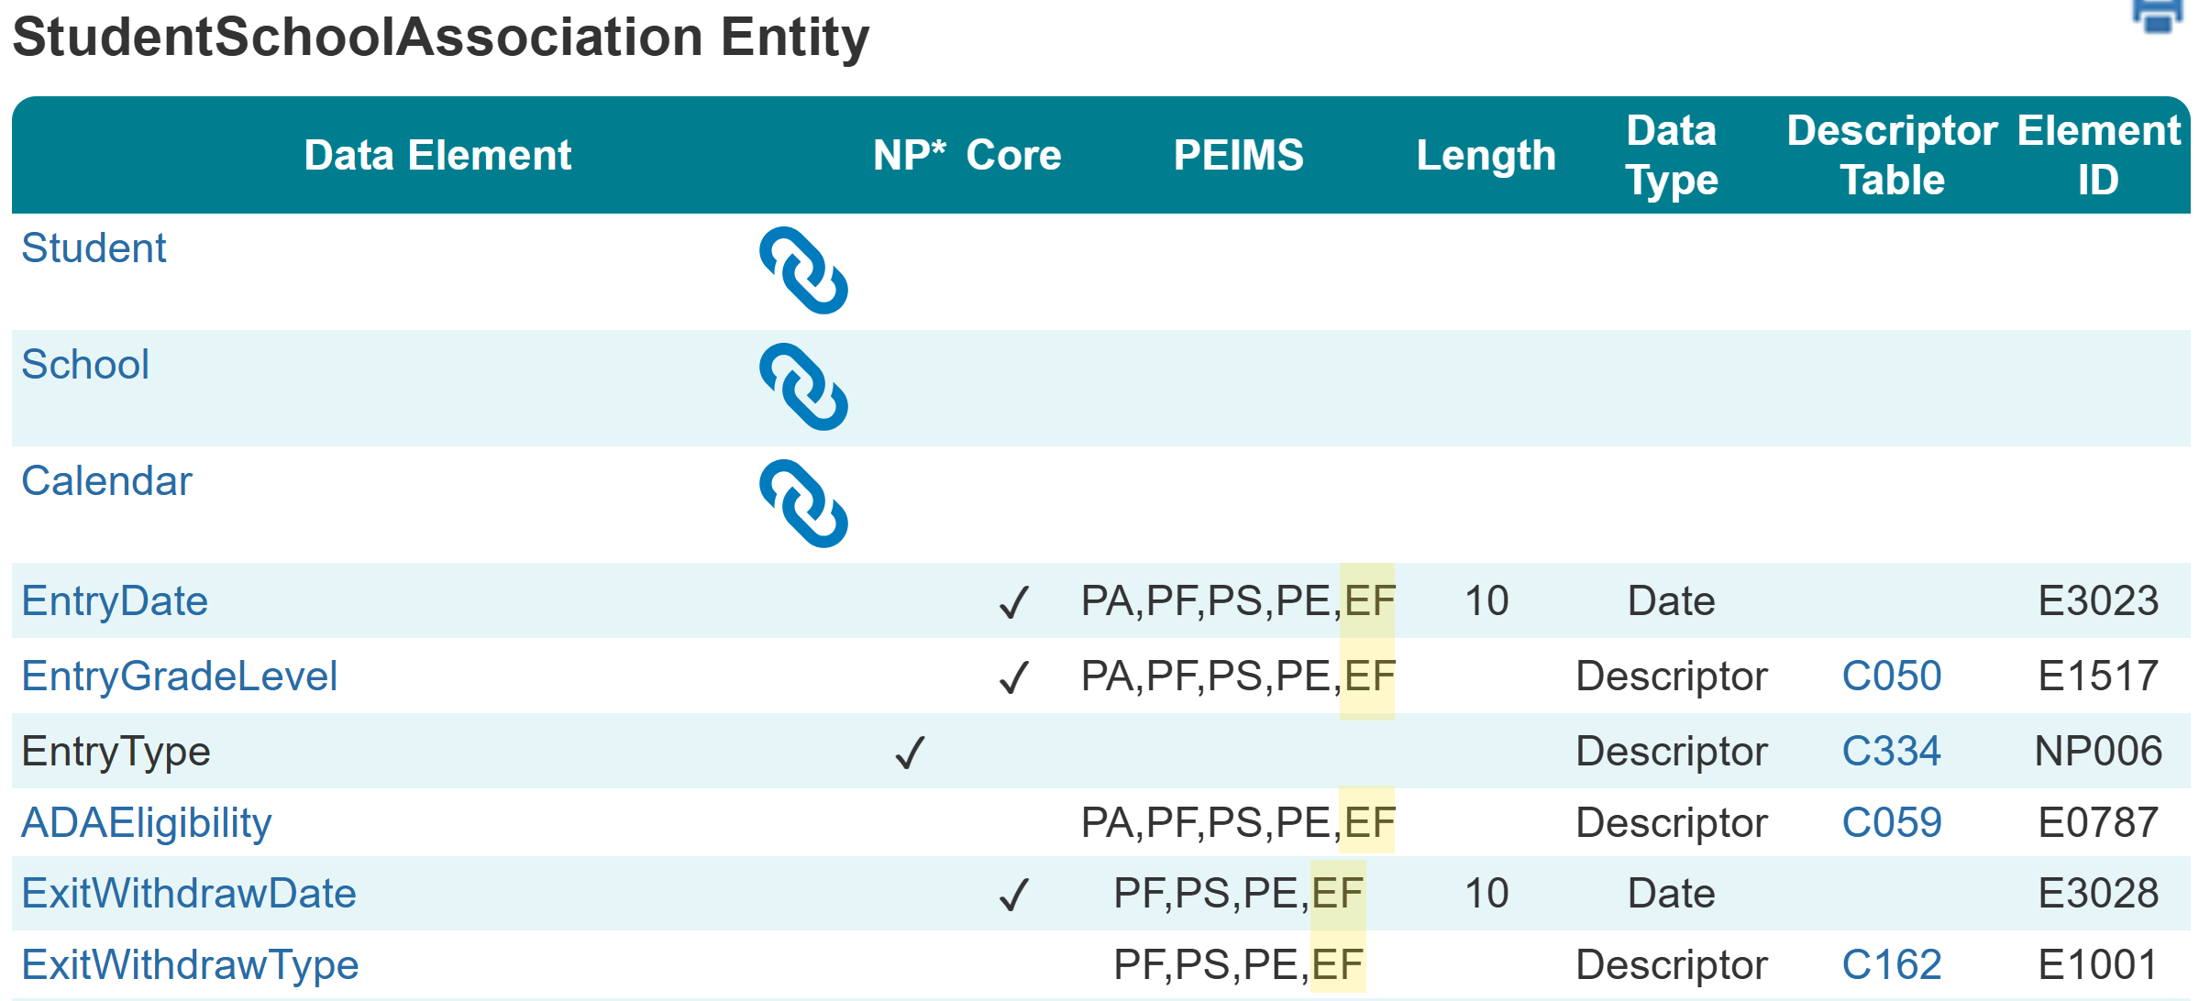
StudentSchoolAssociation Entity
The following is added to the PEIMS Fall Enrollment Submission:
  Data Elements:
    Student (Reference)
    School (Reference)
    Calendar (Reference)
    EntryDate (E3023)
    EntryGradeLevel (E1517)
    ADAEligibility (E0787)
    ExitWithdrawDate (E3028)
    ExitWithdrawType (E1001)

Slide 10
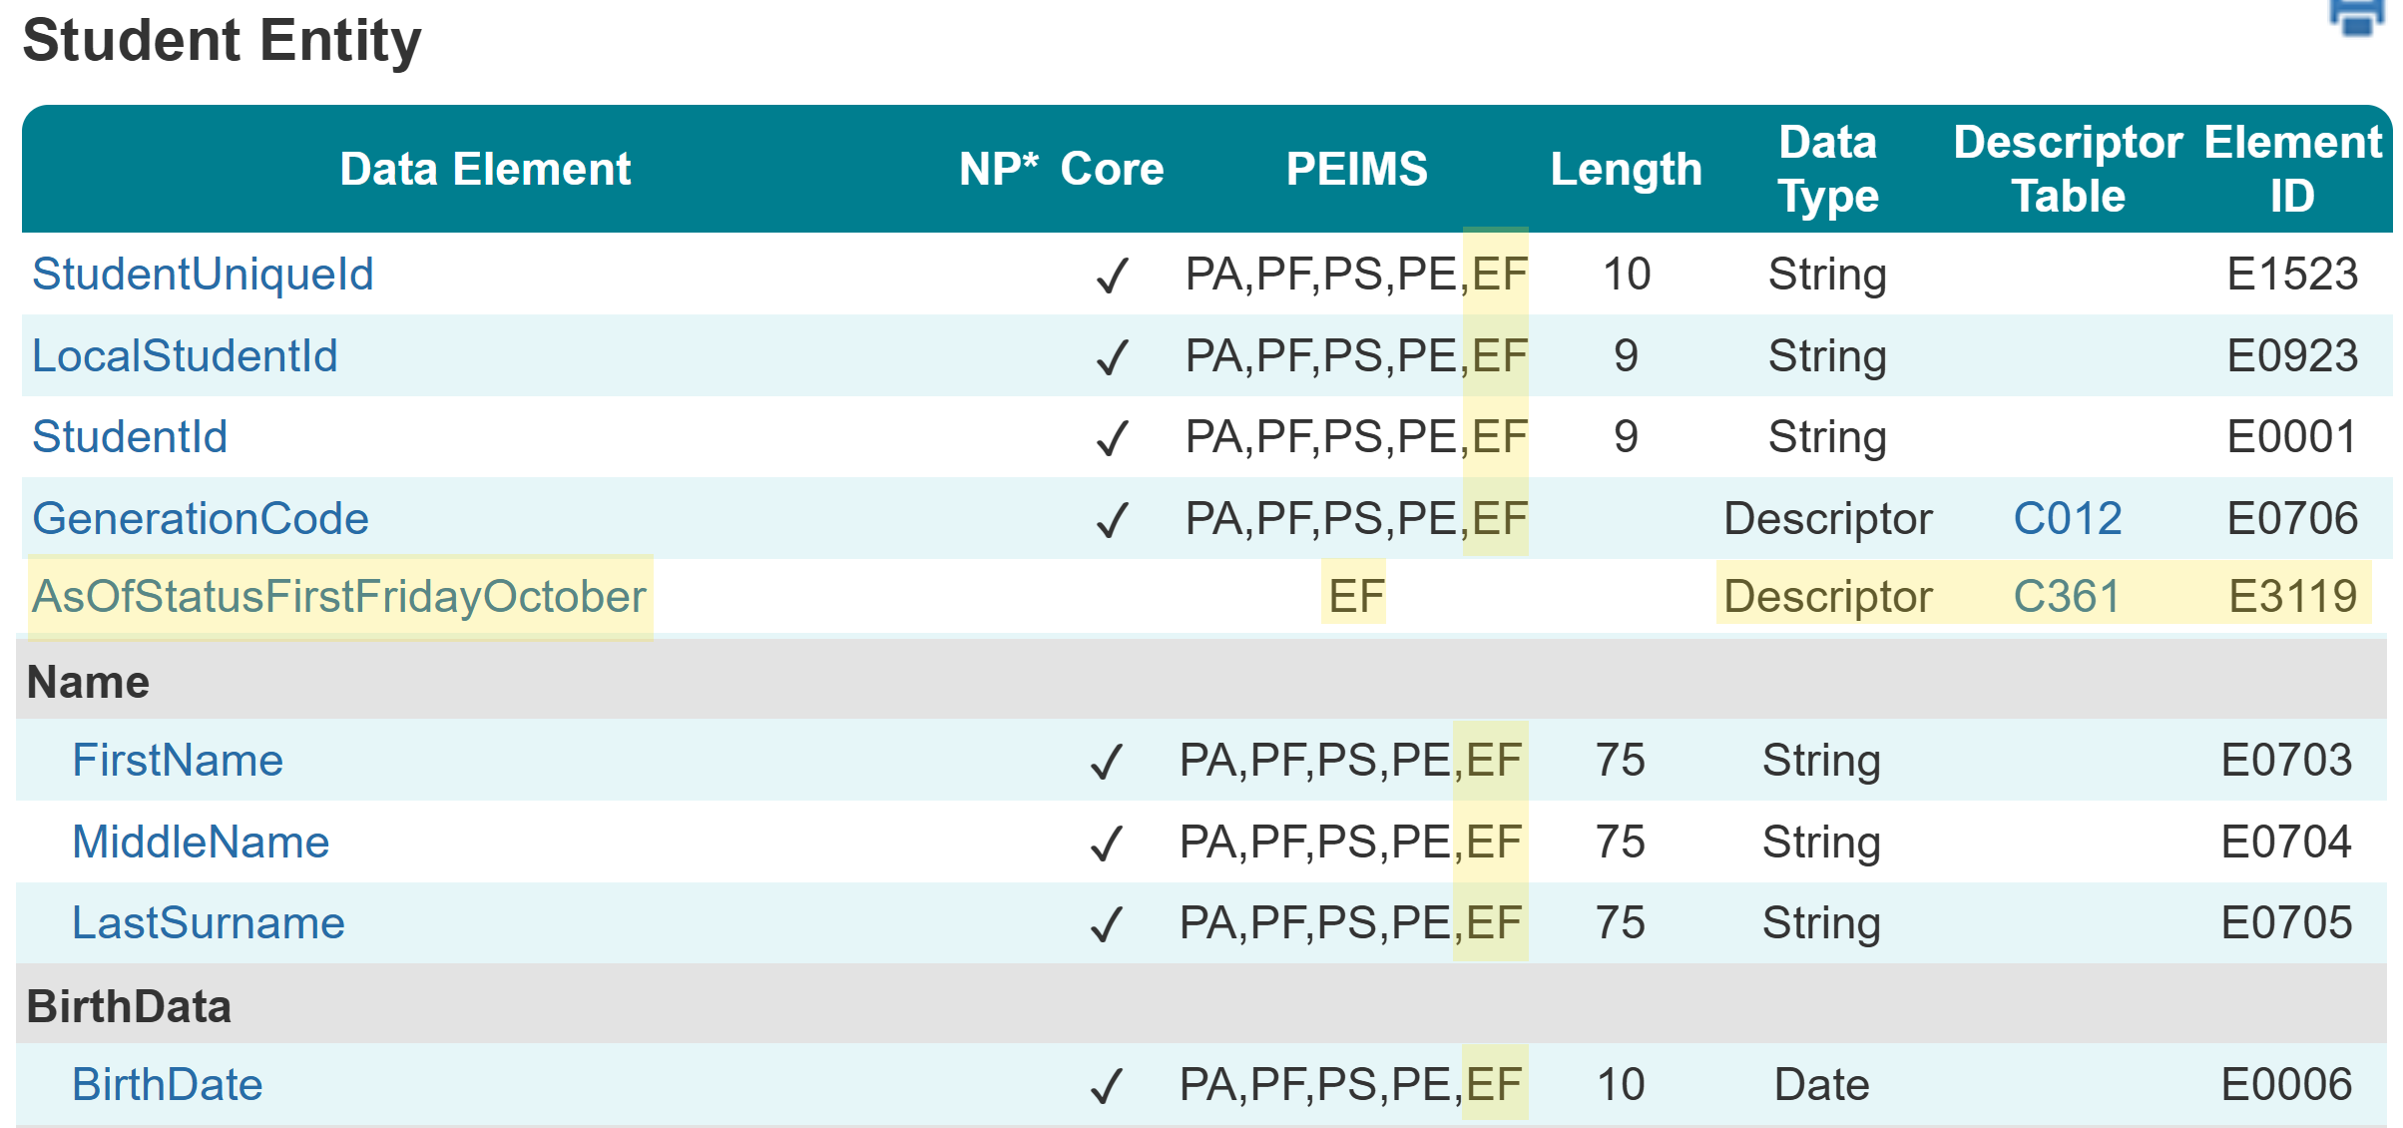
Student Entity
The following is added to the PEIMS Fall Enrollment Submission:
  Common Types:
    Name
    BirthData
  Data Elements:
    StudentUniqueId (E1523)
    LocalStudentId (E0923)
    StudentId (E0001)
    GenerationCode (E0706)
    AsOfStatusFirstFridayOctober (New)
    FirstName (E0703)
    MiddleName (E0704)
    LastSurname (E0705)
    BirthDate (E0006)

Slide 11
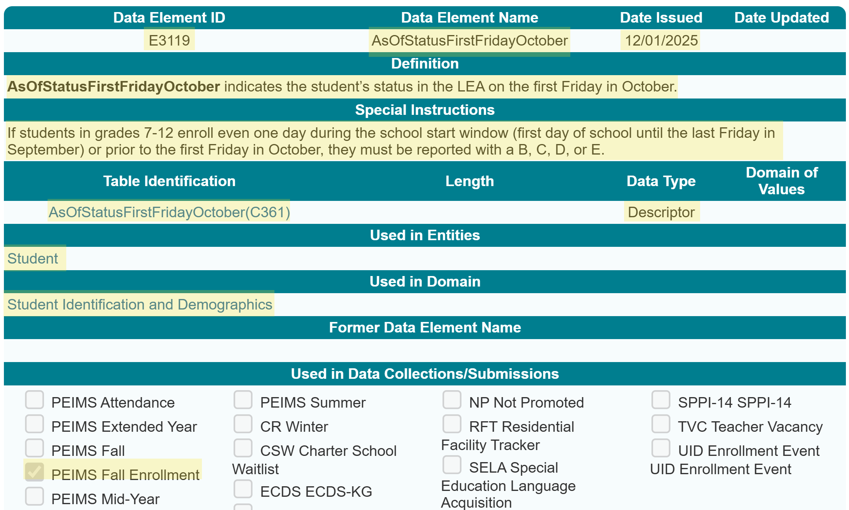
AsOfStatusFirstFridayOctober Data Element

Slide 12
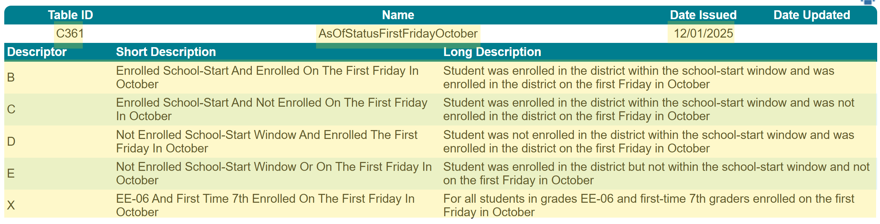
AsOfStatusFirstFridayOctober Descriptor Table

Slide 13
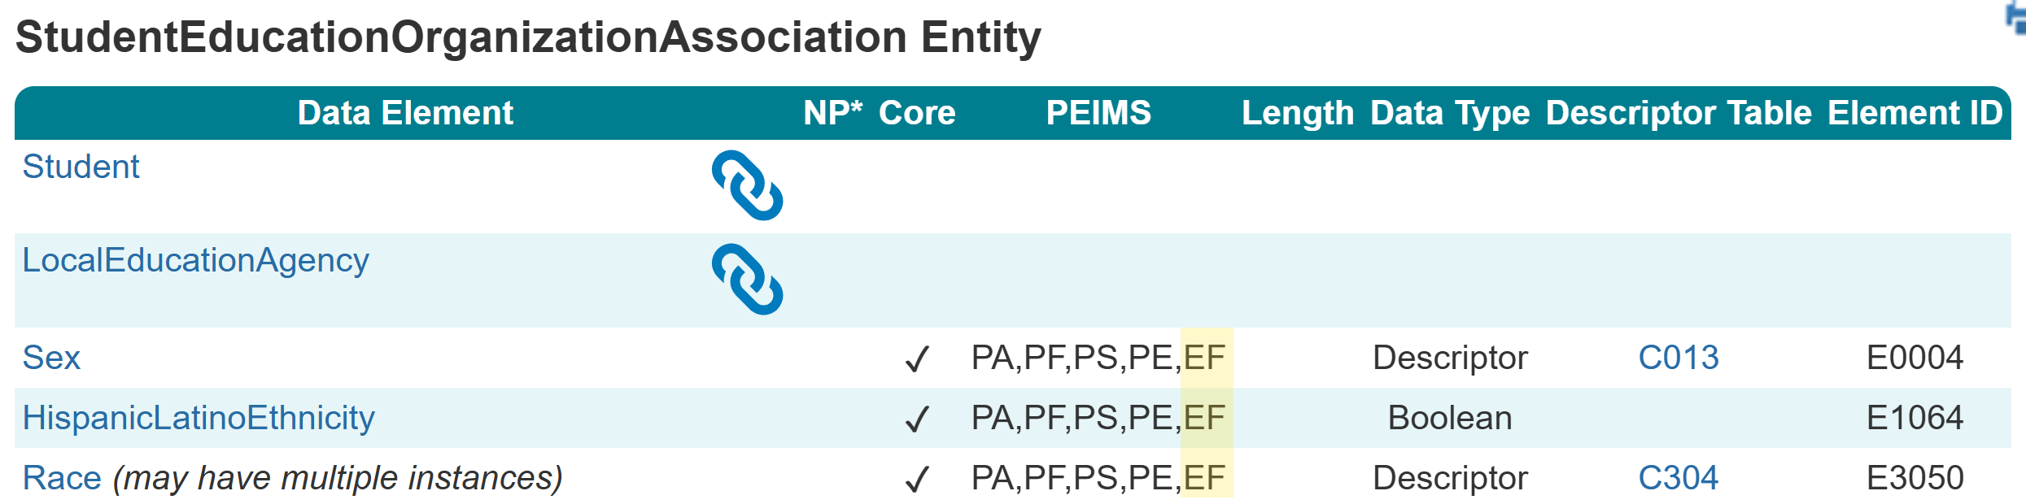
StudentEducationOrganizationAssociation Entity
The following is added to the PEIMS Fall Enrollment Submission:
  Data Elements:
    Student (Reference)
    LocalEducationAgency (Reference)
    Sex (E0004)
    HispanicLatinoEthnicity (E1064)
    Race (E3050)

Slide 14
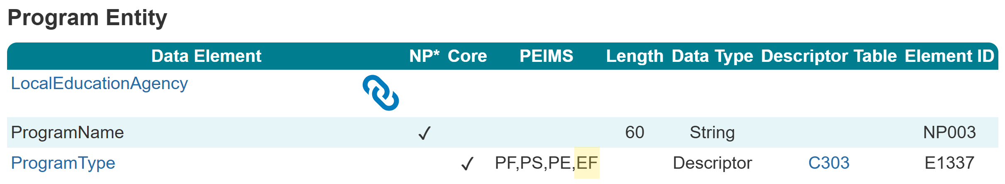
Program Entity
The following is added to the PEIMS Fall Enrollment Submission:
  Data Elements:
    Local Education Agency (Reference)
    ProgramName (E3049)
    ProgramType (E1337)

Slide 15
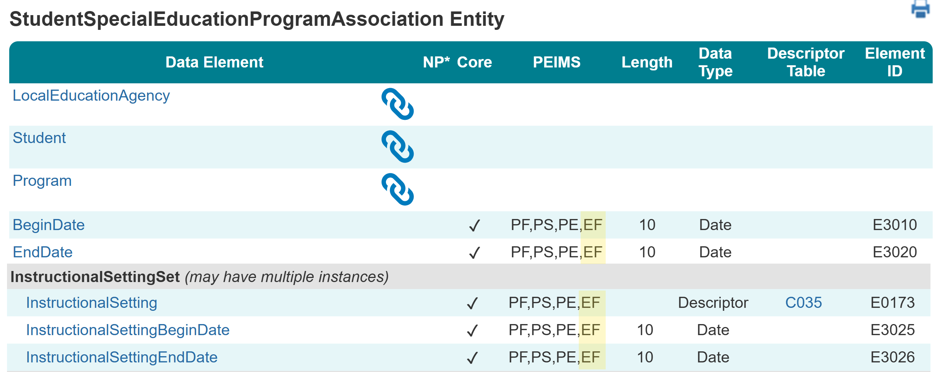
StudentSpecialEducationProgramAssociation
The following is added to the PEIMS Fall Enrollment Submission:
  Common Types:
    InstructionalSettingSet
    Disability
    EducationalEnvironmentSet
  Data Elements:
    School (Reference)
    Student (Reference)
    Program (Reference)
    BeginDate (E3010)
    EndDate (E3020)
    InstructionalSetting (E0173)
    InstructionalSettingBeginDate (E3025)
    InstructionalSettingEndDate (E3026)

Slide 16
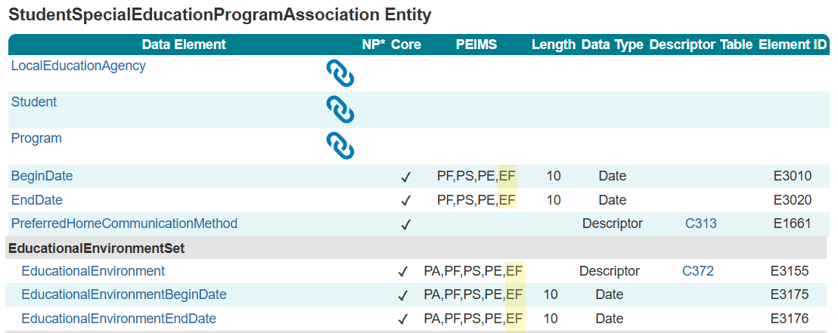
Continued
The following is added to the PEIMS Fall Enrollment Submission:
  Data Elements:
    EducationalEnvironment (E3155)
    EducationalEnvironmentBeginDate (E3175)
    EducationalEnvironmentEndDate (E3176)

Slide 17
TIMELINE

Slide 18
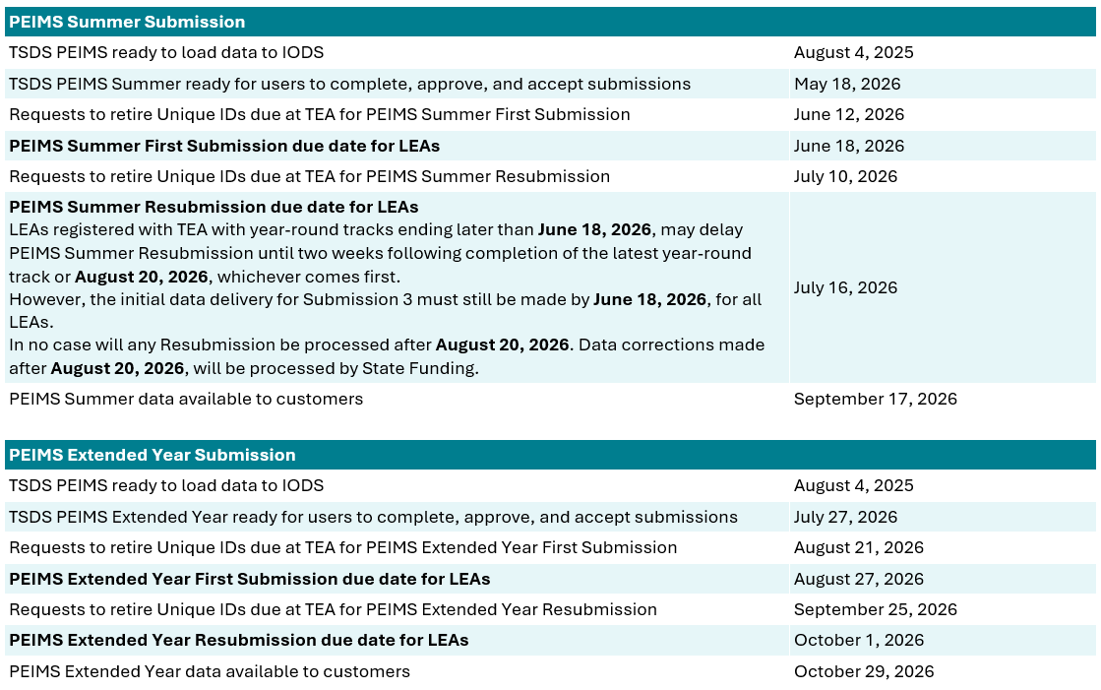
2025-2026 Timeline
2025-2026 School Year
2025-2026 school year Leavers and Graduates reported in the 2025-2026 PEIMS Summer and Extended Year Submissions.

Slide 19
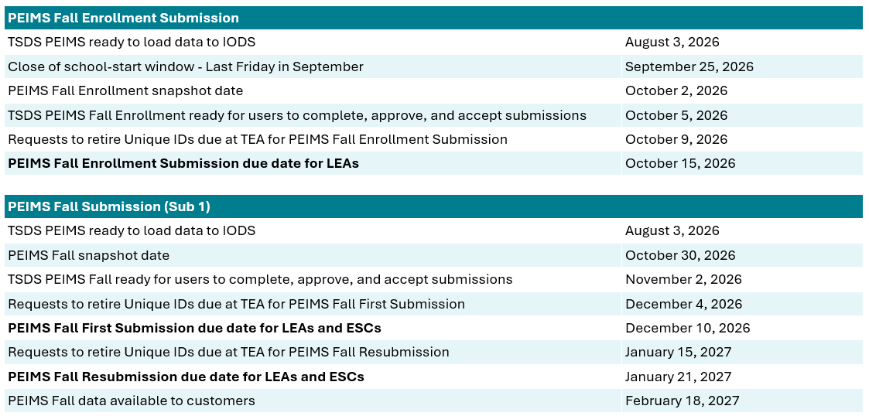
2026-2027 Timeline
2026-2027 School Year
New PEIMS Fall Enrollment Submission.
PEIMS Fall Submission excludes leavers and graduates.

Slide 20
APPLICATION AND PROMOTION LOGIC

Slide 21
PEIMS Application: Overview
Fall Enrollment will be accessible via the PEIMS APPLICATION.
Functionality will be similar to other PEIMS submissions:
  Data Element Summary, Search Submission Data, and Retrieve Submission Data will be available.
  A resubmission will not be available.
  A working submission will be available.

Slide 22
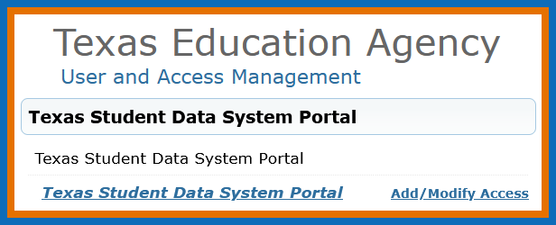
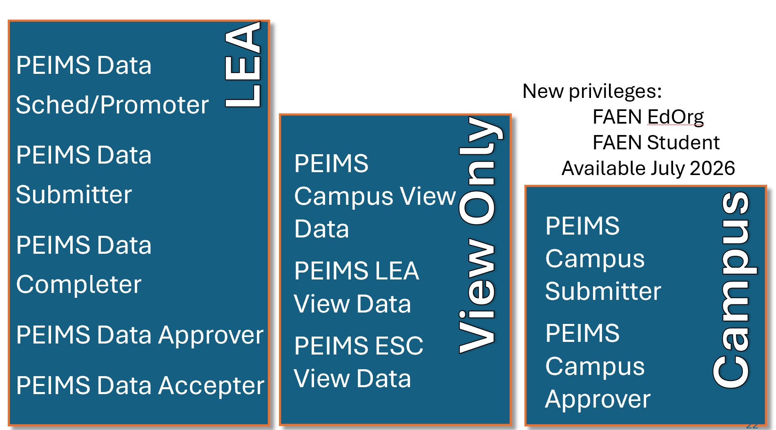
TEAL Roles & Privileges

Slide 23
PEIMS Application: Promotion Logic
The following criteria logic will be applied when promoting students to the PEIMS data mart:
NOTE: In 2026-2027, TEA will pilot *AOSFFO calculation from data provided by LEA.
PEIMS FAEN
Student Buckets
Students in grades EE-6 and first time 7th graders actively enrolled on the first Friday in October AsOfStatusFirstFridayOctober* ‘X’
Students in grade 7-12 with an AsOfStatusFirstFridayOctober* of ‘B’, ‘C’, ‘D’, or ‘E’

Slide 24
BUSINESS RULES

Slide 25
PEIMS Application: Business Rules
Fall Enrollment will utilize both new and existing business rules.
  Refer to TEDS for the complete listing of business rules.
  Additional rules may be added as progress continues in the development of the new submission.
New rules will reflect the new AsOfStatusFirstFridayOctober (E3119) data element.

Slide 26
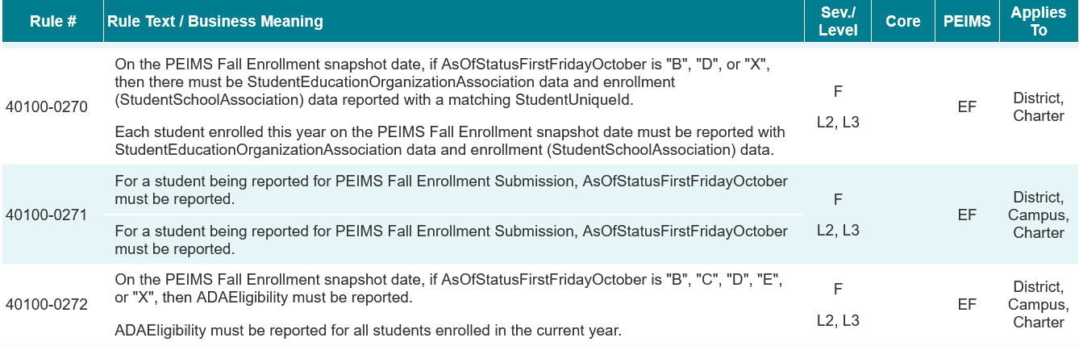
New Business Rules New2
New rules will be added to the PEIMS Fall Enrollment Submission:

Slide 27
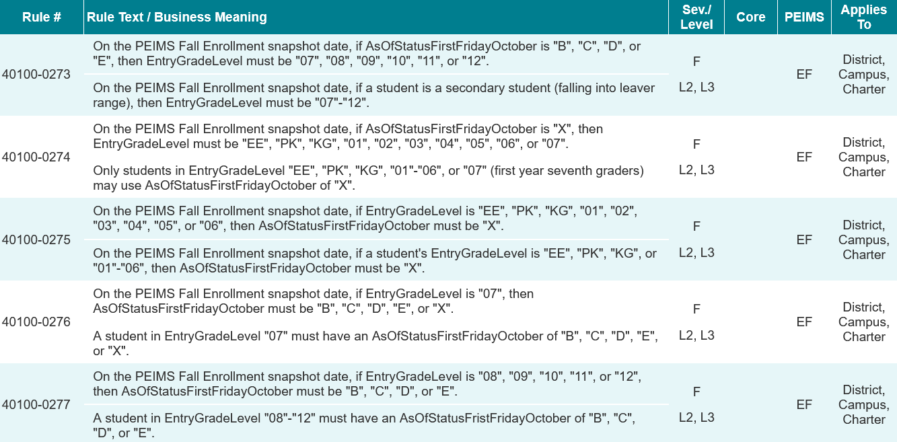
New Business Rules New 2
New rules will be added to the PEIMS Fall Enrollment Submission:

Slide 28
Revised Business Rules 1
Existing rules will be added to the PEIMS Fall Enrollment Submission:
40100-0001
40100-000C
40100-0012
40100-0013
40100-0014
40100-0015
40100-0035
40100-0058
40100-0078
40100-0079
40100-0080
40100-0085
40100-0086
40100-0088
40100-0089
40100-0091
40100-0097
40100-0099
40100-0100
40100-0110
40100-0111
40100-0114
40100-0117
40100-0135
40100-0136
40100-0153

Slide 29

REPORTS

Slide 30
PEIMS FAEN Submission Reports
The PEIMS Fall Enrollment Submission reports are in development.
Twinned PEIMS Fall reports
Reports from several categories will be duplicated into PEIMS FAEN.
Additional new reports
For clarity into the reported data, a few new reports will be created.

Slide 31
Standard Report Groups
PDM6-120-001
PDM6-120-006
PDM6-120-004
PDM6-120-005
PDM6-120-NEW
Student
Student Type by Grade, Ethnicity, and Sex
Students by ADA Eligibility and Grade
Student Data Review
Students Not Enrolled on Selected PEIMS Date
**fall enrollment roster**
Special Education
PDM6-121-002
Special Education Students by Disability
PDM6-121-006
Special Education Roster by Grade
PDM6-121-007
LEA Summary of Special Education Students Disability
PDM6-121-009
Special Education Student Roster

Slide 32
Special Report Groups
Special
PDM6-230-001
Data Element Summary Report
Submission Summary Report
Student Summary by Sex and Ethnicity
PDM6-231-002
Percentage of Change from Prior Year: Student Demographics, Characteristics, & Programs
PDM6-230-002
PDM6-230-003
Student Leaver
PDM6-326-001
Name: TBD
Statewide
PDM6-403-001
Duplicate Student Report for Enrollment and Graduates
ESC-Level
PDM6-454-001
Students Not Enrolled on Fall Enrollment PEIMS Snapshot Date

Slide 33
TRAINING DATES

Slide 34
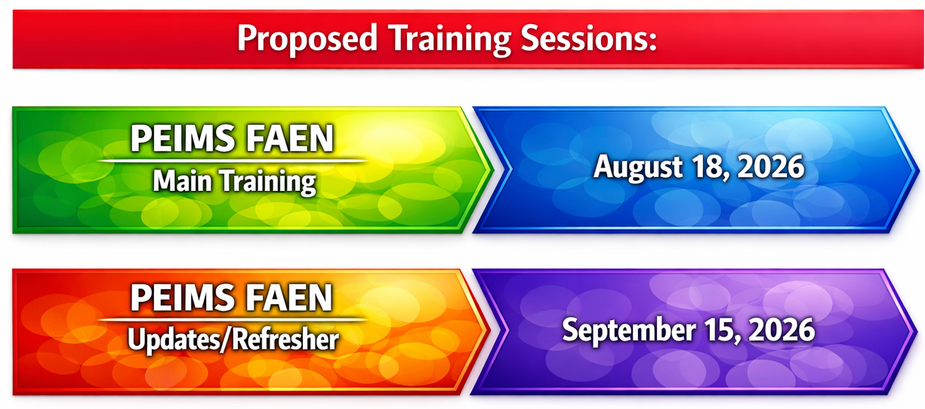
Training Dates For PEIMS FAEN

Slide 35
QUESTIONS
QUESTIONS?

