Slide 1

TITLE SLIDE: Data Standards Changes
2026-2027 DATA STANDARDS CHANGES
April 1, 2026
<NAME OF COMPONENT> (ALL CAPS)
MARCH 19-21, 2024

Slide 2

Agenda – 2026-2027 Data Standards Changes
2026-2027
  PEIMS
    Sunset of EarlyReadingIndicator
    StaffClassification and AuxiliaryRoleId Changes for Nurse
    Sunset of New Tech Student Characteristic
    Pathways in Technology Early High School, Year 5 and Year 6 Student Characteristic Descriptors
    Education Savings Account Student Characteristic
    Applied Sciences Pathway Program Participation Student Characteristic
    Accelerated Instruction Descriptor Tables
    ArmedForcesQualificationTestScore Data Element
    Reason NoSPEDServices Data Element and Descriptor Table
  Questions

Slide 3

TITLE SLIDE: OnRamps Dual Enrollment Indicator
Sunset of EarlyReadingIndicator
NAME OF COMPONENT (ALL CAPS)
MARCH 19-21, 2024

Slide 4
Background
The EarlyReadingIndicator (E1522) was marked as DEPRECATED for the 2025-2026 school year, in the 2026.2.2 Texas Education Data Standards Publication.
The EarlyReadingIndicatorSet Common Type and the EarlyReadingIndicator (E1522), were removed for the 2026-2027 school year in the 2027.1.0 TEDS publication.

Slide 5
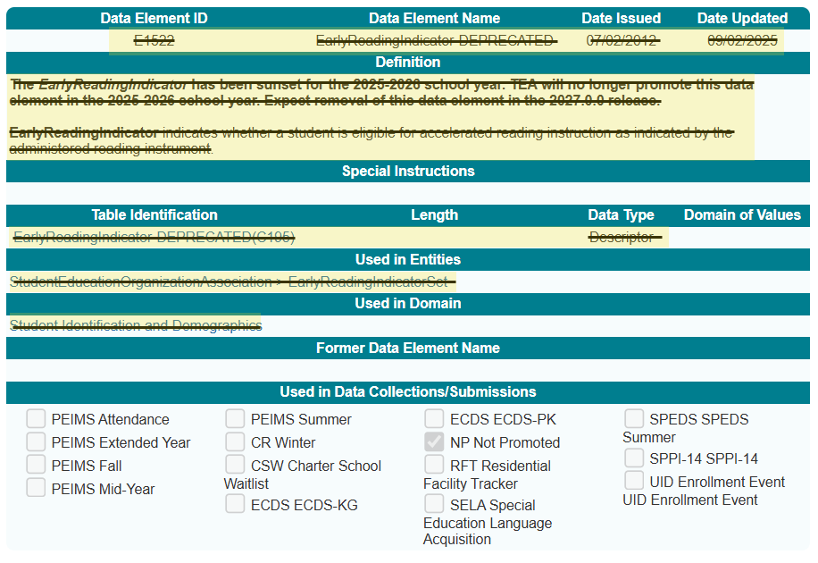
EarlyReadingIndicator (E1522)
Deleted EarlyReadingIndicator (E1522) data element.

Slide 6
StaffClassification and AuxiliaryRoleId Changes for Nurse
NAME OF COMPONENT (ALL CAPS)
MARCH 19-21, 2024

Slide 7
Background 1
Local Education Agencies (LEAs) report all professional, paraprofessional, and auxiliary staff employed as of the last Friday in October in the PEIMS Fall Submission. Professional staff are reported using descriptors in the StaffClassification (C021) descriptor table while auxiliary staff are reported using descriptors in the AuxiliaryRoleId (C213) descriptor table. Currently, the StaffClassification (C021) 022 (School Nurse) descriptor includes Licensed Vocational Nurses (LVNs), Registered Nurses (RNs), and Nurse Practitioners (NPs) This classification is inconsistent with the Texas Administrative Code (TAC) §153.1021, which defines a school nurse specifically as a Registered Nurse (RN) licensed to practice professional nursing in Texas.

Slide 8
Background Continued
One descriptor will be removed, and one descriptor will be added to the StaffClassification (C021) descriptor table to collect in the PEIMS Fall Submission if a staff member is employed as a Registered Nurse (RN).
One descriptor will be added to the AuxiliaryRoleId (C213) descriptor table to collect in the PEIMS Fall Submission if a staff member is employed as a Licensed Vocational Nurse (LVN), Certified Nursing Assistant (CAN), or clinic aide.

Slide 9
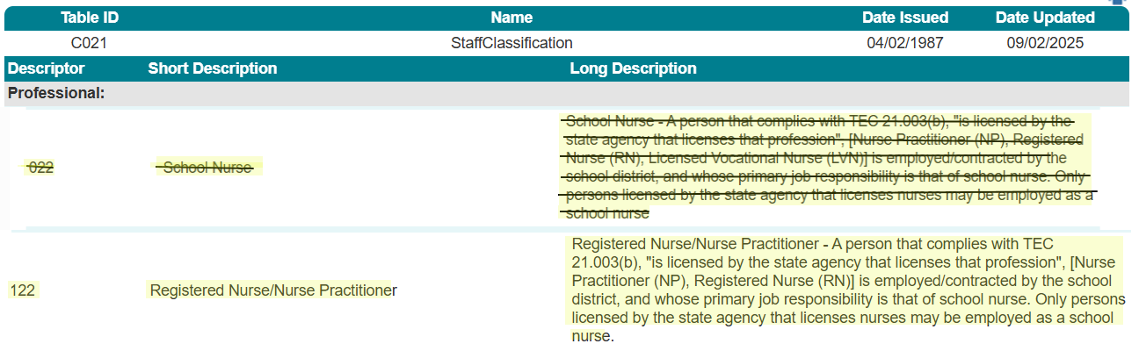
StaffClassification (C021)

Slide 10
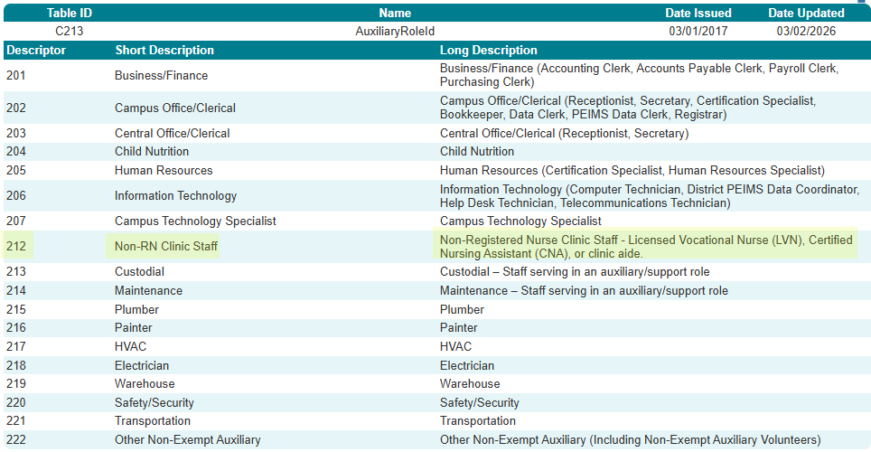
AuxiliaryRoleId (C213)

Slide 11
Business Rule Changes
The following rules will be revised in the PEIMS Fall Submission:
30060-0050
30060-0051
30060-0058
30090-0031
30090-0071
30090-0080

Slide 12
TITLE SLIDE: Accelerated Instruction Changes
Sunset of New Tech Student Characteristic
NAME OF COMPONENT (ALL CAPS)
MARCH 19-21, 2024

Slide 13
Background
House Bill 2 removed the additional $150 per‑student funding for New Tech Network campuses by amending Section 48.106(a‑1) of the Education Code.
The College, Career, and Military Preparation Division sunset descriptor 8 – New Tech, in the StudentCharacteristic (C344) descriptor table used in the PEIMS Fall, Summer, and Extended Year Submissions for 2026–2027, as it was used solely to determine eligibility for the now‑eliminated allotment.

Slide 14
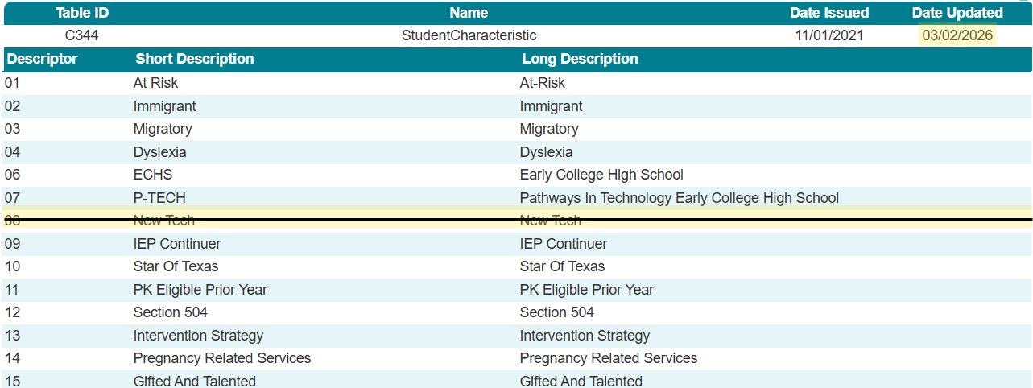
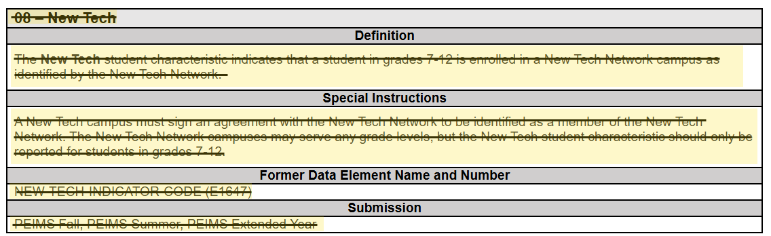
StudentCharacteristic (C344)

Slide 15
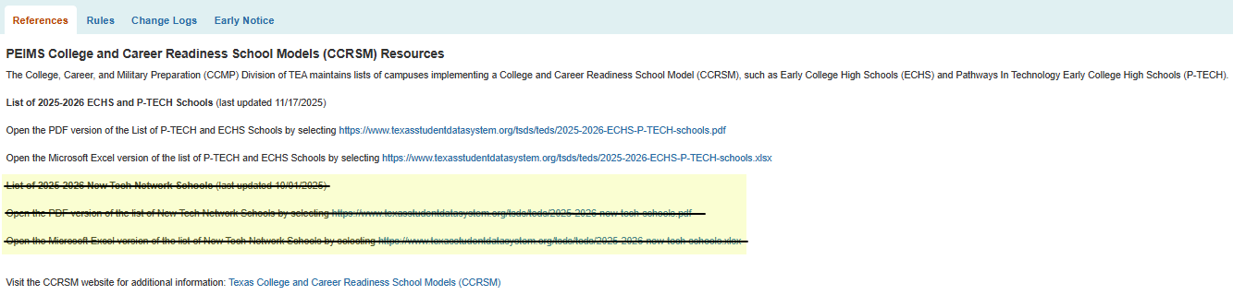
References

Slide 16
Business Rule Changes
The following rules will be deleted in the PEIMS Fall, Summer and Extended Year Submissions:
10020-0057
40100-0194
40100-0195
40100-0196

Slide 17
TITLE SLIDE: Discipline Changes
P-TECH, Year 5 and Year 6 Student Characteristic Descriptors
NAME OF COMPONENT (ALL CAPS)
MARCH 19-21, 2024

Slide 18
Background
Under the current Texas Education Code, §29.551–29.557, the Pathways in Technology Early High School (P-TECH) program must enable students to earn a high school diploma, a postsecondary credential (associate degree, certificate, or industry certification), and complete work-based training within six years of starting high school. P-TECH students are identified in TSDS PEIMS using StudentCharacteristic (C344) code 07. House Bill 2 from the 89th Legislative Session expands eligibility for the Financial Aid for Swift Transfer (FAST) Program and Foundation School Program funding to P-TECH students continuing the program one- or two-years post-graduation.

Slide 19
Background Continued
The College, Career, and Military Preparation Division determined two new student characteristics were needed to identify P-TECH Year 5 students and P-TECH Year 6 students.
Two new descriptors are added to the StudentCharacteristic (C344) descriptor table collected in the PEIMS Attendance, Fall Enrollment, Fall, Summer and Extended Year Submissions.

Slide 20
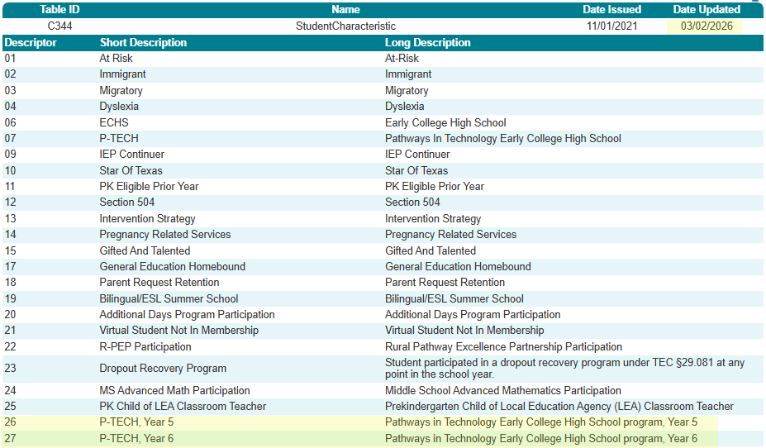
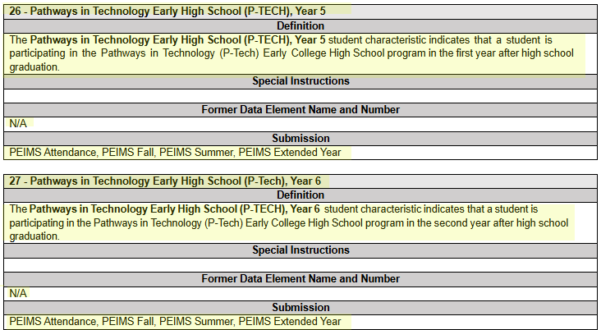
StudentCharacteristic (344)

Slide 21
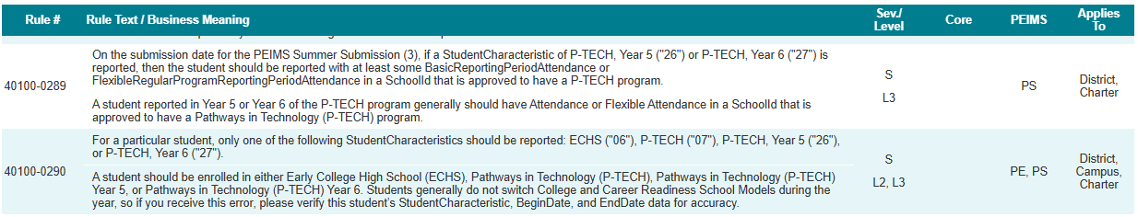
Business Rule Changes 1
The following rules will be added in the PEIMS Summer and Extended Year Submissions:
40100-0289
40100-0290

Slide 22
Business Rule Changes
The following rules will be revised in the PEIMS, Fall, Summer and Extended Year Submissions:
40100-0168
40100-0171
40100-0181

Slide 23
TITLE SLIDE: Advanced Technical Credit
Education Savings Account Student Characteristic
NAME OF COMPONENT (ALL CAPS)
MARCH 19-21, 2024

Slide 24
Background 2
SB 2 adds Subchapter J to Chapter 29 of the Texas Education Code, creating the Education Savings Account (ESA) program. Section 29.3611 outlines funding and accountability rules for students who return to a public or charter school mid‑year after participating in an ESA. Districts and charters receive an additional allotment based on the student’s average daily attendance to ensure adequate funding. The student’s performance is also excluded from accountability ratings for that school year.
One new descriptor is added to the StudentCharacteristic (C344) descriptor table collected in the PEIMS Attendance, Fall, and Summer Submissions.

Slide 25
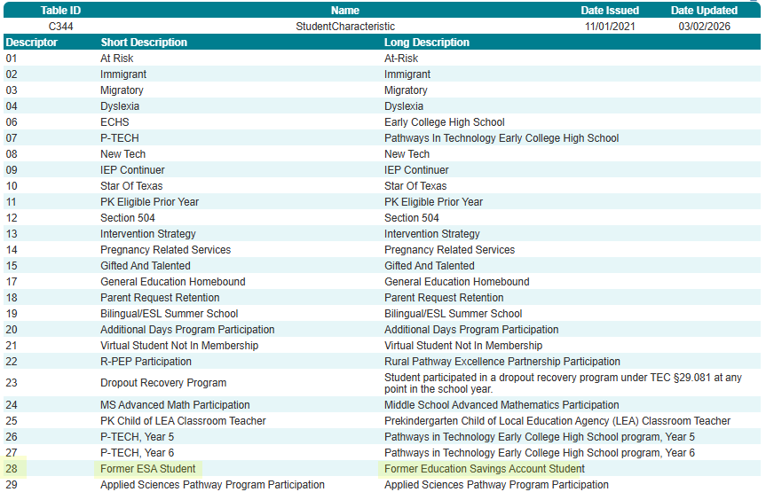
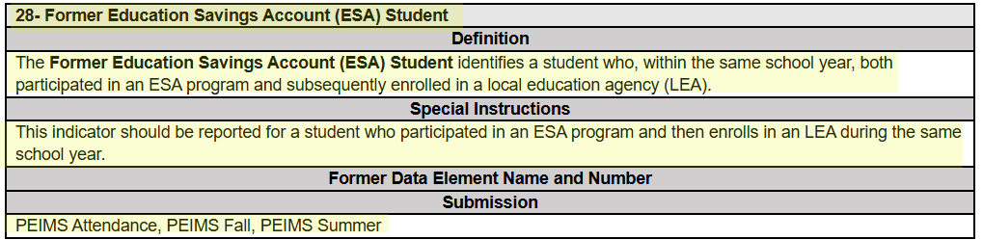
StudentCharacteristic (C344)

Slide 26
Applied Sciences Pathway Program Participation Student Characteristic
NAME OF COMPONENT (ALL CAPS)
MARCH 19-21, 2024

Slide 27
Background
House Bill 20 added Section 29.914 to the Education Code, creating the Applied Sciences Pathway, which lets students earn a high school diploma while completing a certificate in fields like plumbing, electrical, welding, or HVAC through required partnerships between schools and higher education institutions.
One new descriptor, 29 – Applied Sciences Pathway Program Participation, is added to the StudentCharacteristic (C344) descriptor table collected in the PEIMS Fall, Summer, and Extended Year Submissions.

Slide 28
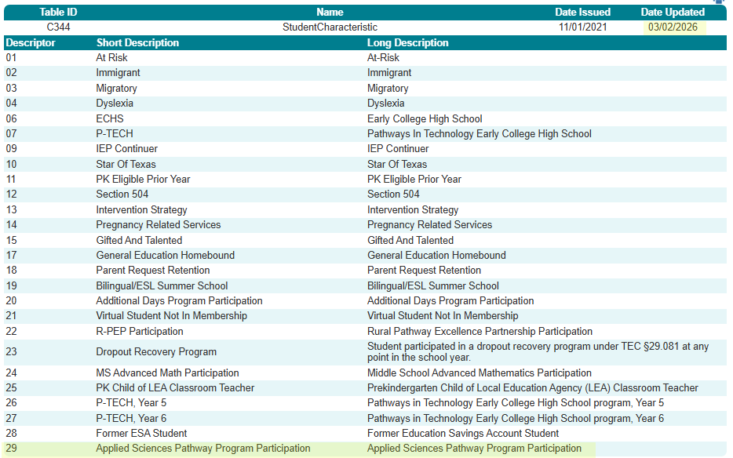
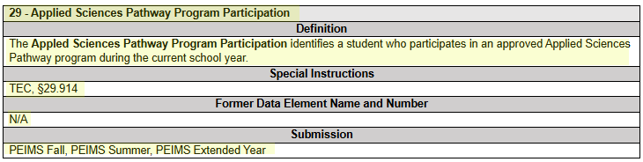
StudentCharacteristic (344)

Slide 29
Business Rule Changes
Rule impacts will be published in the Addendum version v2027.2.0. The rule impacts identified are new rules to verify Applied Sciences students against a list of approved Applied Sciences schools, which should be provided by the program area in June 2026.

Slide 30
TITLE SLIDE: New Classroom Position
Accelerated Instruction Descriptor Tables
NAME OF COMPONENT (ALL CAPS)
MARCH 19-21, 2024

Slide 31
Background 3
House Bill 1416 (88th Legislature, 2023) strengthened accelerated and supplemental instruction requirements for students who do not meet satisfactory performance on state assessments, requiring at least 15 hours of support—or 30 hours for significantly below‑satisfactory performance. TEA initially responded in 2023–2024 by adding TREx elements to transfer accelerated learning plan data, and in 2024–2025 expanded this work through TEDS updates, creating the AcceleratedInstructionSet in the StudentEducationOrganizationAssociation Entity, collected in the PEIMS Summer Submission.
Early data analysis showed the need for additional descriptors to improve accuracy, consistency, and reporting.

Slide 32
Background Continued 1
Texas Education Data Standards Change:
  One new descriptor is added to the StudentAcceleratedInstructionParticipation (C353) descriptor table and one new descriptor to the DifferenceReasonHoursAcceleratedInstruction (C354) descriptor table used in the StudentEducationOrganizationAssociation Entity, collected in the PEIMS Summer Submission.
Texas Records Exchange (TREx) Change:
  One new code is added to the STUDENT-ACCELERATED-INSTRUCTION-PARTICIPATION (TC50) code table.

Slide 33
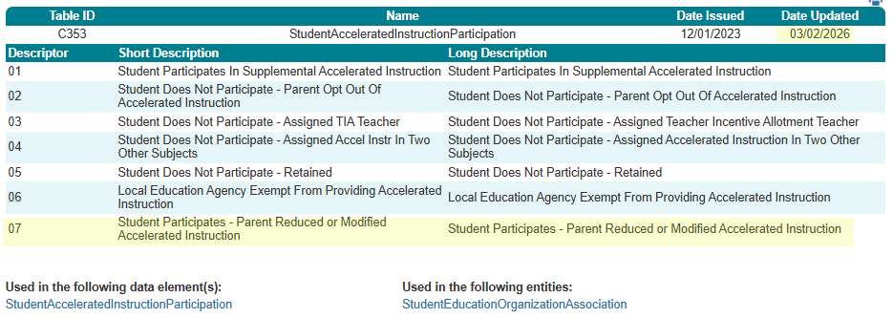
StudentAcceleratedInstructionParticipation (C353)

Slide 34
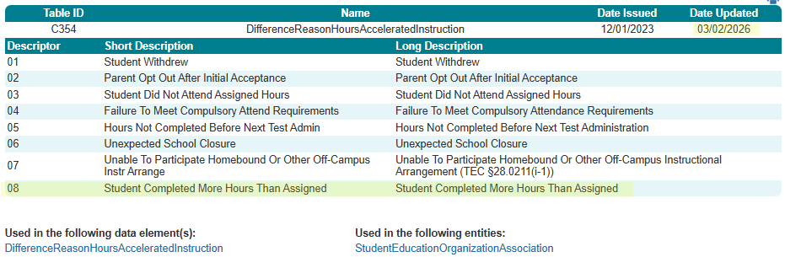
DifferenceReasonHoursAcceleratedInstruction (C354)

Slide 35
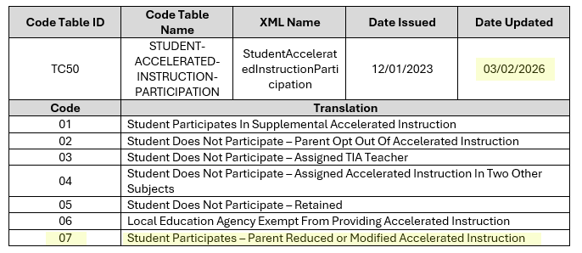
TREx: STUDENT-ACCELERATED-INSTRUCTION-PARTICIPATION Code Table

Slide 36
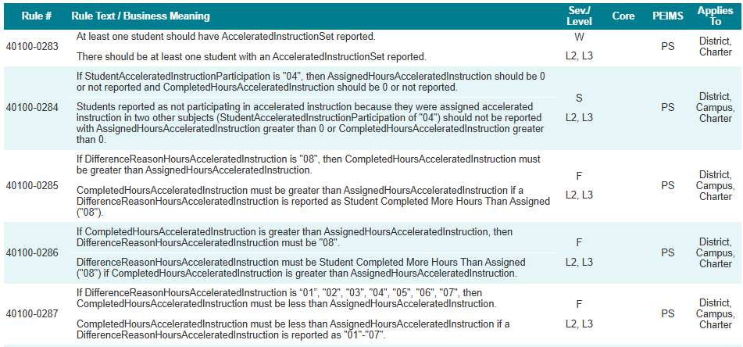
Business Rule Changes 3
The following rules will be added in the PEIMS Summer Submission:
40100-0283
40100-0284
40100-0285
40100-0286
40100-0287

Slide 37
Business Rule Changes 4
The following rules will be revised in the PEIMS Summer Submission:
40100-0256
40100-0257
40100-0258
40100-0263

Slide 38
TITLE SLIDE: Special Education Changes
ArmedForcesQualificationTestScore Data Element
NAME OF COMPONENT (ALL CAPS)
MARCH 19-21, 2024

Slide 39
Background 4
House Bill 8, passed in the Second Special Session of the 89th Texas Legislature, amended TEC §39.053 to add new performance indicators for evaluating high school campuses and districts. One key indicator measures military readiness, recognizing students who achieve a passing score on the Armed Services Vocational Aptitude Battery (ASVAB) test. The passing score is set by the commissioner and aligned with standards from the U.S. Armed Forces. The Armed Forces Qualification Test Score (AFQT) is derived from specific sections of the ASVAB.
One new data element, ArmedForcesQualificationTestScore (E3173), is added to the StudentEducationOrganizationAssociation Entity collected in the PEIMS Summer Submission.

Slide 40
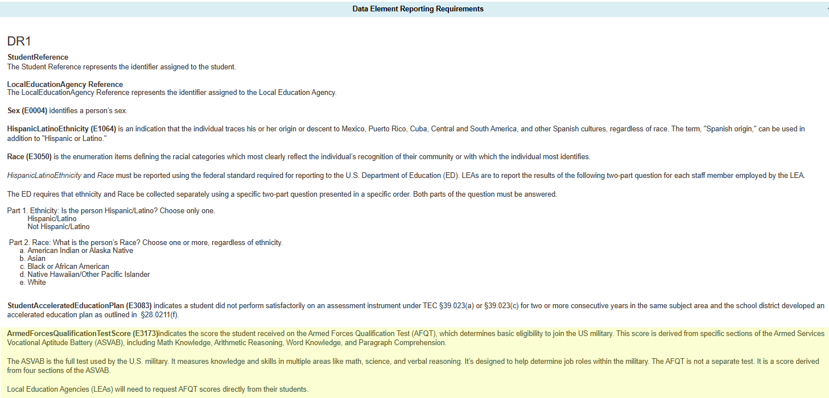
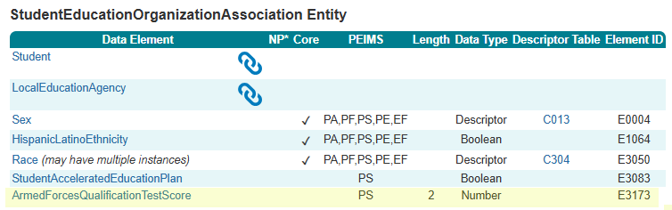
ArmedForcesQualificationTestScore (E3173)

Slide 41
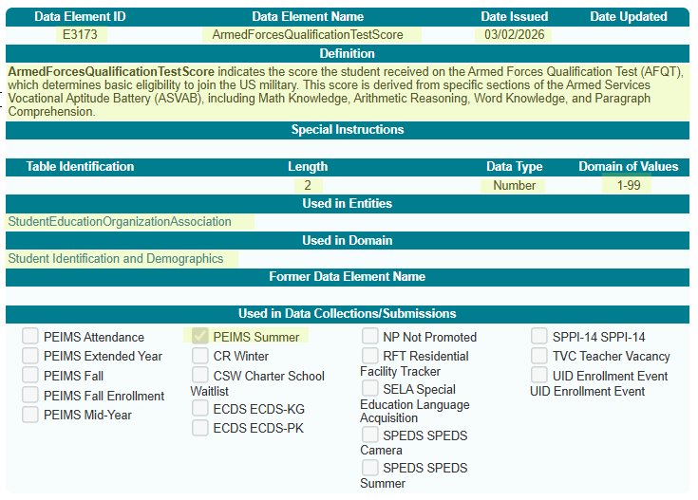
ArmedForcesQualificationTestScore (E3173) 1
New ArmedForcesQualificationTestScore (E3173) data element.

Slide 42
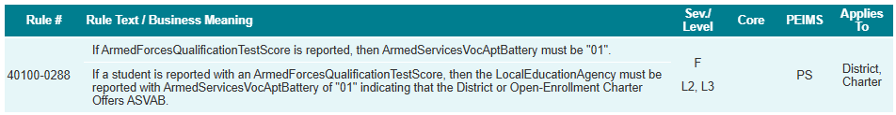
Business Rule Changes
The following rule will be added in the PEIMS Summer Submission:
40100-0288

Slide 43
Reason NoSPEDServices Data Element and
Descriptor Table
NAME OF COMPONENT (ALL CAPS)
MARCH 19-21, 2024

Slide 44
Background 5
Currently, TEA collects only the high-level IDEAIndicator (E1717) data element indicating if a student is eligible and enrolled in special education services. It does not capture details on why services are not provided. This limits monitoring and compliance, especially for parent refusals and private school placements.
The Special Populations and Student Supports Division determined that this data element does not provide sufficient information for accurate special education monitoring and compliance.
One new data element, ReasonNoSPEDServices (E3174), revision of IDEAIndicator (E1717) data element definition, and one new descriptor table, ReasonNoSPEDServices (C377), with four descriptors will be added to the StudentSpecialEducationProgramEligibilityAssociation Entity to be collected in the Special Education Data System Summer Submission.

Slide 45
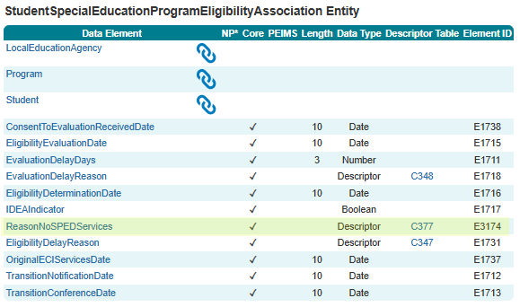
ReasonNoSPEDServices (E3174) Data Element

Slide 46
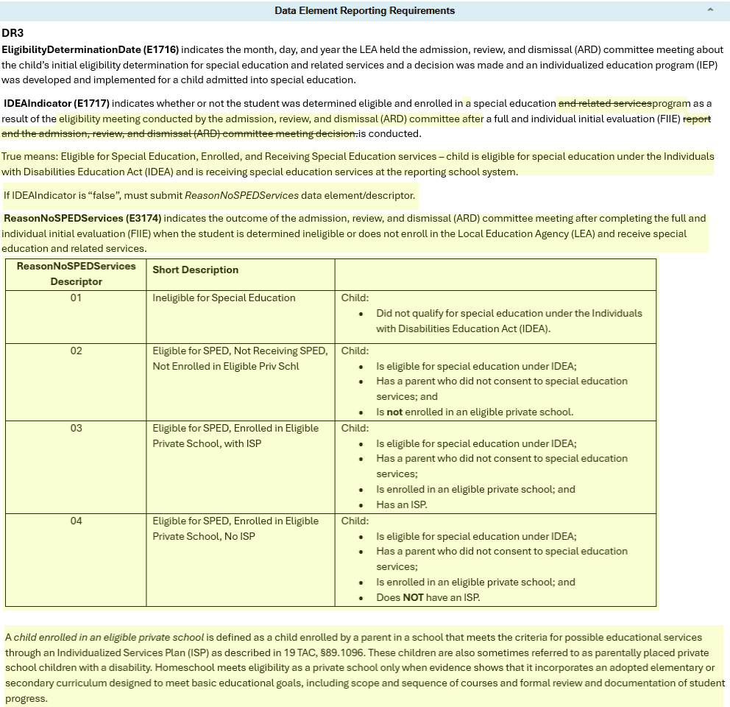
ReasonNoSPEDServices (E3174) and
IDEAIndicator (E1717) Data Elements

Slide 47
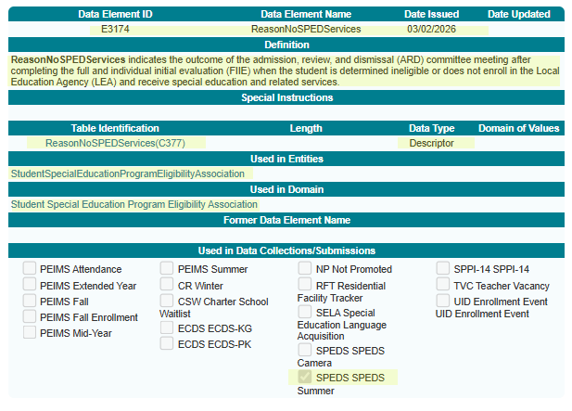
ReasonNoSPEDServices (E3174)
New ReasonNoSPEDServices (E3174) data element.​

Slide 48
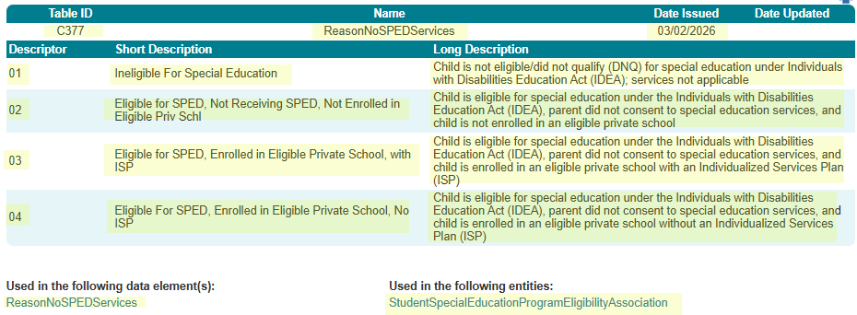
ReasonNoSPEDServices (C377)
New ReasonNoSPEDServices (C377) descriptor table.

Slide 49
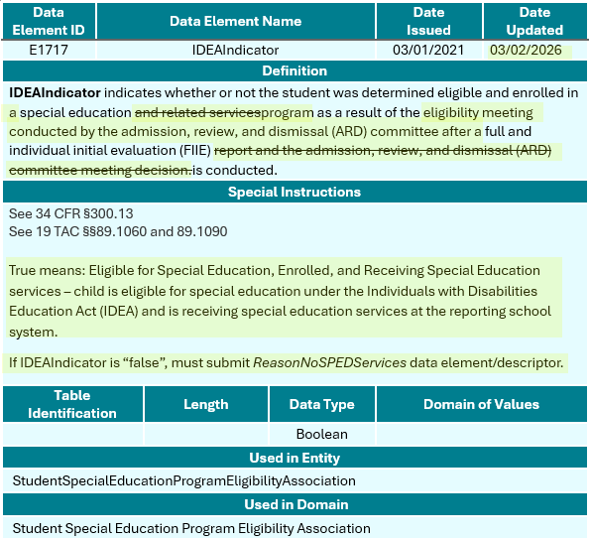
IDEAIndicator (E1717)
Revised IDEAIndicator (E1717) data element.​

Slide 50
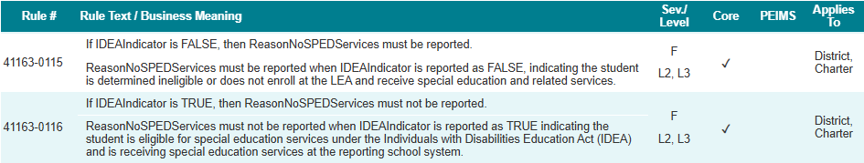
Business Rule Changes
The following rules will be added in the SPEDS Summer Submission:
41163-0115
41163-0116

Slide 51

QUESTIONS
QUESTIONS?

