Slide 1

Collection of Grievance Data
April 1, 2026

Slide 2

Agenda 2026-2027 Collection of Grievance Data
Overview
Timeline
Data Collection Changes
Business Rules
Reports
Closeout
  Frequently Asked Questions
  Key Takeaways
  Technical Resources
Questions

Slide 3

TITLE SLIDE: Overview
Overview
NAME OF COMPONENT (ALL CAPS)
MARCH 19-21, 2024

Slide 4
Background
SB 12 Section 20 amends Subtitle E, Title 2, Education Code, by adding Chapter 26A.
  TEC §26A.001(a) The board of trustees of a school district shall adopt a grievance policy to address grievances received by the district.
  TEC §26A.001(g) Each school district shall annually submit to the agency a report on grievances filed in the district during the preceding year. The report must include, for each grievance, the resolution of the grievance and any corrective action taken.
  TEC § 26A.003(c) A school district shall submit and make accessible to the agency the location on the district’s Internet website at which the information described by Subsection (a) is available.
  https://tea.texas.gov/about-tea/contact-us/general-education-complaints/raising-concerns-with-your-school-local-grievance-process
  TEA has added a new entity to the PEIMS Summer Submission:
  New – GrievanceExt

Slide 5
Grievance Levels Vary by School District Structure
Grievance levels are not the same in every school district.
A school district may have 3 or 4 levels in its grievance process.
The number of levels depends on:
  - The size of the school district, and
  - Whether the school district's local policy adds an extra level of
  review
For those school districts where an additional level of review is added, the definitions for Levels 2-4 will differ from those of school districts with only 3 grievance levels.

Slide 6
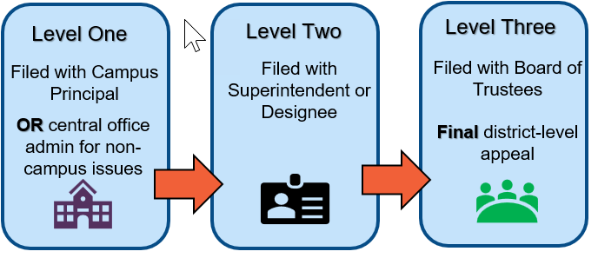
Overview of Grievance Levels and Examples
Generally

Slide 7
Overview of Grievance Levels and Examples 1
LEVEL ONE: Campus Level
Grievance Handling
Filed with campus principal or administrator
Focus on early resolution
Common Grievance Scenarios
Academic or classroom concerns
Access to programs or activities
Health, safety, or wellness issues
General school policy concerns
Resolution and Documentation
Principals review cases, meet involved parties, propose corrections, and keep formal records if issues persist.
Goal of Level One Resolution
  Aim to resolve concerns promptly to maintain trust, minimize disruption, and support student well-being.
  Option to Appeal
  The grievance policy must allow an opportunity to appeal to the next level of review.

Slide 8
Overview of Grievance Levels and Examples 0 1
LEVEL TWO: Superintendent or Designee
Grievance Handling
Filed with district administrator or designee
Review of documentation and campus response
Formal written decision issued
Common Grievance Scenarios
Grievances move to school district administrative level when unresolved at campus.
Resolution and Documentation
District reviews documentation, interviews staff, meets with complainant and ensures legal and policy compliance during grievance evaluation.
Level Two decisions are formal, detailed, and often serve as the final resolution for grievances.
Fairness and Policy Alignment
  School district ensures fairness, consistency, and policy alignment to protect rights of all parties involved.
  Option to Appeal
  The grievance policy must allow an opportunity to appeal to the next level of review.

Slide 9
Overview of Grievance Levels and Examples 2
LEVEL THREE: School Board Level
Grievance Handling
Final local appeal
Review limited to policy and procedure
Decision made in open session
Common Grievance Scenarios
Appeals may include denied student transfer requests or challenges to performance evaluations based on procedural errors.
Governance and Accountability
  This level ensures district adherence to policies, legal requirements, and reinforces transparency and public trust.
  Appeal to the Commissioner
  Individuals may appeal a school board’s final grievance decision to the Commissioner of Education.

Slide 10
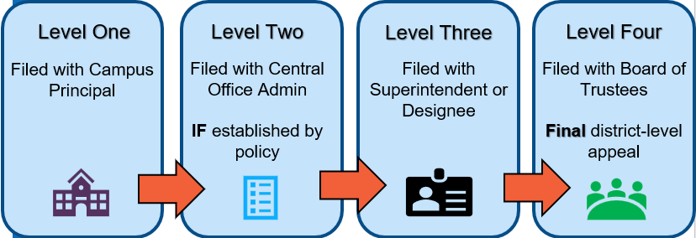
Overview of Grievance Levels and Examples a2

Slide 11
Overview of Grievance Levels and Examples 3
LEVEL ONE: Campus Level
Grievance Handling
Filed with campus principal or administrator
Focus on early resolution
Common Grievance Scenarios
Academic or classroom concerns
Access to programs or activities
Health, safety, or wellness issues
General school policy concerns
Resolution and Documentation
Principals review cases, meet involved parties, propose corrections, and keep formal records if issues persist.
Goal of Level One Resolution
  Aim to resolve concerns promptly to maintain trust, minimize disruption, and support student well-being.
  Option to Appeal
  The grievance policy must allow an opportunity to appeal to the next level of review.

Slide 12
Overview of Grievance Levels and Examples 5
LEVEL TWO: Central Office Administration | Established by Policy
Grievance Handling
Provides an additional administrative review before escalation to the superintendent.
Ensures procedural compliance before escalation.
Common Grievance Scenarios
Procedural review of campus decisions
Parental Rights Concerns (e.g., denial of access to student records)
Record development (e.g., additional documentation submitted by the complainant)
Recusal-related escalations (e.g., when a campus reviewer is subject of the grievance)
Resolution and Documentation
District reviews documentation, interviews staff, meets with complainant and ensures legal and policy compliance during grievance evaluation.
A formal written decision is issued explaining the basis for the determination and identifying supporting documentation.
When needed, the matter may be remanded to a lower level to further develop the record or clarify issues before final resolution.
Level Two decisions may serve as the final resolution under local policy or support escalation to the next level of review.
  Option to Appeal
  The grievance policy must allow an opportunity to appeal to the next level of review.

Slide 13
Overview of Grievance Levels and Examples 4
LEVEL THREE: Superintendent or Designee
Grievance Handling
Filed with district administrator or designee
Review of documentation and campus response
Formal written decision issued
Common Grievance Scenarios
Grievances move to school district administrative level when unresolved at campus.
Resolution and Documentation
District reviews documentation, interviews staff, meets with complainant and ensures legal and policy compliance during grievance evaluation.
Level Two decisions are formal, detailed, and often serve as the final resolution for grievances.
Fairness and Policy Alignment
  School district ensures fairness, consistency, and policy alignment to protect rights of all parties involved.
  Option to Appeal
  The grievance policy must allow an opportunity to appeal to the next level of review.

Slide 14
Overview of Grievance Levels and Examples b
LEVEL FOUR: School Board Level
Grievance Handling
Final local appeal
Review limited to policy and procedure
Decision made in open session
Common Grievance Scenarios
Appeals may include denied student transfer requests or challenges to performance evaluations based on procedural errors.
Governance and Accountability
  This level ensures district adherence to policies, legal requirements, and reinforces transparency and public trust.
  Appeal to the Commissioner
  Individuals may appeal a school board’s final grievance decision to the Commissioner of Education.

Slide 15
D
Timeline
NAME OF COMPONENT (ALL CAPS)
MARCH 19-21, 2024

Slide 16
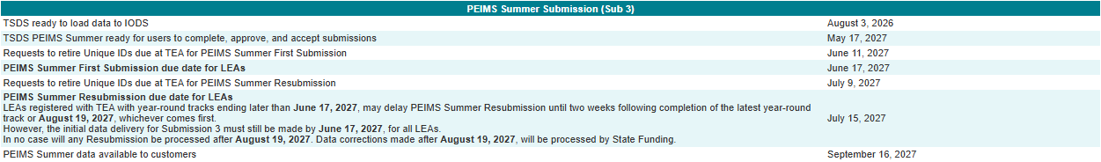
2026-2027 Timeline
2026-2027 School Year​
2026-2027 school year Grievance data will be reported in the 2026-2027 PEIMS Summer Submission.
Districts shall submit grievances filed in the district during the school year. Grievances unresolved within the reporting period must be included in subsequent PEIMS Summer Submissions until final resolution is achieved.

Slide 17

Program Area Resources and Supports
Raising Concerns with Your School: Local Grievance Process | Texas Education Agency
Parent Complaint Navigator
ParentSupportProgram@tea.texas.gov
GeneralInquiry@tea.texas.gov
Sign up for the Governance Local Grievance Newsletter

Slide 18
Data Collection Changes
NAME OF COMPONENT (ALL CAPS)
MARCH 19-21, 2024

Slide 19
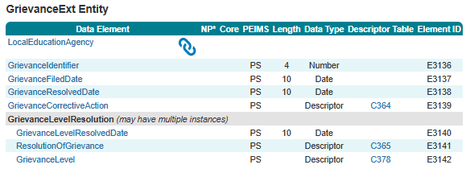
GrievanceExt Entity (New)
In the PEIMS Summer Submission, TEA has added one new entity, GrievanceExt, to collect information regarding the formal written complaint submitted to a school district by a parent, student, employee, or any other individual, including vendors and taxpayers. This entity includes the following new elements:
  GrievanceIdentifier (E3136)
  GrievanceFiledDate (E3137)
  GrievanceResolvedDate (E3138)
  GrievanceCorrectiveAction (E3139)
  New common type: GrievanceLevelResolution
    GrievanceLevelResolvedDate (E3140)
    ResolutionOfGrievance (E3141)
    GrievanceLevel (E3142)

Slide 20
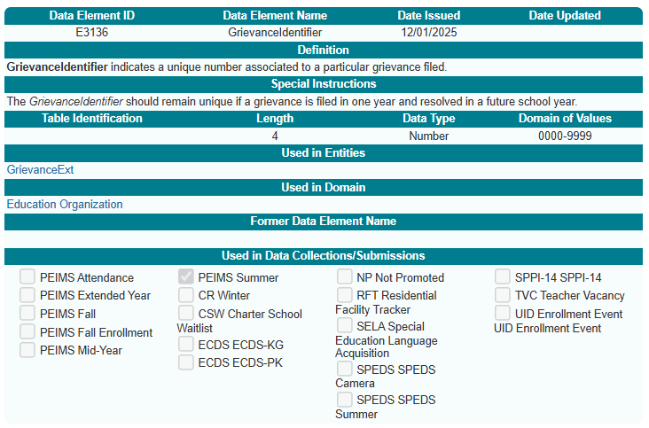
GrievanceIdentifier (E3136)
New GrievanceIdentifier (E3136) data element:

Slide 21
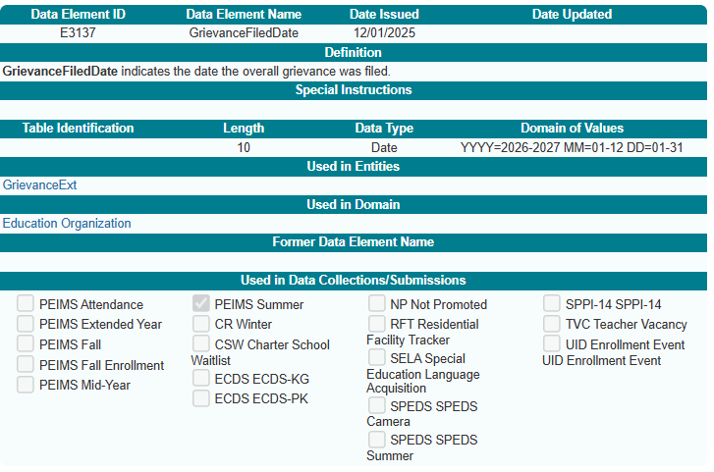
GrievanceFiledDate (E3137)
New GrievanceFiledDate (E3137) data element:

Slide 22
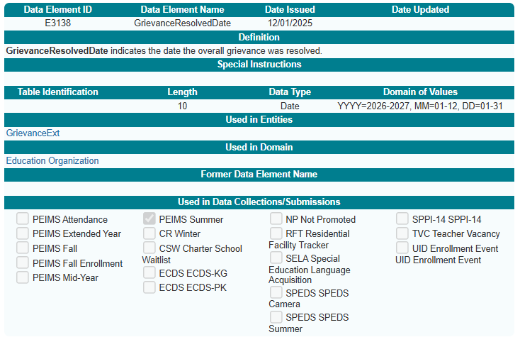
GrievanceResolvedDate (E3138)
New GrievanceResolvedDate (E3138) data element:

Slide 23
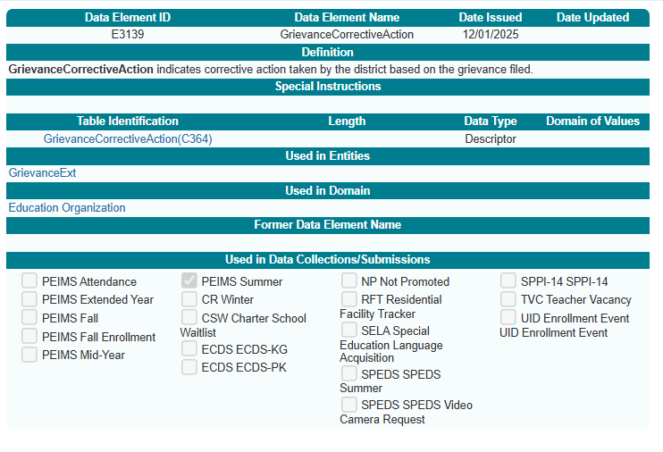
GrievanceCorrectiveAction (E3139)
New GrievanceCorrectiveAction (E3139) data element:

Slide 24
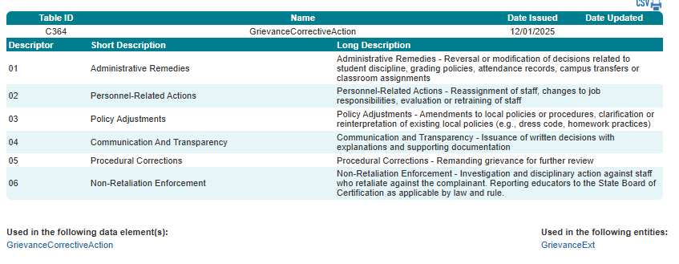
GrievanceCorrectiveAction (C364)
New GrievanceCorrectiveAction (C364) descriptor table:

Slide 25
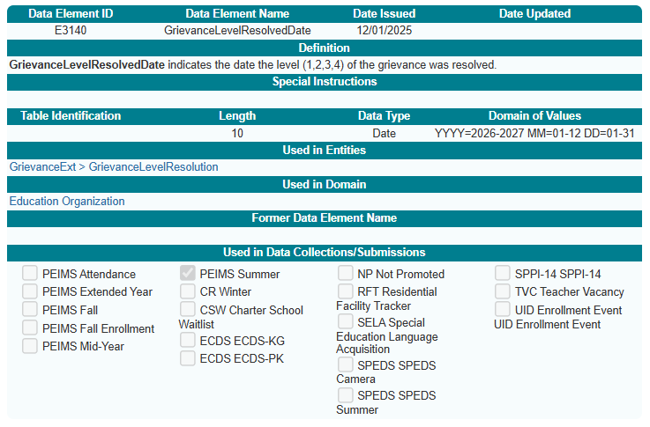
GrievanceLevelResolvedDate (E3140)
New GrievanceLevelResolvedDate (E3140) data element:

Slide 26
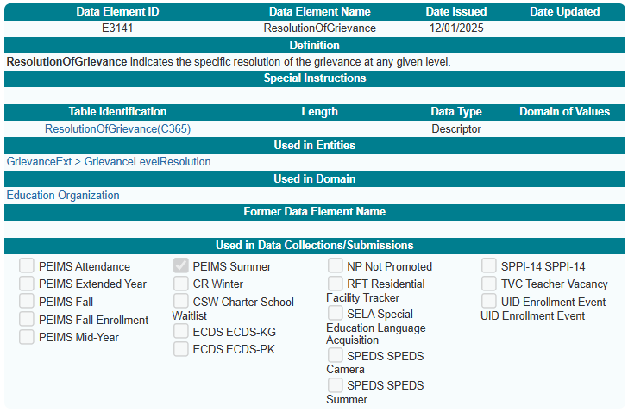
ResolutionOfGrievance (E3141)
New ResolutionOfGrievance (E3141) data element:

Slide 27
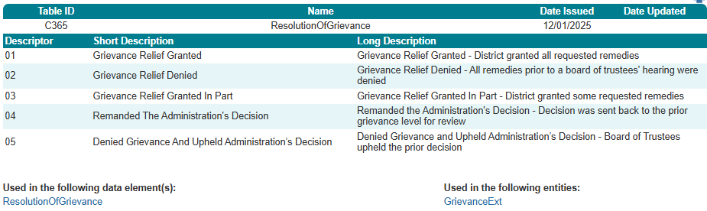
ResolutionOfGrievance (C365)
New ResolutionOfGrievance (C365) descriptor table:

Slide 28
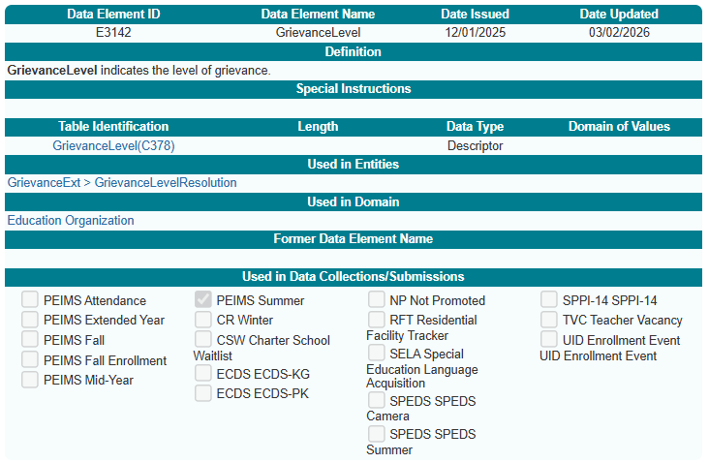
GrievanceLevel (E3142)
New GrievanceLevel (E3142) data element:

Slide 29
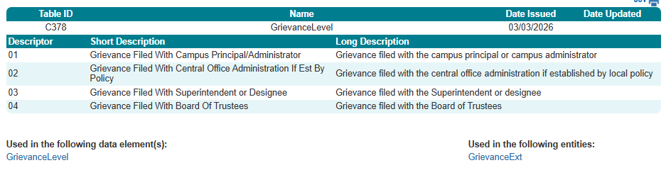
GrievanceLevel (C378)
New GrievanceLevel (C378) descriptor table:

Slide 30
Business Rules

Slide 31
New Business Rules
The following new rules will be added to the PEIMS Summer Submission:
    1 Fatal
      11000-0001
    1 Special Warning
      11000-0002

Slide 32
Business Rule - Fatal
  11000-0001

Slide 33
Business Rule – Special Warning
  11000-0002

Slide 34
Reports

Slide 35
Grievance Reports
Reports:
  Planning to develop a new ‘detail’ report.
  Possibly developing a new ‘summary’ report.

Slide 36
Closeout

Slide 37
FAQ – Start Date For Grievance Reporting
When does grievance reporting begin?
Grievances from the 2026–2027 school year will be reported in the 2026–2027 PEIMS Summer Submission.

Slide 38
FAQ – Start Date For Grievance Reporting 1
Will grievance data be reported through the SIS or the HR system?
School districts will need to work with their vendors to determine which system will store the data.

Slide 39
FAQ – Systems Used for Grievance Reporting
What if a school district uses two different vendors?
School districts must coordinate with their vendors to ensure the data is submitted accurately and without duplication.

Slide 40
FAQ – Grievances Across School Years
Should a grievance be closed at the end of a school year and then reopened the next year using the same identifier?
No. A grievance remains open until it is fully resolved, even if it spans multiple school years. Once the grievance is resolved, the GrievanceResolvedDate (E3138) should be entered.

Slide 41
FAQ – Grievances Across School Years 1
Will there be a business rule preventing a school district from leaving the GrievanceResolvedDate (E3138) blank?
A special warning has been implemented to alert users when the GrievanceResolvedDate (E3138) is missing.

Slide 42
FAQ – Definition of a Grievance Under SB 12
What qualifies as a grievance?
Under Senate Bill (SB) 12, a grievance is a formal complaint filed by a parent, either in writing or online. Informal attempts to resolve an issue are not counted unless they escalate into a formal grievance. SB 12 also allows extended timelines for parents who begin with informal resolution attempts.

Slide 43
FAQ - Whether This Data Is New for School Districts
Is this grievance data new, or have school districts already been collecting it?
School districts already have grievance processes in place, and each school district has its own policies and procedures. What is new under SB 12 is the requirement to formally collect and report this data through PEIMS.

Slide 44
Key Takeaways
What Matters Most For Successful Grievance Data Reporting
Why It Matters
How It Fits
Key Dates
What To Report
Avoid Errors
Supports compliance with SB 12 requirements for grievance reporting
Provides TEA with consistent, annual data on resolutions and corrective actions
Uses new data elements and descriptor tables, including GrievanceLevel, Resolution, and CorrectiveAction
Grievances remain open until fully resolved, even across school years
All grievances from that school year are included in the 2026-2027 PEIMS Summer Submission
Do not leave GrievanceResolvedDate (E3138) blank once resolved. A special warning will flag missing dates.
Captures all formal grievances filed at any level – Campus, Central Office, Superintendent, or Board
Bottom Line
Report a complete set of data for each one
Ensure statewide transparency in how districts handle formal grievances
New GrievanceExt entity added to the PEIMS Summer Submission
Reporting begins with the 2026-2027 school year grievances
Every formal grievance filed, regardless of level
Dates filed and resolved, resolution description, corrective actions, and grievance level
Ensure all descriptor based elements (GrievanceLevel, Resolution, GradeLevel) use valid descriptor codes
Avoid duplicate reporting when grievances move through multiple levels
Capture every formal grievance
Align all data with the new elements, descriptors and data validation rules

Slide 45
Technical Resources
Technical Specifications: ​
  Texas Education Data Standards (TEDS)​
Technical Support:​
  TSDSCustomerSupport@tea.texas.gov ​
Program Area:
  See slide 17 for contact information and resources

Slide 46

QUESTIONS
QUESTIONS?

