Slide 1

Changes to the Early Childhood Data System (ECDS) Collection March 31, 2026

Slide 2

Agenda – Changes to the Early Childhood Data System (ECDS) Collection
Overview
Timeline
ECDS Expansion due to House Bill (HB) 2
New ECDS Submissions
Closeout
Key Takeaways
Technical Resources
Questions

Slide 3

TITLE SLIDE: Overview
Overview
NAME OF COMPONENT (ALL CAPS) MARCH 19-21, 2024

Slide 4
Background
During the 89th Regular Session, HB 2 added Section 28.0063 to the Education Code, requiring the commissioner to approve research‑based reading and math progress‑monitoring instruments for grades K–3. These tools must align with state standards, measure early literacy and numeracy at the beginning, middle, and end of the year, and identify students needing targeted support.
Because eligibility for supplemental tutoring grants depends on consecutive assessment results, data must be collected after each assessment testing window. To meet these requirements, TEA will expand the Early Childhood Data System (ECDS) to include K–3 literacy and numeracy progress‑monitoring data for three new ECDS-Kindergarten Submissions.

Slide 5
Resulting Changes
The Early Childhood Data System Collection for the 2026-2027 school year will continue to include data from student demographics, staff, classroom details, special program data and assessment data.
The changes do not impact the Prekindergarten Submission.
The current Kindergarten Submission will be sunset for the 2027-2028 school year.
TEA will expand the ECDS Collection to include three new submissions with additional grade levels beginning in the 2027-2028 school year. The new submissions will include data from student demographics, special program data, and assessment data.

Slide 6
Timeline

Slide 7
2026-2027 Timeline
2026-2027: Local Education Agencies (LEAs) will continue to report the ECDS Prekindergarten and Kindergarten Submissions as outlined in the 2026-2027 TEDS. TEA will work with all assessment vendors and a limited number of LEAs to test the new ECDS submissions and assess vendor readiness.

Slide 8
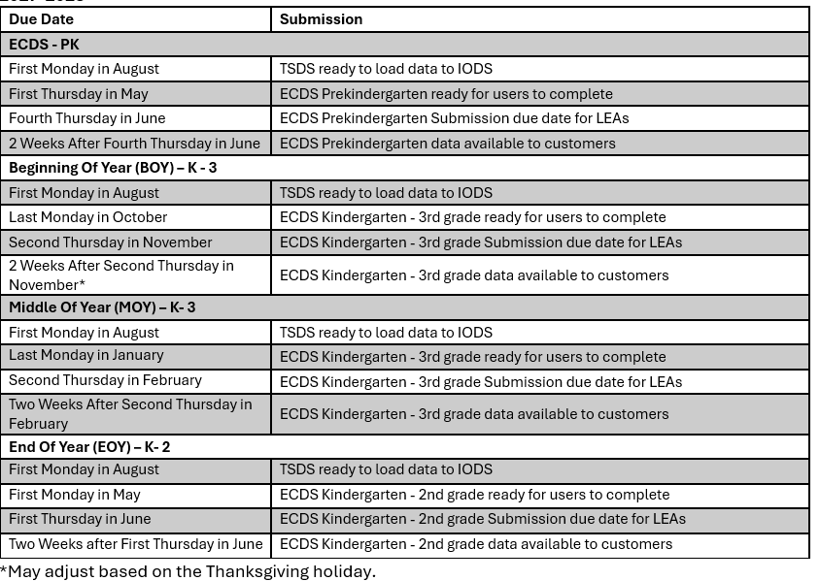
2027-2028 Timeline
2027-2028 School Year
New ECDS Submissions
Beginning Of Year (BOY) K-3
Middle Of Year (MOY) K-3
End Of Year (EOY) K-2
The new ECDS Submissions exclude staff and classroom data.

Slide 9
D
ECDS Expansion due to House Bill (HB) 2
NAME OF COMPONENT (ALL CAPS) MARCH 19-21, 2024

Slide 10
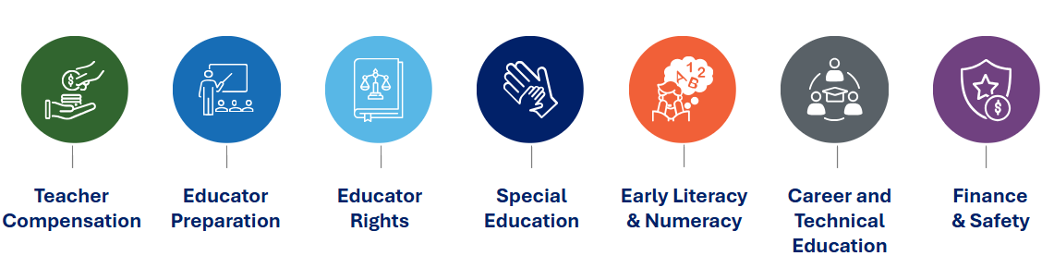
Passage of HB 2, 89th Texas Legislature in June of 2025
Major changes to K–3 assessment requirements

Slide 11


Changes to K–3 Assessments brought by HB 2, Article 5, 89th Legislature
Amended TEC §28.006
Established TEC §28.0063
K
K 1
2
3
BOY
MOY
EOY
BOY
HB2 amended §28.006 to exclusively focus on BOY kindergarten reading readiness, narrowing its scope from multiple grade levels (K–2, 7).
HB2 established §28.0063, which set requirements relating to foundational literacy and numeracy instruments to support student outcomes in K–3.

Slide 12
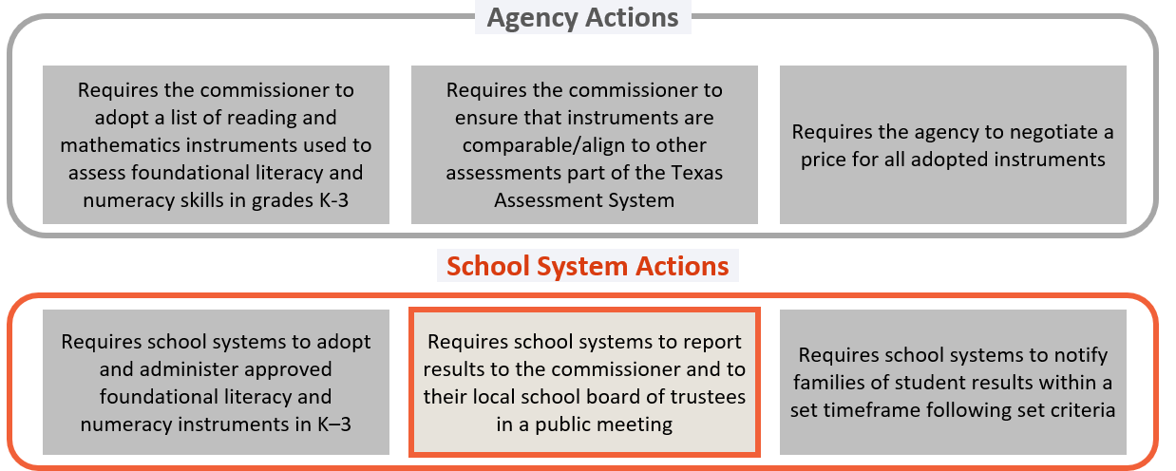
Overarching Requirements for new TEC, §28.0063 – Foundational Literacy and Numeracy Instruments

Slide 13
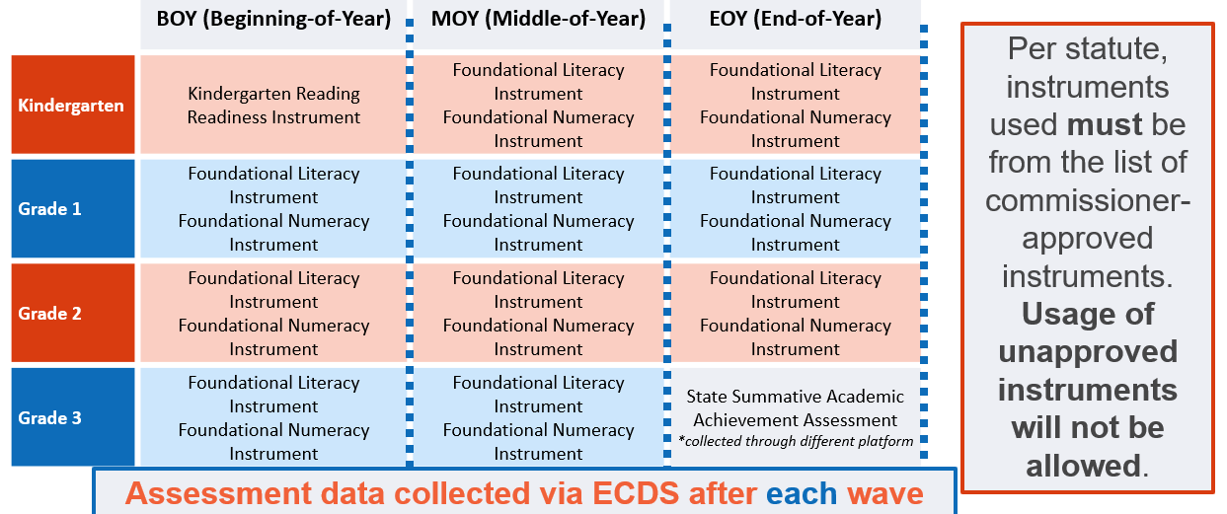
Administration and Data Submission Requirements

Slide 14
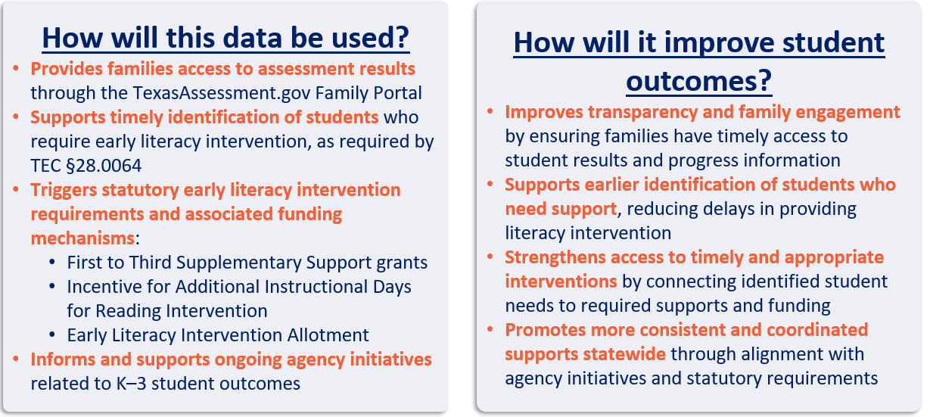
Purpose of Data Collection

Slide 15
New ECDS Submissions

Slide 16
Entities
The ECDS submissions will consist of the following entities:
LocalEducationAgency
School
Student
StudentEducationOrganizationAssociation
StudentSchoolAssociation
Assessment
ObjectiveAssessment
StudentAssessment

Slide 17
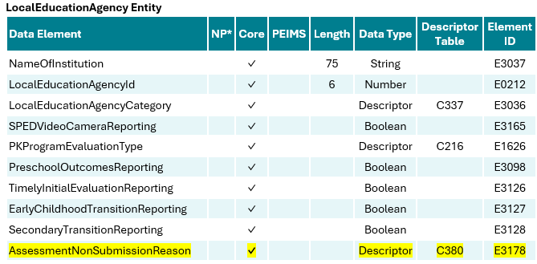
LocalEducationAgency Entity

Slide 18
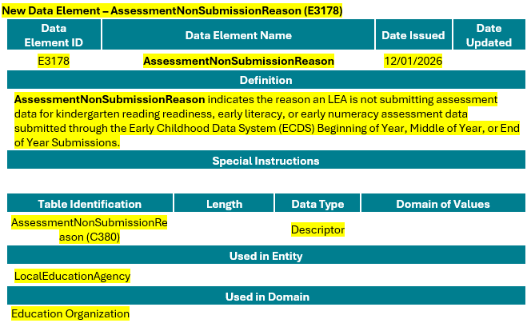
AssessmentNonSubmissionReason (E3178)

Slide 19
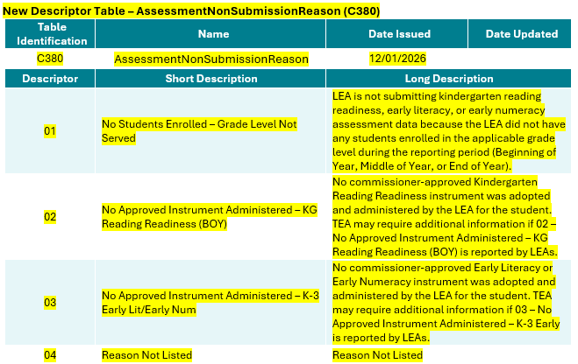
AssessmentNonSubmissionReason (380)

Slide 20
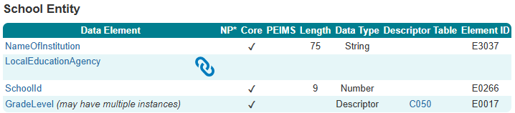
School Entity

Slide 21
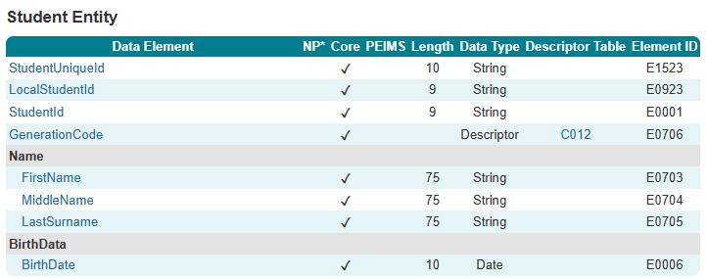
Student Entity

Slide 22
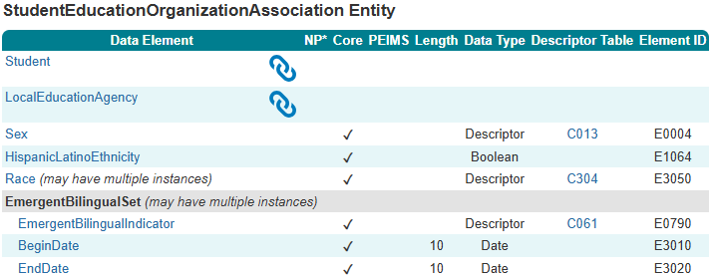
StudentEducationOrganizationAssociation Entity

Slide 23
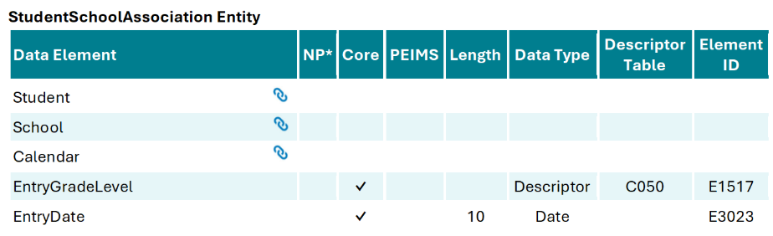
StudentSchoolAssociation Entity

Slide 24
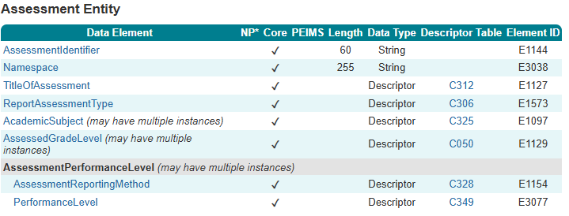
Assessment Entity

Slide 25
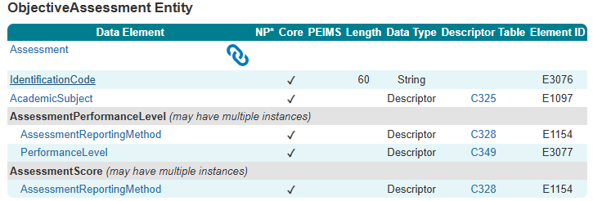
ObjectiveAssessment Entity

Slide 26
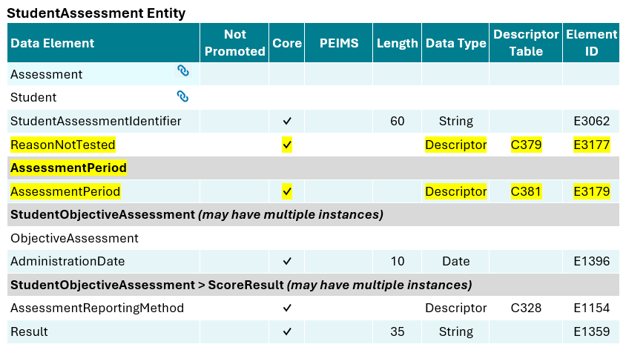
StudentAssessment Entity

Slide 27
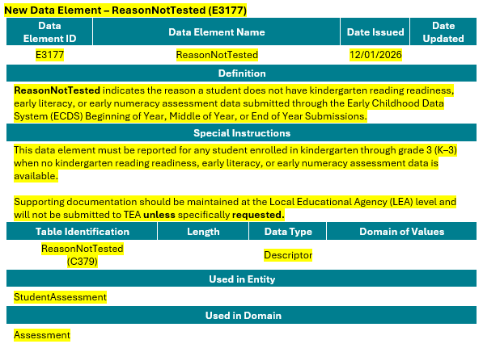
ReasonNotTested (E3177)

Slide 28
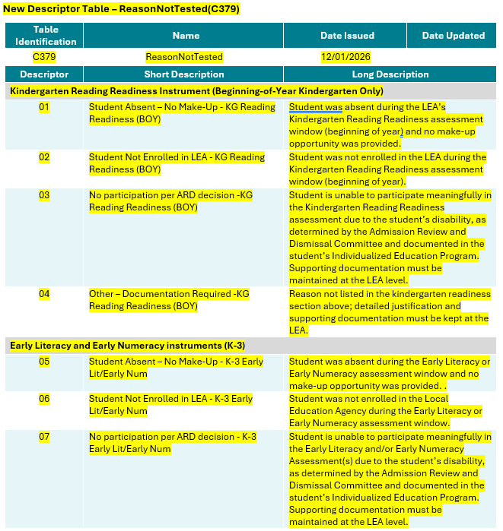
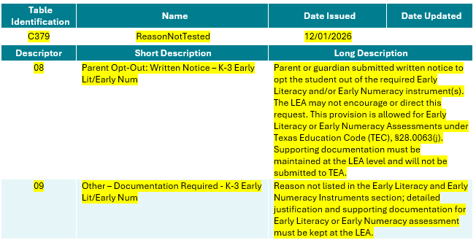
ReasonNotTested (C379)

Slide 29
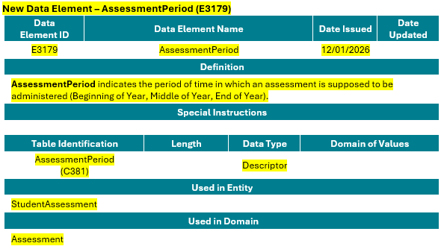
AssessmentPeriod (E3179)

Slide 30
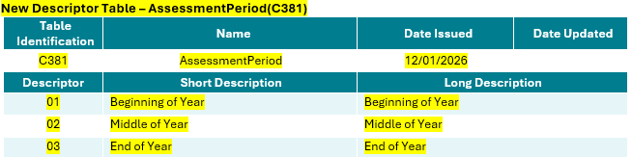
AssessmentPeriod (C381)

Slide 31
Closeout

Slide 32
Key Takeaways
What Matters Most For Successful Submissions (2027-2028)
Why It Matters
How It Fits
Key Dates
What To Report
Avoid Errors
Assessment results for required literacy/numeracy instruments for BOY, MOY, and EOY. AssessmentPeriod (BOY, MOY, EOY) and correct ReportAssessmentType ReasonNotTested when assessment data is missing for any window
Bottom Line
Success depends on using the new data elements, updated descriptors, and meeting TEA deadlines. Accurate reporting ensures early identification, timely interventions, and statewide consistency.
Ensure AssessmentPeriod matches the administration window. Submit ReasonNotTested for students without results in that period. Keep required LEA documentation for ARD and parent opt-out decisions.
BOY K–3
Three statewide submissions: BOY K–3, MOY K–3, EOY K–2 Only student demographics + assessment data required.
Ensures compliance with HB 2 early literacy/numeracy requirements for K–3. Provides accurate progress‑monitoring to support early interventions and tutoring eligibility. New submission reporting
Due: Second Thursday in November
MOY K–3
Due: Second Thursday in February
EOY K–2
Due: First Thursday in June

Slide 33
Technical Resources
Technical Specifications: ​
Texas Education Data Standards (TEDS)​
Technical Support:​
TSDSCustomerSupport@tea.texas.gov ​

Slide 34

QUESTIONS
QUESTIONS?

