Slide 1

Special Education Data Collection Funding Changes
April 1, 2026

Slide 2

Agenda 2026-2027
SPED Data Collection Funding Changes
Overview
Timeline
Data Collection Changes
Business Rules
Reports
Closeout
  Frequently Asked Questions
  Key Takeaways
  Technical Resources
Questions

Slide 3

TITLE SLIDE: Overview
Overview
NAME OF COMPONENT (ALL CAPS)
MARCH 19-21, 2024

Slide 4
Background
HB 2 Section 4.54 amends TEC §48.102, to change the annual allotment for each special education program under Subchapter A, Chapter 29, to be equal to the sum of the basic allotment and the allotment under §48.101 to which the district is entitled multiplied by a weight in an amount set by legislature in the General Appropriations Act for the highest tier of intensity of service for which the student qualifies.
HB 2 Section 4.55/SB 568 Section 56 amends Subchapter C, Chapter 48, Education Code by adding TEC §48.1021. TEC §48.1021 provides a Special Education Service Group Allotment for each six-week period in which a student in a special education program under Subchapter A, Chapter 29, receives special education services. The commissioner by rule shall establish at least four service groups for use in determining funding. At least 55 percent of the funds allocated under this section must be used for a special education program under Subchapter A, Chapter 29.

Slide 5
D
Timeline
NAME OF COMPONENT (ALL CAPS)
MARCH 19-21, 2024

Slide 6
2026-2027 Timeline
2026-2027 School Year​
For the 2026-2027 academic year, students who receive special education services will be reported using both sets of data elements (Instructional Setting and Tier of Intensity). More detailed guidance and training will be made available in the coming weeks.

Slide 7
2027-2028 Timeline
2027-2028 School Year​
TEA will review existing special education data components and sunset those that are no longer needed for the 2027–2028 school year.

Slide 8
Data Collection Changes
NAME OF COMPONENT (ALL CAPS)
MARCH 19-21, 2024

Slide 9
New Data for SPED Funding
TEA added the following to the PEIMS Attendance, Summer, and Extended Year Submissions:
New Entities:
  SpecialEducationTierOfIntensityAttendance
  FlexibleSpecialEducationTierOfIntensityAttendance
New common types to the StudentSpecialEducationProgramAssociation Entity:
  TierOfIntensitySet*
  SPEDServiceGroupSet
  NumberOfMinutesInSPEDSet
  EducationalEnvironmentSet
*Tier of Intensity in the StudentSpecialEducationProgramAssociation Entity is only used in Granular Attendance reporting.

Slide 10
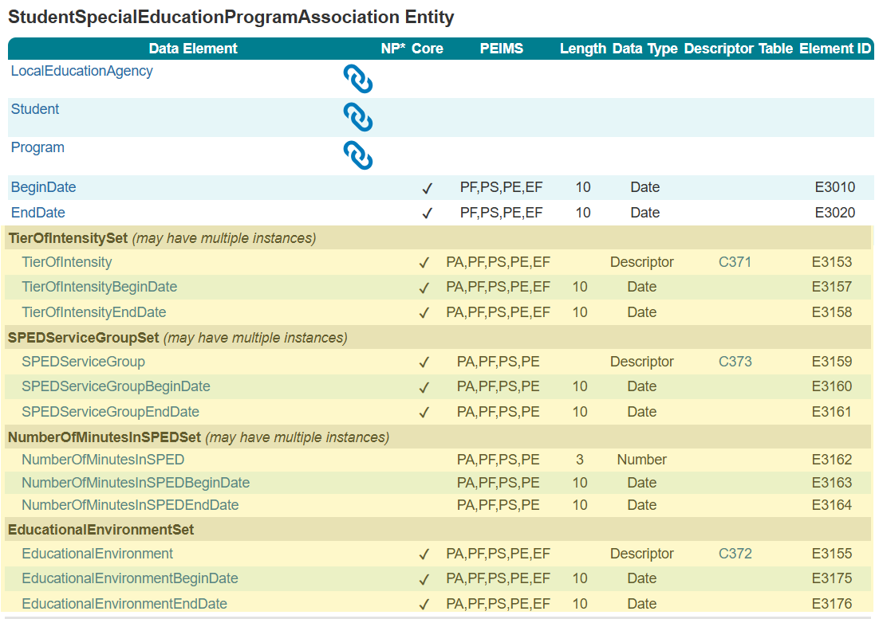
StudentSpecialEducationProgramAssociation Entity

Slide 11
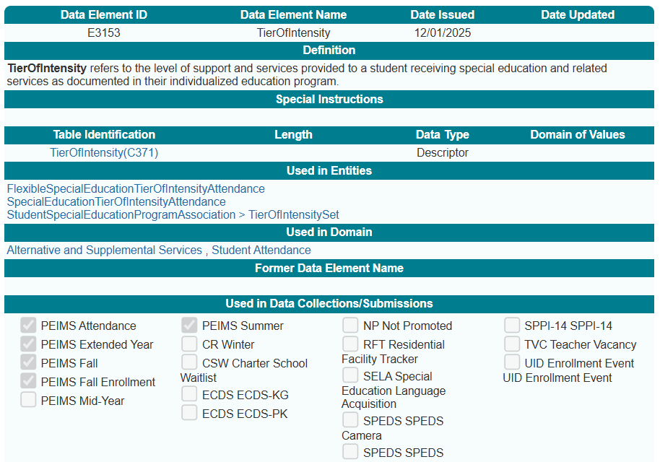
TierOfIntensitySet Common Type
New TierOfIntensity (E3153) data element:

Slide 12
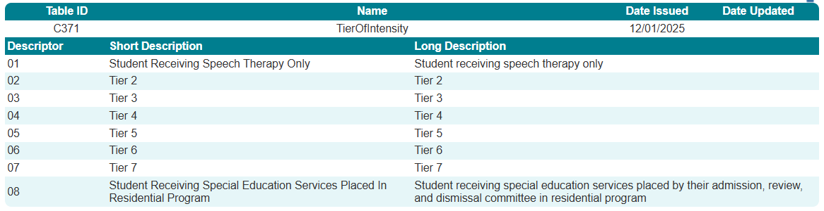
TierOfIntensitySet Common Type 1
New TierOfIntensity (C371) descriptor table:

Slide 13
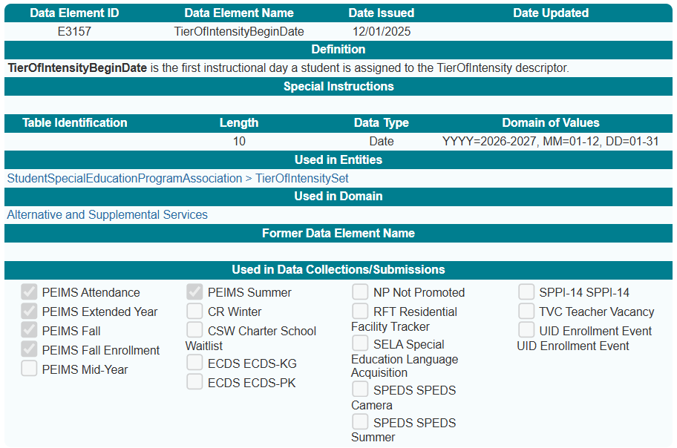
TierOfIntensitySet Common Type a
New TierOfIntensityBeginDate (E3157) data element:

Slide 14
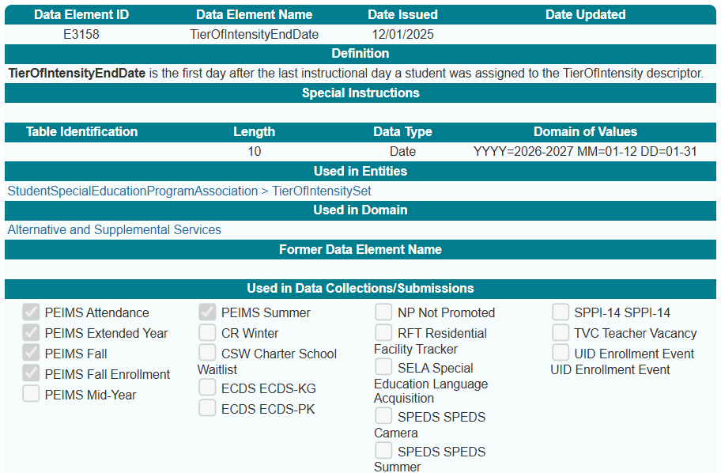
TierOfIntensitySet Common Type 2
New TierOfIntensityEndDate (E3158) data element:

Slide 15
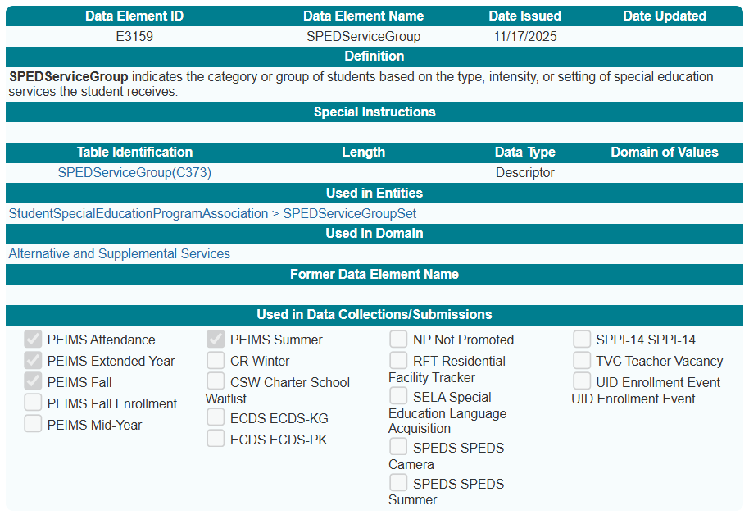
SPEDServiceGroupSet Common Type
New SPEDServiceGroup (E3159) data element:

Slide 16
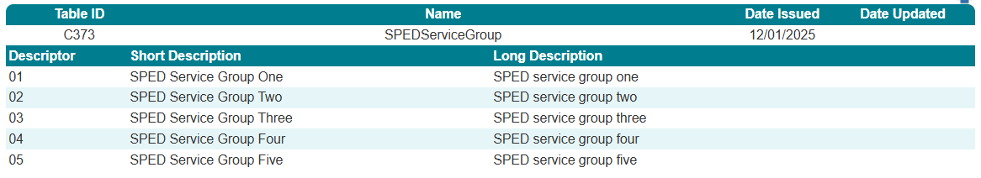
SPEDServiceGroup Common Type
New SPEDServiceGroup (C373) descriptor table:

Slide 17
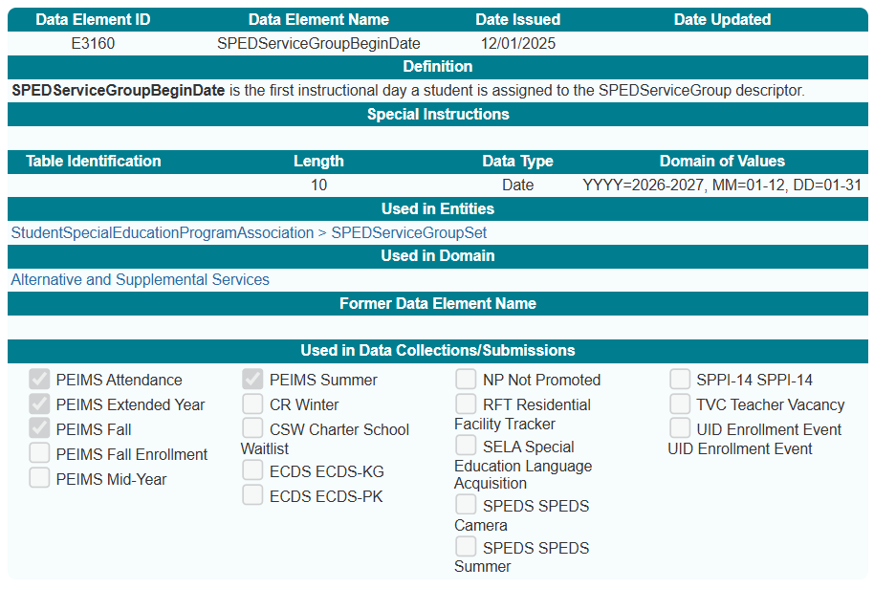
SPEDServiceGroupSet Common Type 1
New SPEDServiceGroupBeginDate (E3160) data element:

Slide 18
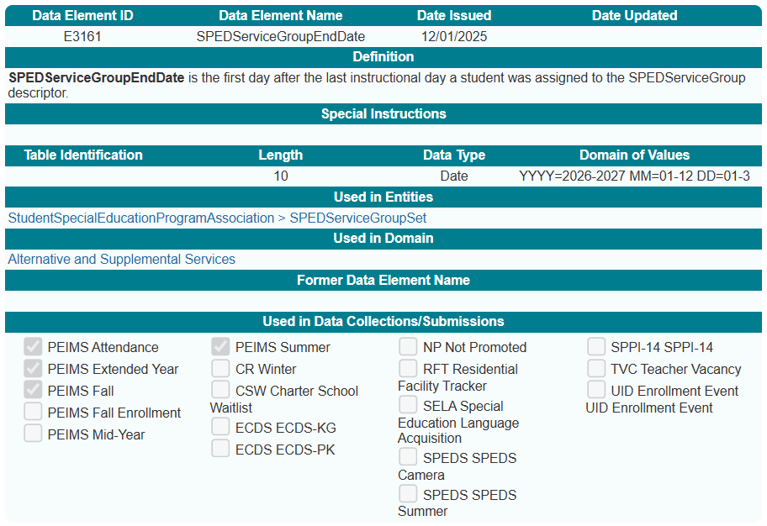
SPEDServiceGroupSet Common Type 2
New SPEDServiceGroupEndDate (E3161) data element:

Slide 19
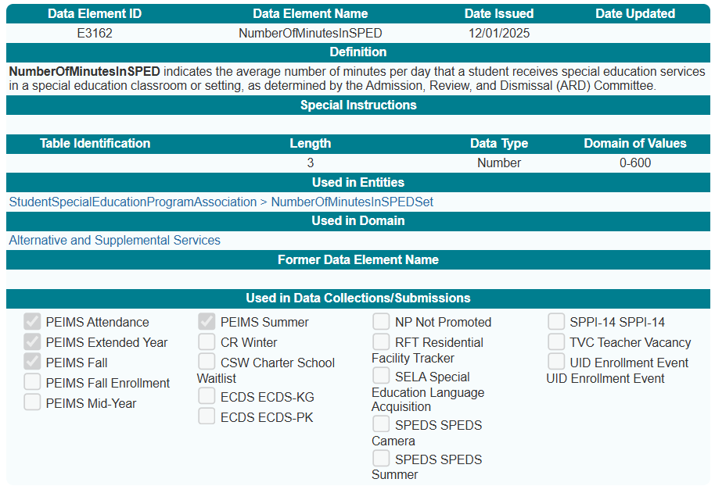
NumberOfMinutesInSPEDSet Common Type
New NumberOfMinutesInSPED (E3162) data element:

Slide 20
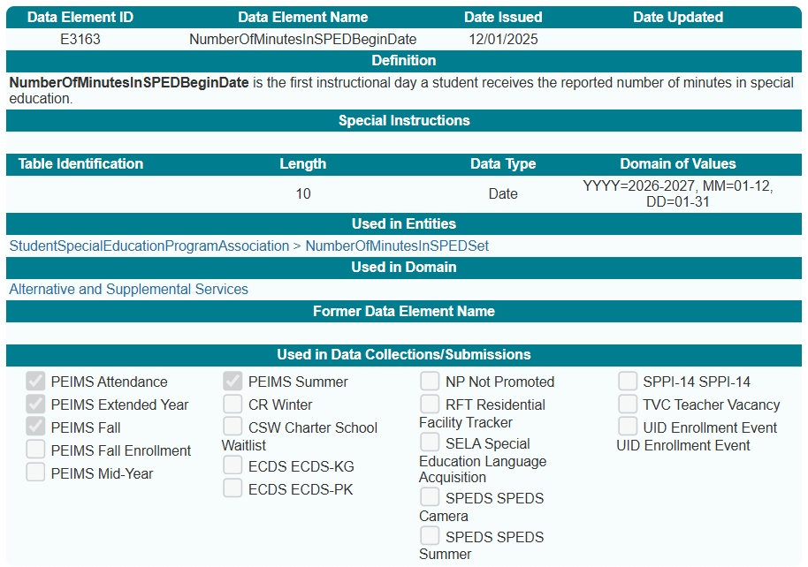
NumberOfMinutesInSPEDSet Common Type 2
New NumberOfMinutesInSPEDBeginDate (E3163) data element:

Slide 21
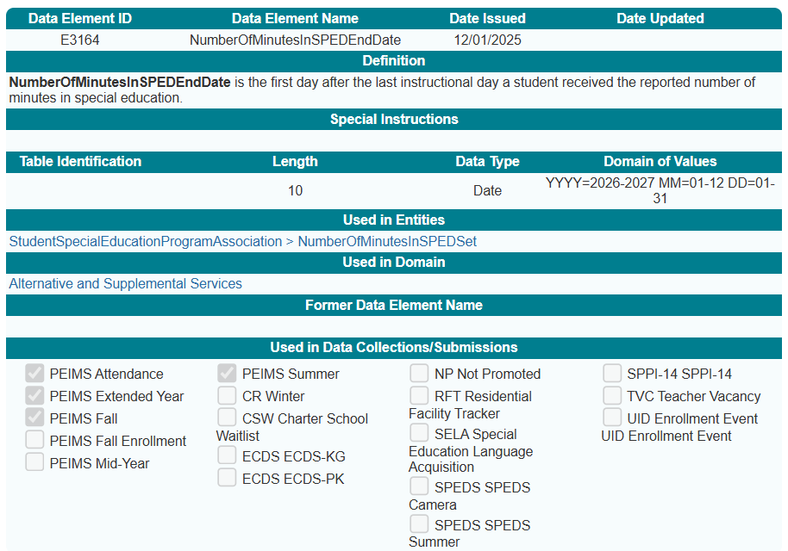
NumberOfMinutesInSPEDSet Common Type 3
New NumberOfMinutesInSPEDEndDate (E3164) data element:

Slide 22
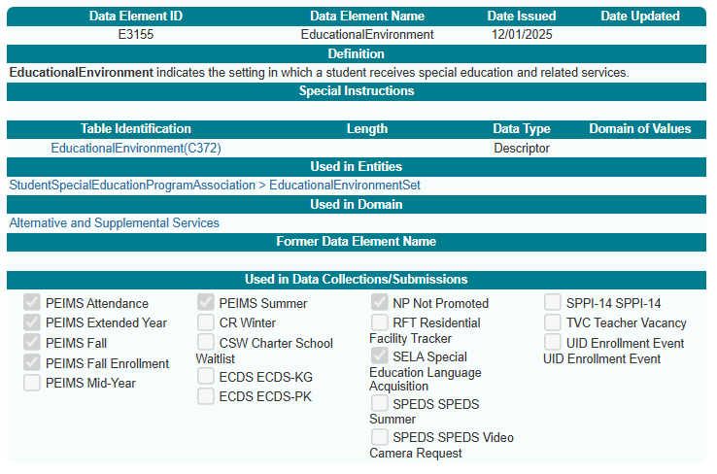
EducationalEnvironmentSet Common Type
New EducationalEnvironment (E3155) data element:

Slide 23
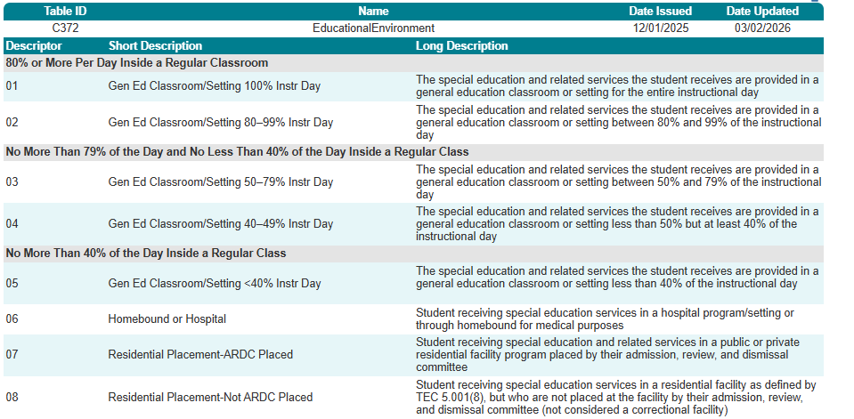
EducationalEnvironment (C372)
New EducationalEnvironment (C372) descriptor table:

Slide 24
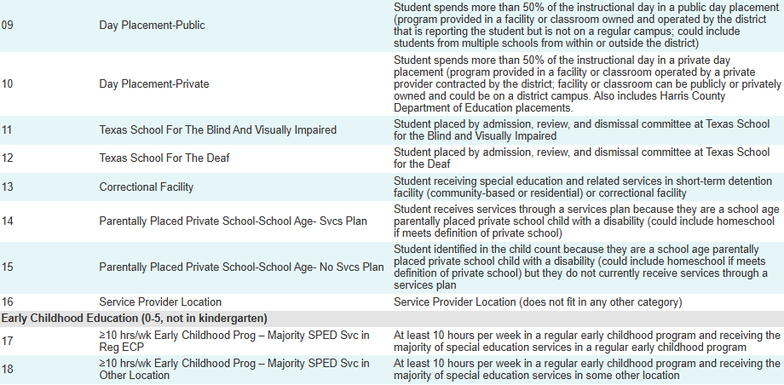
EducationalEnvironment (C372) continued

Slide 25
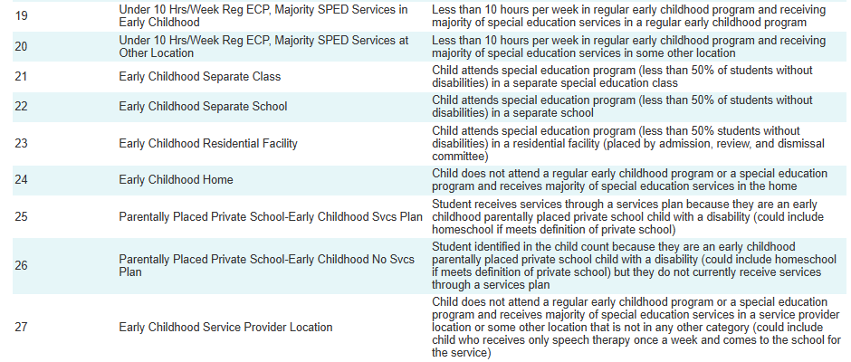
EducationalEnvironment (C372) continued 1

Slide 26
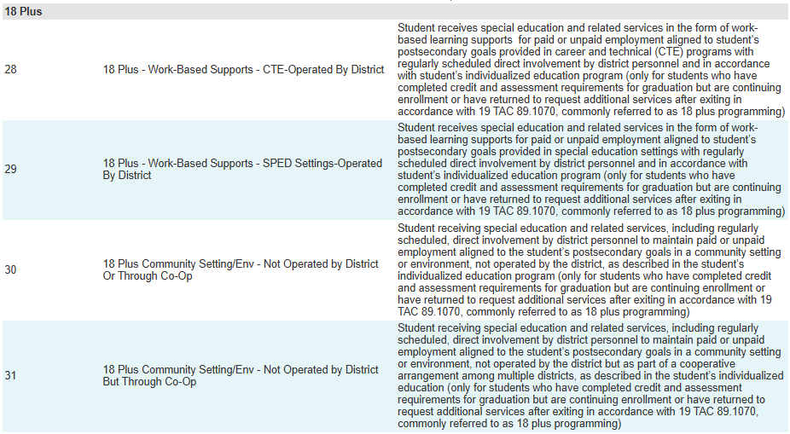
EducationalEnvironment (C372) continued 4

Slide 27
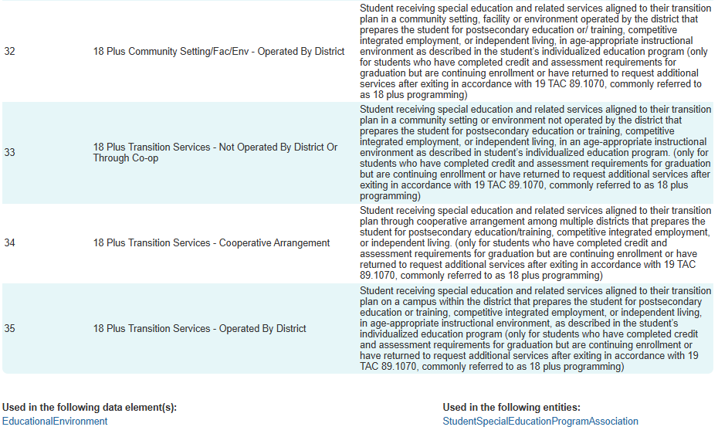
EducationalEnvironment (C372) continued 2

Slide 28
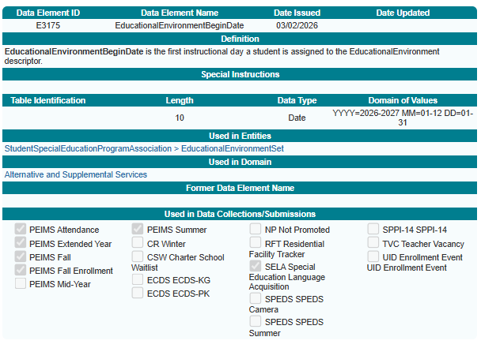
EducationalEnvironmentSet Common Type 2
New EducationalEnvironmentBeginDate (E3175) data element:

Slide 29
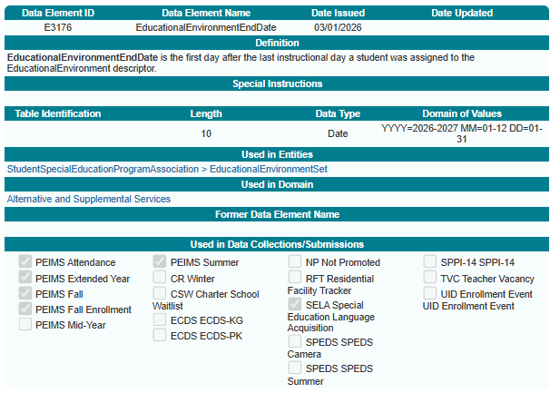
EducationalEnvironmentSet Common Type 1
New EducationalEnvironmentEndDate (E3176) data element:

Slide 30
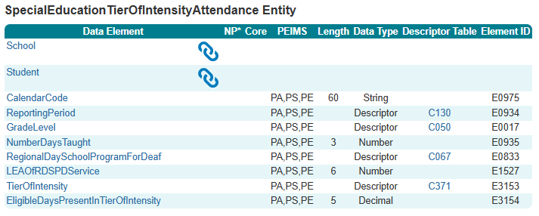
New SpecialEducationTierofIntensityAttendance Entity

Slide 31
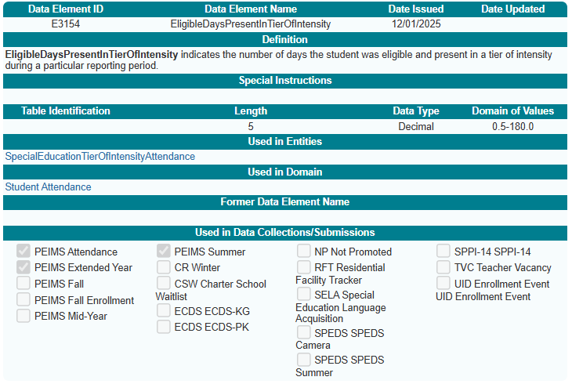
EligibleDaysPresentInTierOfIntensity (E3154)
New EligibleDaysPresentInTierOfIntensity (E3154) data element:

Slide 32
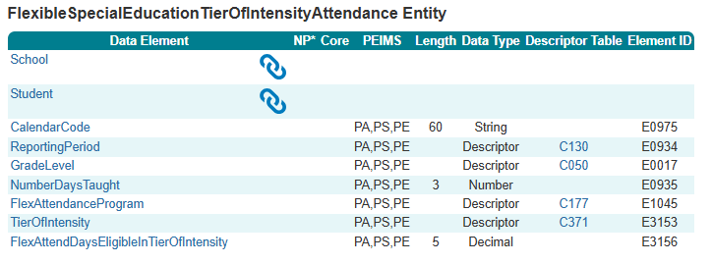
New FlexibleSpecialEducationTierOfIntensityAttendance Entity

Slide 33
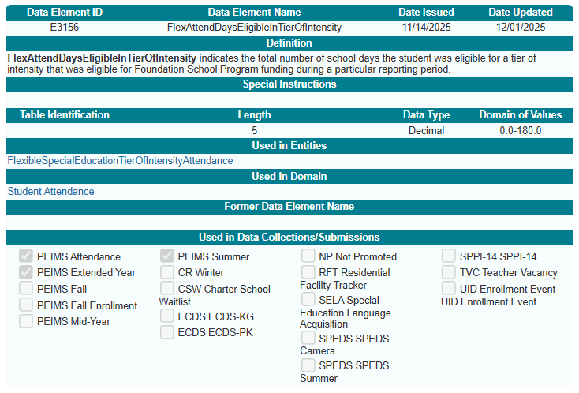
FlexAttendDaysEligibleInTierOfIntensity (E3156)
New FlexAttendDaysEligibleInTierOfIntensity (E3156) data element:

Slide 34
Business Rules

Slide 35
New Business Rules
The following rules have been added to or revised in the PEIMS Attendance, Fall, Summer, and Extended Year Submissions:
    20 Fatals
      41163-0111
      41163-0112
      41163-0113
      41163-0114
      42405-0002
      42405-0004
      42405-0005
      42405-0016
      42405-0031
      42405-0050
      42405-0058
      42405-0059
      42405-0060
      42505-0002
      42505-0004
      42505-0016
      42505-0023
      42505-0026
      42505-0027
      42505-0028
    1 Special Warning
      42405-0017
    1 Warning
      42505-0017

Slide 36
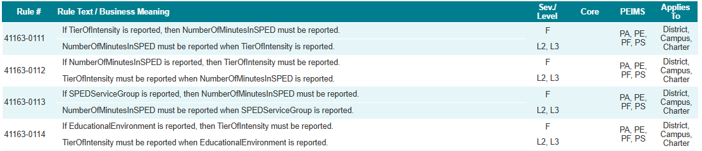
Business Rules - Fatal
  41163-0111
  41163-0112
  41163-0113
  41163-0114

Slide 37
Reports

Slide 38
Reports 1
Changes to Reports
  PDM#-121-### reports are being evaluated to see if the new Tier of Intensity can be added or if we need a new report.
  ALL Attendance Funding reports will be updated to add a new row for the Tier of Intensity.
TEDS & TSDS will continue working closely with the program area to finalize and implement the new funding structure into PEIMS reporting in the 2026-2027 school year.

Slide 39
Closeout

Slide 40
FAQ – NumberOfMinutesInSPED Clarification
How should the NumberOfMinutesInSPED (E3X10) data element be reported?
Report the average number of minutes per instructional day that a student receives SPED services. For example, if a student receives one hour of service per week, divide by five and report 12 minutes per day. This approach helps calculate the general education offset for funding purposes.
Under the new tiered model, there is no direct correlation, but daily minutes in a SPED setting are still needed to calculate the offset from the basic allotment, as outlined in TEC §48.051.

Slide 41
FAQ – NumberOfMinutesInSPED Clarification 1
How are minutes reported for students receiving speech therapy?
Report minutes based on how the service is delivered:
  Pull‑out speech therapy (outside the general education classroom) → Report these minutes in NumberOfMinutesInSPED.
  Push‑in speech therapy (service delivered in the general education classroom) → Do not include these minutes as special education minutes.

Slide 42
FAQ – EducationalEnvironment vs. SPEDMinutes
Should the EducationalEnvironment (E3155) data element align with the NumberOfMinutesInSPED (E3162) data element?
No. These elements serve different purposes. EducationalEnvironment (E3155) is used for federal reporting, while NumberOfMinutesInSPED (E3162) is used for funding calculations. They may not fully align.

Slide 43
FAQ – Service Groups and Tiers Definitions
When will the descriptors for TierOfIntensity (C371) and SPEDServiceGroup (C373) be available?
These descriptors will be established through commissioner’s rules, with final information expected in summer 2026.

Slide 44
Key Takeaways
What Matters Most For Successful SPED Data Funding Reporting
Why It Matters
How It Fits
Key Dates
What To Report
Avoid Errors
Ensures LEAs report accurate data used for calculating new SPED funding formulas.
Supports statewide consistency as TEA transitions to tier‑based and service‑group‑based funding.
Adds new descriptor tables for Tier of Intensity, Educational Environment, and SPED Service Group.
Number of Minutes in SPED with associated begin and end dates
LEAs continue to use 2025–2026 elements along with new data elements for the first year. More guidance to come.
Ensure descriptor codes reflect the correct tier, service group, or educational environment.
Bottom Line
LEAs must ensure accurate, timely reporting aligned to ARD determinations to ensure proper funding under HB 2.
Implements HB 2 requirements to align funding with levels of service intensity.
Adds two new attendance entities.
New reporting requirements begin with the 2026–2027 school year.
SPED Service Group and Educational Environment, along with begin and end dates for each student
Regular or flexible attendance days for each Tier of Intensity
Enter begin/end dates accurately for all common types.
The collection shifts SPED reporting to a tier‑based funding model, supported by new attendance entities, descriptors, and common types.
Introduces four new common types: TierOfIntensitySet, SPEDServiceGroupSet, and NumberOfMinutesInSPEDSet, EducationalEnvironmentSet

Slide 45
Technical Resources
Technical Specifications: ​
  Texas Education Data Standards (TEDS)​
Technical Support:​
  TSDSCustomerSupport@tea.texas.gov ​
Special Education Division:
  specialeducation@tea.texas.gov

Slide 46

QUESTIONS
QUESTIONS?

