Slide 1

Special Education Data System
SPEDS Video Camera Request Submission
April 1, 2026

Slide 2

Agenda – SPEDS Video Camera Request Submission
Overview
Timeline
Data Collection Changes
Business Rules
Promotion Logic and Reports
Closeout
Frequently Asked Questions
Key Takeaways
Technical Resources
Questions

Slide 3

TITLE SLIDE: Overview
Overview
NAME OF COMPONENT (ALL CAPS) MARCH 19-21, 2024

Slide 4
Background
HB 2 Section 4.22/SB 568 Section 22 amends TEC §29.022 (q), Video Surveillance of Special Education Settings. (q) The agency shall collect through the Public Education Information Management System (PEIMS) data relating to requests made under this section and actions taken by a school district or open-enrollment charter school in response to a request, including the number of requests made, authorized, and denied.
TEA has added a new submission to the Special Education Data System Collection, Video Camera Request Submission with three new entities:
LocalEducationAgency
School
New - SPEDVideoCameraRequestExt

Slide 5
Timeline

Slide 6
2026-2027 Timeline
2026-2027 School Year
For the 2026–2027 school year, all Special Education Video Camera Requests will be submitted in the 2026–2027 SPEDS Video Camera Request Submission.

Slide 7
D
Data Collection Changes
NAME OF COMPONENT (ALL CAPS) MARCH 19-21, 2024

Slide 8
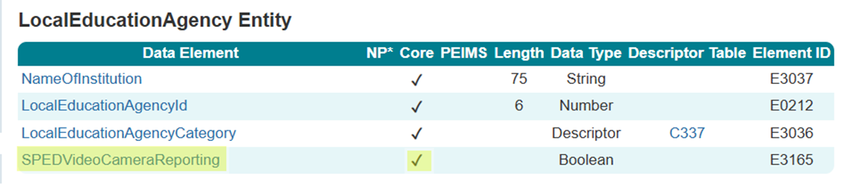
LocalEducationAgency Entity
The following is added to the LocalEducationAgency Entity for use by the SPEDS Video Camera Request Submission :
Data Elements:
SPEDVideoCameraReporting (E3165)

Slide 9
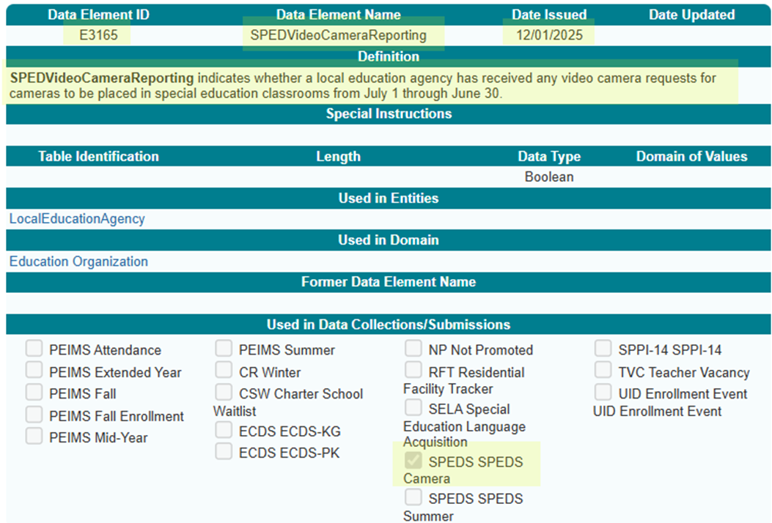
SPEDVideoCameraReporting
New SPEDVideoCameraReporting (E3165) data element:

Slide 10
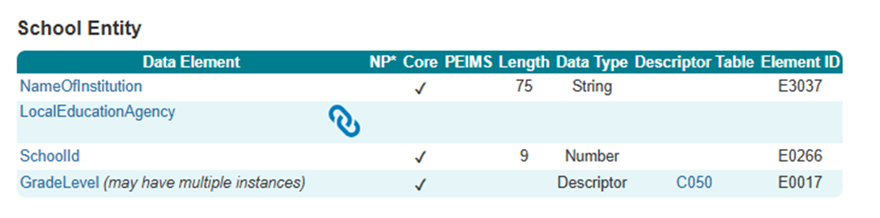
School Entity

Slide 11
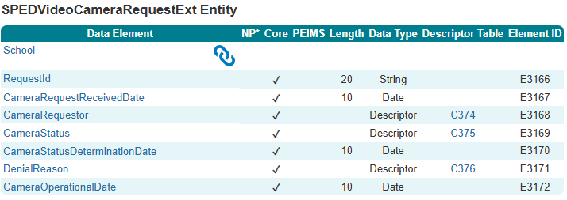
SPEDVideoCameraRequestExt Entity (New)
The following is added to the SPEDS Video Camera Request Submission
Date Elements:
School (Reference)
RequestId (E3166)
CameraRequestReceivedDate (E3167)
CameraRequestor (E3168)
CameraStatus (E3169)
CameraStatusDeterminationDate (E3170)
DenialReason (E3171)
CameraOperationalDate (E3172)

Slide 12
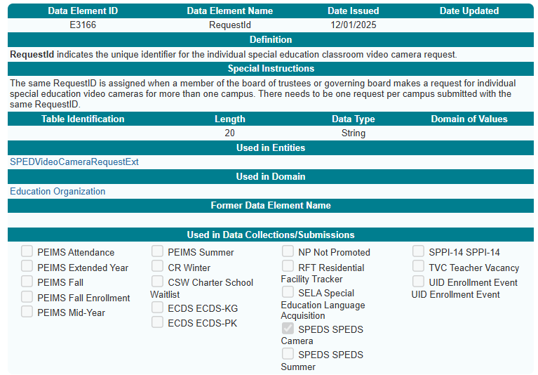
RequestId (E3166)
New RequestId (E3166) data element:

Slide 13
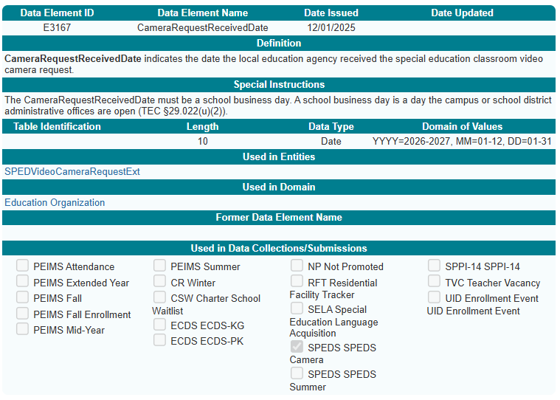
CameraRequestReceivedDate (E3167)
New CameraRequestReceivedDate (E3167) data element:

Slide 14
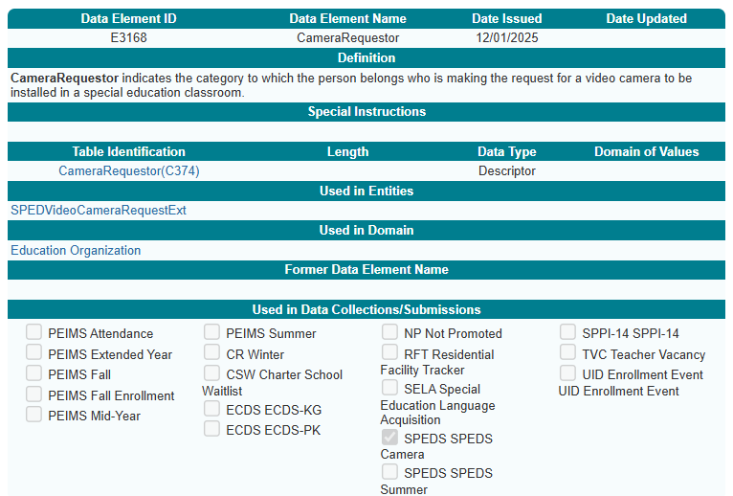
CameraRequestor (E3168)
New CameraRequestor (E3168) data element:

Slide 15
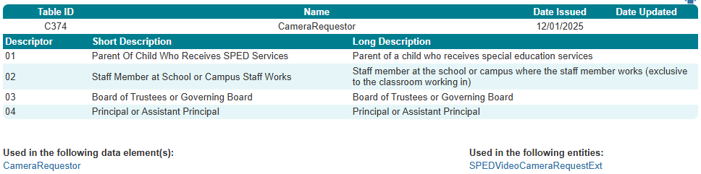
CameraRequestor (C374)
New CameraRequestor (C374) descriptor table:

Slide 16
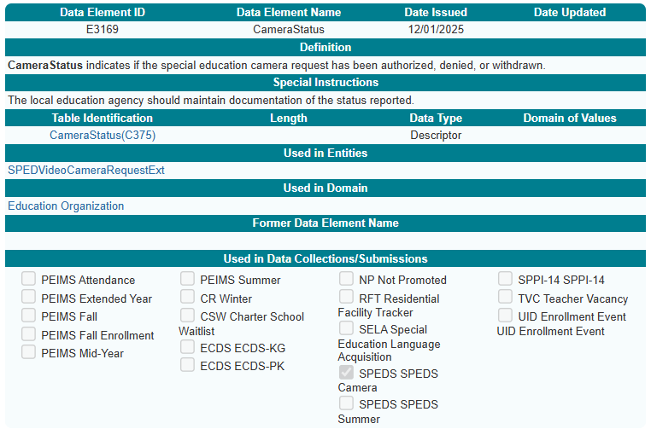
CameraStatus (E3169)
New CameraStatus (E3169) data element:

Slide 17
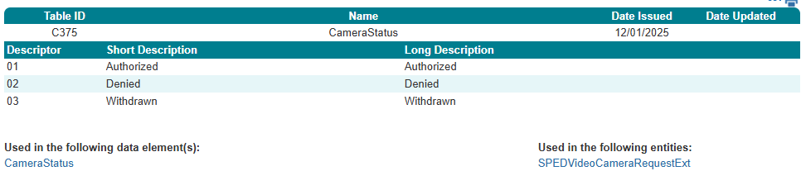
CameraStatus (C375)
New CameraStatus (C375) descriptor table:

Slide 18
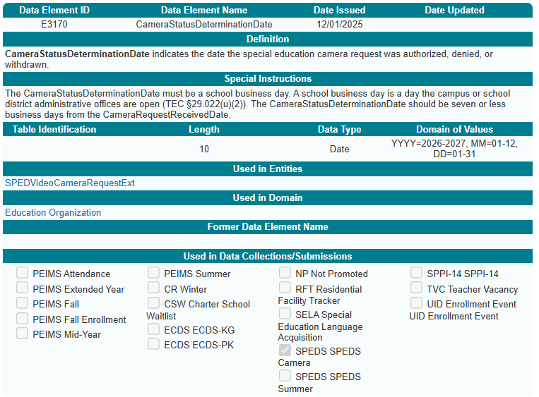
CameraStatusDeterminationDate (E3170)
New CameraStatusDeterminationDate (E3170) data element:

Slide 19
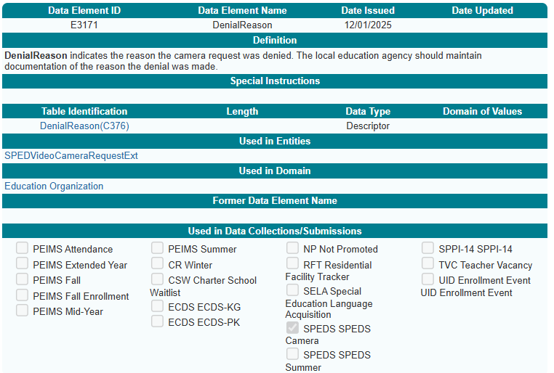
DenialReason (E3171)
New DenialReason (E3171) data element:

Slide 20
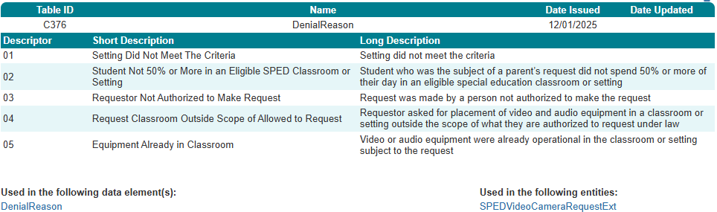
DenialReason (C376)
New DenialReason (C376) descriptor table:

Slide 21
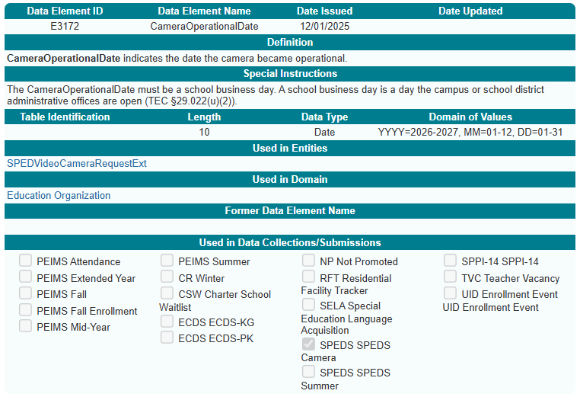
CameraOperationDate (E3172)
New CameraOperationalDate (E3172) data element:

Slide 22
Business Rules

Slide 23
New Business Rules
The following new rules will be added to the SPEDS Video Camera Request Submission:
6 Fatals
10010-0015
10010-0034
10010-0035
12000-0001
12000-0002
12000-0003
2 Special Warnings
12000-0004
12000-0005

Slide 24
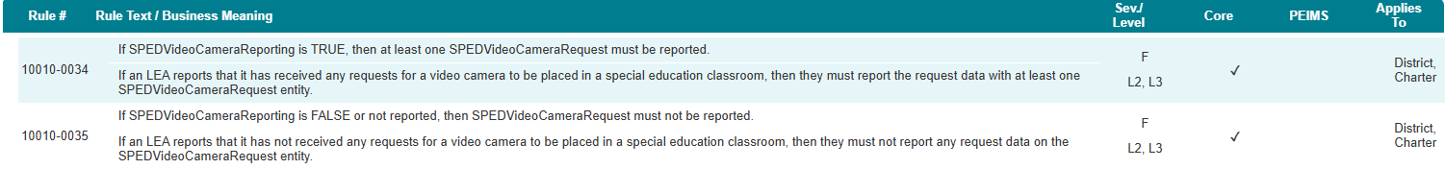
Data Business Rules - Fatal
10010-0034
10010-0035

Slide 25
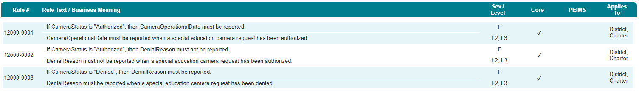
Data Business Rules – Fatal Continued
12000-0001
12000-0002
12000-0003

Slide 26
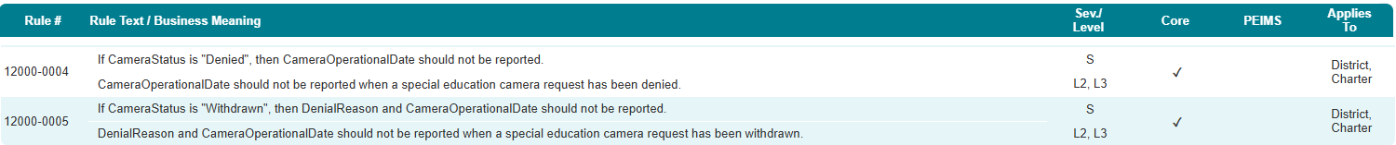
Data Business Rules – Special Warning
12000-0004
12000-0005

Slide 27
Promotion Logic and Reports

Slide 28
Promotion Logic and Reports 1
Expected Reports
One detail report at the LEA and ESC levels.
The report will provide the counts required by statute.
The report will include:
RequestID
Number of requests:
Made
Authorized
Denied w/DenialReason descriptor
CameraRequestor descriptor
The report will provide sorting options.
Promotion Logic is in development
Simplified Promotion Logic Document expected to be published Fall 2026
Training for the SPEDS Video Camera Request Submission is currently in development, with timing to be communicated once finalized.

Slide 29
Closeout

Slide 30
FAQ – SPED Setting Clarification
Does the term “setting” in DenialReason (C376) descriptor 02 also include special education (SPED) transportation services?
No. The DenialReason (C376) descriptor 02: Student Not 50% or More in an Eligible SPED Classroom or Setting, refers only to instructional environments where the student spends 50% or more of their day. Transportation services, such as SPED bus services, are not included.

Slide 31
FAQ – Camera Request Eligibility
Are only individuals listed in the CameraRequester (C374) descriptor table eligible to submit a special education video camera request?
Yes. Only individuals identified in the CameraRequester descriptor table are authorized to submit a special education video camera request.

Slide 32
FAQ – Camera Request Eligibility con’t
Can students aged 18 or older submit a camera request on their own behalf?
No. Students are not permitted to submit camera requests on their own behalf.

Slide 33
FAQ – Camera Request During SPED Evaluation
Can a parent submit a camera request while their child is undergoing special education testing?
No, a parent may submit a camera request only after the Admissions, Review & Dismissal (ARD) committee has determined the special education services a student will receive.

Slide 34
FAQ - Operational Date for Existing Camera
Would LEAs report a prior year operational date for cameras already installed in classrooms?
No, the data collection for cameras only applies to requests made during the current school year. If a camera is already present in a classroom, any new request for that room would be denied, and no operational date would be required for the existing camera.

Slide 35
FAQ – Expectations of LEAs to Submit Data
Are all districts and charters expected to submit this data or only those with a request?
Yes. All LEAs (districts and charters), are expected to submit the LocalEducationAgency Entity. Each LEA must indicate ‘true’ or ‘false’ for the SPEDSVideoCameraReporting (E3165) data element to show whether they received any requests for video cameras in special education classrooms.

Slide 36
FAQ – Calendar Data in SPEDS Video Camera Requests
Will the SPEDS Video Camera Request Submission reference the campus calendar data submitted in PEIMS Summer?
No, the three reported dates within the submission are defined in TEDS as “a school business day,” which includes any day when the campus or district administrative offices are open. There will be no validation check against calendar data to ensure a school business day is reported.

Slide 37
FAQ – TEAL Roles Needed
Will the SPEDS Video Camera Request Submission require additional roles or privileges in TEAL?
No, access to SPEDS Video Camera Request will be attached to the existing SPEDS Access privilege. The SPEDS Access privilege will grant access to both the SPEDS Summer and SPEDS Video Camera Request submissions.

Slide 38
Key Takeaways
Why It Matters
How It Fits
Key Dates
What To Report
Avoid Errors
Supports state oversight of camera requests
Ensures transparency and consistency statewide
Ties camera requests to actions taken by LEAs
Report each camera request once and reflect the associated final CameraStatus (E3169).
Receiving a camera request CameraRequestReceivedDate ( E3167) is different from Authorizing CameraStatusDeterminationDate (E3170) a camera request.
Indicate whether any camera requests were received by using CameraRequestReceivedDate (E3167).
Each camera request must be reported..
LEA – level Indicator
Bottom Line
The SPEDS Video Camera Request Submission may be new, but the logic is straightforward.
When reporting a CameraStatus, (E3169) verify that a CameraRequestReceivedDate (E3167) exists.
Ensure the reported CameraStatus (E3169) accurately reflects the state of the underlying camera request.
Ensure the reported data aligns with the defined business rules.
CameraStatus indicates whether the camera request has been authorized, denied, or withdrawn.
What Matters Most For Successful SPEDS Video Camera Request Reporting

Slide 39
Technical Resources
Program Area – Kristin McGuire
specialpopulations@tea.texas.gov
Technical Specifications: ​
Texas Education Data Standards (TEDS)​
Technical Support:​
TSDSCustomerSupport@tea.texas.gov ​

Slide 40

QUESTIONS
QUESTIONS?

