Slide 1

Teacher Vacancy Collection March 31, 2026

Slide 2

Agenda – 2026-2027 Teacher Vacancy Collection
Overview
Timeline
Data Collection Changes
Business Rules
Promotion Logic and Reports
TEAL Roles
Closeout
Frequently Asked Questions
Key Takeaways
Technical Resources
Questions

Slide 3

TITLE SLIDE: Overview
Overview
NAME OF COMPONENT (ALL CAPS) MARCH 19-21, 2024

Slide 4
Background
HB 2 Section 3.08 amends Subchapter J, Chapter 21, Education Code by adding TEC §21.468, which adds a collection of data from school districts and open-enrollment charter schools to address teacher retention and recruitment, including the classifications, grade levels, subject areas, duration, and other relevant information regarding vacant teaching positions at districts.
TEA has added a new core collection, Teacher Vacancy Collection (TVC) with three entities:
LocalEducationAgency
New - OpenStaffPositionExt
New - RequisitionExt

Slide 5
Timeline

Slide 6
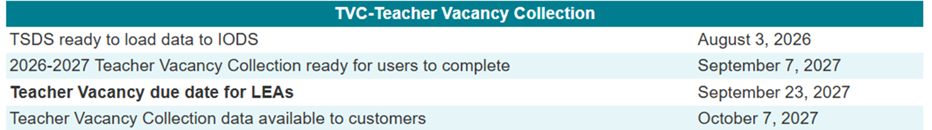
2026-2027 Timeline
2026-2027 School Year
The Teacher Vacancy Collection will be due yearly on the fourth Thursday of September.
*vacant positions from September 1, 2026, through August 31, 2027, will be promoted for the 2026-2027 school year.
Subsequently, if the posting is still vacant on September 1, 2027, the LEA will republish it to the next year’s Individual Operational Data Store (IODS).

Slide 7
D
Data Collection Changes
NAME OF COMPONENT (ALL CAPS) MARCH 19-21, 2024

Slide 8
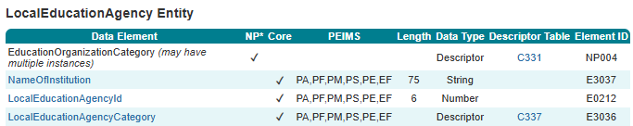
LocalEducationAgency Entity

Slide 9
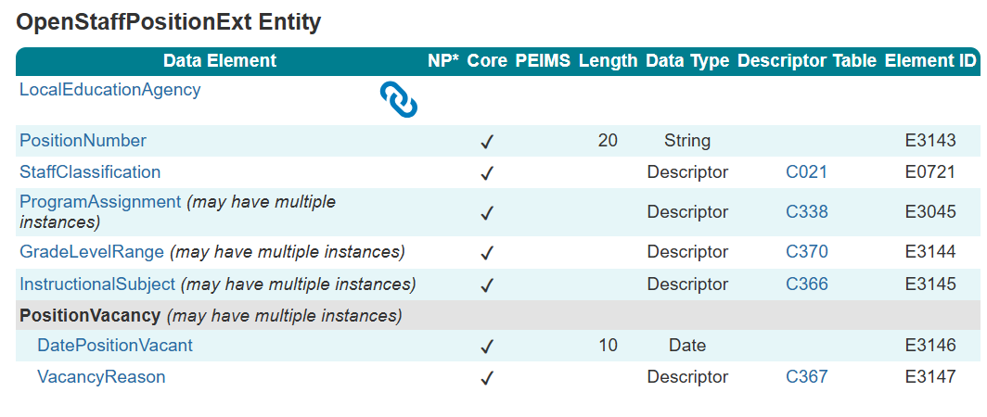
OpenStaffPositionExt Entity

Slide 10
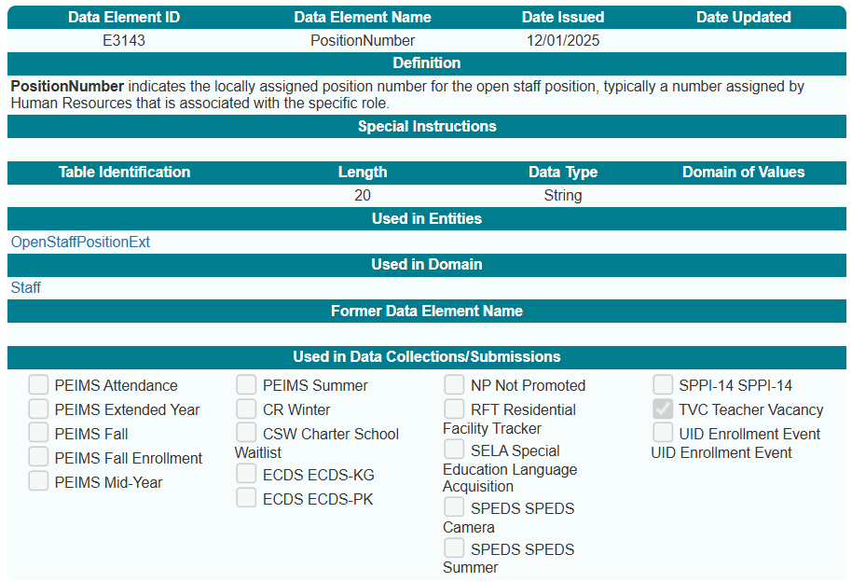
PositionNumber (E3143)
New PositionNumber (E3143) data element:

Slide 11
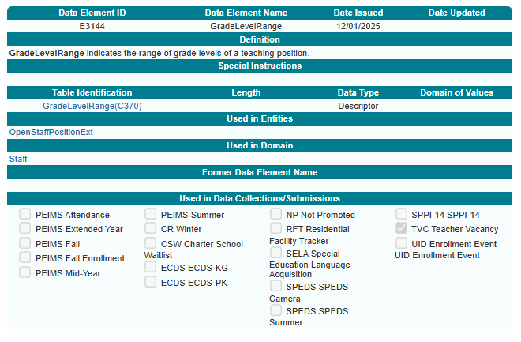
GradeLevelRange (E3144)
New GradeLevelRange (E3144) data element:

Slide 12
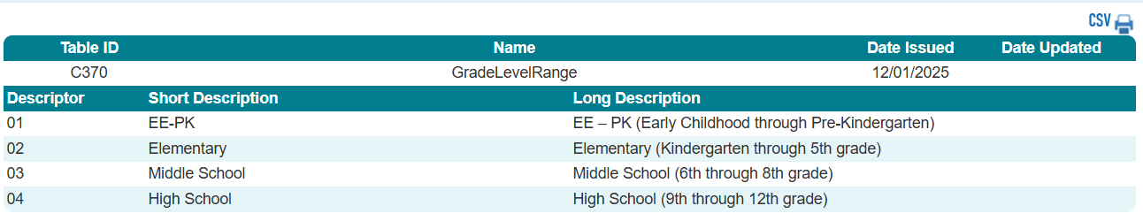
GradeLevelRange (C370)
New GradeLevelRange (C370) descriptor table:

Slide 13
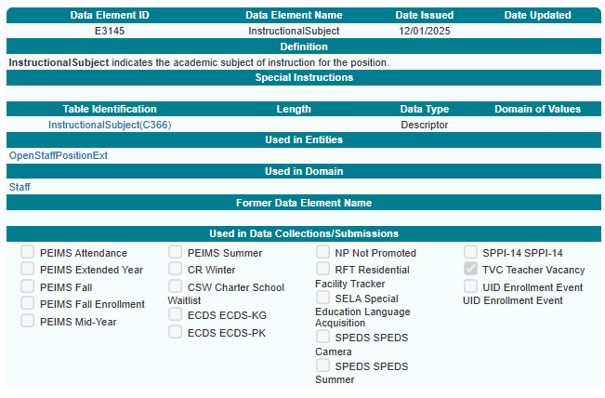
InstructionalSubject (E3145)
New InstructionalSubject (E3145) data element:

Slide 14
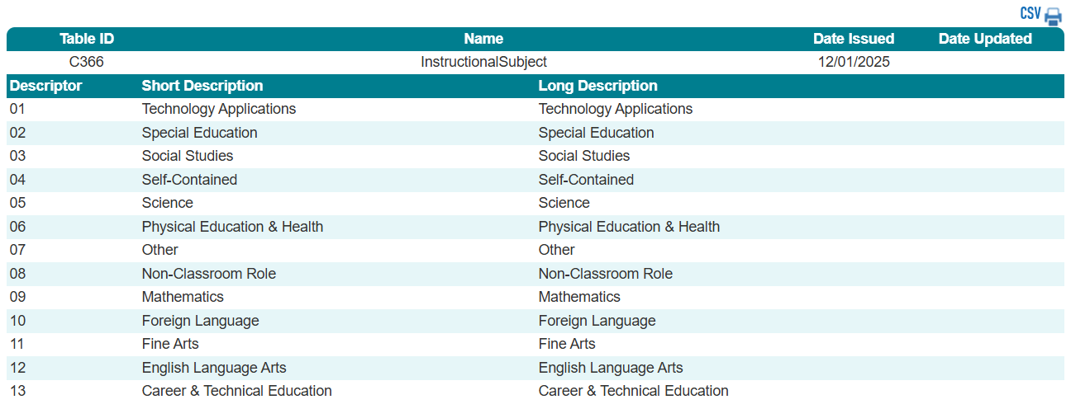
InstructionalSubject (C366)
New InstructionalSubject (C366) descriptor table:

Slide 15
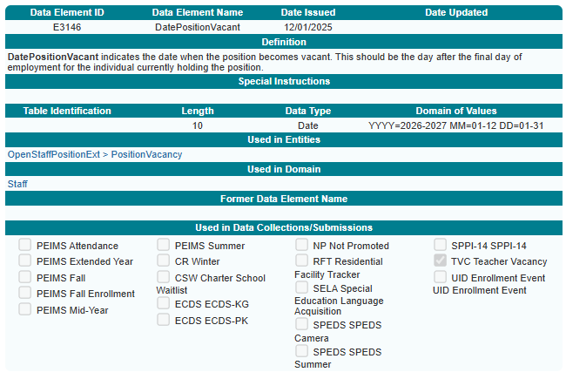
DatePositionVacant (E3146)
New DatePositionVacant (E3146) data element in the PositionVacancy common type:

Slide 16
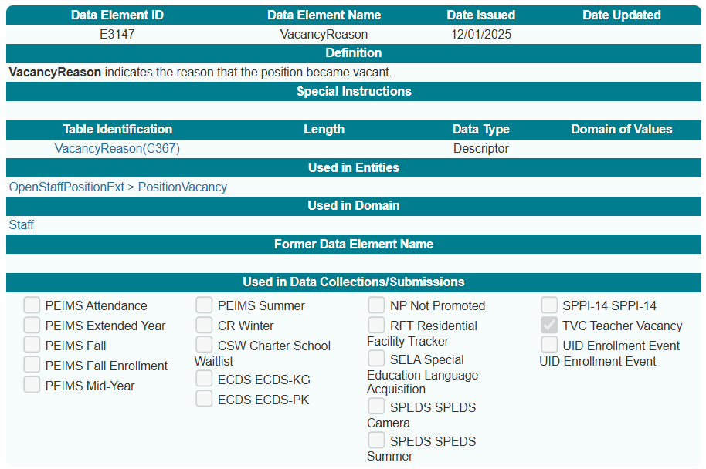
VacancyReason (E3147)
New VacancyReason (E3147) data element in the PositionVacancy common type:

Slide 17
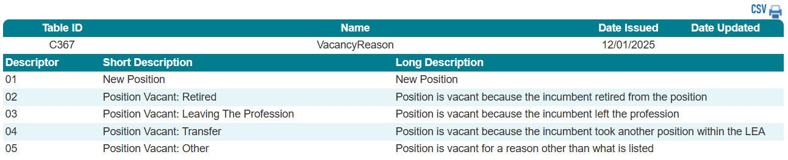
VacancyReason (C367)
New VacancyReason (C367) descriptor table:

Slide 18
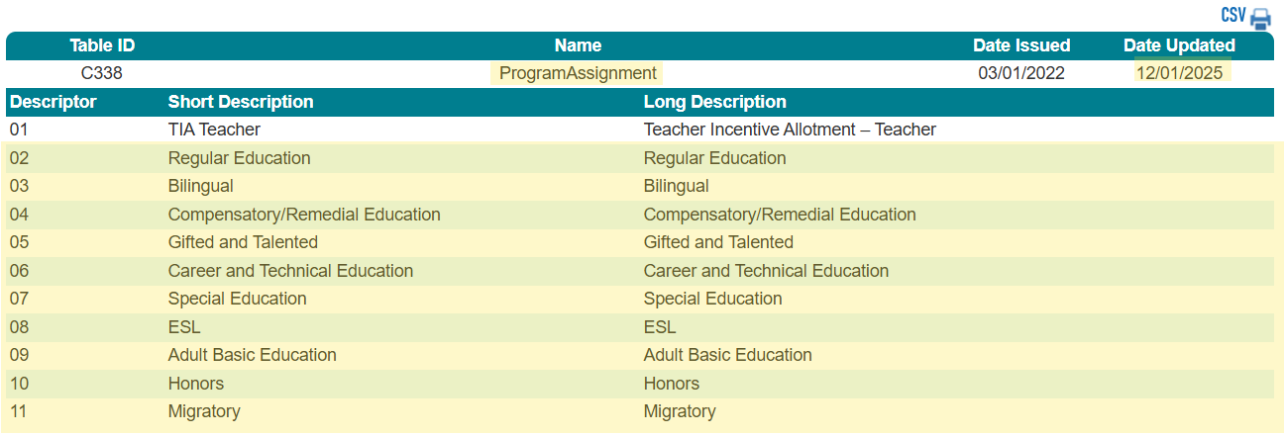
ProgramAssignment (C338)
Revised ProgramAssignment (C338) descriptor table:

Slide 19
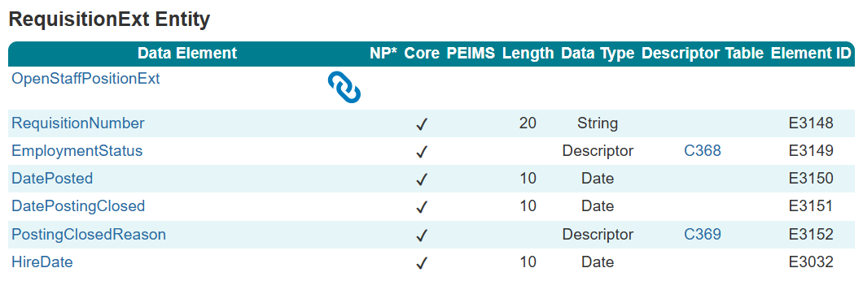
New RequisitionExt Entity

Slide 20
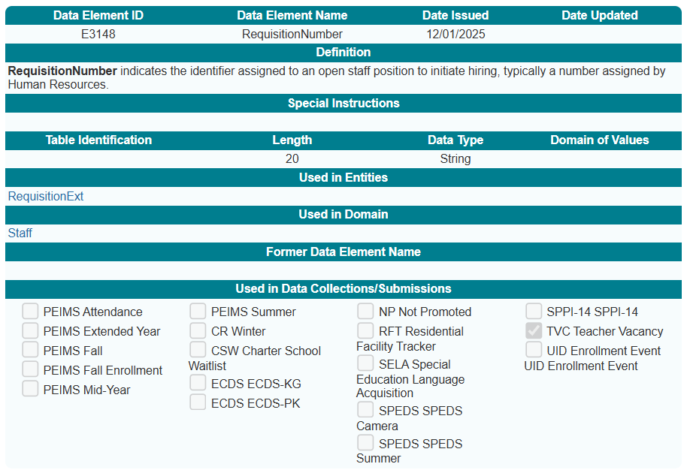
RequisitionNumber (E3148)
New RequisitionNumber (E3148) data element:

Slide 21
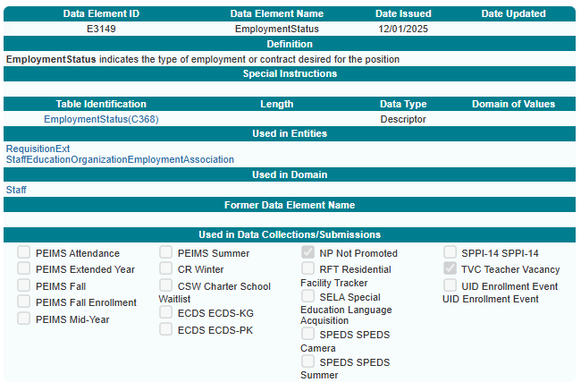
EmploymentStatus (E3149)
New EmploymentStatus (E3149) data element:

Slide 22
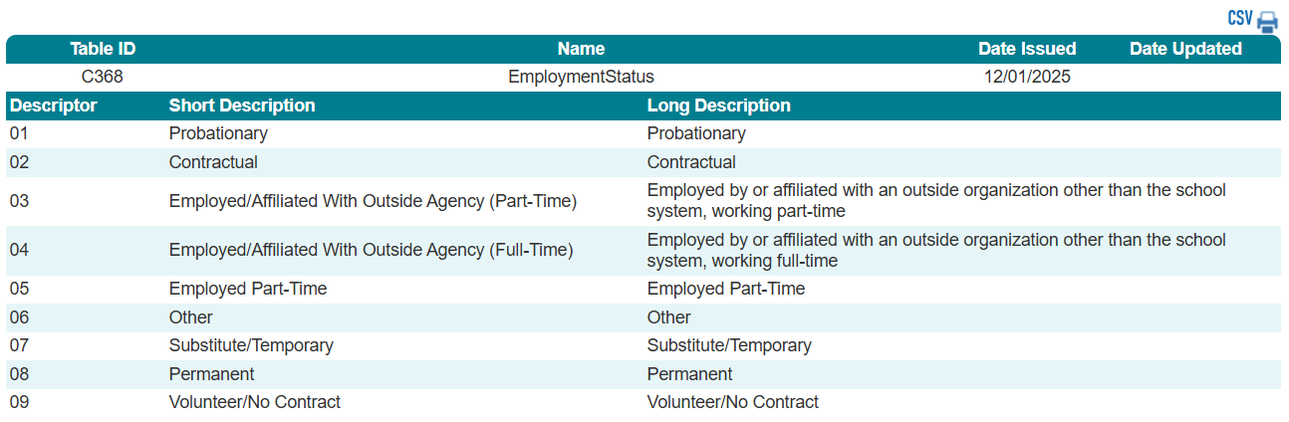
EmploymentStatus (C368)
New EmploymentStatus (C368) descriptor table:

Slide 23
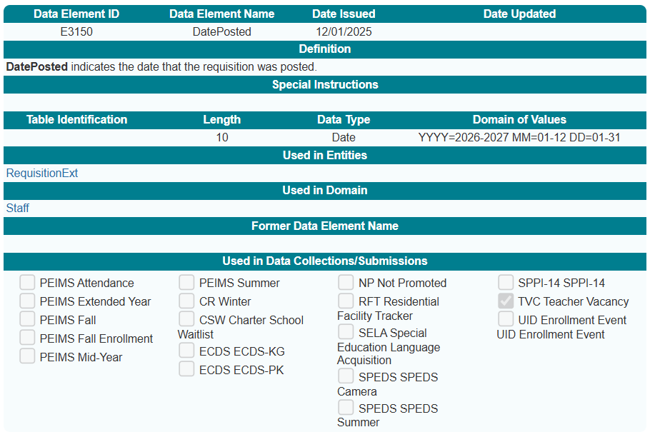
DatePosted (E3150)
New DatePosted (E3150) data element:

Slide 24
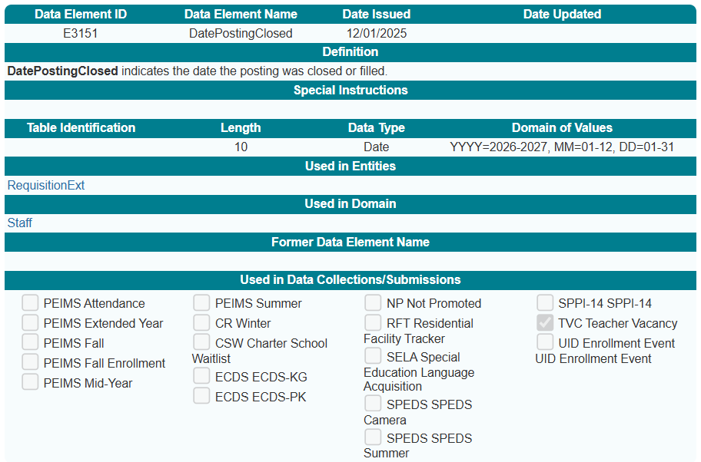
DatePostingClosed (E3151)
New DatePostingClosed (E3151) data element:

Slide 25
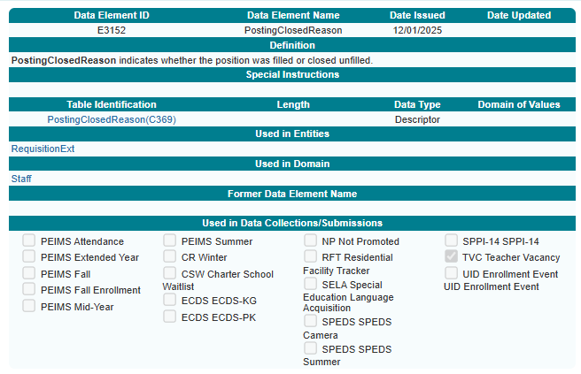
PostingClosedReason (E3152)
New PostingClosedReason (E3152) data element:

Slide 26
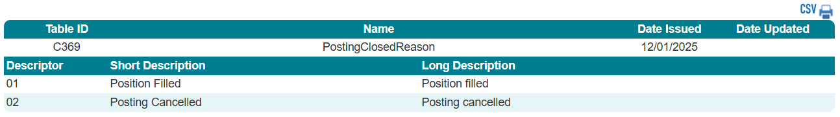
PostingClosedReason (C369)
New PostingClosedReason (C369) descriptor table:

Slide 27
Business Rules

Slide 28
New Business Rules
The following new rules will be added to the Teacher Vacancy Collection:
2 Fatals – 31000 is a new sub-category – Teacher Vacancy
31000-0001
31000-0002
2 Special Warnings
31000-0003
31000-0004

Slide 29
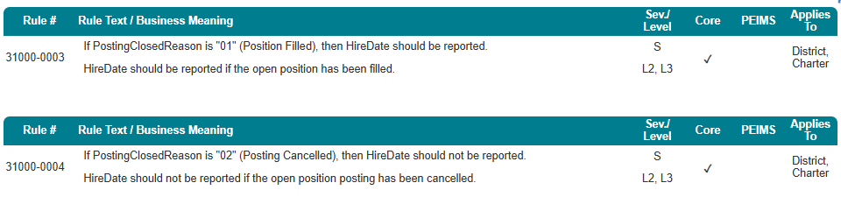
Business Rules – Special Warning
31000-0003
31000-0004

Slide 30
Promotion Logic and Reports

Slide 31
Promotion Logic and Reports
Promotion Logic
New: Staff > Teacher Vacancy subcategory
RequisitionExt data is promoted only when the RequisitionExt Entity is associated with an OpenStaffPositionExt Entity where the DatePositionVacant Entity is during the reporting year.
Reports
One detailed report to include all reported elements per each vacancy reported
Training
Training for the Teacher Vacancy Collection is currently in development, with timing to be communicated once finalized.

Slide 32
Teal Roles

Slide 33
TEAL Roles 1
A new privilege - Teacher Vacancy Access
will be available for each of these roles:
Core ESC Data Viewer
Core LEA Data Approver
Core LEA Data Completer
Core LEA Data Promoter
Core LEA Data Viewer
Core TEA Data Viewer
Users will need to apply for this new privilege even if they already have one of the roles above.

Slide 34
Closeout

Slide 35
FAQ – Reporting Timeline and School Year Alignment
Why is the vacancy reporting timeline set from September 1 to August 31, and does this mix school years?
The September 1–August 31 timeline is intended to capture vacancies associated with the school year, as reflected in the LEA’s Individual Operational Data Store (IODS).
Although hiring activity often occurs in the summer, this approach helps avoid requiring two separate collections in one year. Any position that is vacant at any point within this timeframe should be reported for that corresponding school year.

Slide 36
FAQ – Reporting Timeline and School Year Alignment.
How should vacancies be reported when they occur at the end of one school year but are filled before the next begins?
Vacancies are reported based on when the position became vacant. For example, if a position becomes vacant in May and is filled in July, it should be reported for the school year in which the vacancy occurred.
A position vacant between September 1 and August 31 is included in that year’s Teacher Vacancy Collection, even if it is filled before the first day of instruction in the next school year.

Slide 37
FAQ – Vacancies Spanning Multiple Reporting Periods
How is a vacancy reported when it spans two separate reporting periods?
A vacancy that remains open across reporting periods must be reported in both periods.
In the first reporting period, the vacancy will be reported without Posting Closed information because the position has not yet been filled.
In the second reporting period, the vacancy is reported again, this time including the Posting Closed information once the position is filled.

Slide 38
FAQ – Vendor Responsibility for Vacancy Reporting
Which vendor is responsible for reporting teacher vacancy data—the SIS, the HR system, or a third‑party recruiting vendor?
TEA shared reporting requirements with all vendors, but cannot mandate which specific system must report the data.
LEAs are responsible for coordinating with their vendors to ensure the required vacancy data is reported.

Slide 39
FAQ – Internally Filled Vacancy Reporting
How should vacancies be reported when a position is filled through internal movement—for example, a vacant 5th‑grade position filled by shifting a kindergarten teacher, followed by hiring a new kindergarten teacher?
Reporting is tied to the original vacancy. Only the original 5th‑grade vacancy should be reported.
Reporting focuses on the initial teacher vacancy, not on who later filled the secondary position created by internal movement.

Slide 40
FAQ – Staff Classification and Reporting
Are vacancies reported for StaffClassification (C021) codes 087 (Teacher) and 047 (Substitute Teacher)?
No. Only vacancies for StaffClassification 087 (Teacher) are reported.

Slide 41
Key Takeaways
What Matters Most For Successful Teacher Vacancy Data Reporting
Why It Matters
How It Fits
What’s New
What To Report
Business Rules
Ensures consistent, transparent data
Helps identify trends in teacher shortages
Reports any open teaching position from September 1- August 31. A vacancy can be reported across multiple years.
Only report the original vacancy when internal moves occur
Report all teacher (087) vacancies within the reporting period, including unfilled vacancies from a prior reporting period
Align data with descriptor tables and required elements for each status
Bottom Line
Identify all vacancies in the required timeframe
New 31000-series validations
New descriptor tables for subjects, grade levels, and reasons
Base reporting on when the position became vacant
Uses three entities to capture vacancy details
Ensure consistency in reporting by using published guidance and business rules
Two new entities
New data elements (PositionNumber, GradeLevelRange, InstructionalSubject, Vacancy Reason, RequisitionNumber, EmploymentStatus, DatePosted, DatePostingClosed, PostingClosedReason)
A new yearly core collection due every fourth Thursday of September
Supports statewide teacher vacancy reporting

Slide 42
Technical Resources
Technical Specifications: ​
Texas Education Data Standards (TEDS)​
Technical Support:​
TSDSCustomerSupport@tea.texas.gov ​

Slide 43

QUESTIONS
QUESTIONS?

