Slide 1

Virtual and Hybrid Education
2026 Spring TSDS ESC Coordinator Training
March 31, 2026

Slide 2



Virtual/Hybrid Education Team
Ann Rajan
Division Director of Virtual and Hybrid Education
Eric Fredrickson
Deputy Director of Virtual and Hybrid Authorization
Dr. Sara Baker
Deputy Director of Virtual and Hybrid Resources and Support
Virtual.hybrid@tea.texas.gov

Slide 3
Virtual and Hybrid Education Overview

Slide 4



Virtual and Hybrid Models Address Needs Across the Education Ecosystem
Virtual and Hybrid program and campuses offer flexible, personalized learning for students and families while enabling school systems to expand access, optimize staffing, and reimagine programs.
Broader Course Offerings
Provide access to advanced courses and personalized pathways to more students
Operational Flexibility
Adapt to staffing gaps
Accommodate health and life challenges for students and caregivers
Program Customization
​
Streamline resources to boost credit recovery and work-based learning opportunities aligned with student goals

Slide 5
89th Session: SB 569 Overview
Individual Courses
  LEAs may offer individual virtual or hybrid courses and certify that those courses cover the TEKS, provide grade-level rigor and mastery of the subject or grade-level, and meets standards of quality
Full-Time Virtual/Hybrid Programs
  LEAs may offer virtual/hybrid programs within campuses without authorization if enrollment is less than 50% of students enrolled at the campus
Full-Time Virtual/Hybrid Campuses
  LEAs may offer virtual/hybrid campuses after receiving authorization from TEA through an application process
  Increased accountability requirements
SB 569 establishes
three delivery formats & streamlines requirements
for virtual/hybrid learning.

Slide 6


Virtual and Hybrid Model Definitions
Virtual
Hybrid

Slide 7
Hybrid Class Schedule Options
Hybrid
a student attends in-person classes for less than 90% of instructional time. Instruction can be delivered online (synchronously or asynchronously), in person, or through other methods.
Schedule A
Class 1
Class 2
Class 3
Class 4
Class 5
Class 6
Class 7
Schedule B
Class 1
Class 2
Class 3
Class 4
Class 5
Class 6
Class 7
Schedule Option B: Some in-person classes and some virtual classes
Schedule Option A: All hybrid classes
7

Slide 8
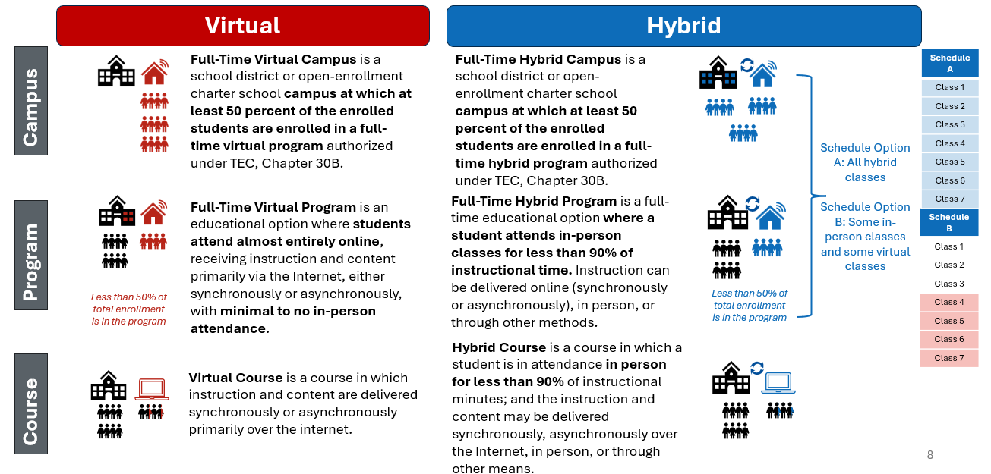
Virtual and Hybrid Model Definitions

Slide 9
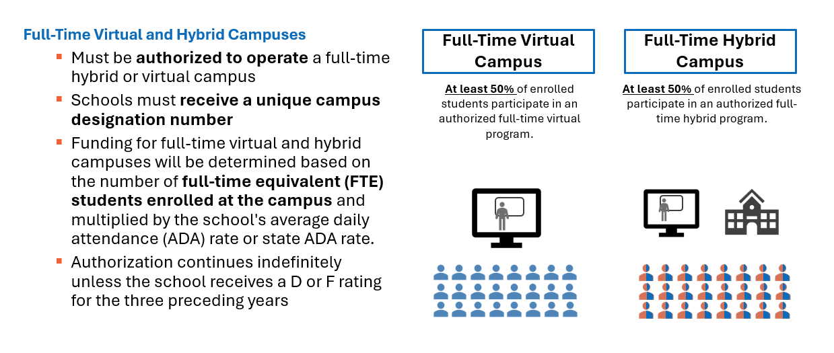
Virtual and Hybrid Campuses

Slide 10








Virtual and Hybrid Model Definitions 2
Instructional Delivery
Synchronous Instruction: real-time, scheduled learning sessions where instructors and students interact simultaneously over the internet through live video and interactive tools
Asynchronous Instruction: online learning where students access the instructional material and complete assignments at an individual pace and schedule. Minimal to no mandatory real-time sessions with the instructor
Virtual
Hybrid
Campus
At least 50% of total enrollment is in the program
At least 50% of total enrollment is in the program
Program
Less than 50% of total enrollment is in the program
Less than 50% of total enrollment is in the program

Slide 11
Campus, Program, or Courses?
What School Systems Consider Before Deciding
Full-time Virtual or Full-time Hybrid CAMPUS | Full-time Virtual or Full-time Hybrid PROGRAM | Virtual or Hybrid COURSE Offerings
Enrollment-Based Funding (Enrolled students x attendance rate) | ADA Funding (Daily engagement evidence) | ADA Funding (Same as in-person)
Requires Authorization from TEA | School Systems May Launch Independently | School Systems May Launch Independently
School Systems Create a New Campus with a Specific Focus | Exists within a Current Campus & Serves less than 50% of students | Offer district or statewide

Slide 12
TEC, Chapter 30B is undergoing the rulemaking process.
Rules will go into effect in the Summer of 2026

Slide 13
Attendance and Funding

Slide 14
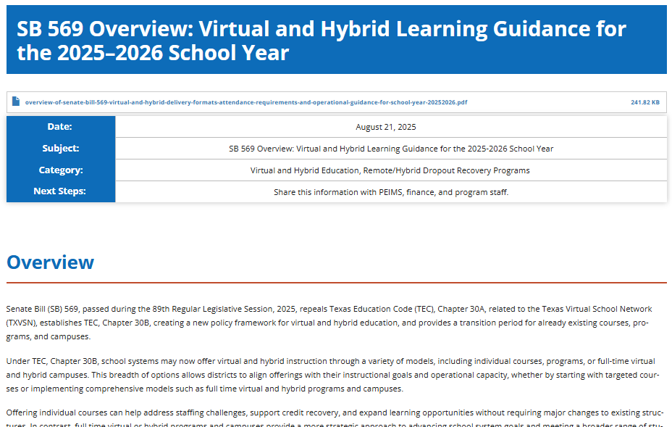
SY 2025-26: Transition Year
TXVSN Online Schools and Waiver Schools continue operating under TEC 30A as before, except for changes in funding.
Shared TAA on SB 569 for offering virtual and hybrid options in SY 2025-26 and clarity around attendance and funding

Slide 15
Attendance and Funding
 | Full-time Virtual and Hybrid Campuses (Existing schools that operated under, or have a previous waiver for, TEC Chapter 30A—such as TXVSN and TXVSN waiver schools) | Full-time Virtual and Hybrid Programs (Programs under TEC, Chapter 30B) | Virtual or Hybrid Courses (supplemental courses such as in TXVSN course catalog or new courses under TEC, Chapter 30B)
Attendance Taking for Funding Purposes | A student is reported as present for each day the student is enrolled on the campus. | Report attendance for students participating in either synchronous or asynchronous methods based on the school system-approved instructional plan and policy. Attendance is taken daily and may be conducted anytime between 12:00 am and 11:59 pm each day the campus is open, or within a more specific daily time frame as specified by the approved policy. Daily measurement options for attendance include: • Daily progress in the learning management system (LMS) that confirms students accessed instruction, as defined by the school system; or • Daily check-in via teacher-student interactions that confirm students accessed instruction, as defined by the school system; or • Completion/turn-in of assignments from student to teacher (potentially via email or online). School systems must maintain documentation to support the daily attendance a student has earned. | Students enrolled in virtual or hybrid courses who are present on campus for part of the day will have their attendance recorded during their scheduled on-campus class times. If a student is on campus for part of the day but not during the official attendance-taking period, attendance may be recorded during an alternative attendance-taking time. See 3.6.2.2 Alternative Attendance-Taking Time for Certain Student Populations for instructions on how to record attendance for these students.
Funding Calculation | For full-time hybrid or virtual campuses, average daily attendance will be calculated using the number of enrolled full-time equivalent students multiplied by the average attendance rate of the district or charter school offering the campus, excluding students enrolled in those hybrid or virtual campuses. If a reliable attendance rate is not available, the statewide average will be used instead. | Districts and open-enrollment charter schools receive the same amount of funding per student for a full-time hybrid program, or full-time virtual program as it would for the same course or program offered fully in person. | Districts and open-enrollment charter schools receive the same amount of funding per student for a hybrid course, virtual course, as it would for the same course or program offered fully in person.

Slide 16
Full-time Virtual and Hybrid Campuses
Existing schools that operated under, or have a previous waiver for, TEC Chapter 30A—such as TXVSN and TXVSN waiver schools)
Attendance Taking for Funding Purposes | A student is reported as present for each day the student is enrolled on the campus.
Funding Calculation | For full-time hybrid or virtual campuses, average daily attendance will be calculated using the number of enrolled full-time equivalent students multiplied by the average attendance rate of the district or charter school offering the campus, excluding students enrolled in those hybrid or virtual campuses. If a reliable attendance rate is not available, the statewide average will be used instead.

Slide 17
Full-time Virtual and Hybrid Programs
Existing schools with Programs under TEC, Chapter 30B
Attendance Taking for Funding Purposes | Report attendance for students participating in either synchronous or asynchronous methods based on the school system-approved instructional plan and policy. Attendance is taken daily and may be conducted anytime between 12:00 am and 11:59 pm each day the campus is open, or within a more specific daily time frame as specified by the approved policy. Daily measurement options for attendance include: • Daily progress in the learning management system (LMS) that confirms students accessed instruction, as defined by the school system; or • Daily check-in via teacher-student interactions that confirm students accessed instruction, as defined by the school system; or • Completion/turn-in of assignments from student to teacher (potentially via email or online). School systems must maintain documentation to support the daily attendance a student has earned.
Funding Calculation | Districts and open-enrollment charter schools receive the same amount of funding per student for a full-time hybrid program, or full-time virtual program as it would for the same course or program offered fully in person.

Slide 18
Virtual or Hybrid Courses
Supplemental courses such as in TXVSN course catalog or new courses under TEC, Chapter 30B
Attendance Taking for Funding Purposes | Students enrolled in virtual or hybrid courses who are present on campus for part of the day will have their attendance recorded during their scheduled on-campus class times. If a student is on campus for part of the day but not during the official attendance-taking period, attendance may be recorded during an alternative attendance-taking time. See 3.6.2.2 Alternative Attendance-Taking Time for Certain Student Populations for instructions on how to record attendance for these students.
Funding Calculation | Districts and open-enrollment charter schools receive the same amount of funding per student for a hybrid course, virtual course, as it would for the same course or program offered fully in person.

Slide 19
Remote/Hybrid Dropout Recovery
Remote/hybrid dropout recovery programs must now operate as full-time hybrid or virtual programs or campuses under TEC, Chapter 30B.

Slide 20
Changes to Remote/Hybrid Dropout Recovery Programs
NEW - TEC §29.081
(e-2) A remote or hybrid dropout recovery education program must:
  (9) be a full-time hybrid program or a full-time virtual program, as those terms are defined by TEC, §30B.001, or a full-time hybrid or virtual campus authorized under Chapter 30B
(f-1) The commissioner shall include a student enrolled in a remote or hybrid dropout recovery education program under Subsection (e-2) in the computation of the district's or school’s average daily attendance for funding purposes in the same manner as students enrolled in a full-time hybrid or virtual program or full-time hybrid or virtual campus, as applicable, under TEC, Chapter 30B.
Removed course completion for funding starting in SY2025-26
Remote/Hybrid dropout recovery programs must be virtual or hybrid programs under TEC, Chapter 30B.
Funding and attendance reporting for these programs now follow the same rules as other full-time hybrid/virtual programs under TEC, Chapter 30B.

Slide 21
Transition Year Implementation: SY 25-26
For SY 25-26, all remote/hybrid dropout recovery programs were treated as virtual and hybrid programs since there was not yet a path to authorize campuses under TEC, Chapter 30B.
Attendance: Mechanism aligned with daily attendance for virtual and hybrid programs
  Report daily attendance for students in synchronous or asynchronous instruction per approved local policy, using options such as access instructional content and show progress via LMS activity, teacher-student check-in, or assignment submission.
These programs follow dropout recovery requirements of 43,200 minutes, compared to 75,600 minutes for other virtual/hybrid programs under TEC, Chapter 30B.
ADA Eligibility: Students must be scheduled for and receive 120 minutes/day for half-day or 240 minutes/day for full-day ADA funding

Slide 22
Data Reporting for Virtual/Hybrid Programs, Remote/Hybrid Dropout Recovery Programs, and Optional Flexible School Day Program (OFSDP) for SY 2025-2026
 | Virtual or Hybrid Programs | Remote/Hybrid Dropout Recovery Programs without OFSDP | Remote/Hybrid Dropout Recovery Programs with OFSDP
Attendance | Report attendance daily for students participating in either synchronous or asynchronous methods based on the school system-approved instructional plan and policy. | Report attendance daily for students participating in either synchronous or asynchronous methods based on the school system-approved instructional plan and policy. | Report attendance daily for students participating in either synchronous or asynchronous methods based on the school system-approved instructional plan and policy.
ADA Eligibility (E0787/C059) | 01 – Eligible for Full Day Attendance 02 – Eligible for Half Day Attendance | 01 – Eligible for Full Day Attendance 02 – Eligible for Half Day Attendance | 07 – Eligible – Flexible Attendance Program 08 – Ineligible – Flexible Attendance Program Participation
Non-Campus Based Instruction (E1072/C182) | 12 – Local Virtual Course 13 – Statewide Virtual Course | 12 – Local Virtual Course 13 – Statewide Virtual Course | 11 - Optional Flex School Day Online Dropout Recovery Program - TEC 29.081 (e-2)
Calendar Type (E1600/C215) | 18 - Full-time Hybrid or Virtual Program | 05 - Dropout Recovery Program/Campus TEC | 05 - Dropout Recovery Program/Campus TEC
Full Time Hybrid Virtual Program Participation (E3131/C363) | 01 - Full-Time Hybrid Program Participation 02 - Full-Time Virtual Program Participation | 01 - Full-Time Hybrid Program Participation 02 - Full-Time Virtual Program Participation | 01 - Full-Time Hybrid Program Participation 02 - Full-Time Virtual Program Participation
Flex Attendance Program (E1045/C177) |  |  | 6 – OFSDP Online Dropout Recovery Program – TEC 29.081(e-2)
Attendance Event Category (E3008/C329) |  |  | 7 – OFSDP Online Dropout Recovery Program

Slide 23
Context: Dropout Recovery Programs
Pre-Existing Campus Eligibility Requirements (SB 569 did not affect this)
  Campus must be designated by TEA as an Alternative Education Campus (AEC) of Choice – Dropout Recovery School (DRS) through the Alternative Education Accountability (AEA process) TEC §29.081(e-2)(7).
Dropout recovery programs serve at-risk students who need flexible attendance options. Many dropout recovery programs used the Optional Flexible School Day Program (OFSDP) for attendance flexibility.
Attendance-taking requirements for virtual and hybrid programs under TEC, Ch.30B limits flexibility by requiring daily attendance.
Pending Rules – Beginning SY 26-27, dropout recovery programs may choose the attendance path that best meets student needs.

Slide 24
Pathways for Remote/Hybrid Dropout Recovery Programs in SY 26-27 (Pending Rules)
Pathway Options | Requirements | Benefits | TEA Process
Run a virtual or hybrid program under Chapter 30B | Must comply with requirements under TEC, Ch 30B. Attendance-taking method relies on daily engagement | Does not have to meet requirements in TEC §29.081(e-2) | No application or review for programs
School offers a remote/hybrid dropout recovery program under TEC §29.081(e-2) | Must comply with virtual/hybrid program requirements under TEC Ch 30B Must meet requirements in TEC §29.081(e-2) | Follows a more robust approach for programmatic requirements that is specific to this type of virtual/hybrid program. | There is no current application or review of these programs.
School offers a remote/hybrid dropout recovery program under TEC §29.081(e-2) and utilize OFSDP | Must comply with virtual/hybrid program requirements under TEC Ch 30B Must meet requirements in TEC §29.081(e-2) Must meet requirements in TEC §29.0822(OFSDP). Since funding based on course completion is no longer an option, schools need a system to track minutes | Removes the requirement for daily engagement via OFSDP. Schools can track instructional minutes. | There is an application process for OFSDP

Slide 25
Data Reporting for Virtual/Hybrid Programs, Remote/Hybrid Dropout Recovery Programs, and Optional Flexible School Day Program (OFSDP) for SY 2026-2027
 | Virtual or Hybrid Programs | Remote/Hybrid Dropout Recovery Programs without OFSDP | Remote/Hybrid Dropout Recovery Programs with OFSDP – Proposed Changes
Attendance | Report attendance daily for students participating in either synchronous or asynchronous methods based on the school system-approved instructional plan and policy. | Report attendance daily for students participating in either synchronous or asynchronous methods based on the school system-approved instructional plan and policy. | For each four hours or 240 minutes of eligible instruction a student receives, the student earns one eligible day present. Eligible days present are then converted to ADA for funding purposes
ADA Eligibility (E0787/C059) | 01 – Eligible for Full Day Attendance 02 – Eligible for Half Day Attendance | 01 – Eligible for Full Day Attendance 02 – Eligible for Half Day Attendance | 07 – Eligible – Flexible Attendance Program 08 – Ineligible – Flexible Attendance Program Participation
Non-Campus Based Instruction (E1072/C182) | 12 – Local Virtual Course 13 – Statewide Virtual Course | 12 – Local Virtual Course 13 – Statewide Virtual Course | 11 - Optional Flex School Day Online Dropout Recovery Program - TEC 29.081 (e-2)
Calendar Type (E1600/C215) | 18 - Full-time Hybrid or Virtual Program | 05 - Dropout Recovery Program/Campus TEC | 05 - Dropout Recovery Program/Campus TEC
Full Time Hybrid Virtual Program Participation (E3131/C363) | 01 - Full-Time Hybrid Program Participation 02 - Full-Time Virtual Program Participation | 01 - Full-Time Hybrid Program Participation 02 - Full-Time Virtual Program Participation | 01 - Full-Time Hybrid Program Participation 02 - Full-Time Virtual Program Participation
Flex Attendance Program (E1045/C177) |  |  | 6 – OFSDP Online Dropout Recovery Program – TEC 29.081(e-2)
Attendance Event Category (E3008/C329) |  |  | 7 – OFSDP Online Dropout Recovery Program

Slide 26
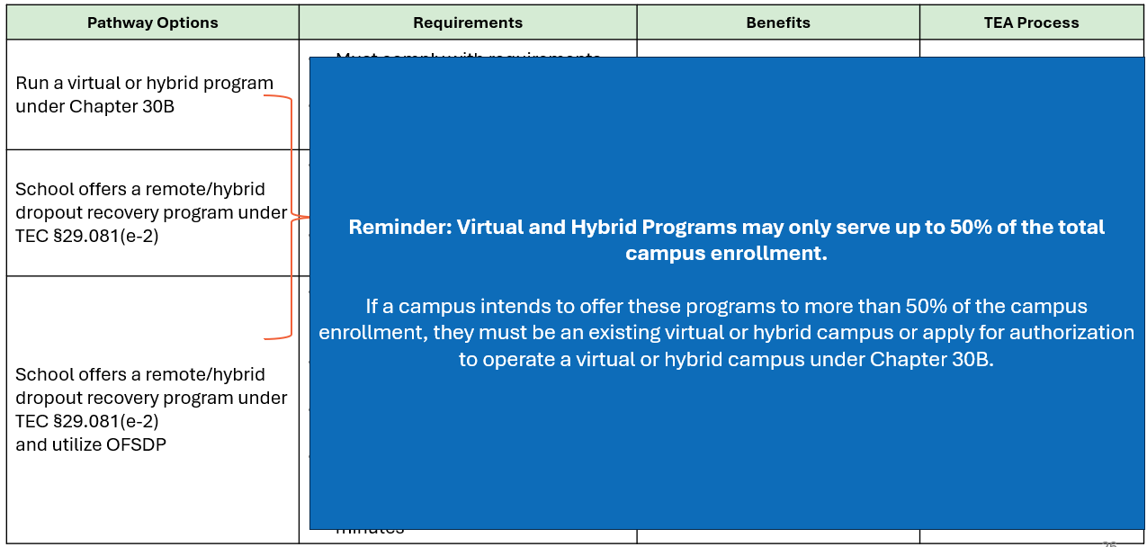
Pathways for Remote/Hybrid Dropout Recovery Programs

Slide 27




How is the data collected used?
Verifies student participation and instructional modality in virtual and hybrid programs.
Identifies school systems offering virtual and hybrid courses, programs, and campuses.
Provides insight into attendance patterns, course enrollment, and staffing in virtual and hybrid settings.
Enables comparison of virtual and hybrid instructional data with in‑person settings.
For virtual and hybrid instructional models, PEIMS reporting data plays several key roles:

Slide 28
Questions

